Slide 1


Métis N4 Construction

Slide 2
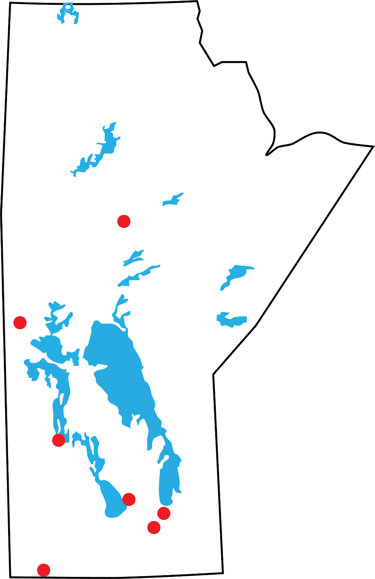
Métis N4 Construction Inc
Capital Project Development
Projects (Completed/Underway)
Thompson
The Pas
Winnipegosis
St. Laurent
RM of St. Andrews
Selkirk
Winnipeg
Metigoshe

Slide 3
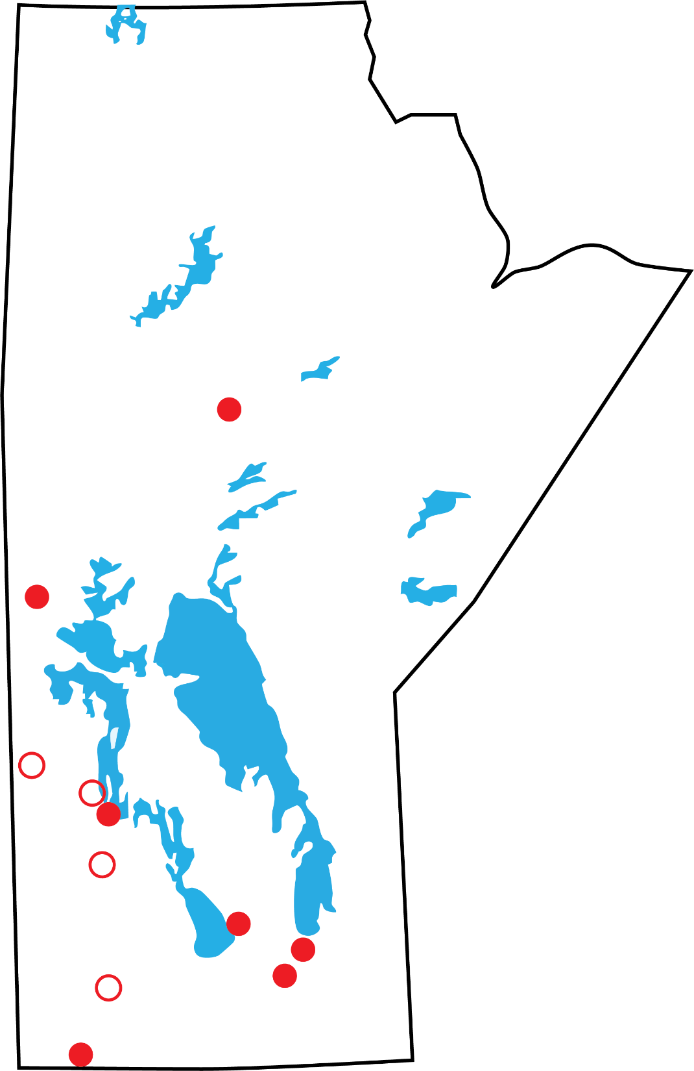
Métis N4 Construction Inc
Capital Project Development
Projects (Upcoming)
Swan River
Camperville
Dauphin
Brandon

Slide 4
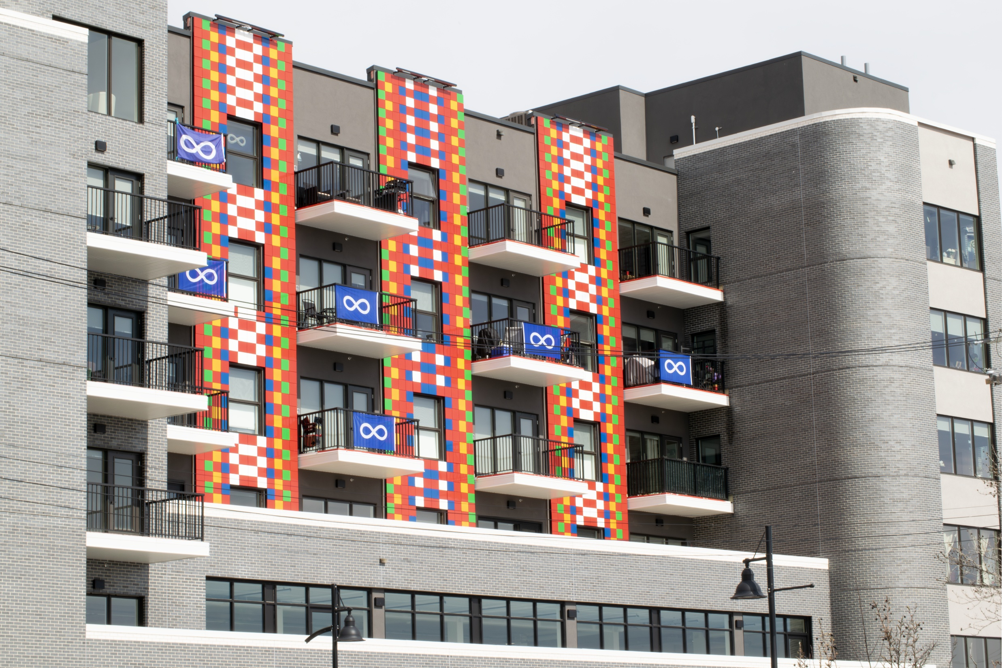
Eveline Housing Development
355 Eveline, Selkirk, MB

Slide 5
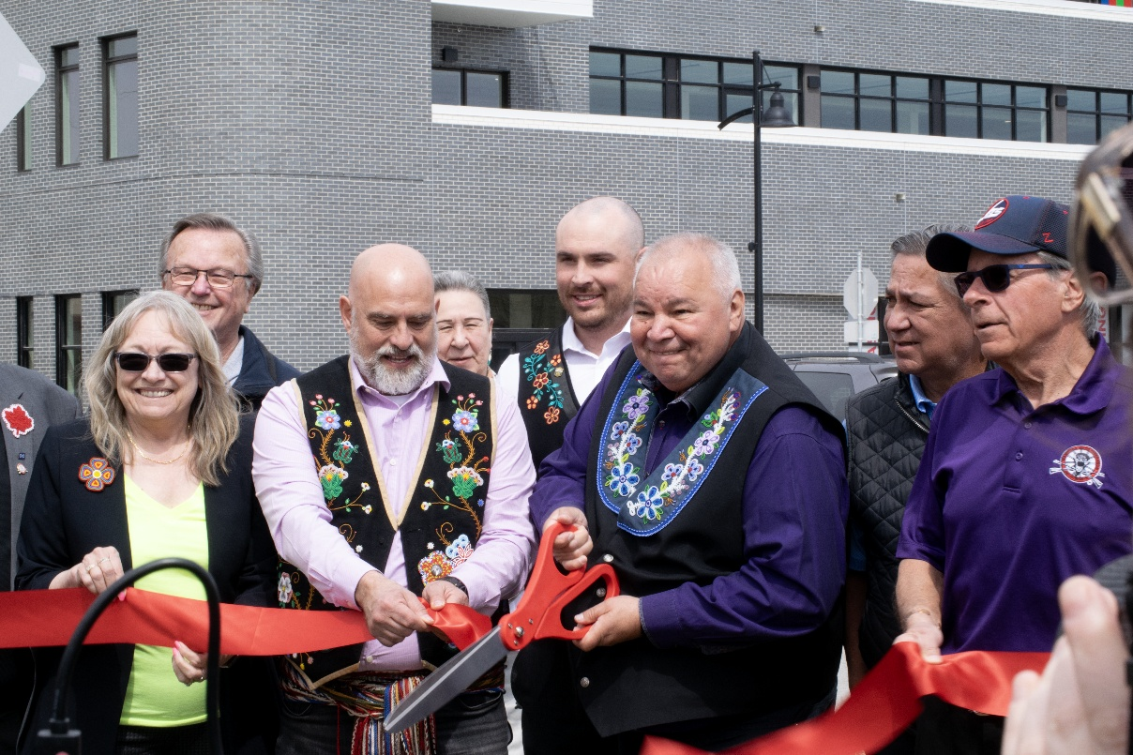
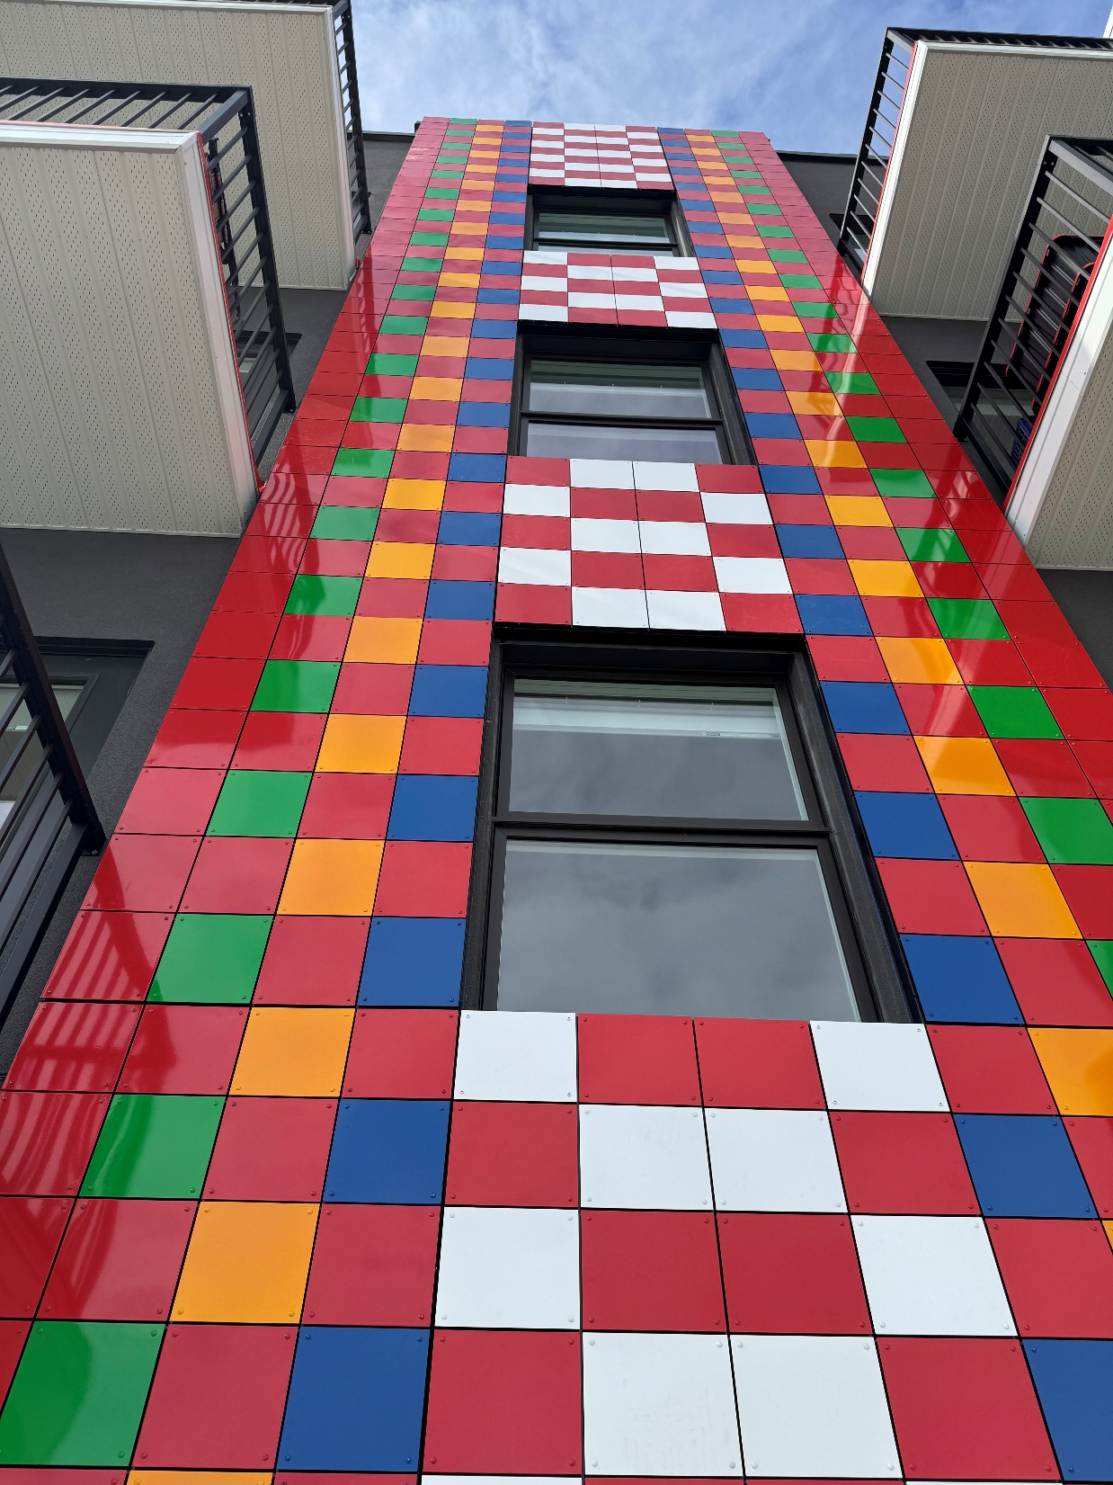
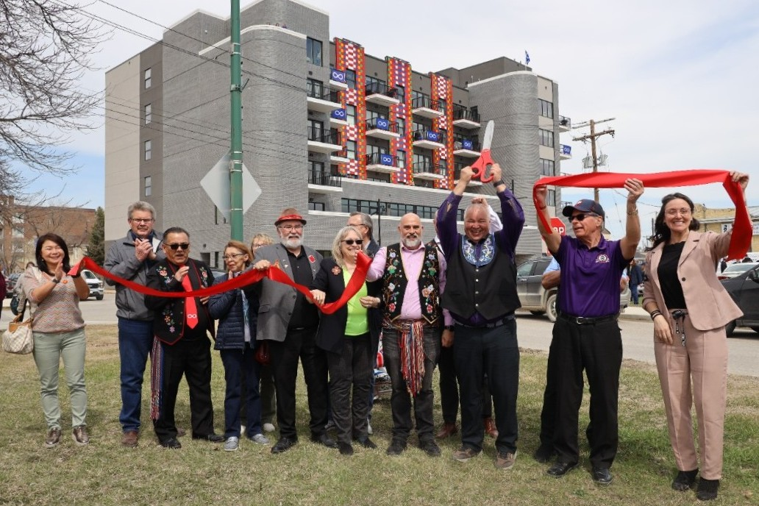
Eveline Housing Development
355 Eveline, Selkirk, MB

Slide 6
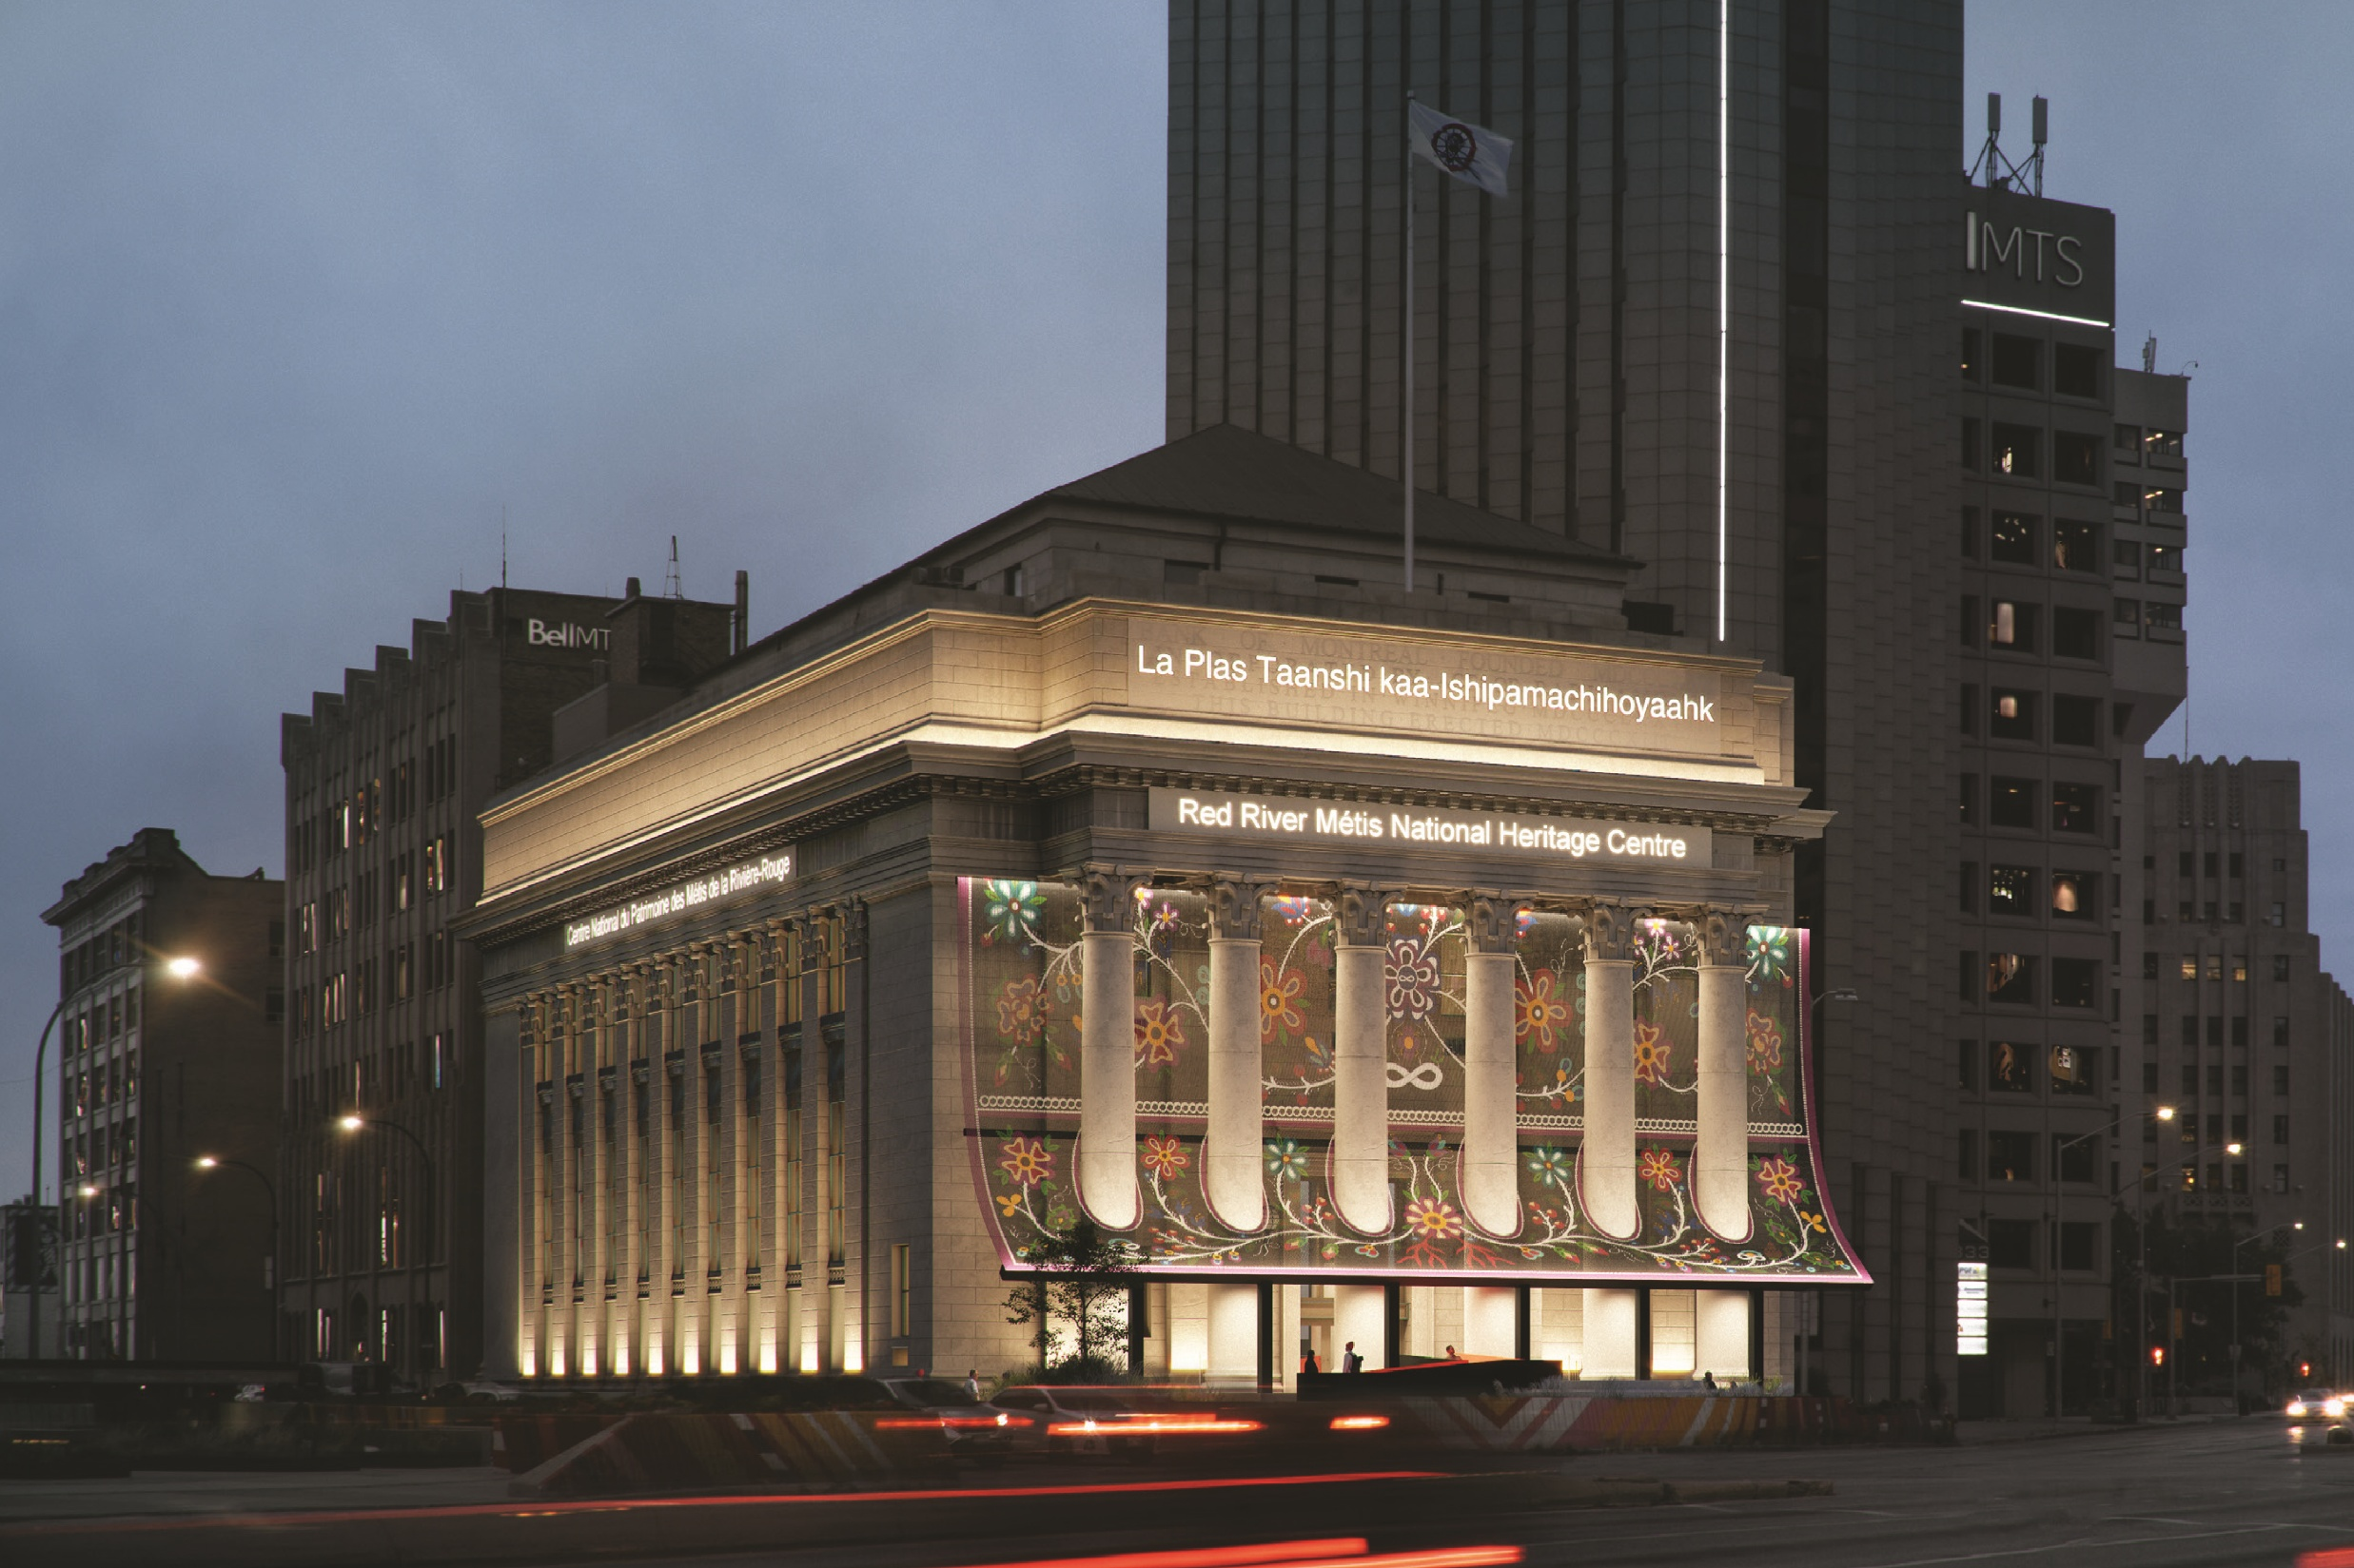
Red River Métis National Heritage Centre
La Plas Taanshi kaa-Ishipamachihoyaahk

Slide 7
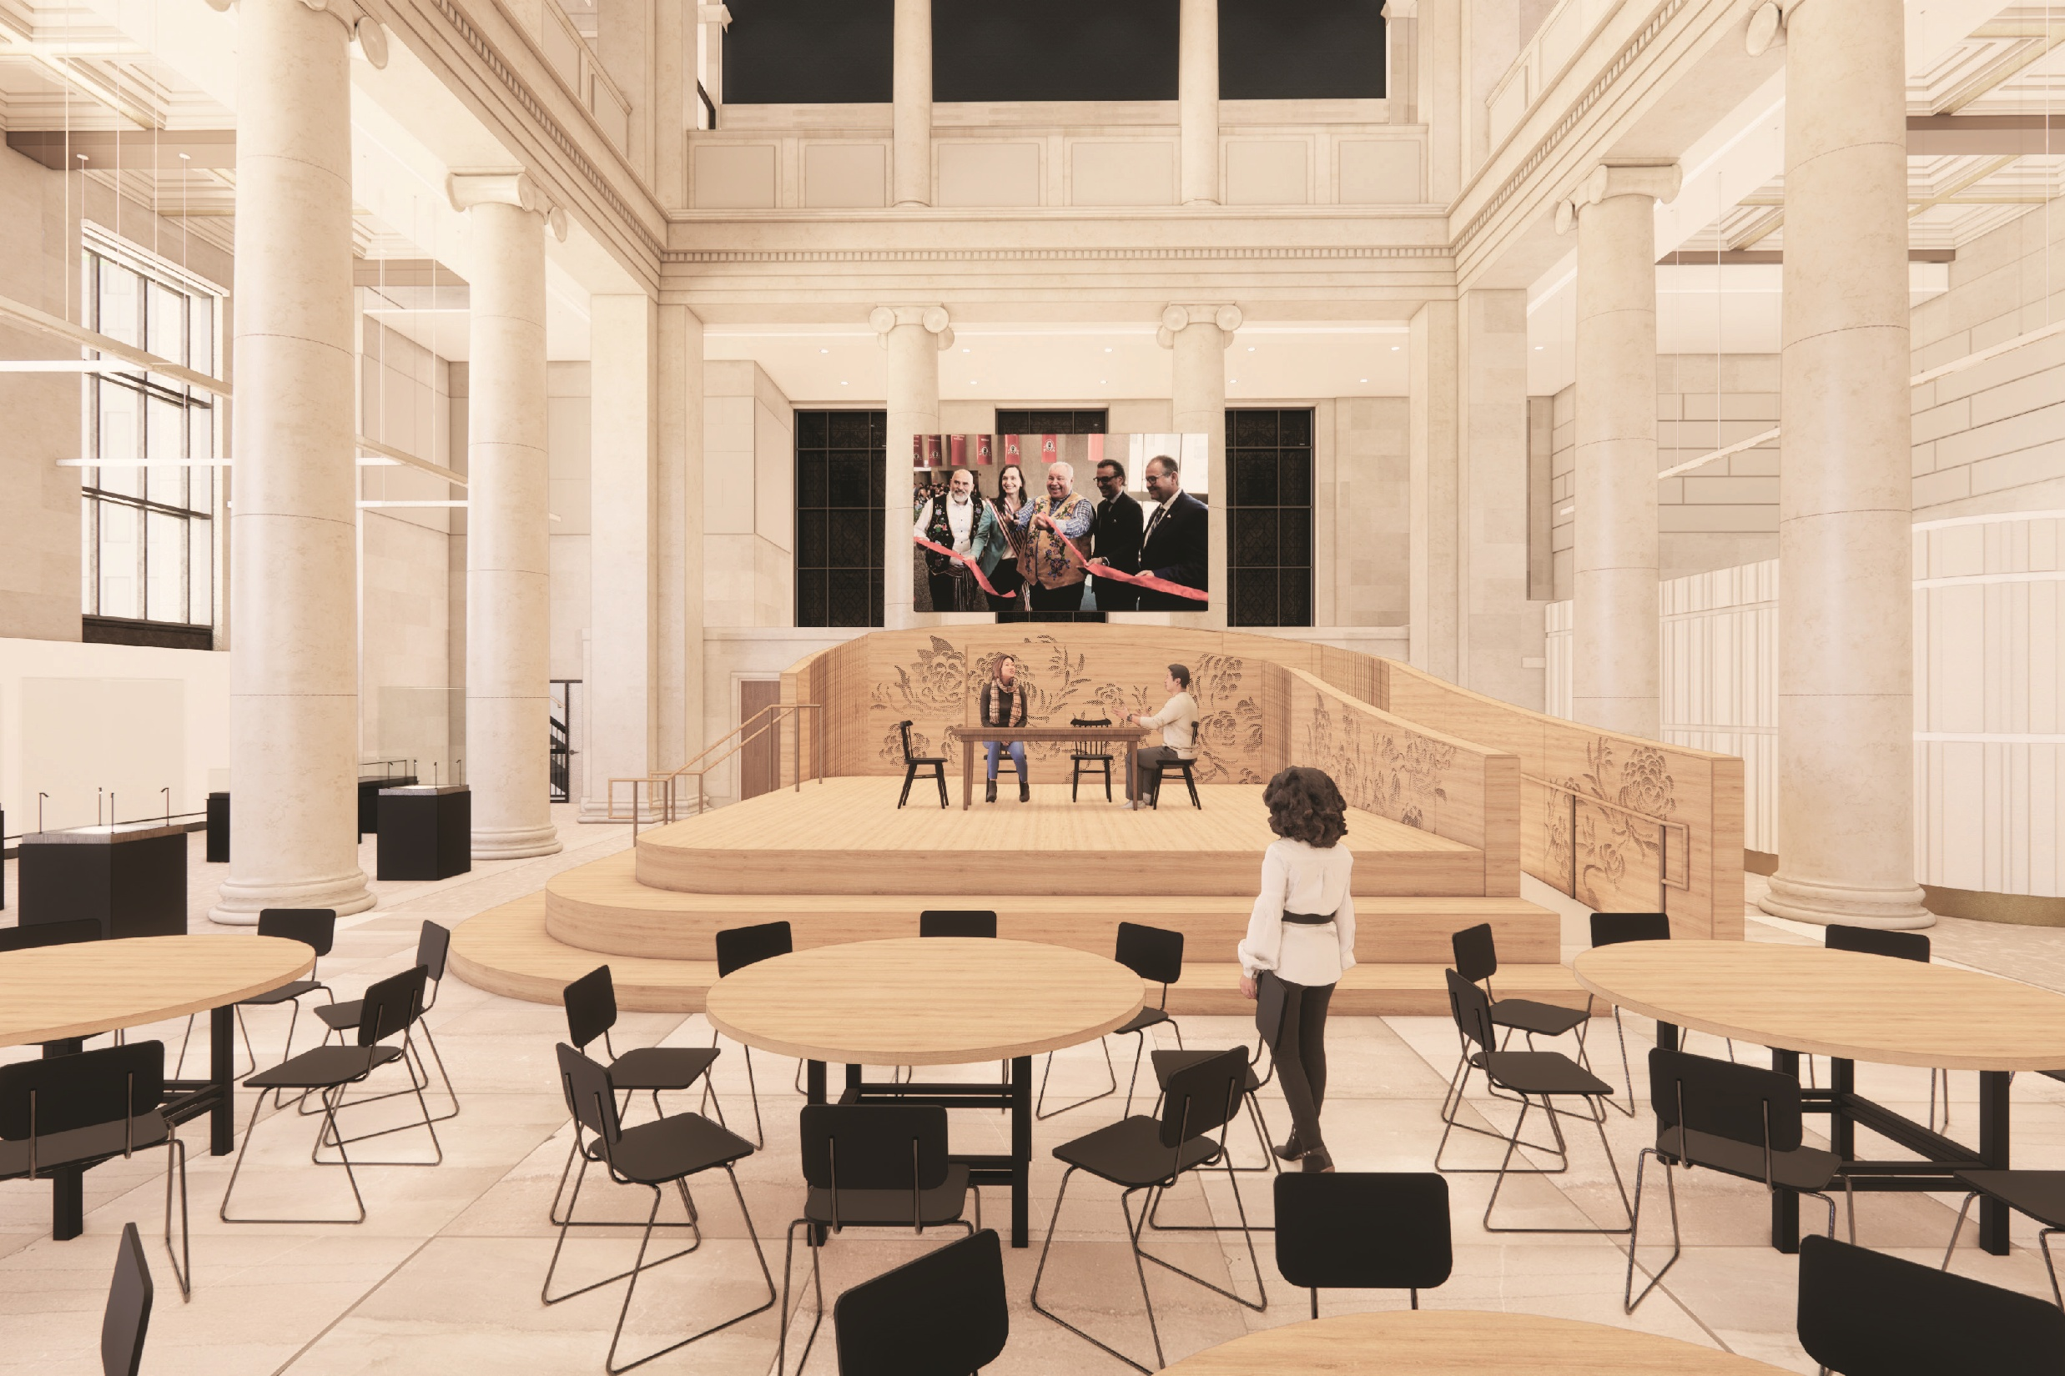
Red River Métis National Heritage Centre
La Plas Taanshi kaa-Ishipamachihoyaahk

Slide 8
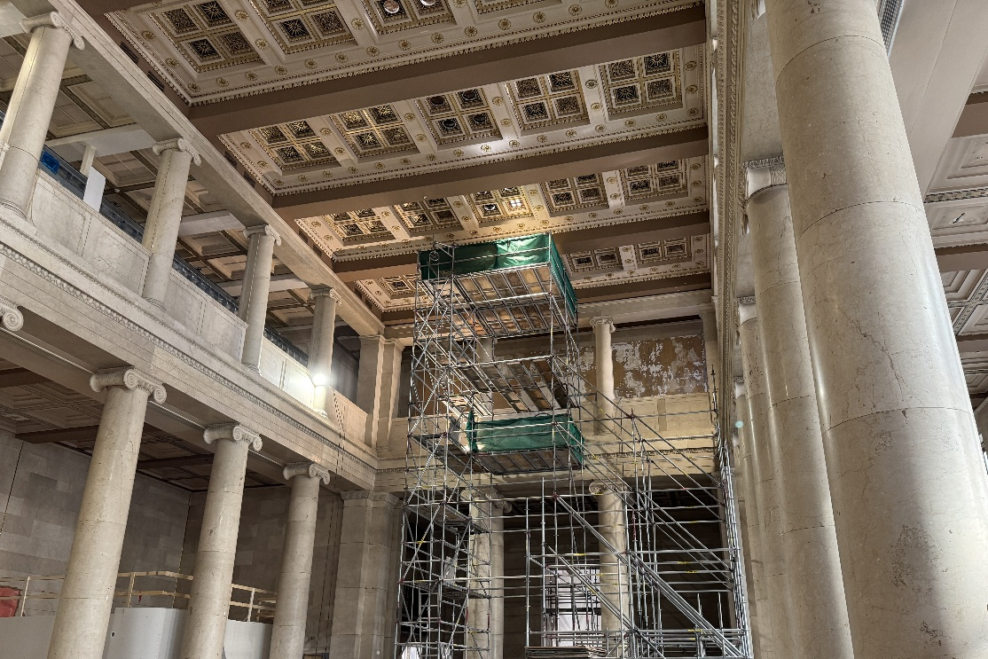
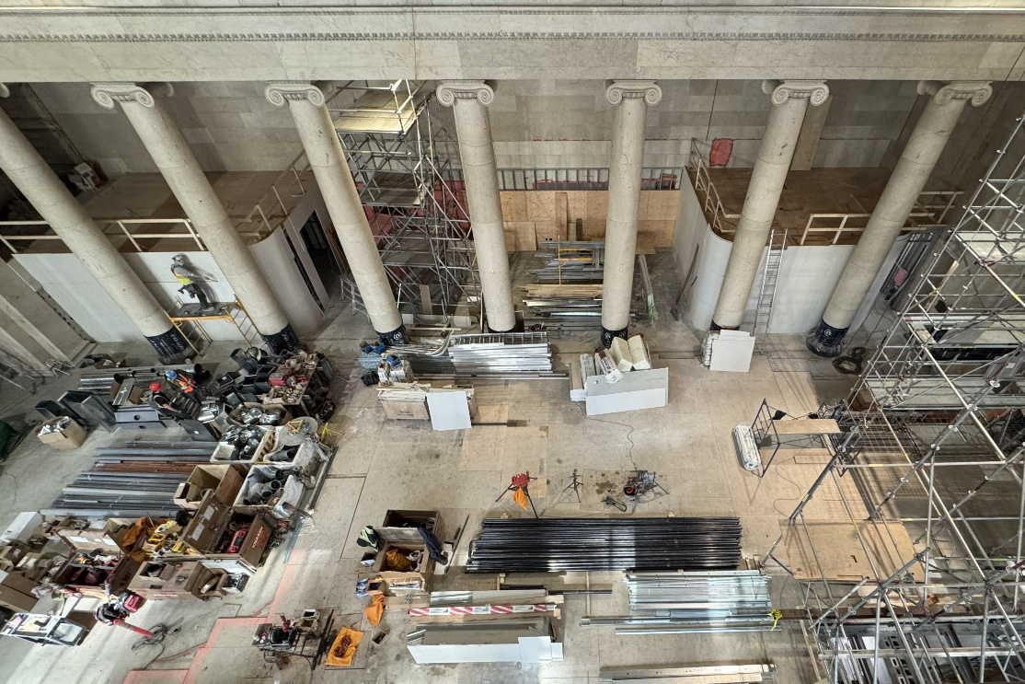
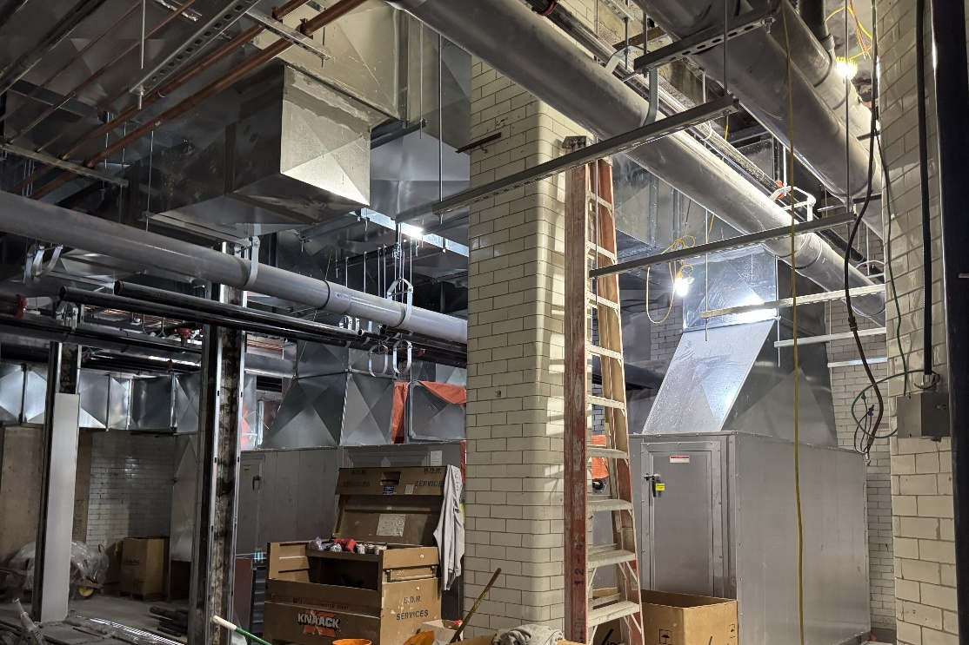
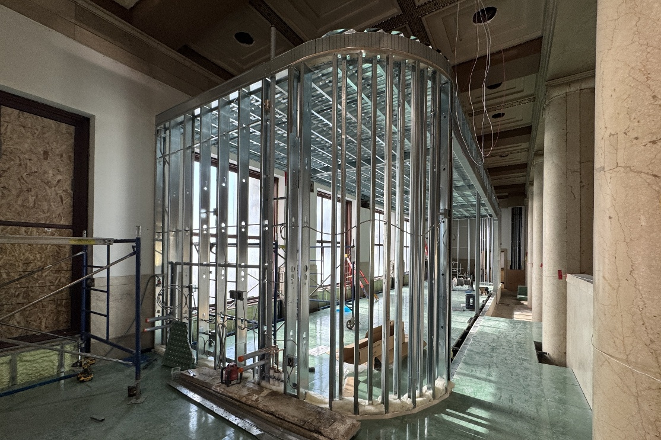
Red River Métis National Heritage Centre
La Plas Taanshi kaa-Ishipamachihoyaahk

Slide 9
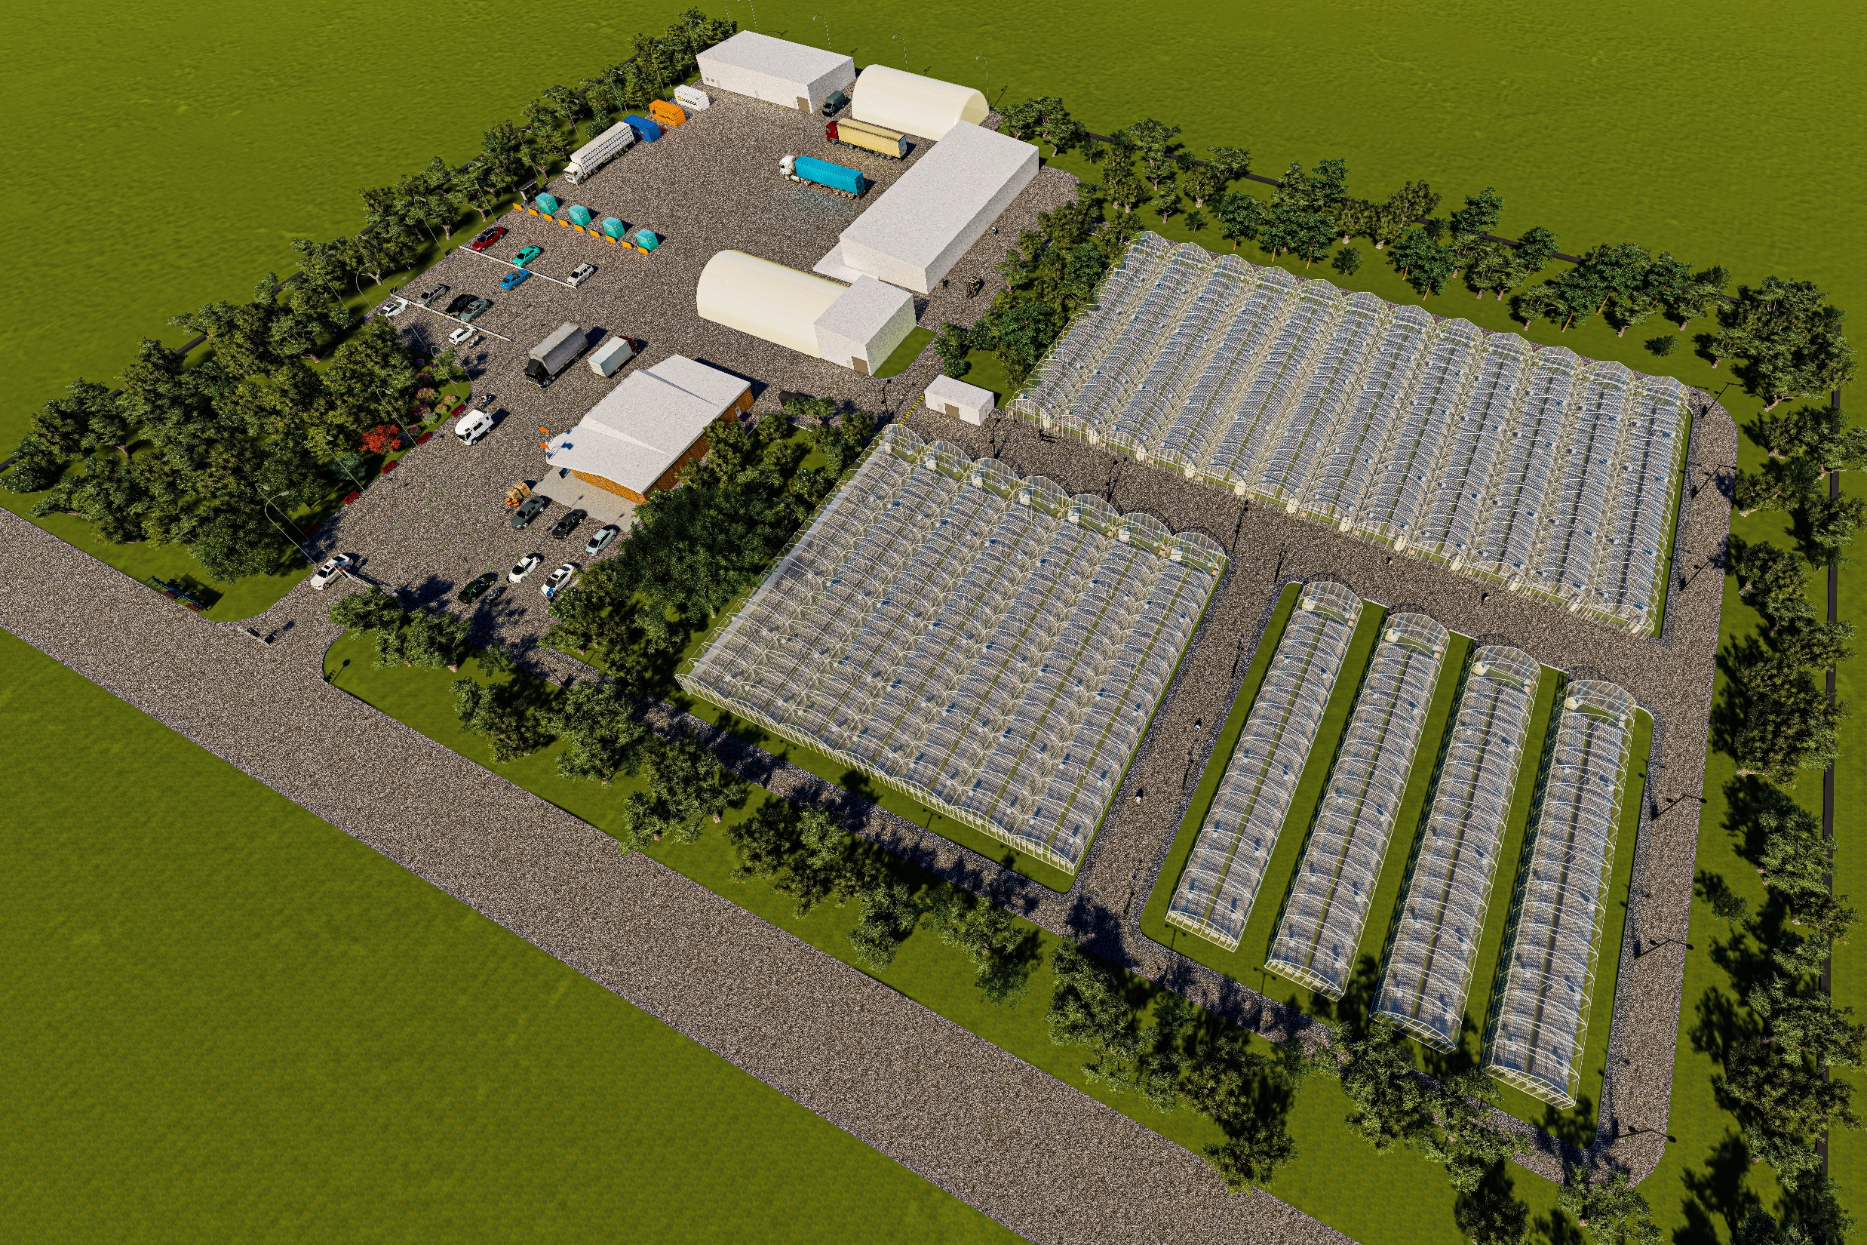
Red River Métis Tree Nursery
RM of St. Andrews, MB

Slide 10
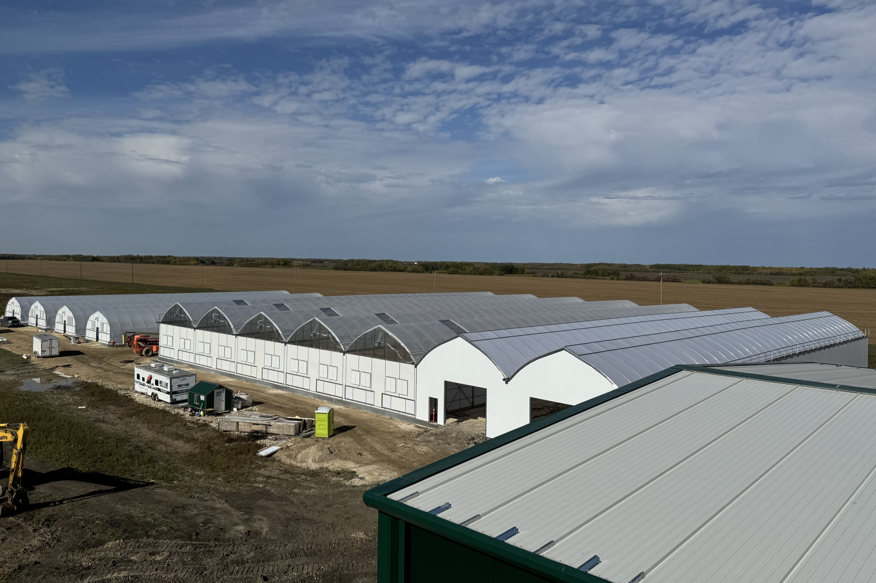
Red River Métis Tree Nursery
RM of St. Andrews, MB

Slide 11
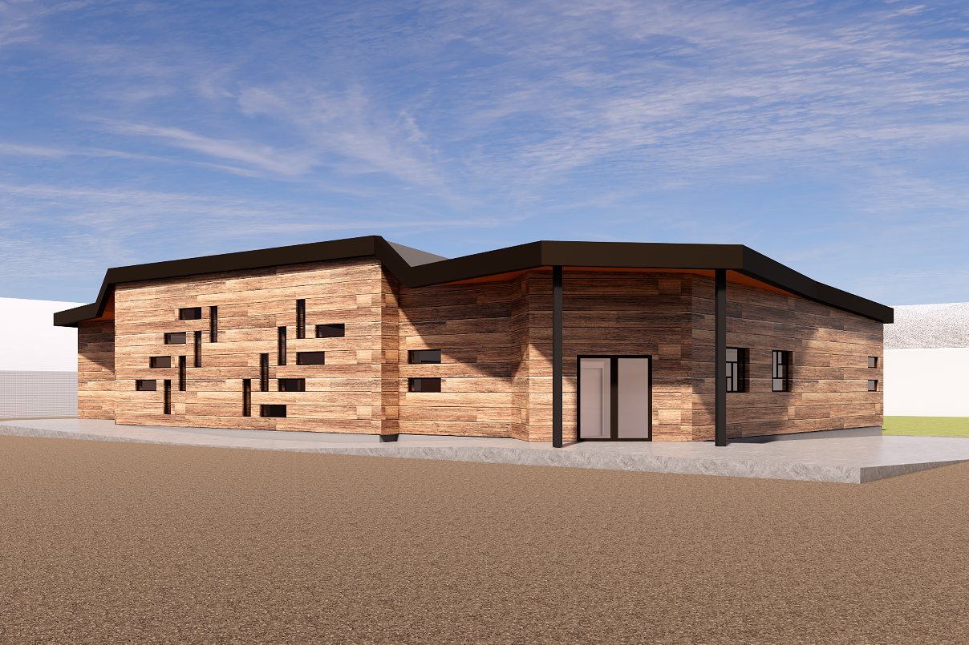
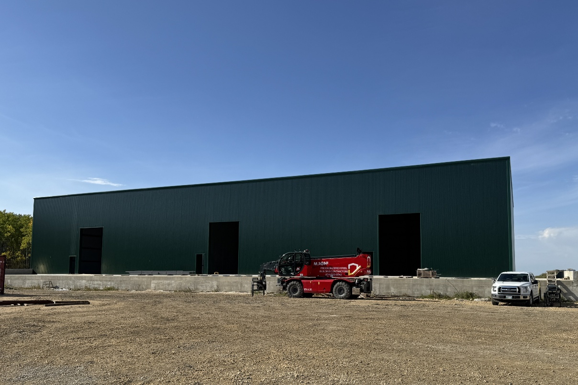
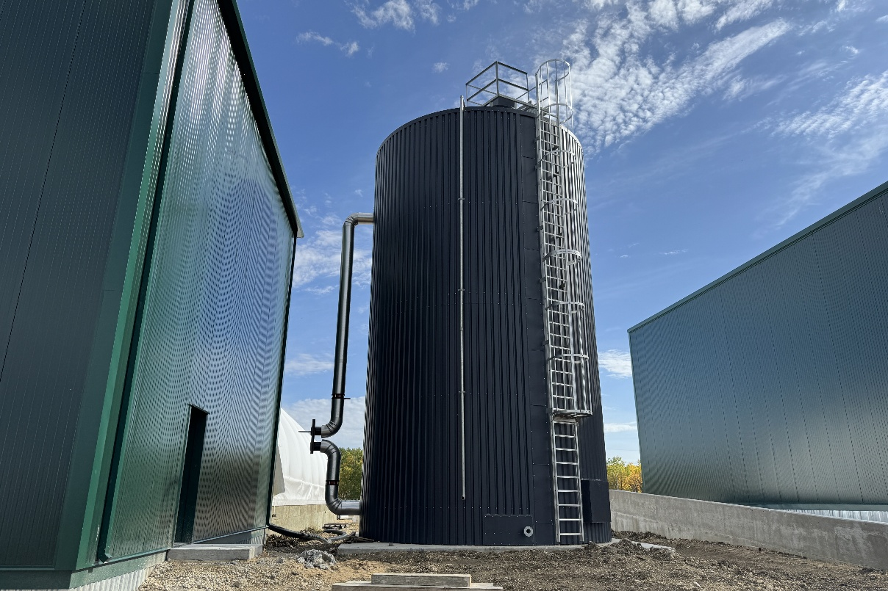
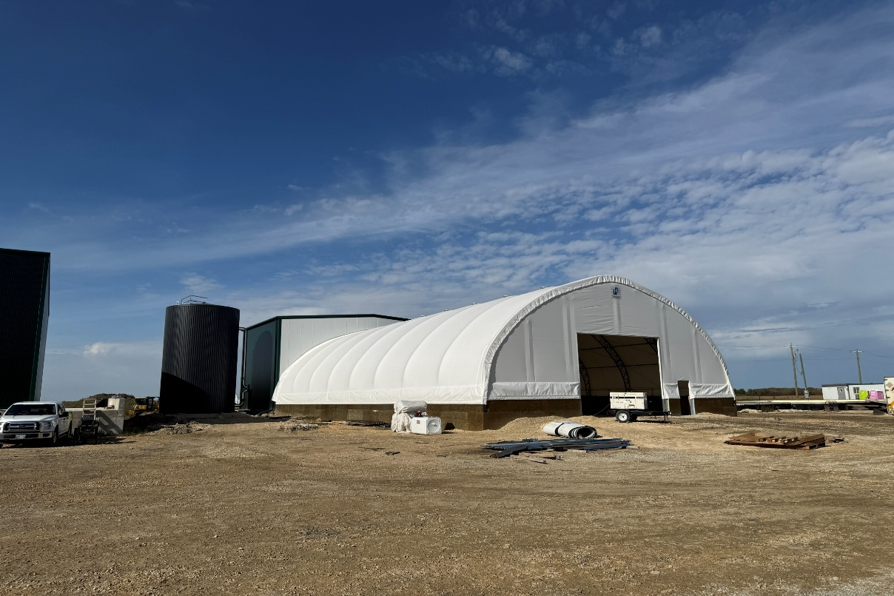
Red River Métis Tree Nursery
RM of St. Andrews, MB

Slide 12
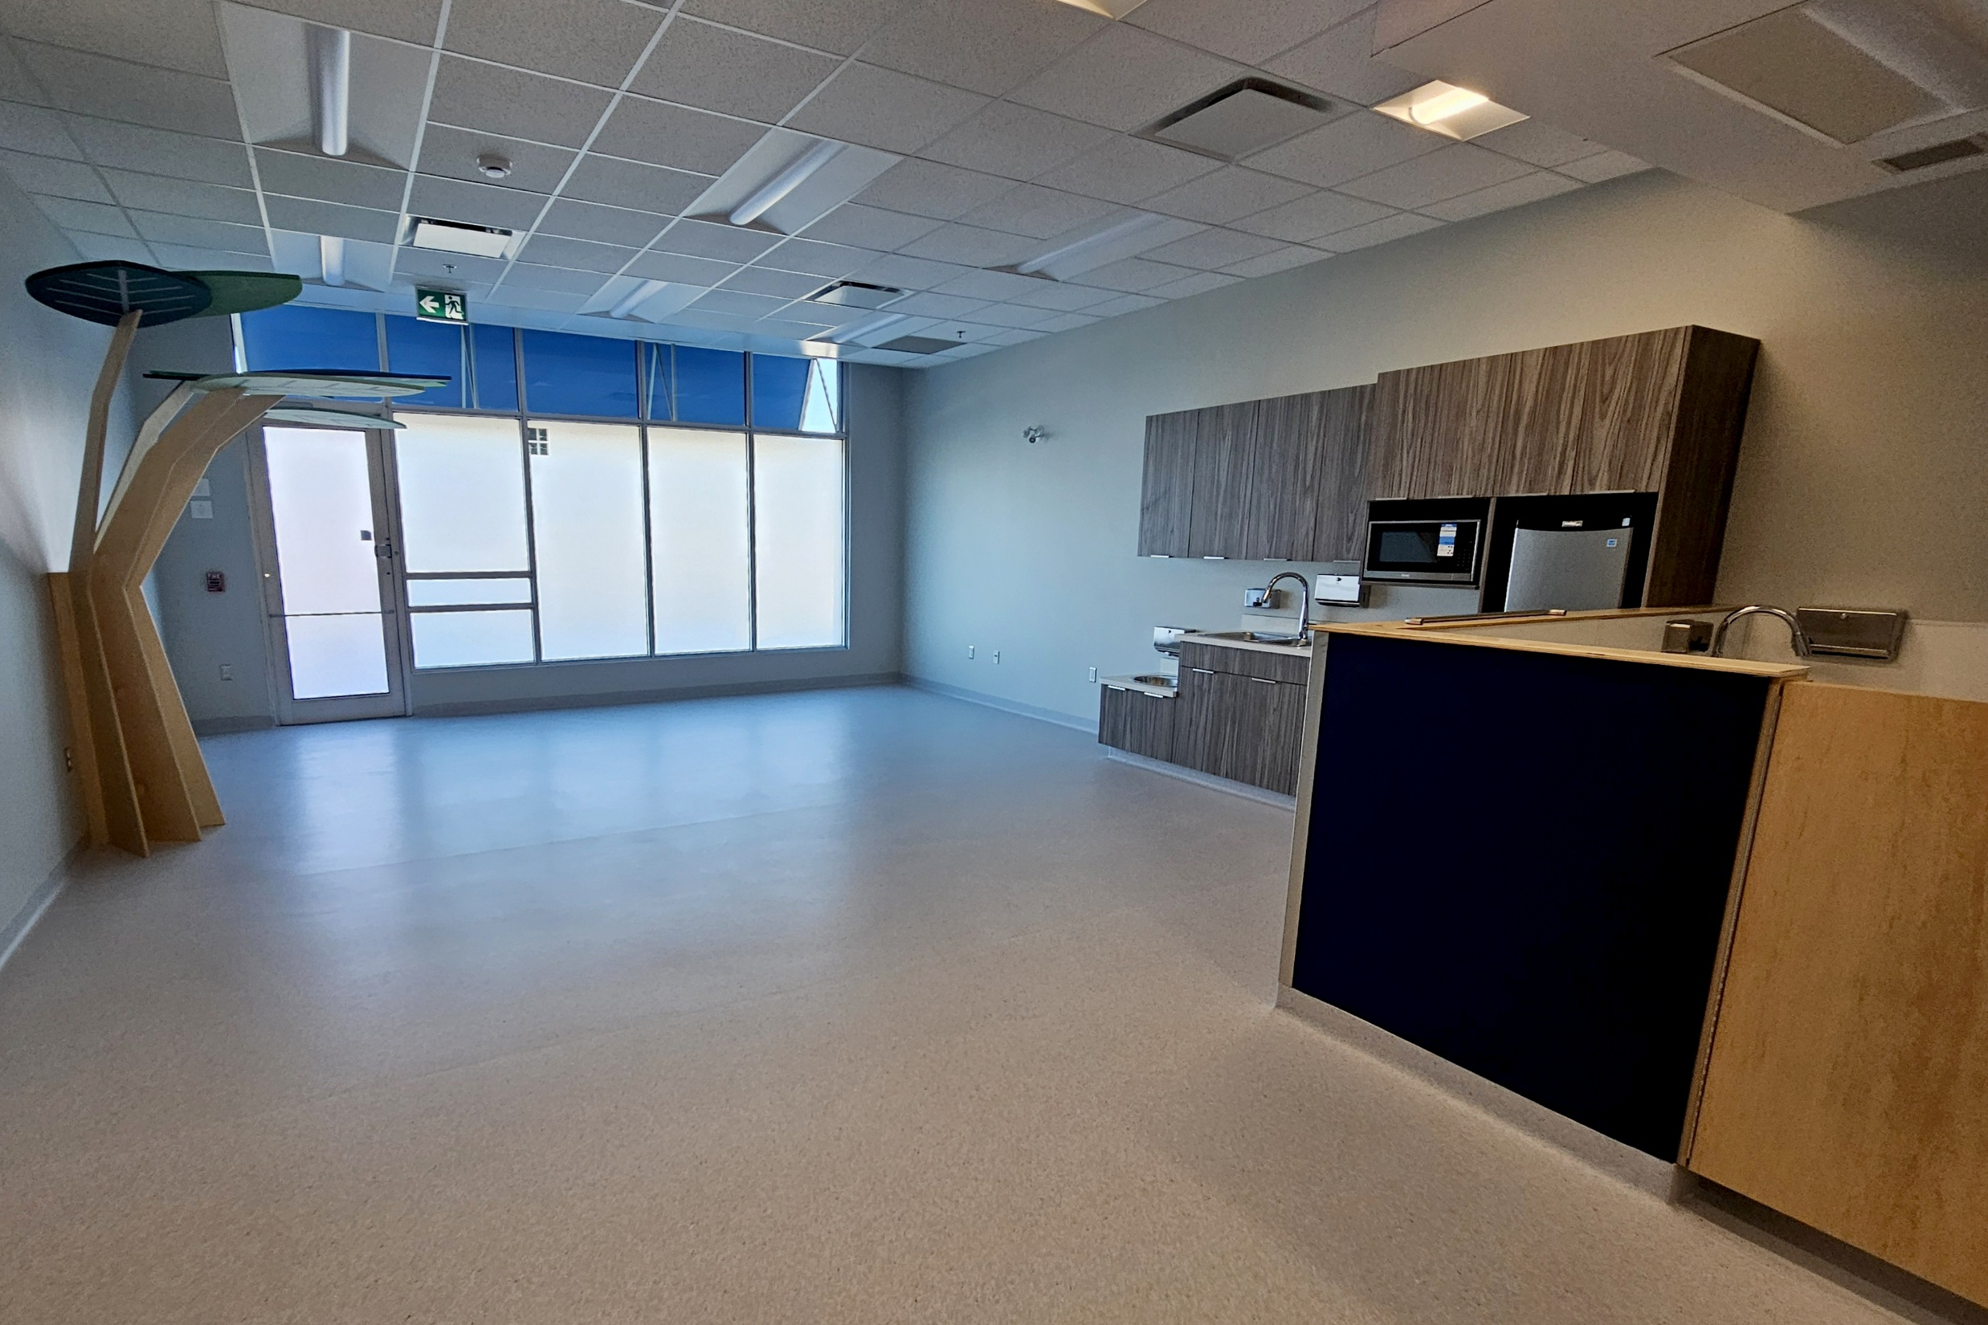
Little Fox Child Care Centre
200 Main St, Winnipeg, MB

Slide 13
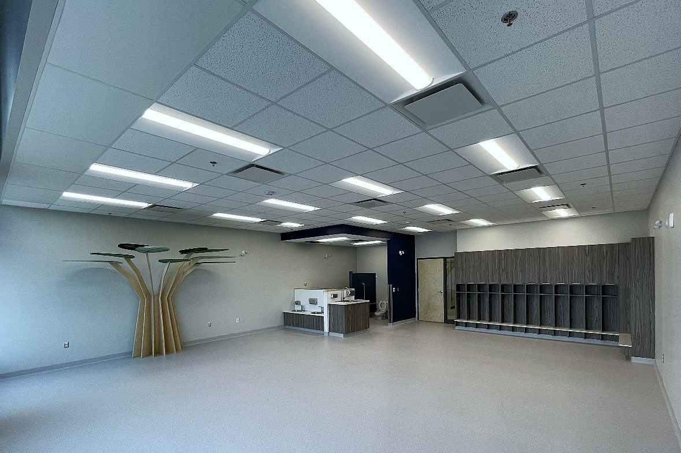
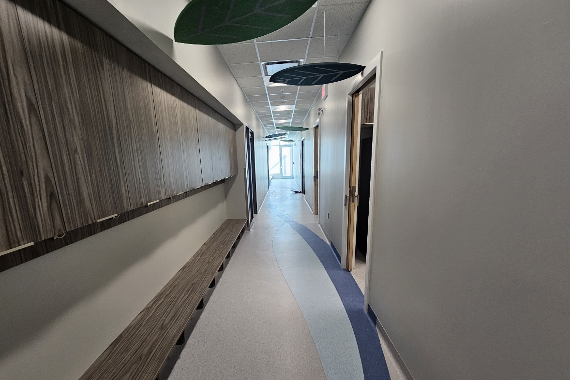
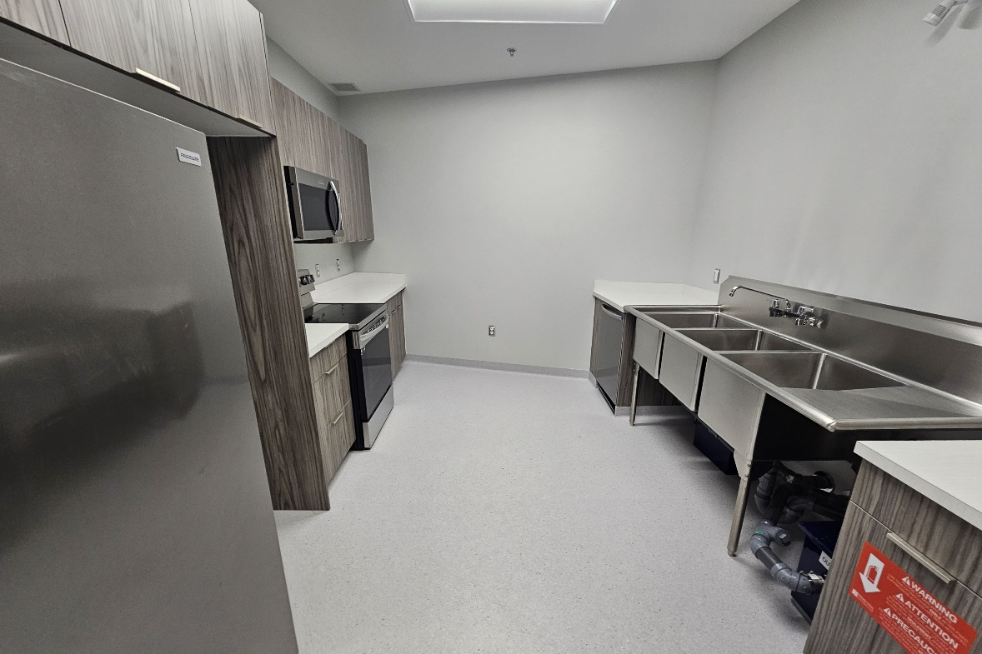
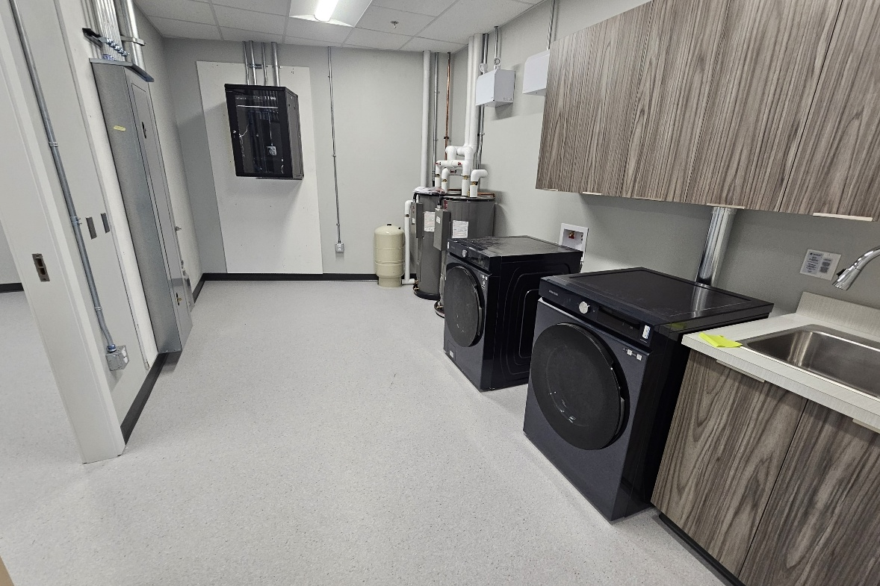
Little Fox Child Care Centre
200 Main St, Winnipeg, MB

Slide 14
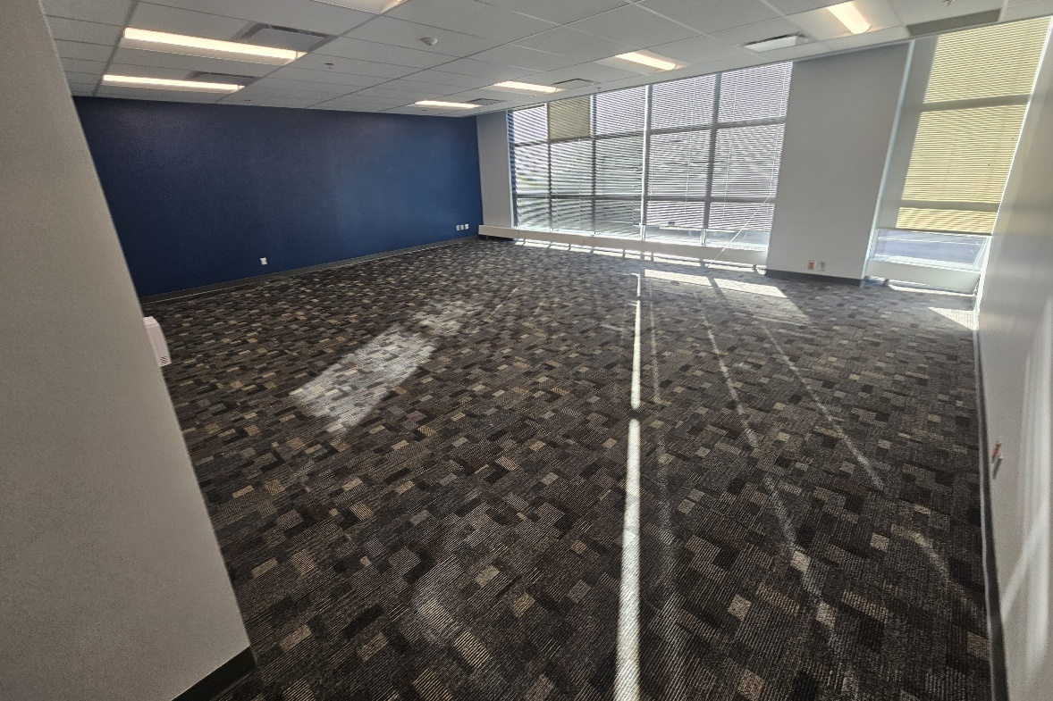
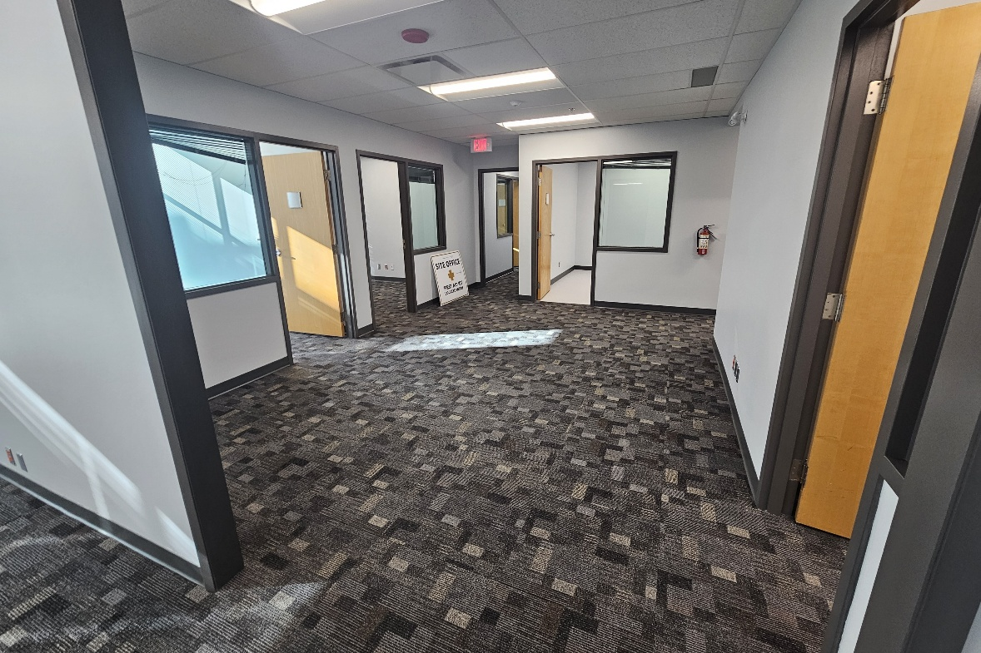
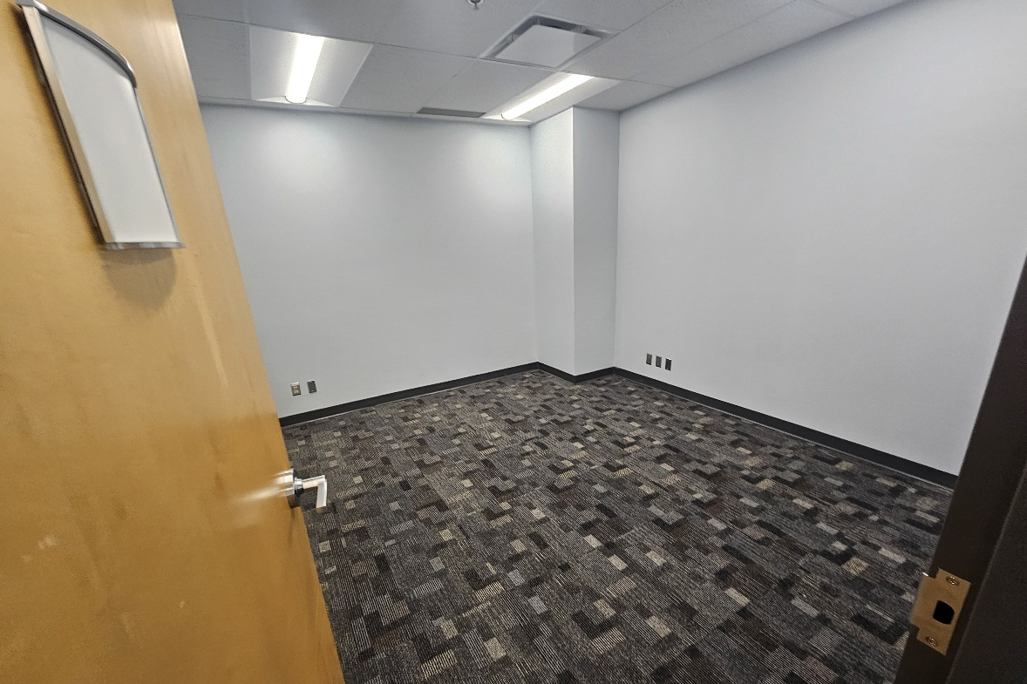
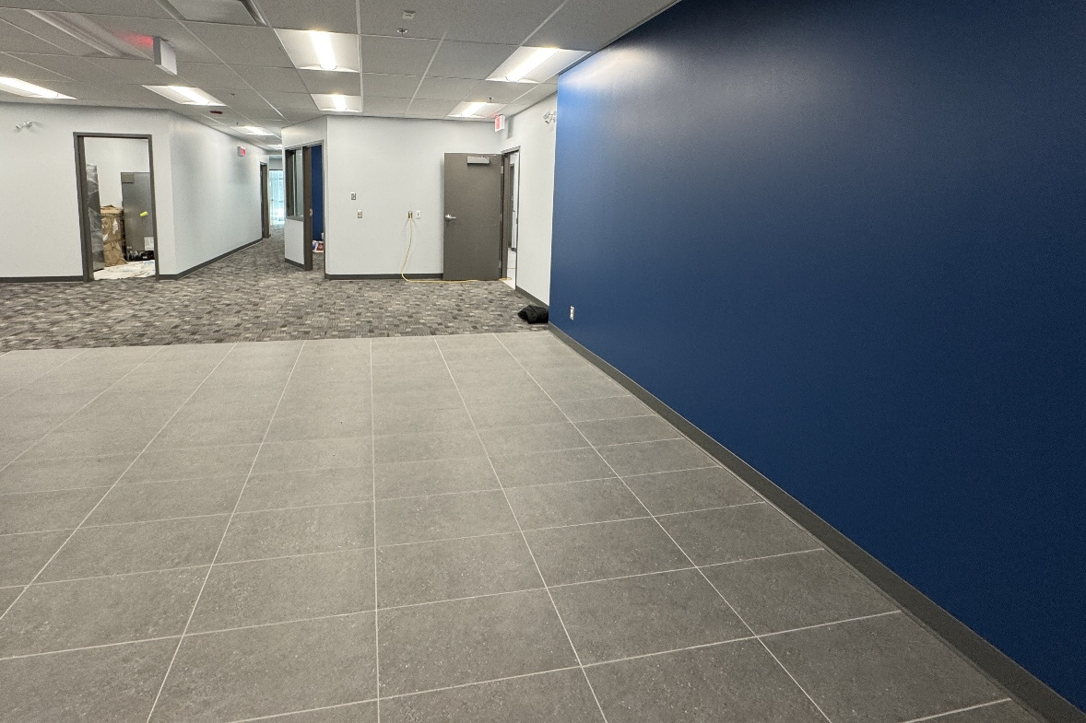
Louis Riel College
200 Main St, Winnipeg, MB

Slide 15
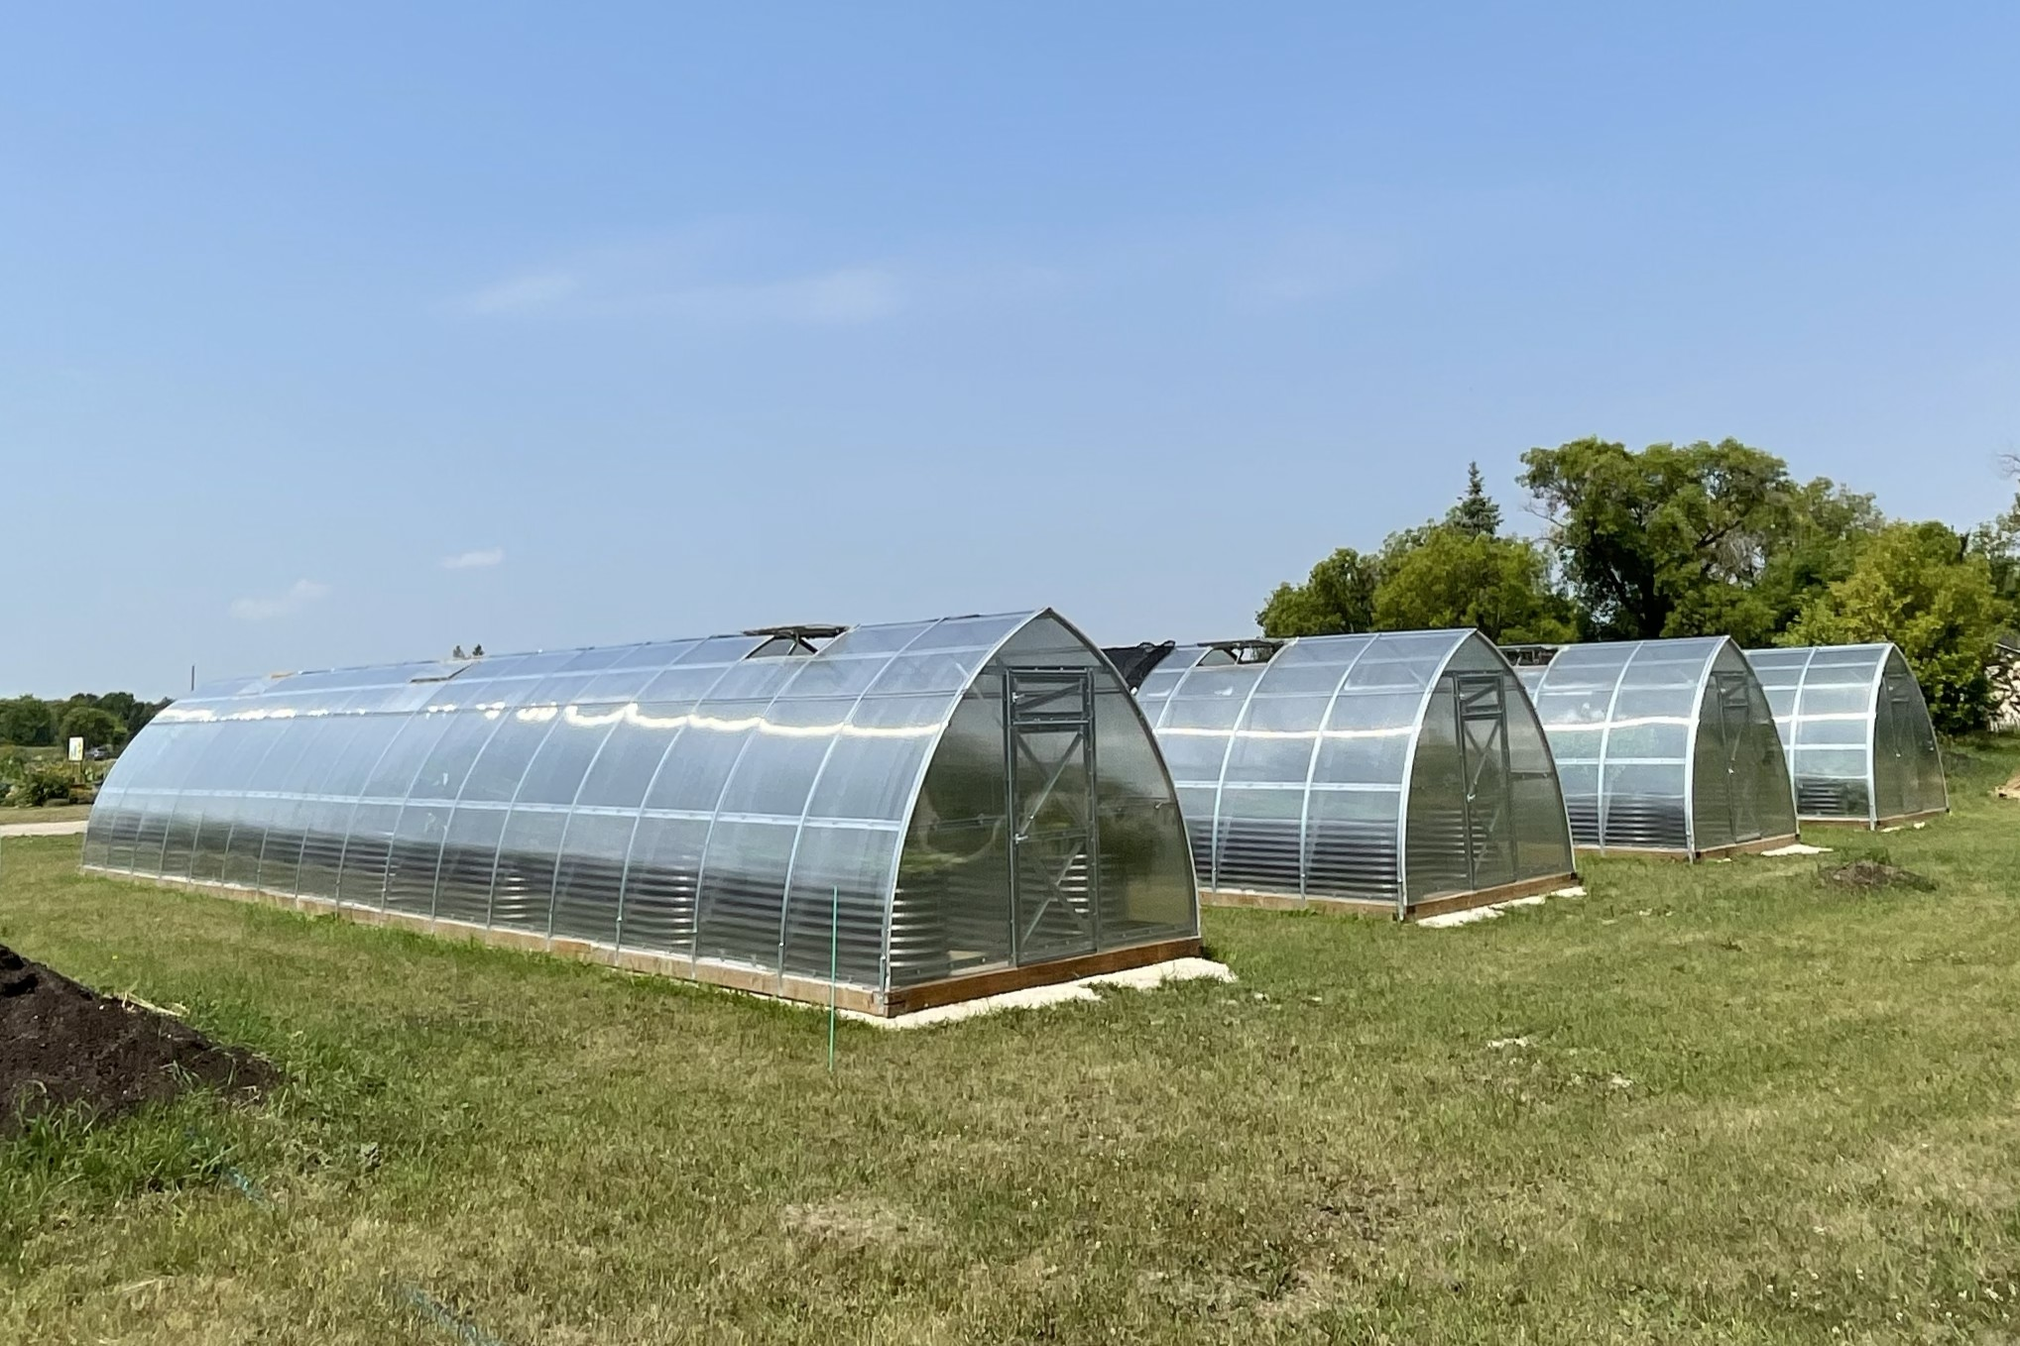
Food Security Greenhouses

Slide 16
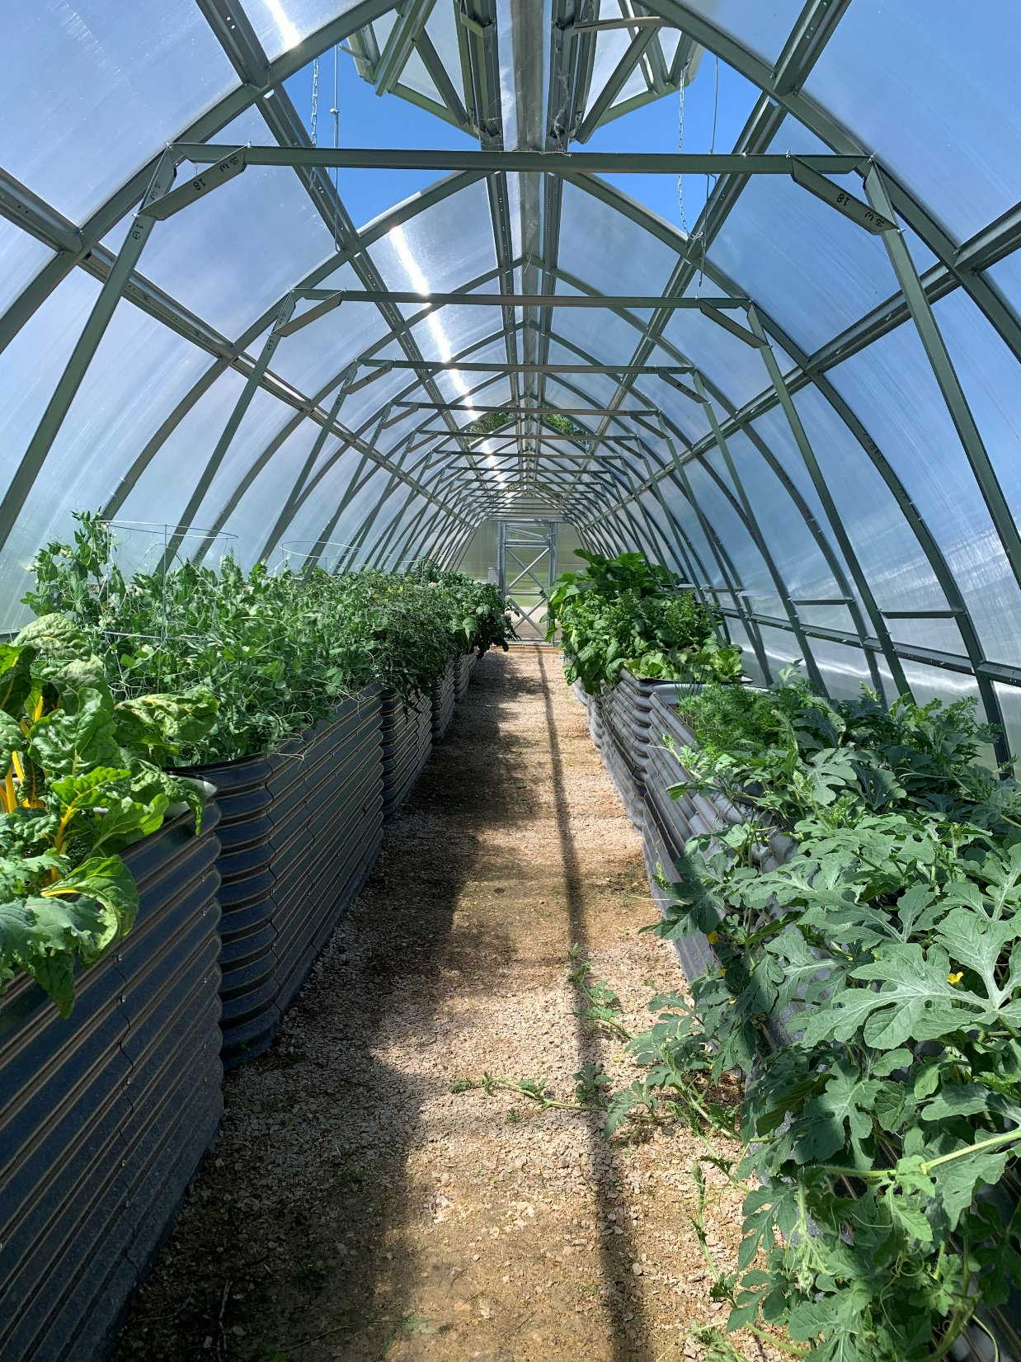
Food Security Greenhouses
Completed
Metigoshe
St. Laurent
The Pas
Thompson
Winnipeg
Winnipegosis

Slide 17
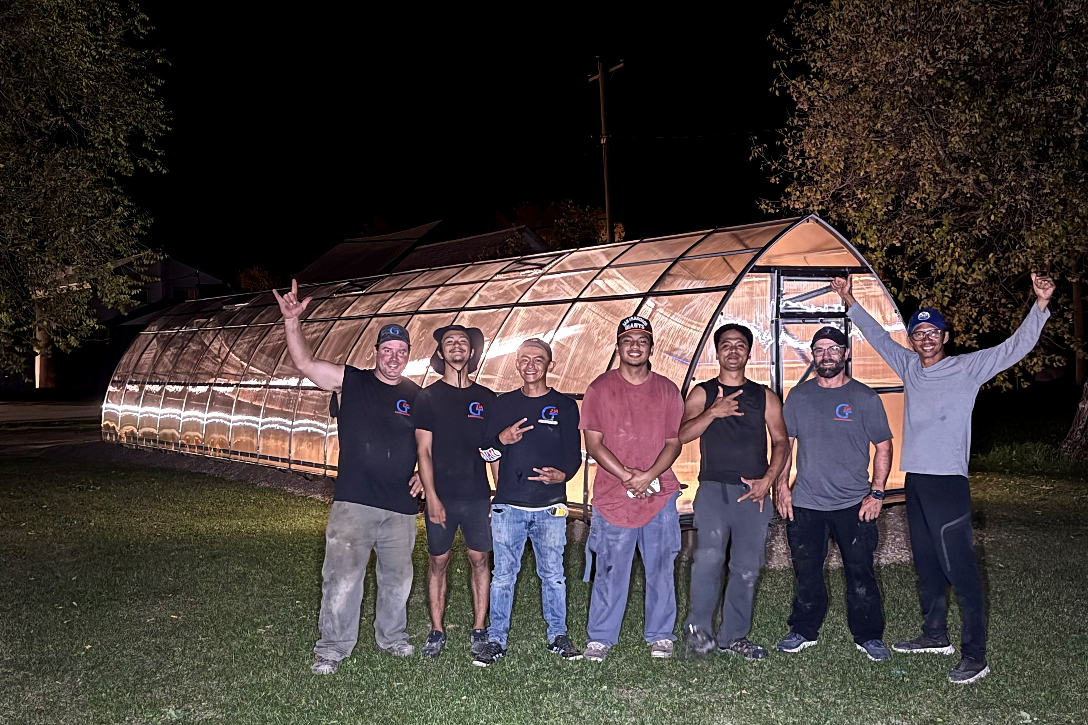
Food Security Greenhouses

Slide 18

Métis Equitable Participation Program
Métis-Owned Businesses Engagement

Slide 19
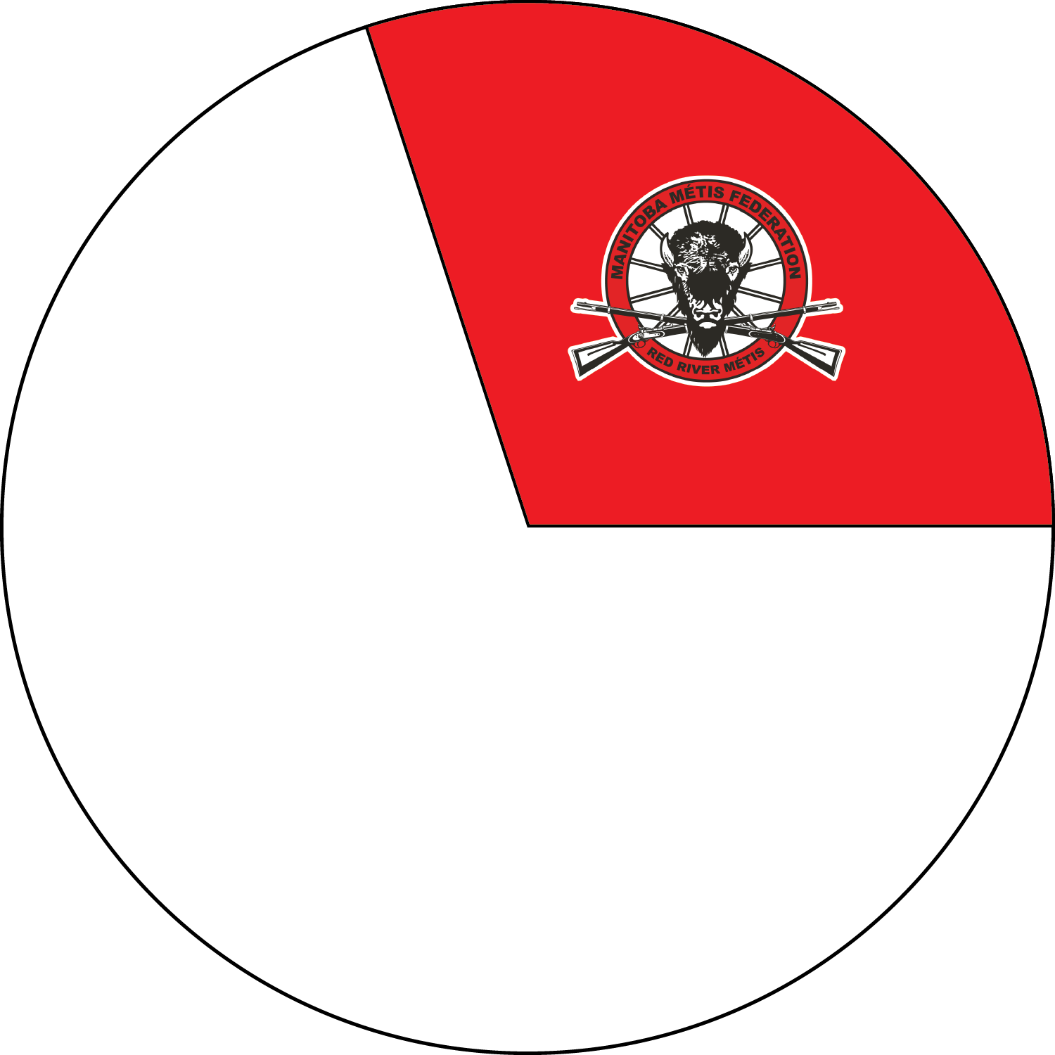

Métis Equitable Participation Program
Métis Citizen Labour Hours
VS
29% of Project Labour
Red River Métis
8% of MB Population
Red River Métis

Slide 20

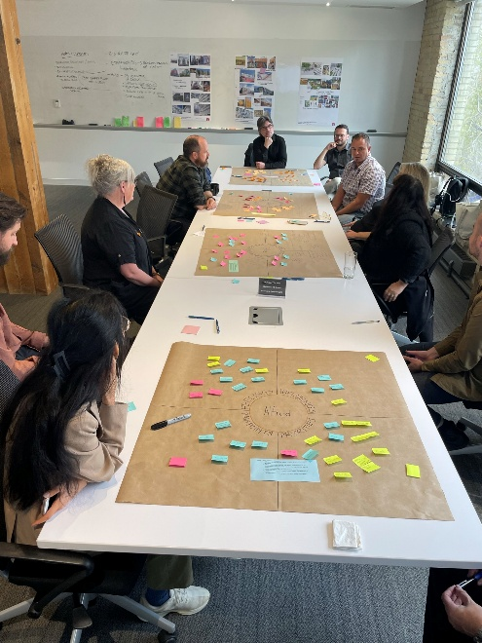
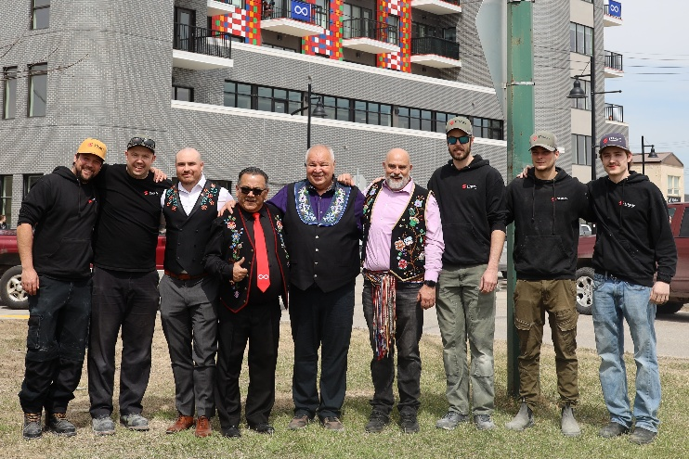
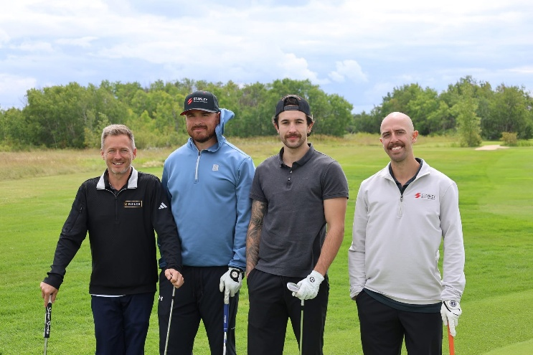
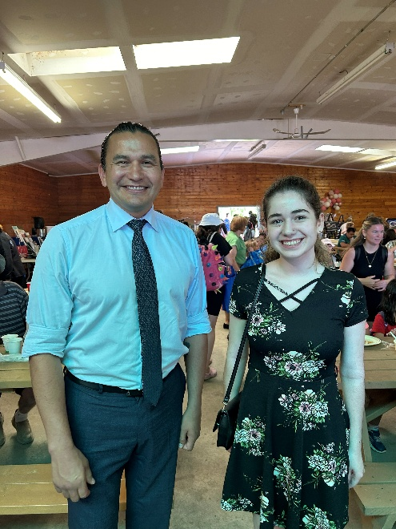
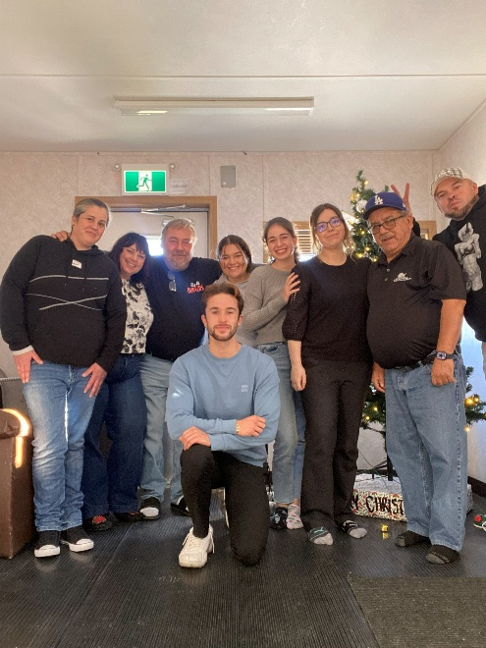

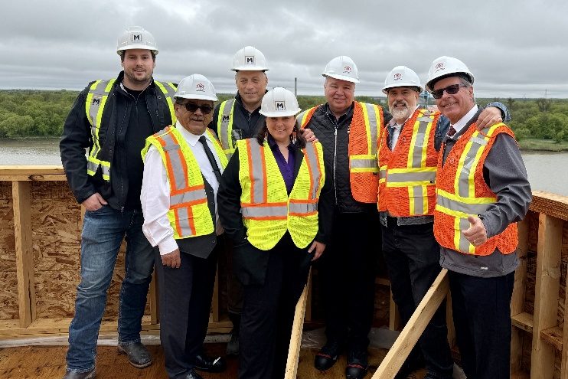

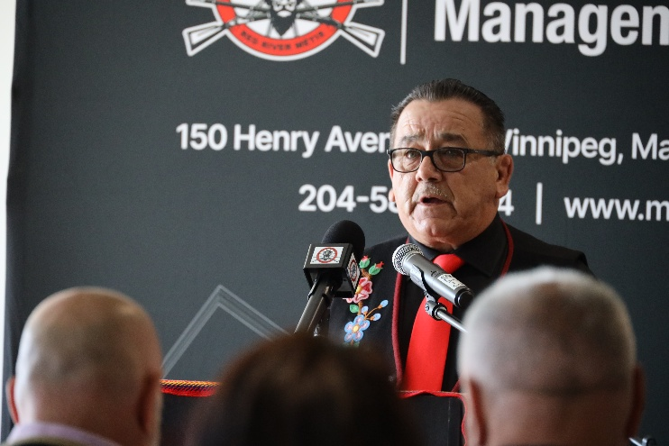
MAARSII!

