Slide 1

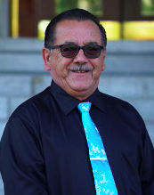
Energy and Infrastructure
Minister Jack Park

Slide 2
Our Relationship with Canada
Growing Together
Energy and Infrastructure Beyond Borders
Regulatory Processes
Canadian Nuclear Safety Commission - CNSC
Canada Energy Regulator - CER
Impact Assessment Agency of Canada – IAAC
Natural Resources Canada – NRCan
Department of Fisheries and Oceans - DFO

Slide 3
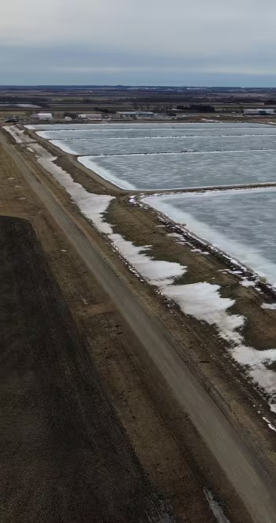
Housing, Infrastructure, and Communities Canada (HICC)
Wastewater Treatment Lagoon Expansion
Wastewater Treatment Facility Upgrades
Water Treatment Facility Upgrades

Slide 4
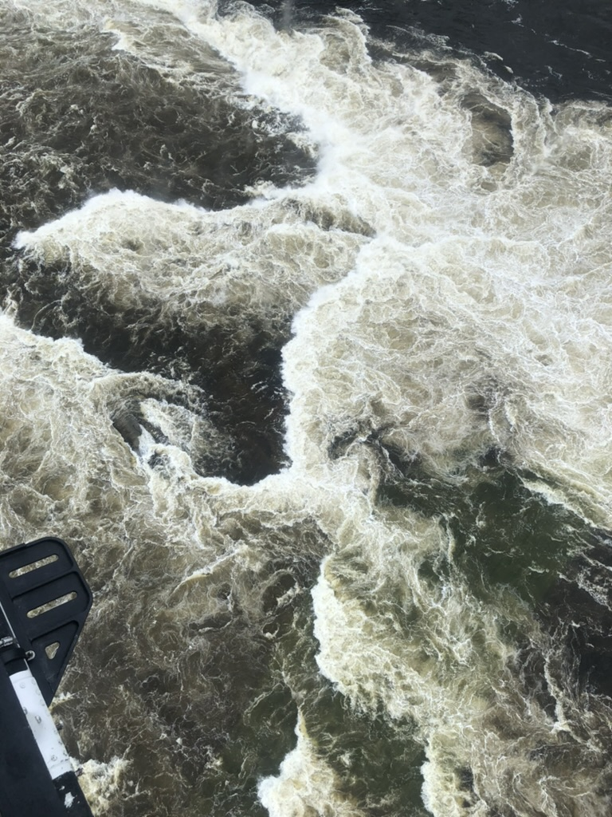
Manitoba Hydro
Revitalization Agreement, Monitoring, and Hydro Liaison
Technical Advisory Committee on Hydro’s Integrated Resource Planning Initiative
Provincial Environmental Approvals Branch

Slide 5
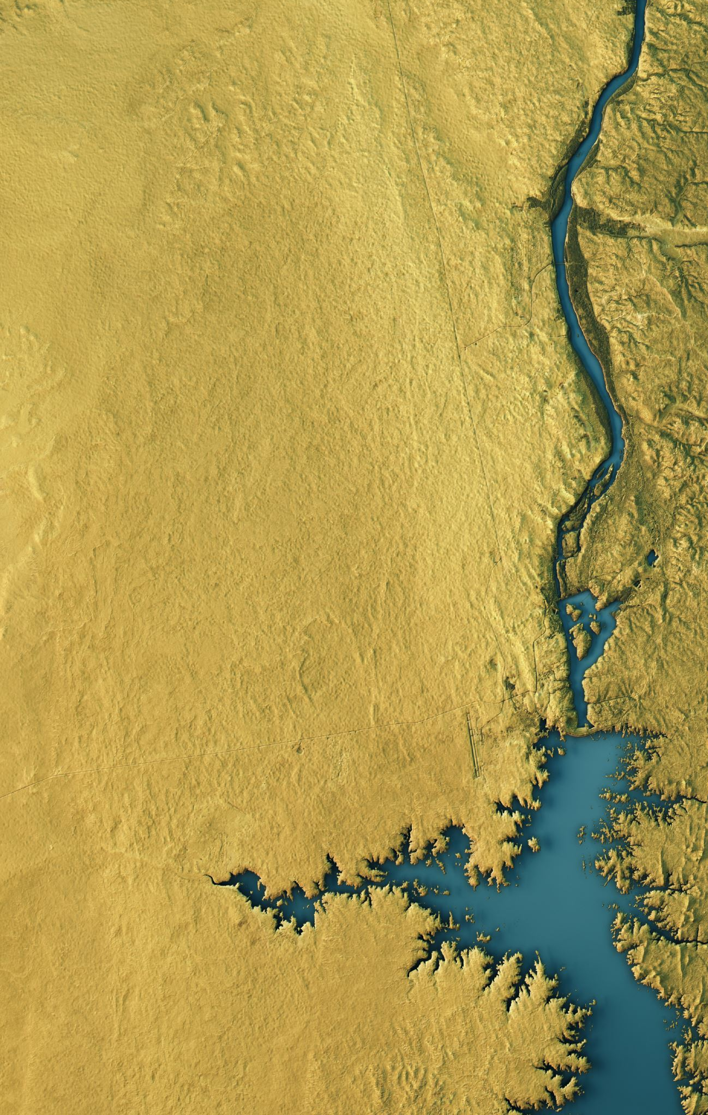
Working with the Province of Manitoba
Manitoba Transportation and Infrastructure (MTI)
  Bridge Construction and Rehabilitation
  Dam Construction and Rehabilitation
  Roadway Construction, Rehabilitation, and Twinning
  Lake Manitoba & Lake St. Martin Outlet Channels (LMLSMOC)

Slide 6

Métis Energy Efficiency Offers
What is MEEO?
  From 2022 to now
Progress Update
  Summary of support
  New offers

Slide 7

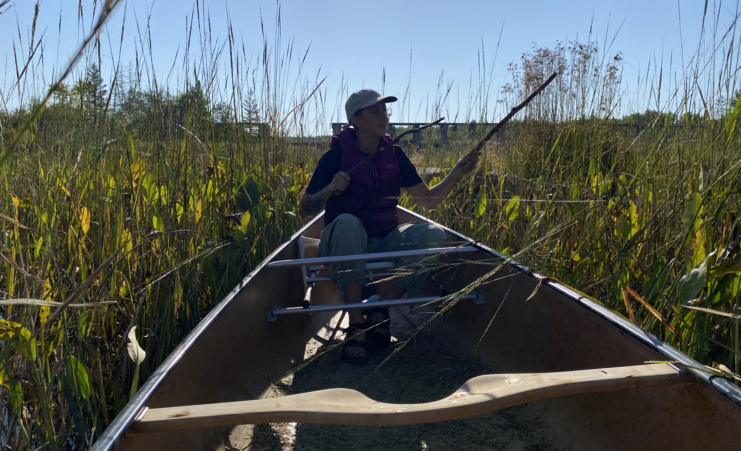
Environmental Study Initiatives
Broadening Environmental Analysis and Dietary Sustainability (BEADS)
Wild Rice Study

Slide 8
Thank you!
Questions, Comments, Concerns?
Follow up with:
Marci Riel
Senior Director of Energy, Infrastructure, and Resource Management
marci.riel@mmf.mb.ca
204-586-8474 ext. 2790
Enjoy the rest of the Assembly!

