Slide 1

Citizenship, Constitution, Rights, Governance, and Beyond Borders

Slide 2
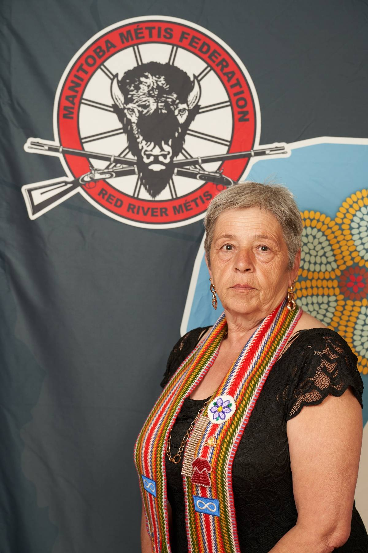
Minister Judy Mayer
  Minister responsible for:
    Citizenship
    Constitution
    Rights
    Governance
    Beyond Borders

Slide 3

Citizenship
  Mandate Foundations:
    Work with CRO to continue to maintain our high standards for Citizenship, while enhancing the experience of our Citizens and potential Citizens across the Homeland and beyond.

Slide 4

2024-25 Citizen Application Stats
Citizenship
Approved New Applications: 5,928
Approved New Male Citizens: 2,860
Approved New Female Citizens: 3,045
Approved New Non-Binary Citizens: 23
Approved New Youth: 2,111
Approved New Adults: 3,817
Approved New Harvesters: 3,947
Approved New Citizens Living Outside of Manitoba: 704
Total Approved Citizens: 60,253
Total Approved Harvesters: 37,336

Slide 5
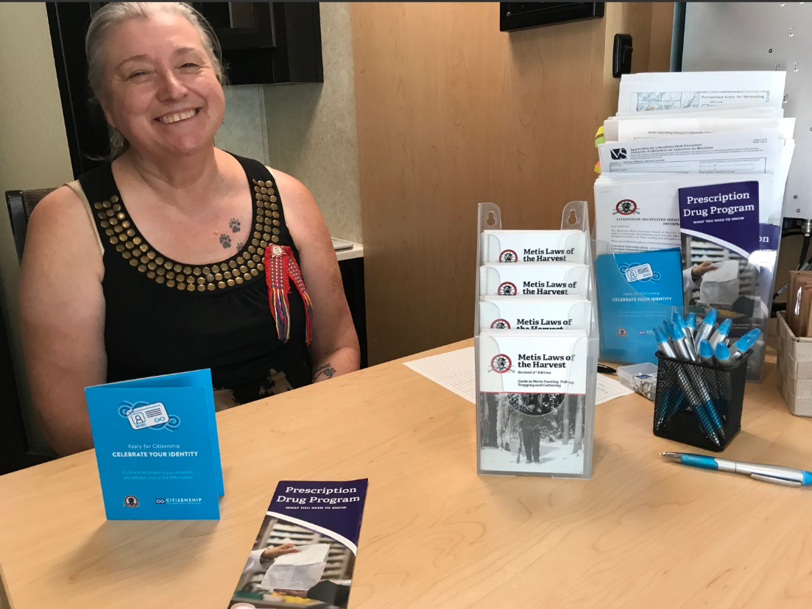
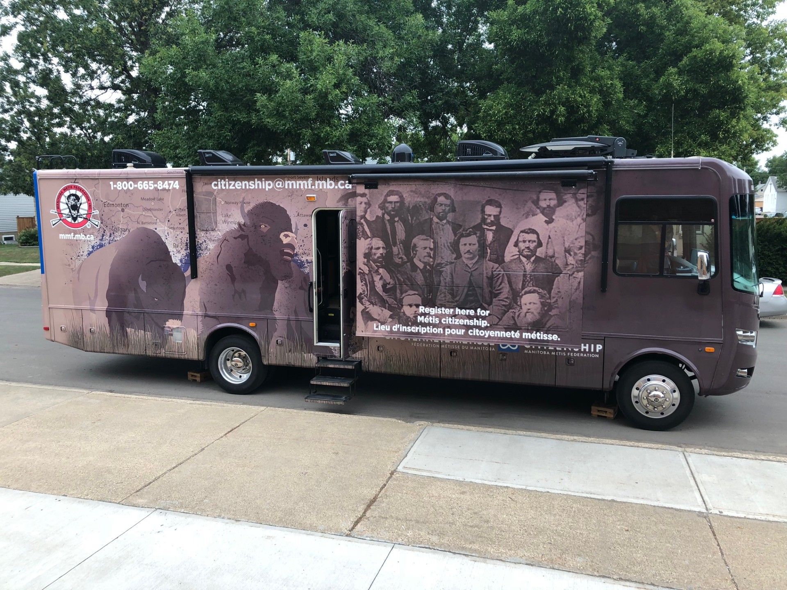
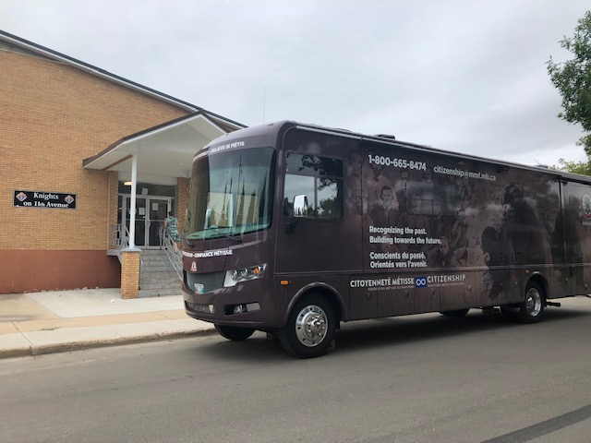
Mobile Citizenship Office
Citizenship

Slide 6
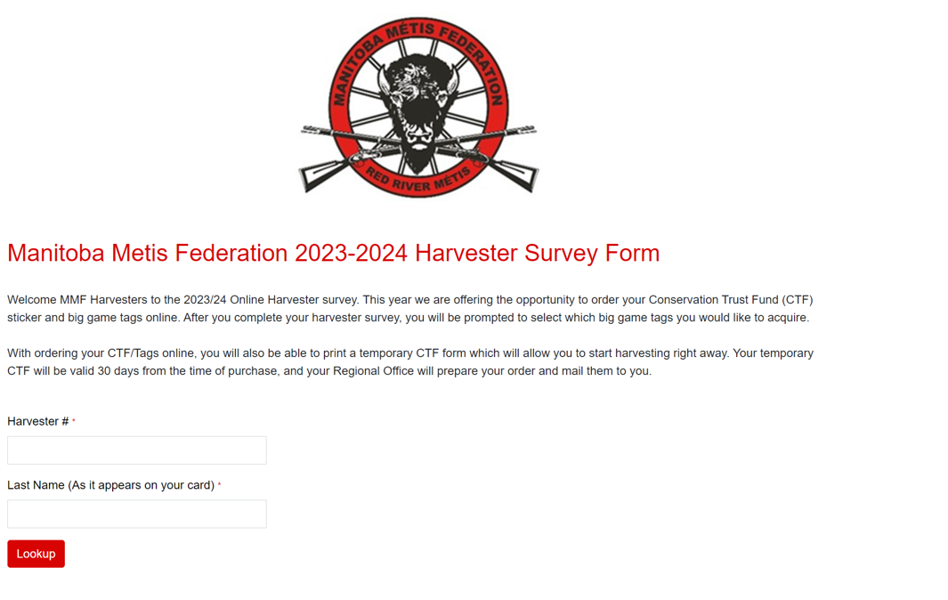
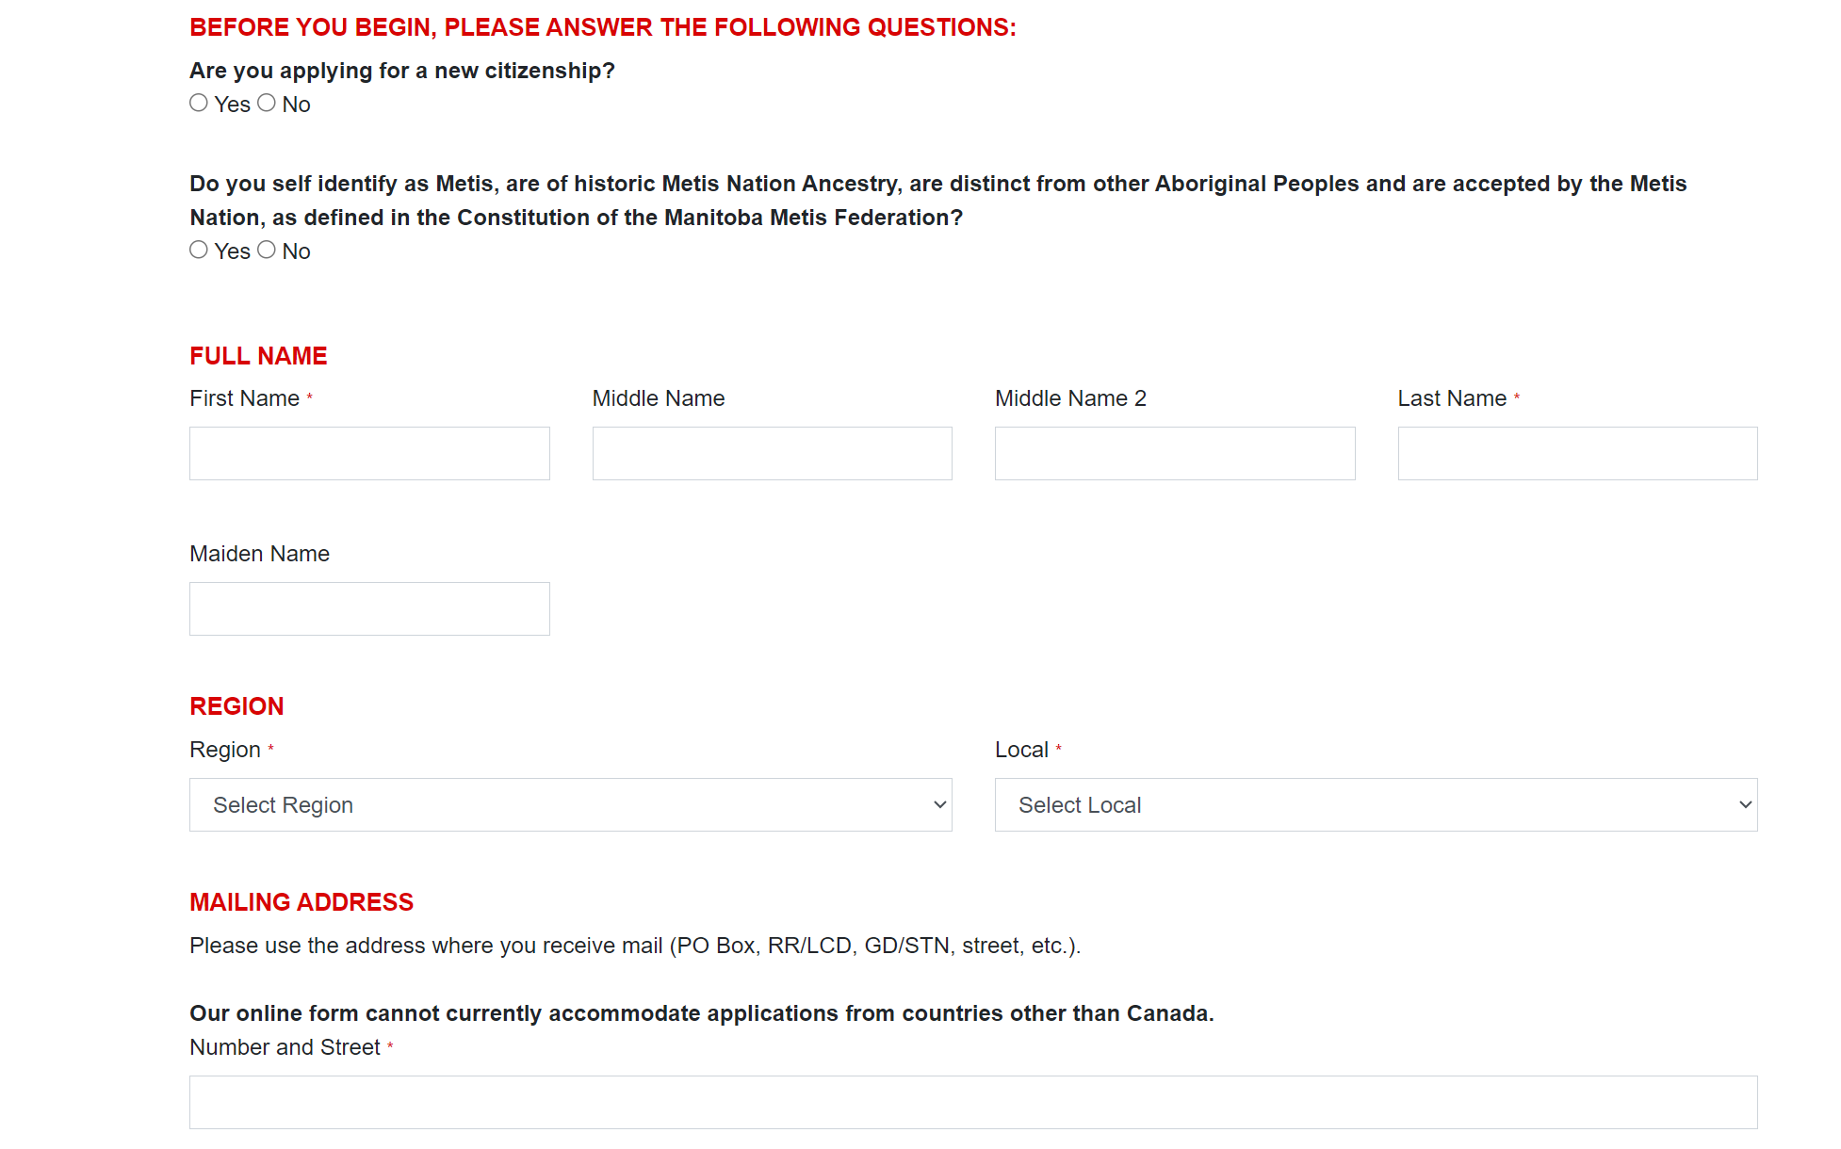

Citizenship
Technology Development Updates

Slide 7
Constitution & Governance
  Mandate Foundations:
    Chair the Constitution & Governance Committee and guide amendments aligning with the Self-Government Recognition and Implementation Treaty (2024)
    Strengthen grassroots democracy by empowering Locals and modernizing governance tools.
    Ensure internal consistency and transparency across MMF systems.

Slide 8
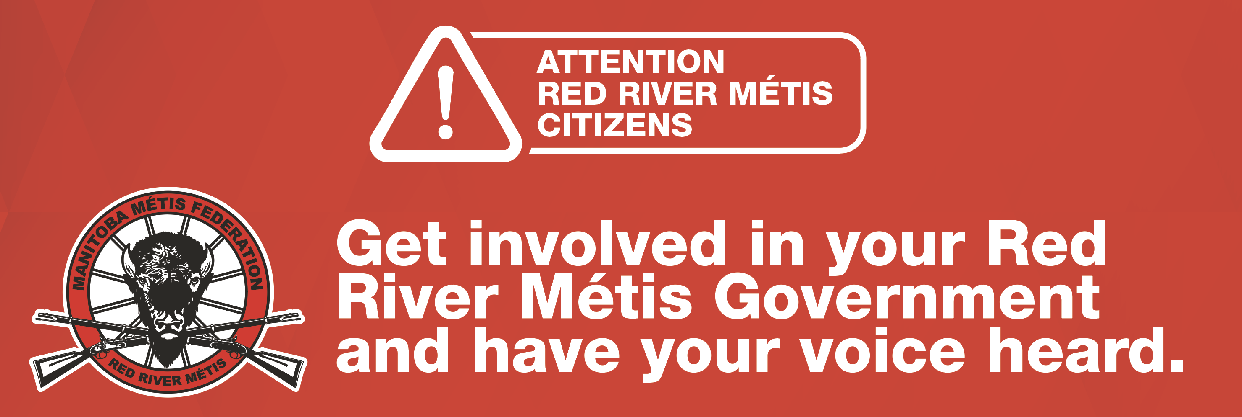
Constitution & Governance
  2024/2025 Progress:
    Treaty Transition: preparing for MMF Inc. to dissolve, transitioning fully to the National Government of the Red River Métis.
    Local Bylaw:
      7 regional workshops completed, scheduled virtual townhalls
      2,700+ pages of Citizens feedback submitted
      2,500 survey responses received

Slide 9
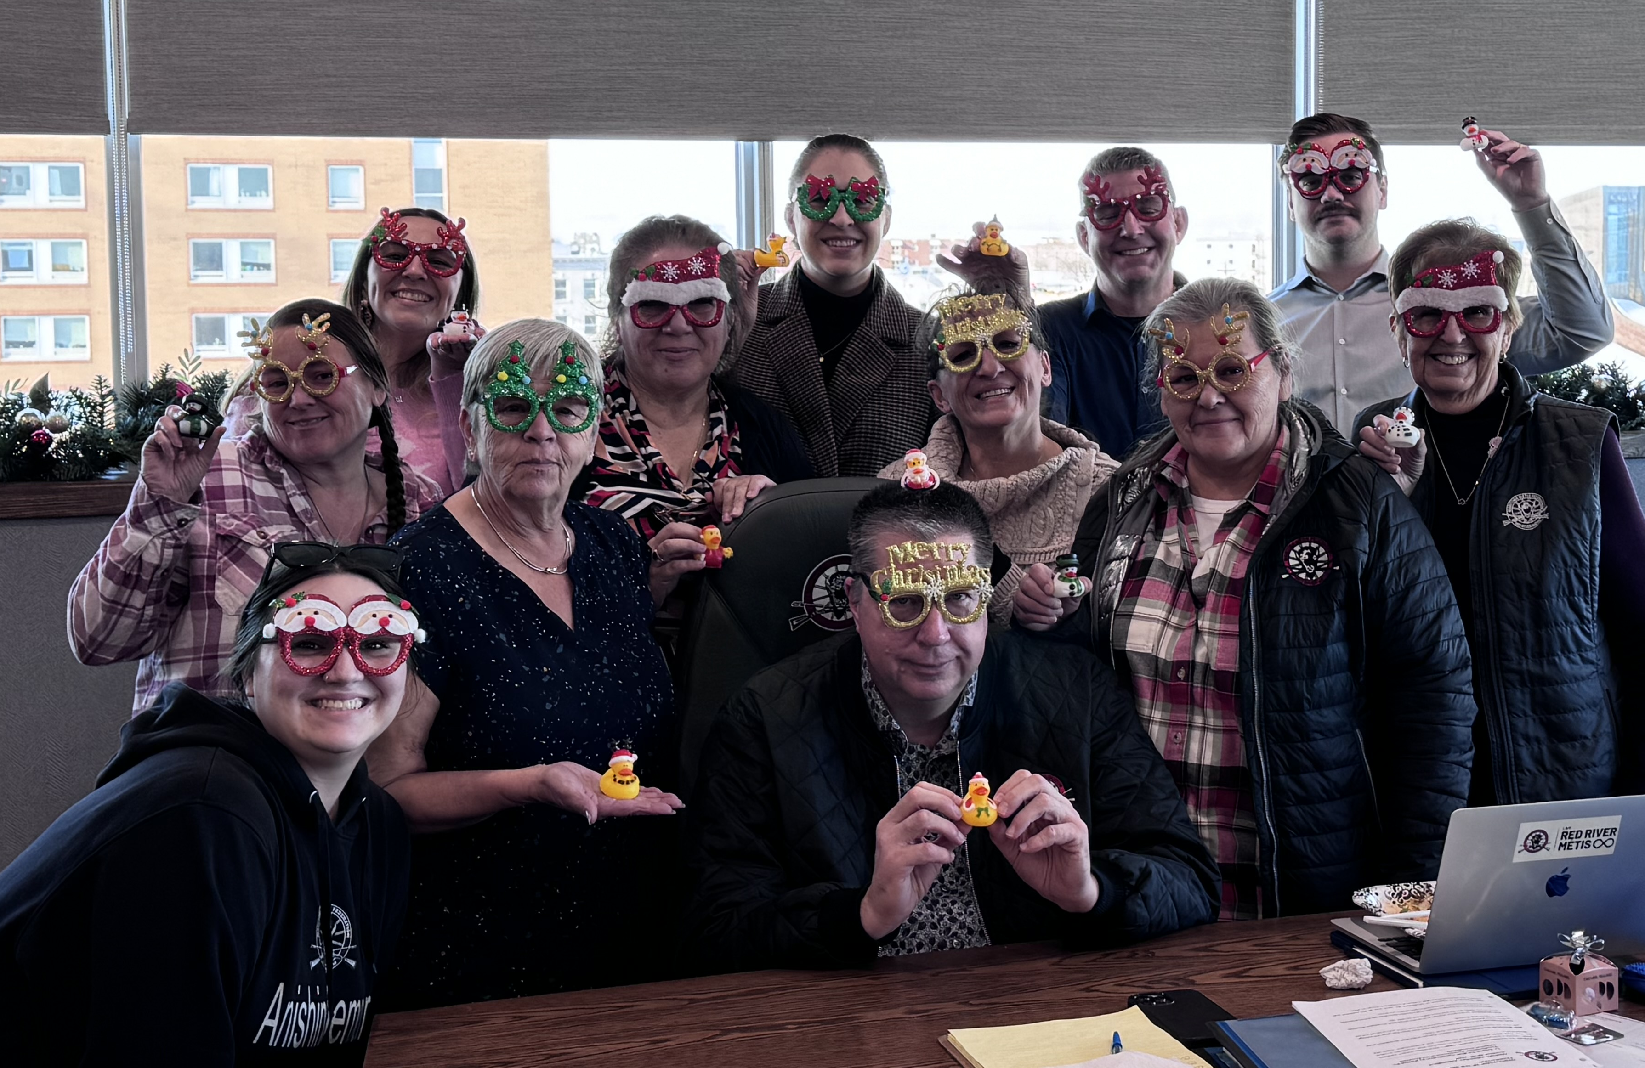
Constitution & Governance
  Next Steps 2025/2026:
    Local Bylaw redraft and Constitutional Amendments for AGA 2026
    Implementation of Red River Métis Research and Ethics Protocol
    Continued policy development

Slide 10

Rights
  Focus: Protecting Red River Métis Rights and Knowledge
    Continued development of the Red River Métis Research and Ethics Protocol
    Advancing MMF’s authority to approve and monitor research involving Red River Métis Citizens

Slide 11
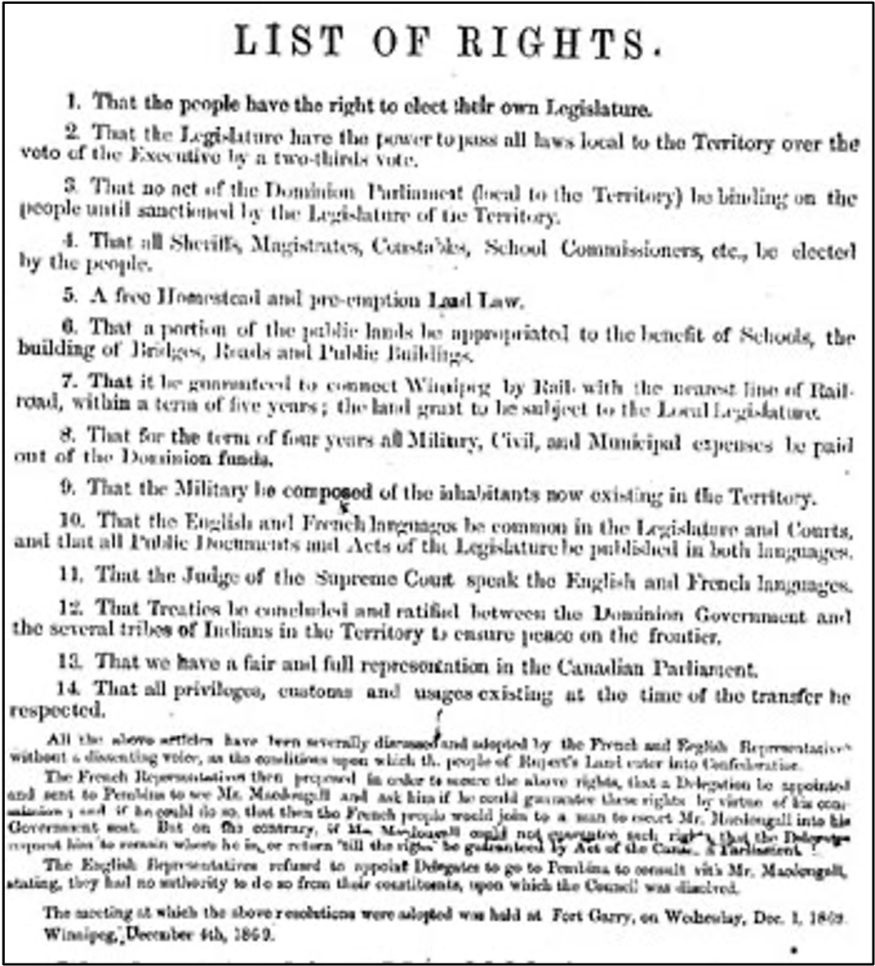
Rights
  Outcome
    Our Research and Ethics Protocol is a modern expression of our sovereignty, it protects our stories, knowledge, and identity from misrepresentation while ensuring that research serves purpose and delivers priorities important to the Red River Métis.

Slide 12

Beyond Borders
  Mandate Foundations:
    Deliver programs and services for Citizens beyond the province of Manitoba
    Implement the Beyond Borders Task Force Report (2022) and coordinate departmental support.

Slide 13
Beyond Borders
  2024/2025 Progress:
    Finalizing Departments and Affiliates Guide to centralize information for all Citizens
    Facilitation of cross-departmental advocacy on service delivery barriers.
    Strengthened trust and belonging for Citizens living beyond Manitoba

Slide 14
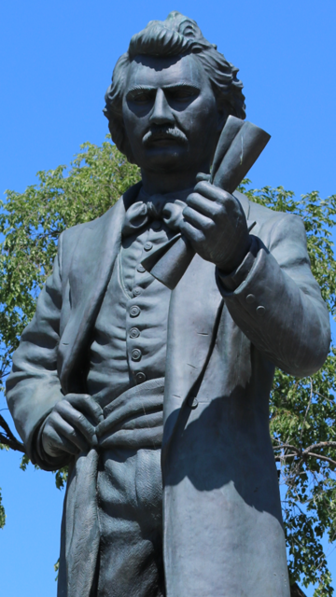
Beyond Borders
  Next Steps 2025/2026:
    Mobilize service feasibility study to expand access to services
    Launch MMF Department and Affiliates Guide for Citizens
    Continued support of inclusion models for out-of-province program and service delivery.

Slide 15
Thank You
Merci
Maarsii

