Slide 1



Slide 2
Your Story...Starts Here
I welcome Red River Metis Citizens to the 2025 Annual General Assembly. As the Minister of Pemmican Publications Inc. (Pemmican), an Affiliate of the Manitoba Métis Federation (MMF) – National Government of the Red River Métis – I am pleased to report our fiscal year accomplishments.
Pemmican continues to play an important role in acknowledging and publishing information brought forward through literary works. Pemmican continues to be successful in supporting authors and illustrators who have been supplying content and driving excitement for Pemmican Publications.
Pemmican will continue to innovate and generate new and exciting publishing opportunities for Red River Métis Citizens. For Citizens who have a story to tell or an idea to share, Pemmican welcomes an opportunity to publish your ideas and tell your stories.

Slide 3
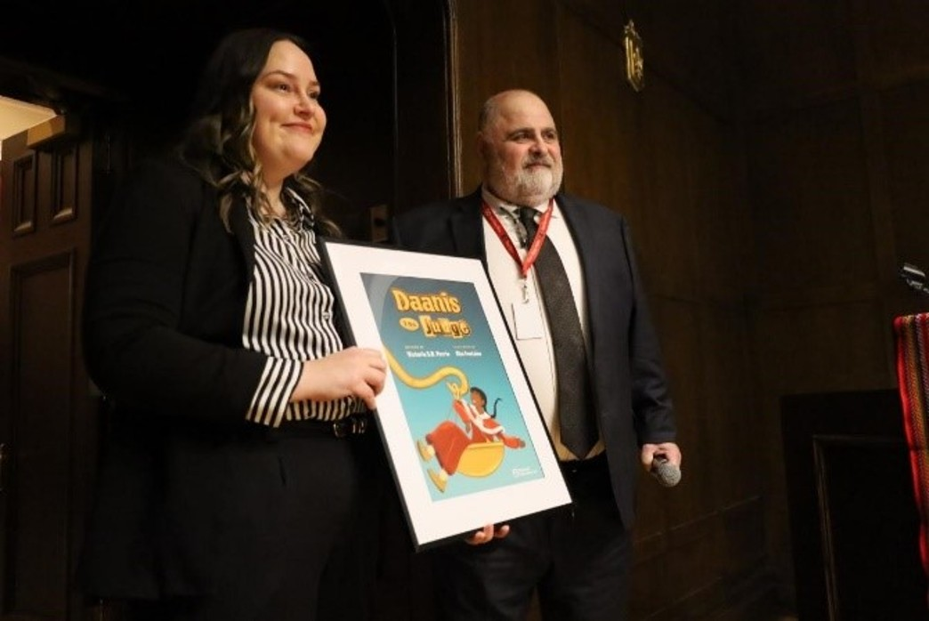
Pemmican’s mandate is to promote Canadian Red River Métis writers and illustrators through stories that are informed by Métis experience. With each new year that means a wider spectrum of stories. Our objective is to build a catalogue of informative, entertaining and commercially viable titles that reflects both the history and hopes of Red River Métis people past and present. The objective is to produce stories that will provide affirmation and encouragement for Métis readers, while also offering much to enlighten and entertain everyone who enjoys the timeless value of a good story told with passion and flair.
Pemmican was founded as a non-profit organization in Winnipeg, Manitoba in 1980 by the MMF.

Slide 4

BUSINESS REVIEW
A viable strategic plan was developed that involved:
A review and development of business operations:
  Established new guidelines for the board of directors;
  Presented the board of directors’ nominees to MMF Cabinet;
  Obtained control of existing website;
  Established new author and illustrator submission guidelines.
An assessment of business requirements:
Financial review and budget development;
  Developed an operational budget for 2024-2025;
  Researched new and previous funding opportunities.
Dialog with new authors and illustrators;
  23 new manuscripts have been submitted;
  11 new authors/ illustrators have approached Pemmican;
  15 books are in the works to be published:
    12 external books
    3 internal books

Slide 5

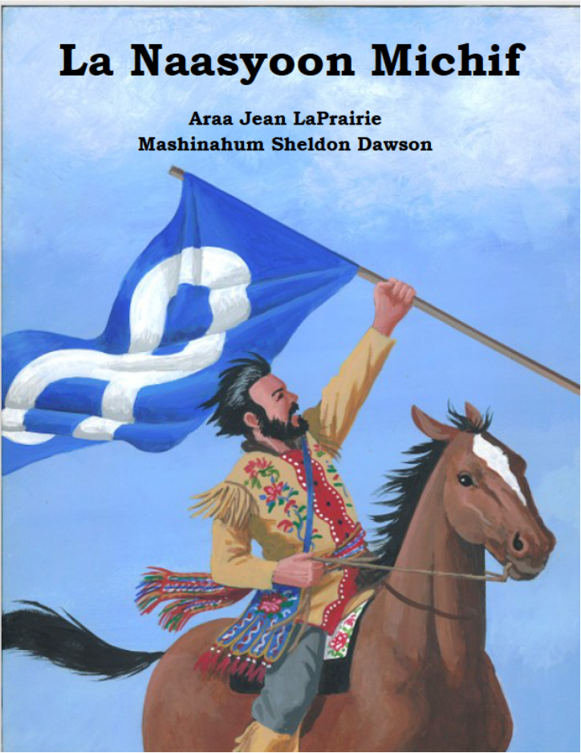
3. Developed Sales and Marketing Plans:
Developed Sales Plans:
  Prepared a catalogue of existing Pemmican books for sale;
    Pemmican was revitalized with an inventory of the previous catalogue. This inventory is essential in generating seed money for new publications.
  Examined current day business avenues. eBooks, audible, magazines opportunities, art and entertainment, partnerships;
    New business opportunities in publishing are centered around e-commerce. Currently, Pemmican is working on developing an e-commerce platform.
Developed Marketing Plans:
  Find as many Red River Métis authors as possible to share stories and build content to be potentially published. Finding accurate sources of cultural and heritage based historical material is important and essential.
Received Michif Funding

Slide 6


Print Services:
  Internal;
    Print and publish services for MMF Departments and Affiliates;
    Partnership with Edward Simard General Store Inc.(ESGS) to source materials and fulfill print and request needs;
    Researched data for content;
  External;
    Print and publish services.
Book Services:
    Partnership with ESGS to acquire books and fulfill book request needs for MMF Departments and Affiliates.

Slide 7

STATISTICS
Red River Citizens’ requests:
  116 inquiries;
  9 new author requests;
  8 old authors requests;
  20 manuscripts;
  9 current projects.
Number of Michif Projects Pursuing:
  Internal Projects (6)
  External Projects (3)
With our partnership with the MMF’s Michif Languages Department, Pemmican is the designated printer and publisher for Michif opportunities.
“Help us help you tell your story!”
PemmicanPublications@mmf.mb.ca
www.PemmicanPublications.ca

