Slide 1

Agriculture Portfolio

Slide 2
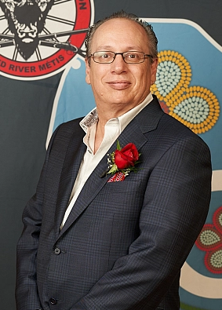
Agriculture Portfolio
The MMF’s Agriculture Portfolio seeks to advocate for Red River Métis interests in agriculture and agri-food.
The 2024-25 year saw progress towards:
  Supporting the environmental and economic sustainability of Red River Métis-owned farms
  Addressing food insecurity
  Expanding the database of Red River Métis Citizens involved in agriculture and agri-food

Slide 3
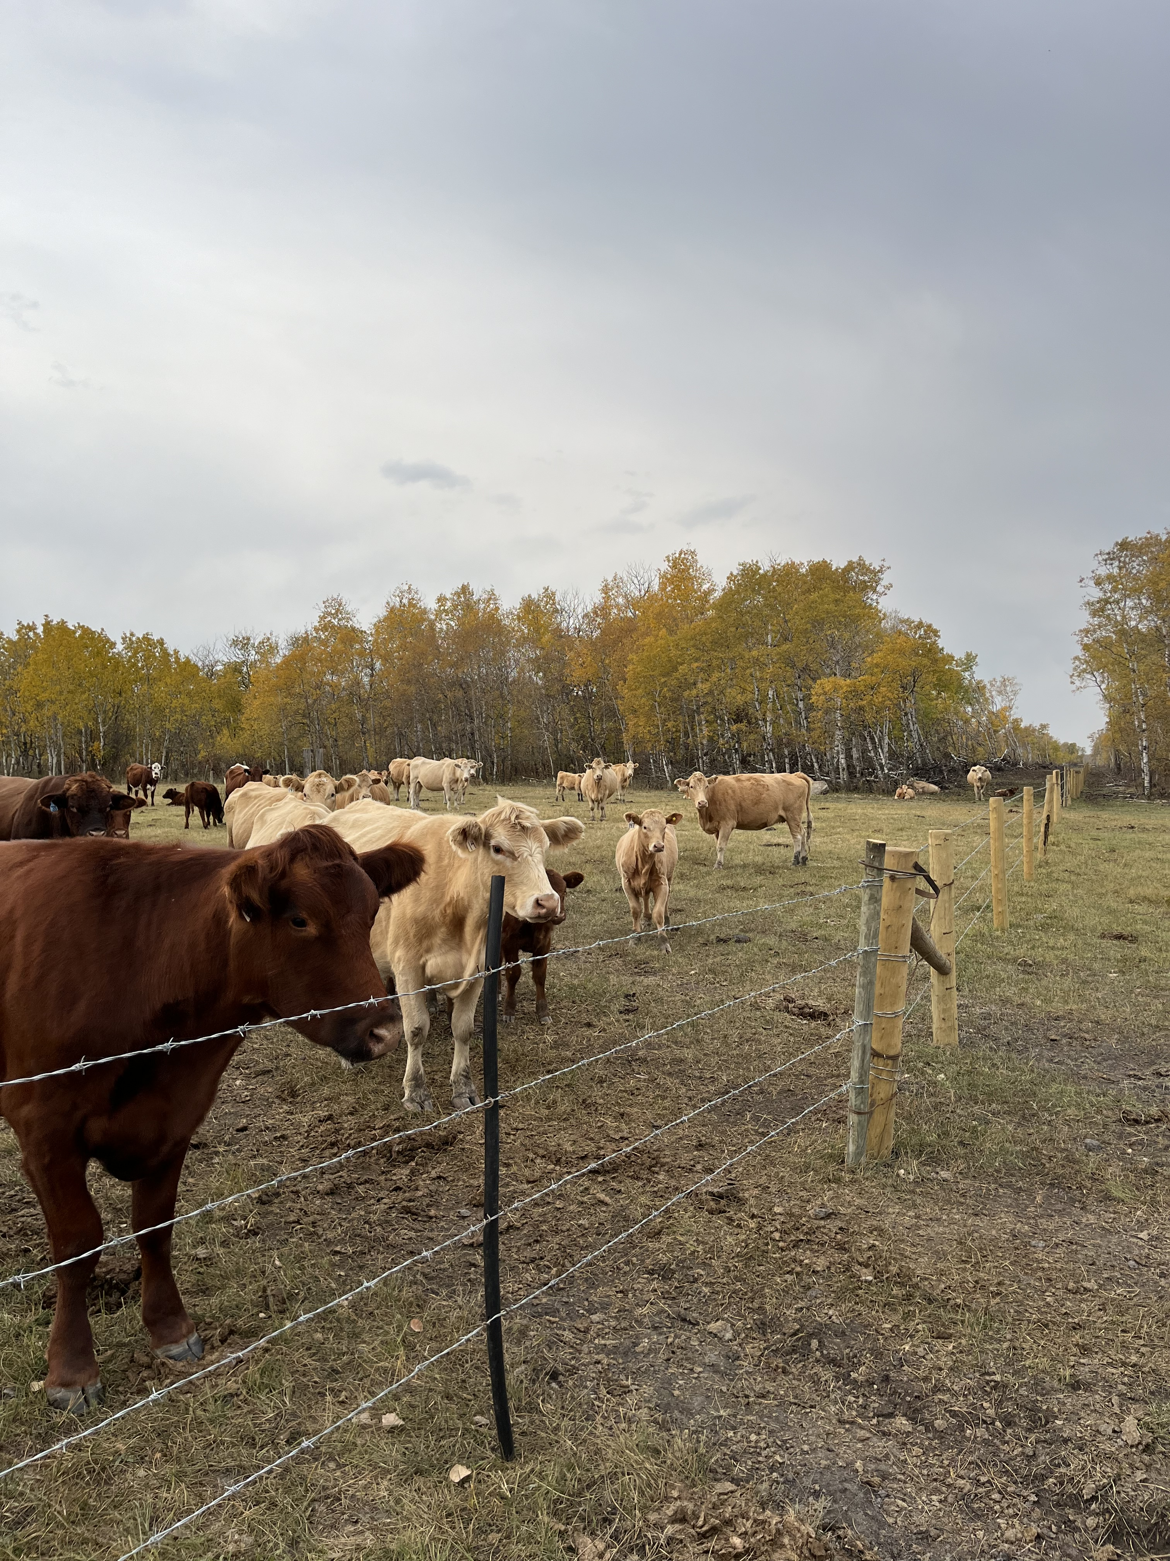
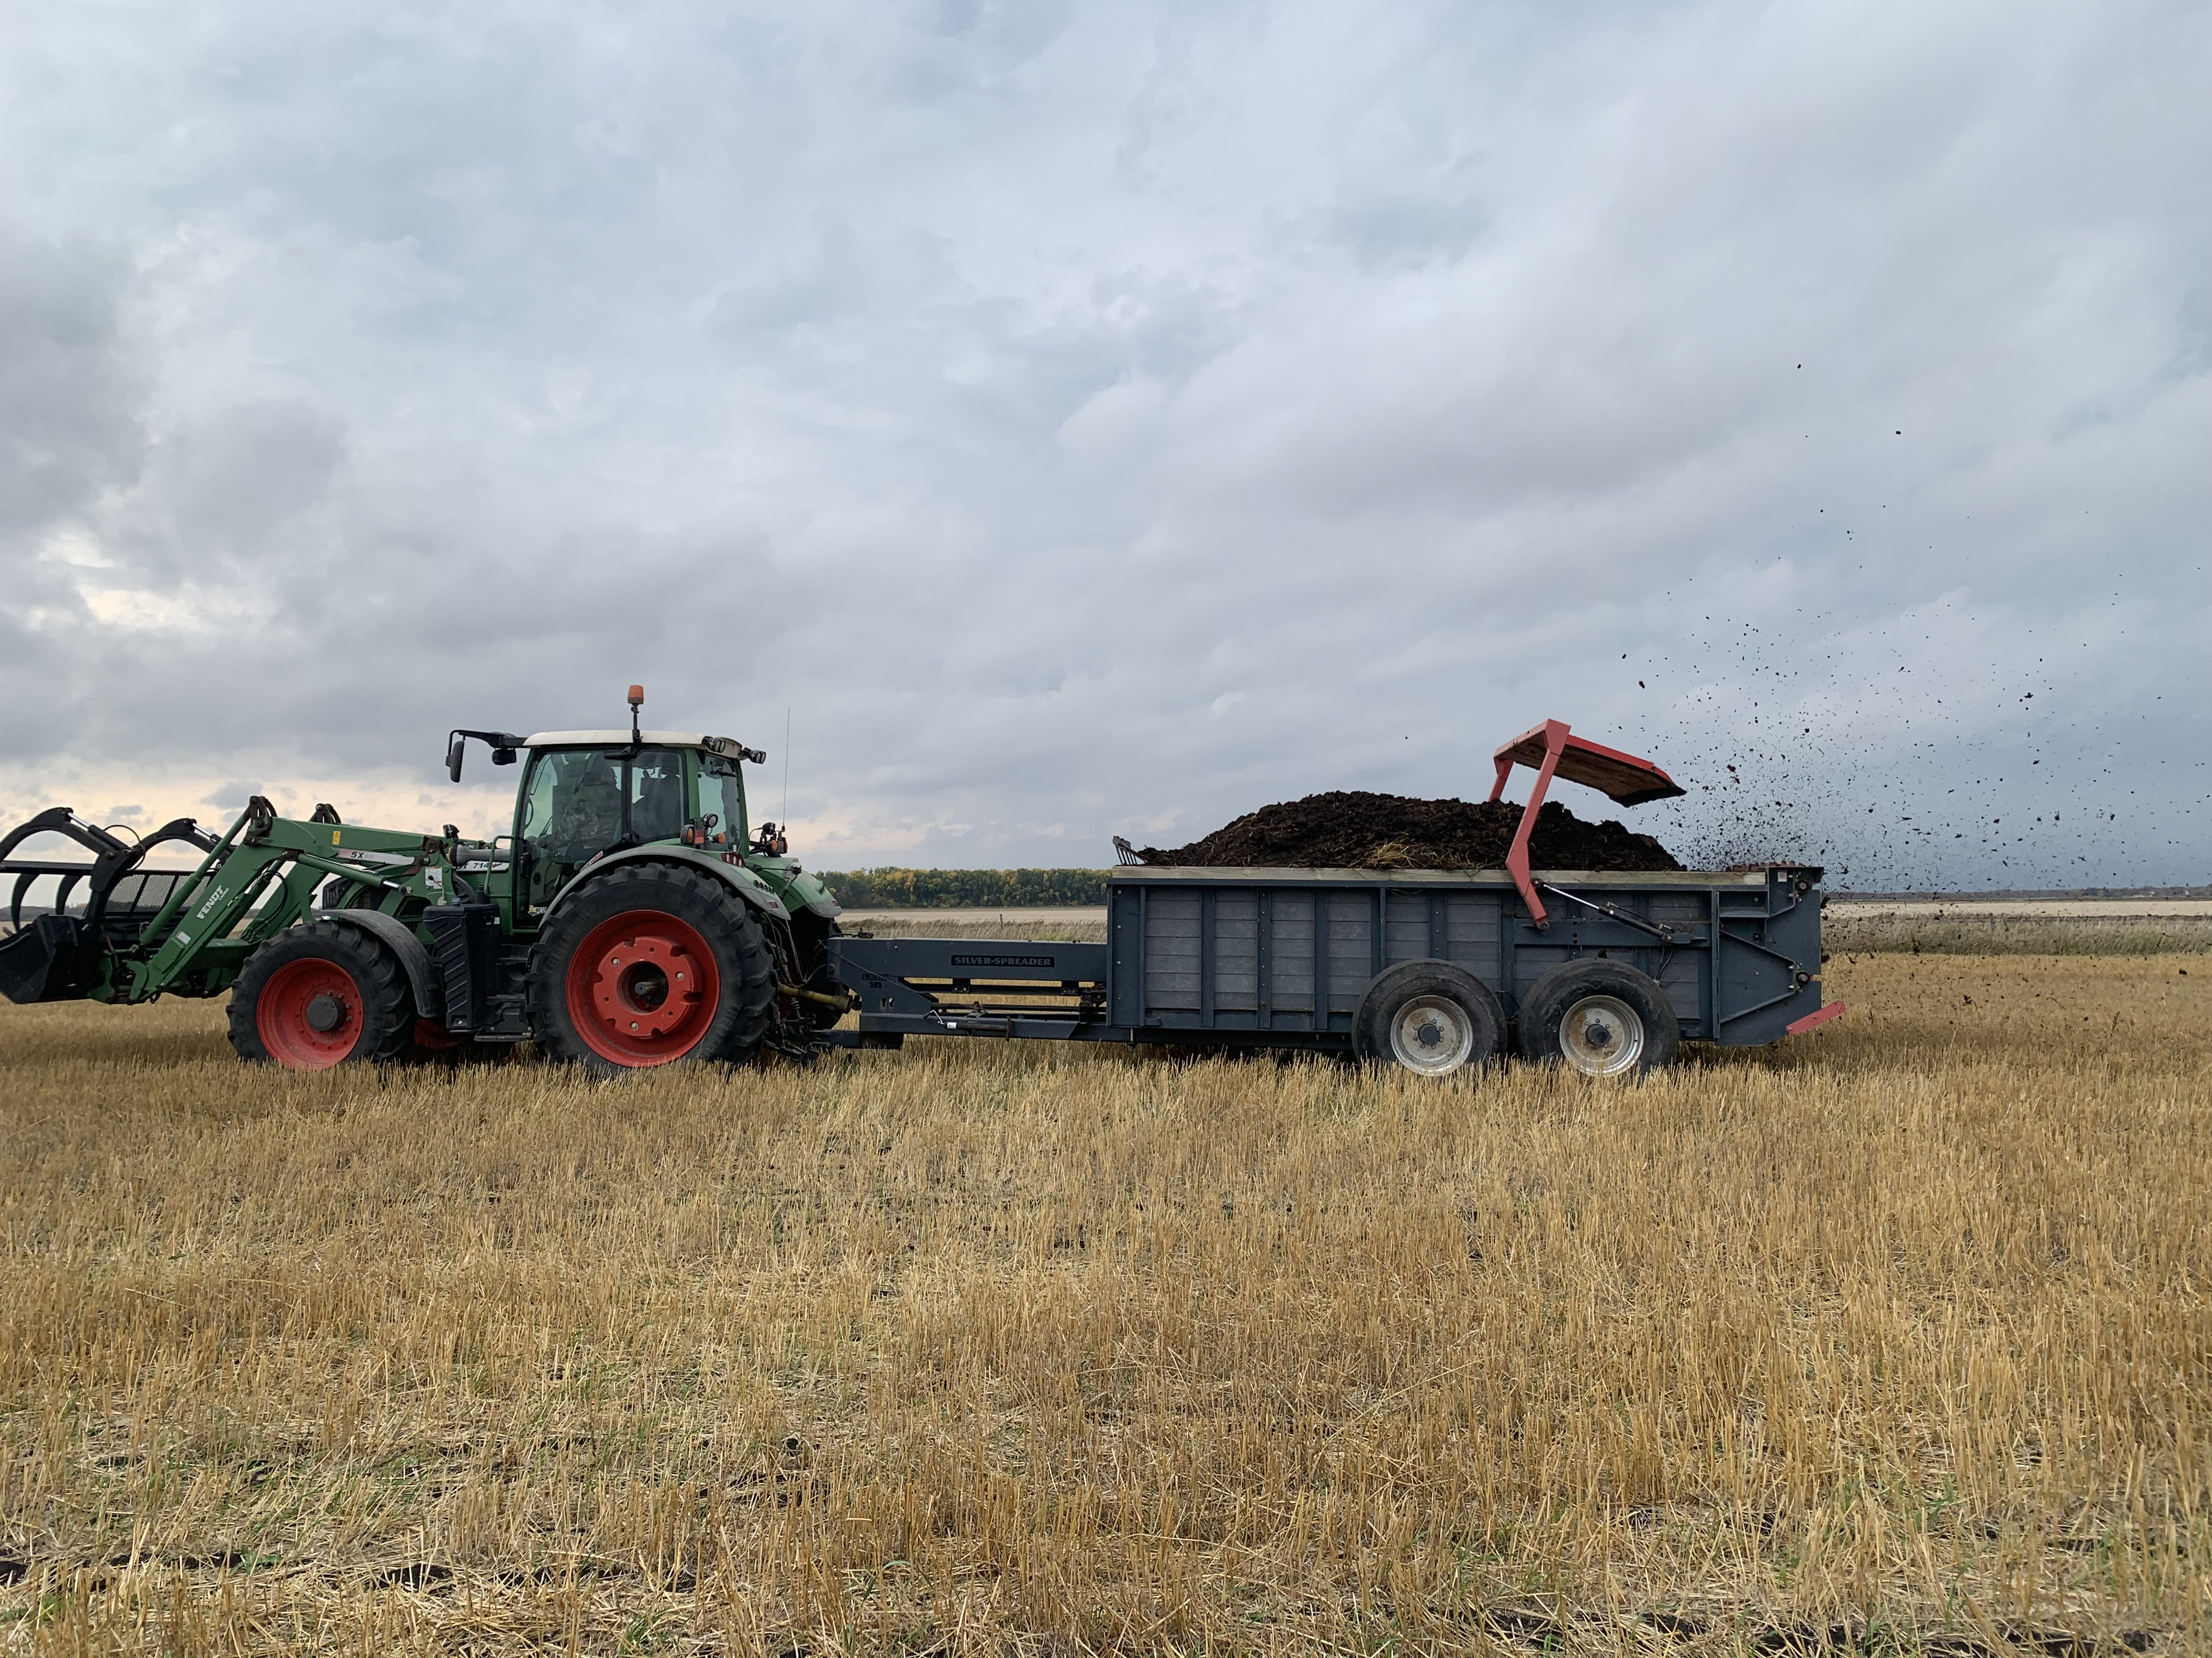
Red River Métis
On-Farm Climate Action Program
The MMF secured over $11M over three years to support Red River Métis agricultural producers across the National Homeland in adopting climate-conscious farm practices.
In 2024-25, over $3M in funding was awarded to 68 producers across 6 MMF Regions.

Slide 4
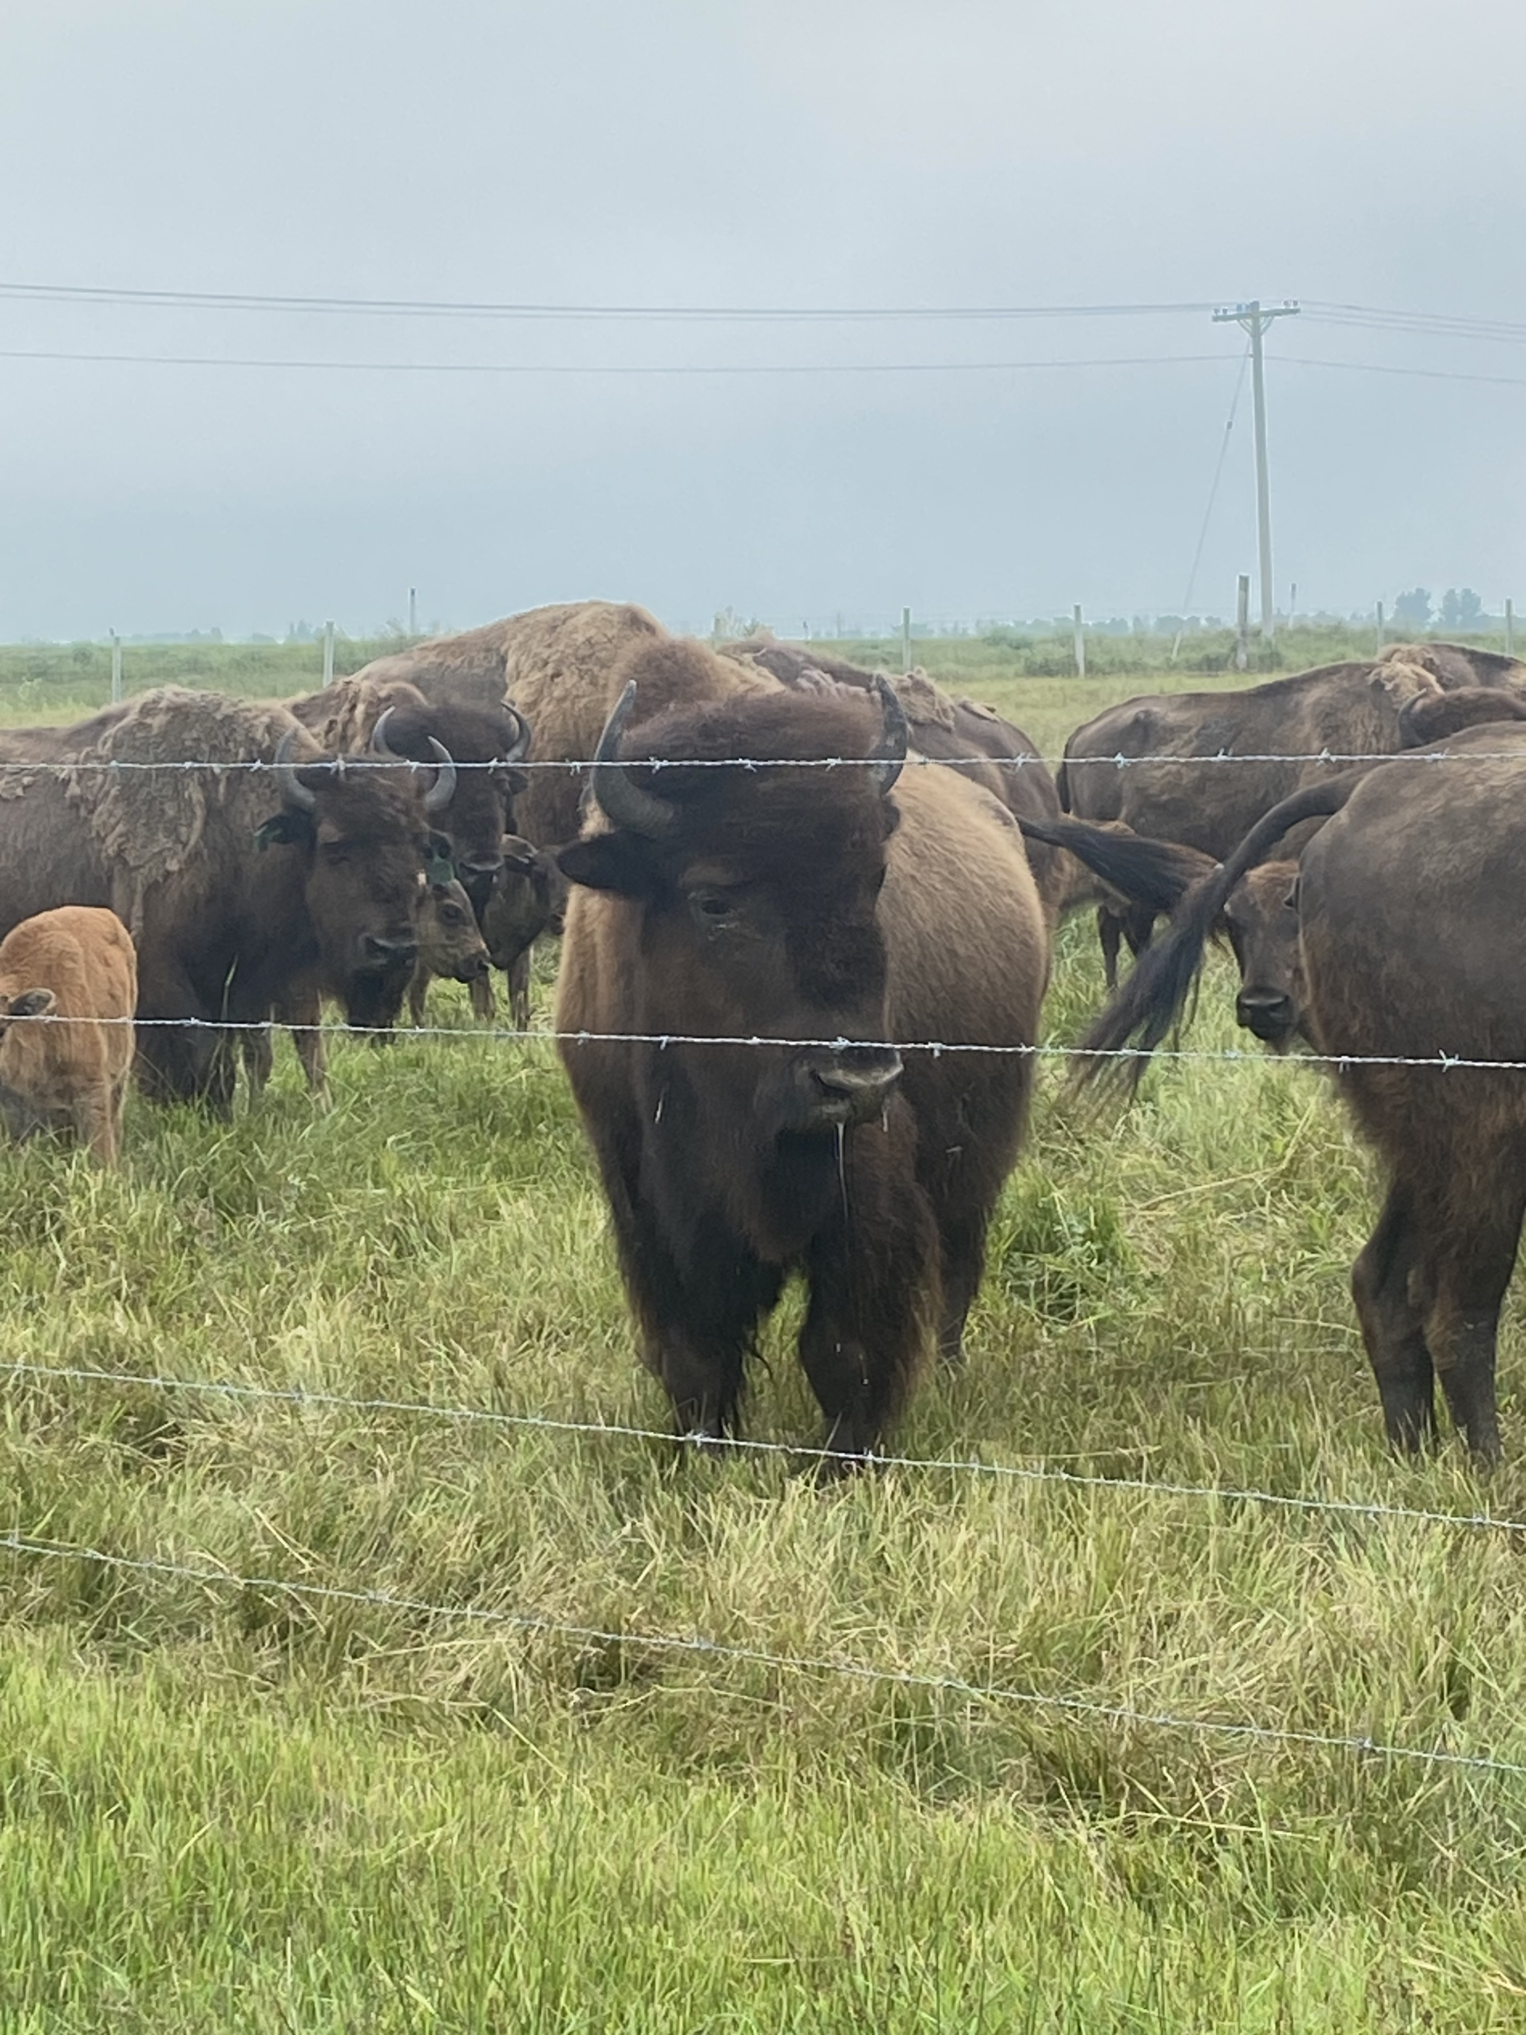
Bison Herd
The MMF’s herd consists of 21 animals, including 9 cows.
The herd is cared for by Red River Métis-owned Iron Head Bison Ranch.
Bison symbolize Red River Métis culture, and provide opportunities for education, economic development, and traditional food distribution.

Slide 5
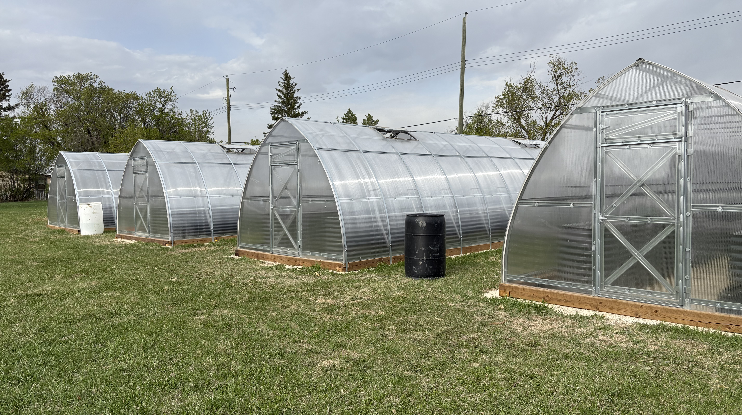
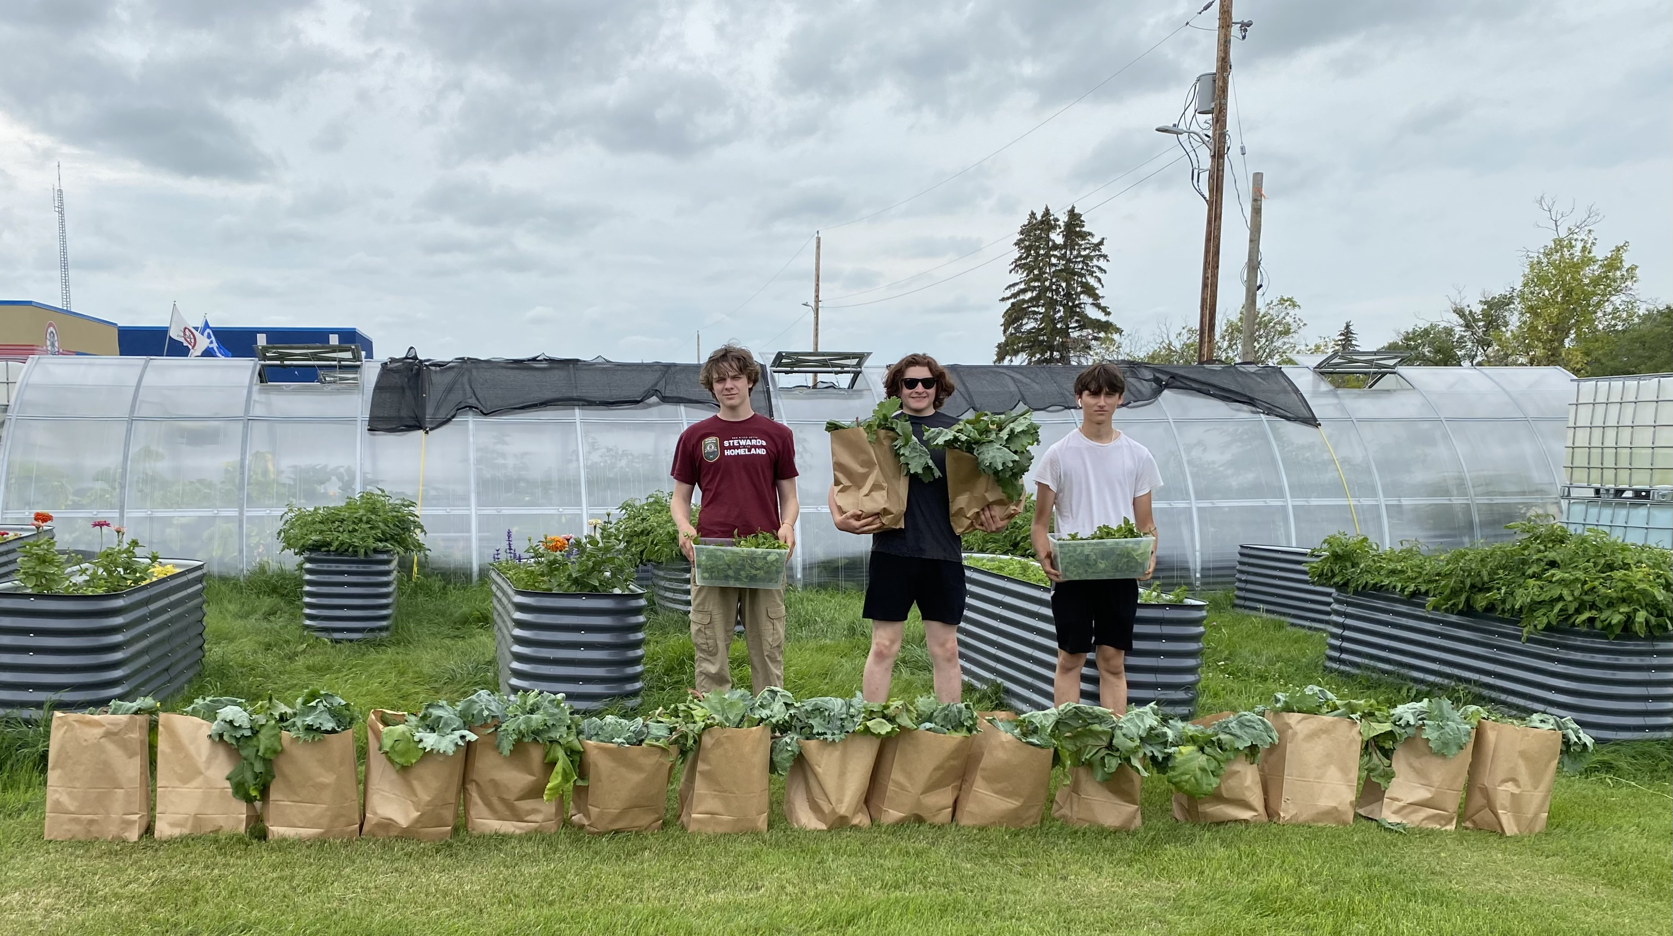
Food Security Initiative
To address food insecurity, the MMF is establishing a network of greenhouses and community gardens across the National Homeland.
In 2024, locations in Interlake and Southwest Regions were operational.
Additional locations were constructed in The Pas, Thompson, and Winnipeg Regions.

Slide 6
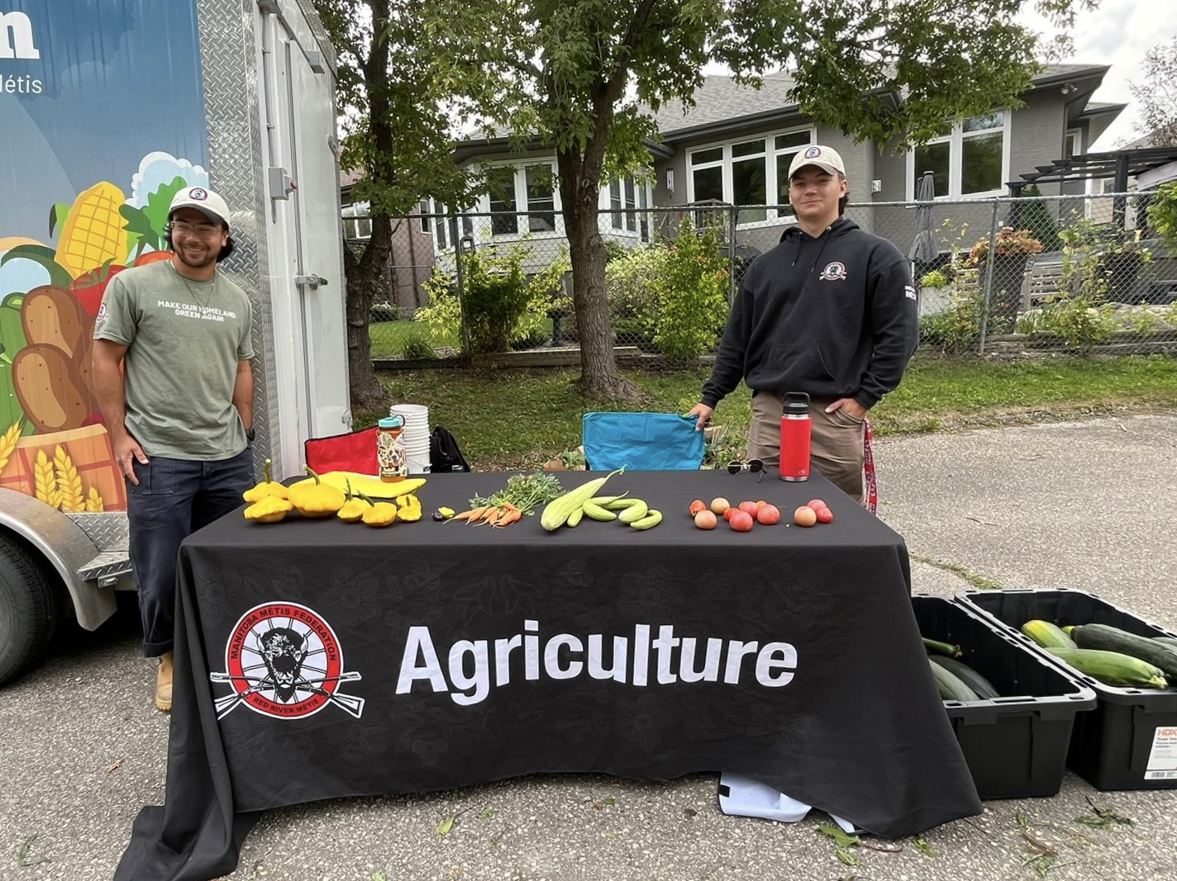
Riel House Garden
MMF oversees care of the vegetable gardens at Riel House National Historic Site, in partnership with Parks Canada.
In 2024, over 700lbs of produce was harvested and distributed.
Riel House gardens also provide summer employment opportunities for Red River Métis Youth.

Slide 7
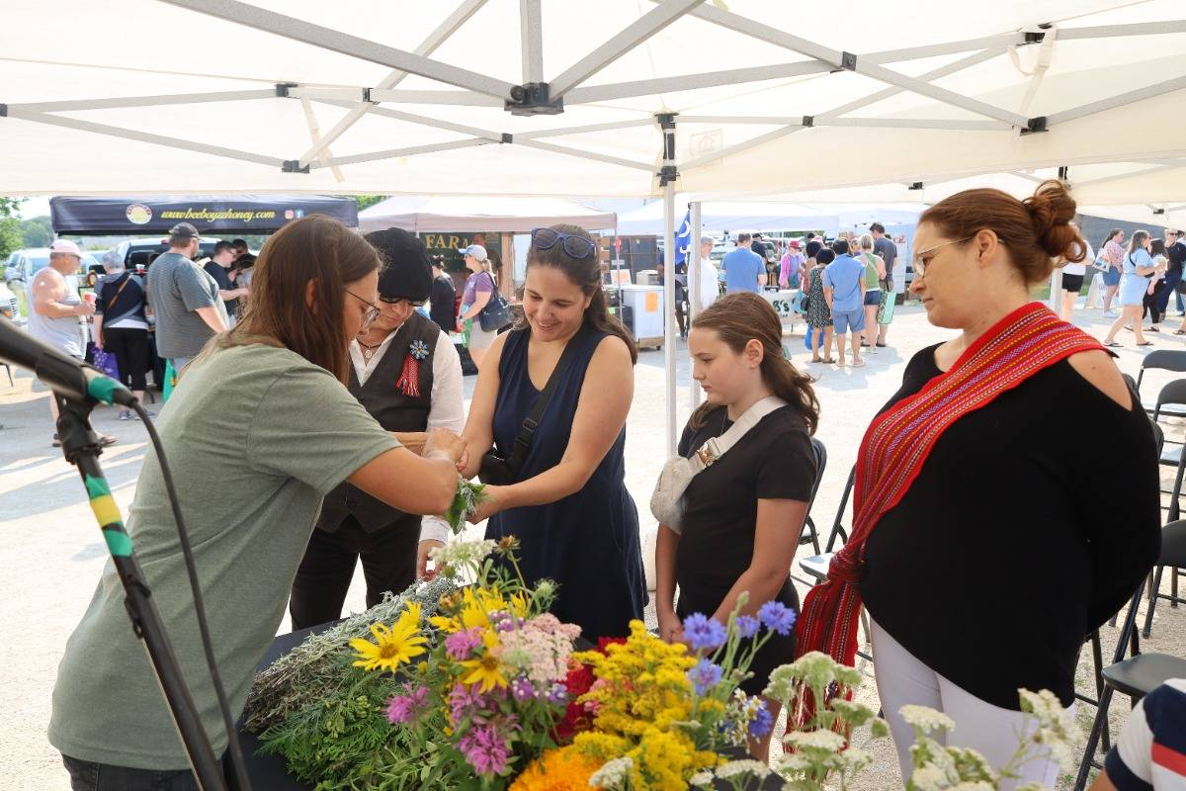
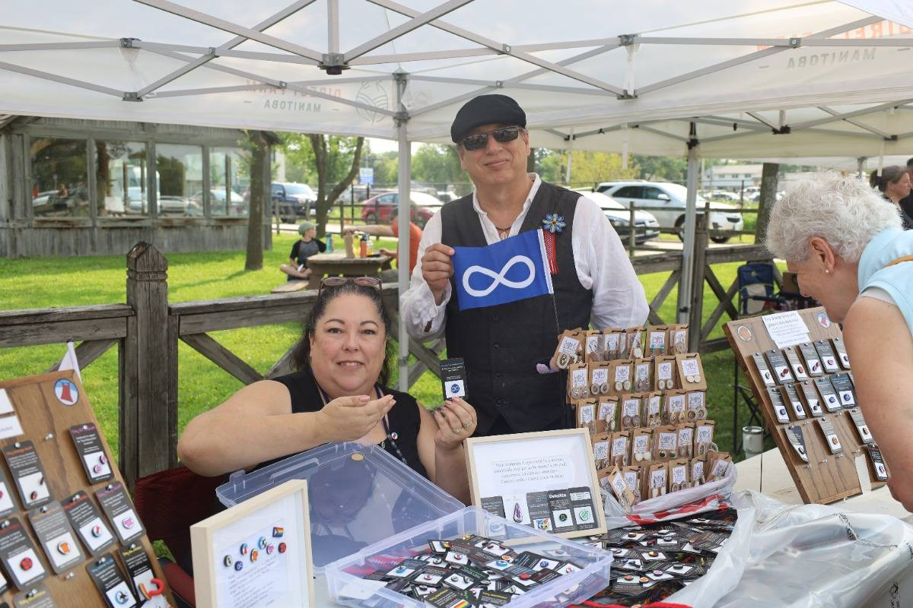
Farmers Markets
The 2nd Annual Red River Métis Market Day at Le Marché St. Norbert Farmers Market was held July 27, 2024.
This event showcased Red River Métis culture and tradition through interactive workshops, food, Red River Métis artisans, traditional music and dance.

Slide 8

Maarsii, Thank you
If you have any questions or concerns regarding the Agriculture Portfolio, please contact:

