Slide 1


Slide 2
Sixties Scoop Annual Report
2024-2025
Empowering Healing, Restoring Dignity
Presented by: Minister Denise Thomas (Minister of Sixties Scoop)

Slide 3
Introduction
Our department is dedicated to addressing the painful legacy of the Sixties Scoop — a chapter that disrupted families, erased identities, and caused generations of loss.
Guided by Survivors and grounded in Red River Métis traditions, our department supports Red River Métis Survivors and families affected by the Sixties Scoop, Residential and Day Schools.

Slide 4
Key Activities – Sixties Scoop Focus
Kitchen Table Talks (Oct, Nov 2024): Strength-based, capacity-building and family centred sessions for survivor resilience.
Bridge to Justice Fund Launch (Oct 2024): $2M initiative to support Survivors. $5000 per eligible Red River Métis Citizen, 320 Applications received so far, about 169 Approved and Paid.

Slide 5
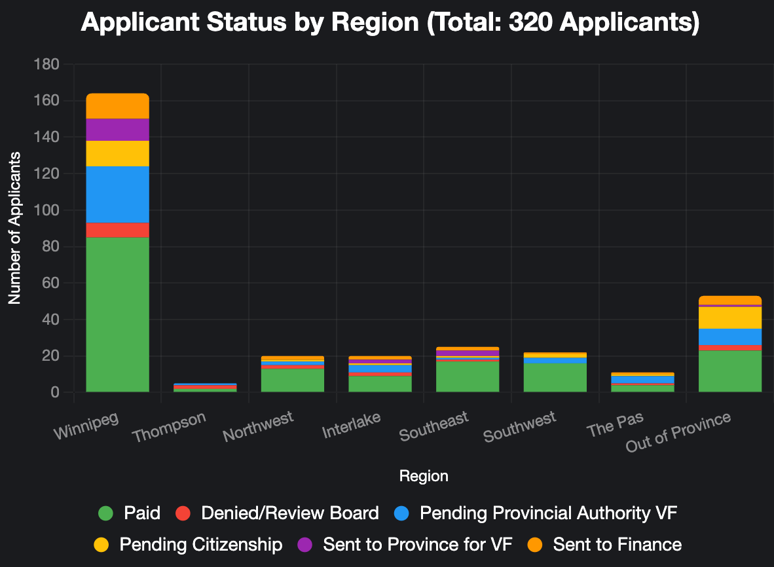
Paid: 52.8%||Denied/Review Board: 5.9%||Pending Provincial Authority VF: 17.2% Pending Citizenship: 10% ||Sent to Province for VF: 5.6% || Sent to finance: 8.4%

Slide 6
Looking Ahead
Application for the Bridge to Justice Fund is still open till we reach 400 approved Applications.
Expansion of the current Kitchen Table Talks to reach more Survivors and families

Slide 7
Looking Ahead
Advocate for sustainable funding for Métis-specific programs and services.
Building partnerships
Advancement of the Sixties Scoop Mandate

Slide 8
Conclusion
Committed to honoring Survivor voices and fulfilling President David
Chartrand’s mandates.
Gratitude to Elders, Survivors, Citizens, and partners for guidance.
Building a future where the wounds of the Sixties Scoop are healed through truth, unity, and dignity

