Slide 1
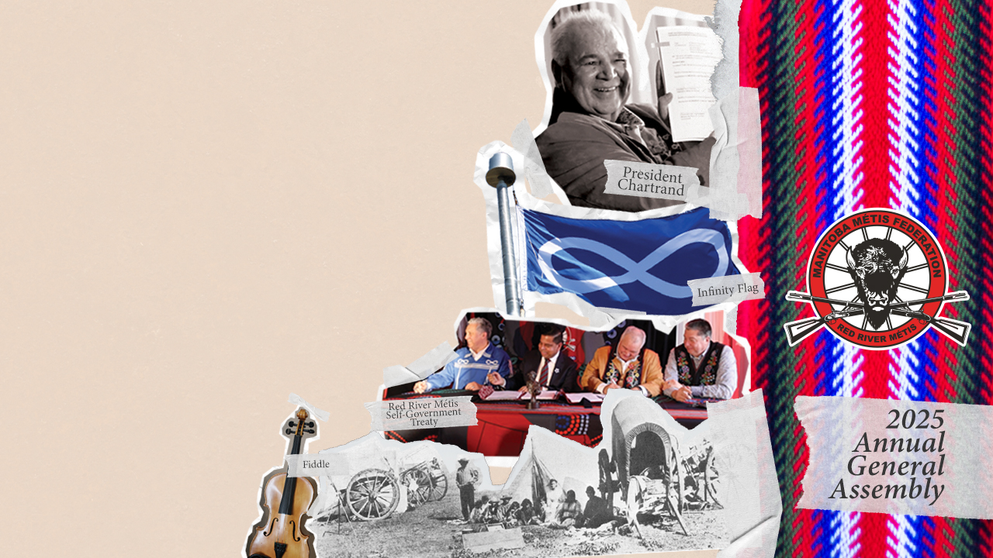

Engagement &
Consultation
2024-2025

Slide 2

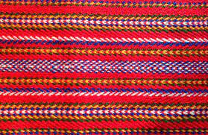








Our History
Resolution No. 8 was passed unanimously at the 2007 Annual General Assembly.
Formed in 2013 to ensure Citizens are consulted on projects or plans that potentially impact your rights.
Natural resource projects
Social initiatives
National strategies
Legislative changes
Energy & infrastructure projects
Education
Health strategies & initiatives
… and more

Slide 3
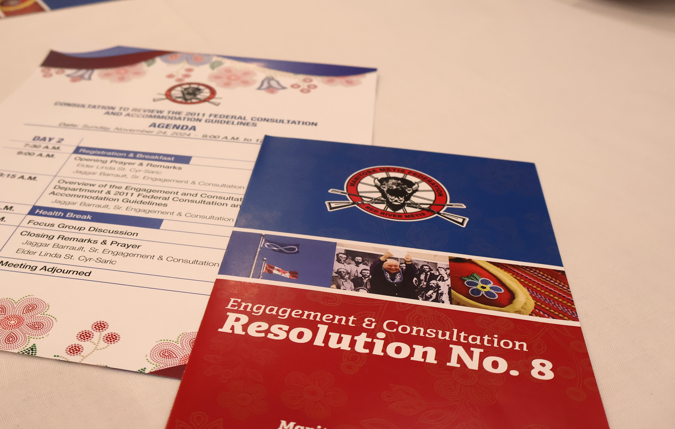
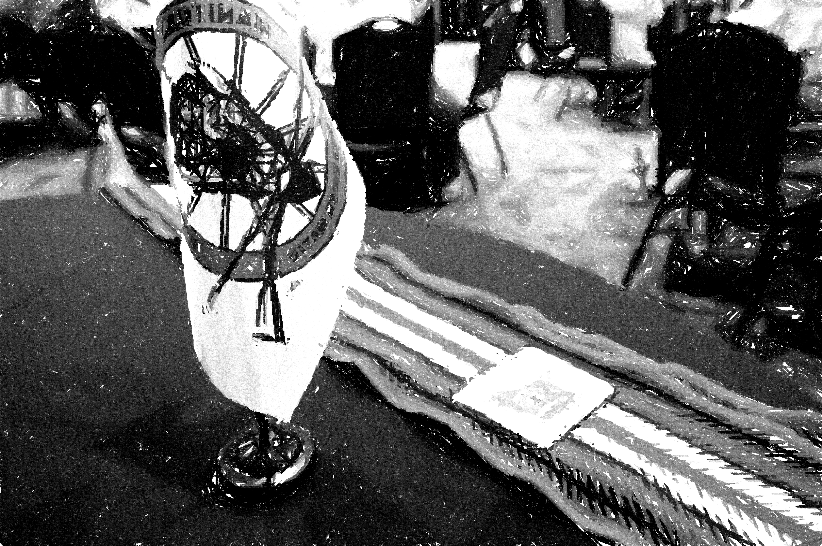
Resolution No. 8
Notice & Response
1
Research & Capacity
2
Engagement or Consultation
3
Partnership & Accommodation
4
Implementation
5

Slide 4
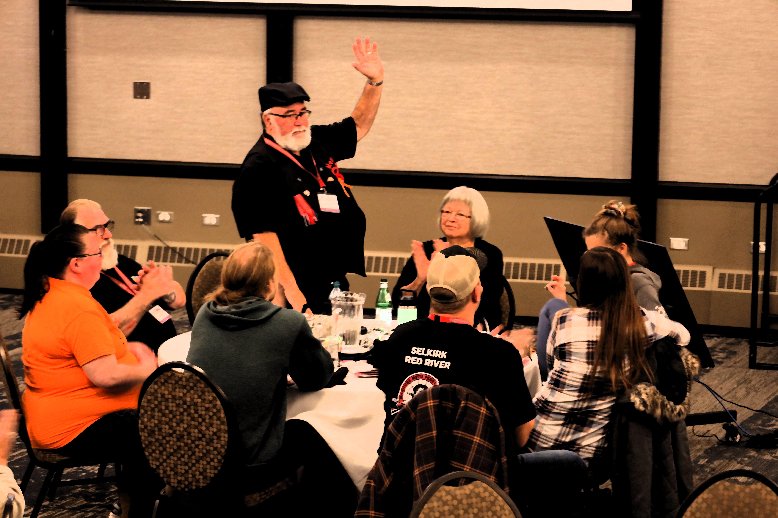
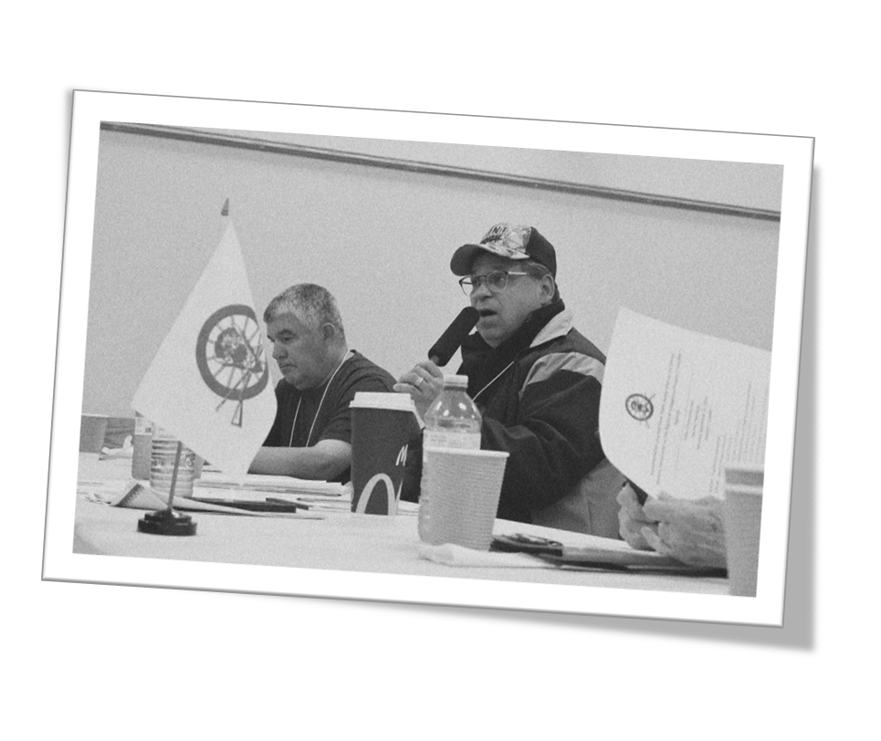
Consultations
2024-2025
Working Towards a Red River Métis UNDRIP Action Plan
A survey completed by ~ 3,269 Citizens;
Semi-structured interviews with 30 MMF departments and affiliates
Three Citizen engagement sessions:
  The Pas – September 21, 2024
  Beyond Borders (virtual) – November 2, 2024
  Winnipeg – November 23, 2024
We heard: your concerns on identity theft, fiscal uncertainty, and distinctions-based neglect of the Red River Métis.

Slide 5
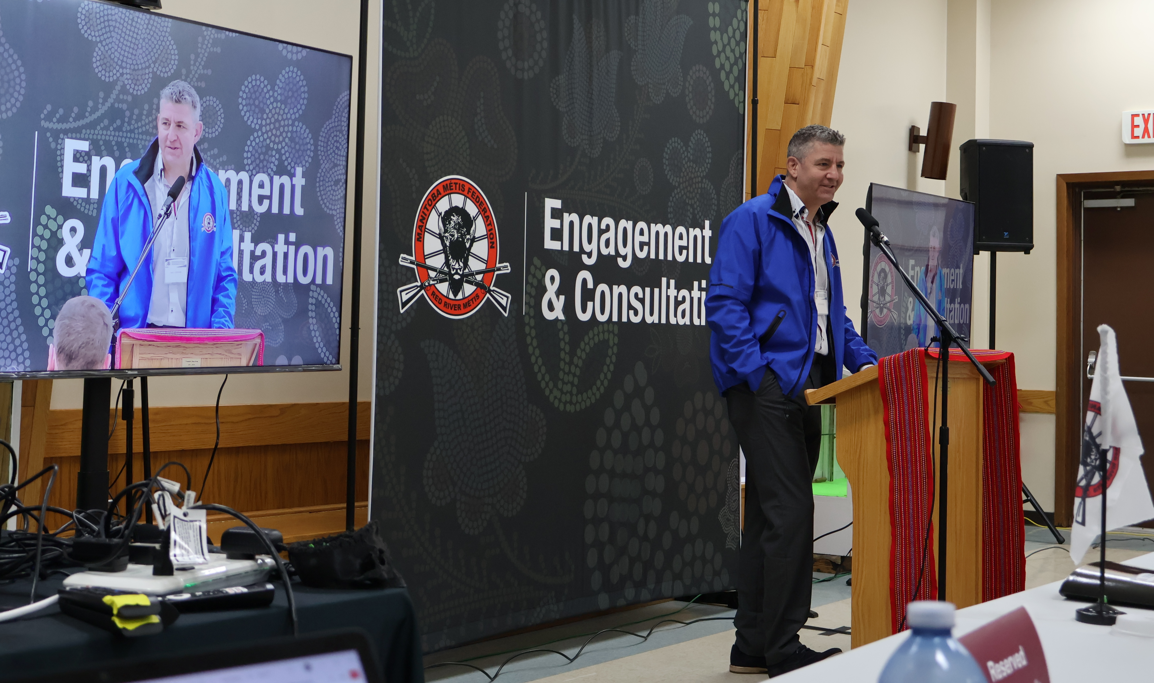
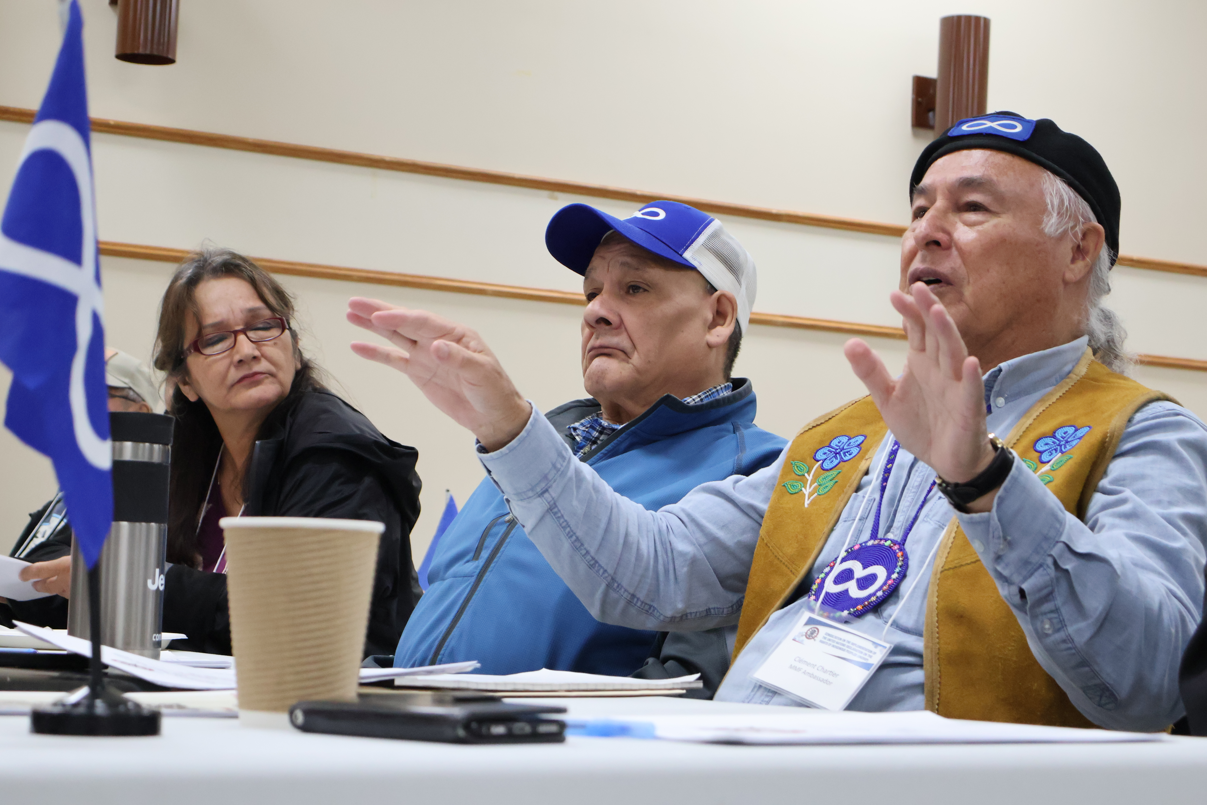
Consultations
2024-2025
Review of 2011 Federal Consultation Guidelines
Created educational tools and held consultations across the Homeland to get meaningful feedback on the Guidelines.
Alignment with UNDRIP: Discussions emphasized re-aligning the Guidelines with Articles 18, 19, 26, 32.
We heard: your concern on the lack of a clear mandate requiring federal officials to follow the Guidelines.
Continuing to work with CAU to refine the Guidelines in line with Citizen feedback and UNDRIP.

Slide 6

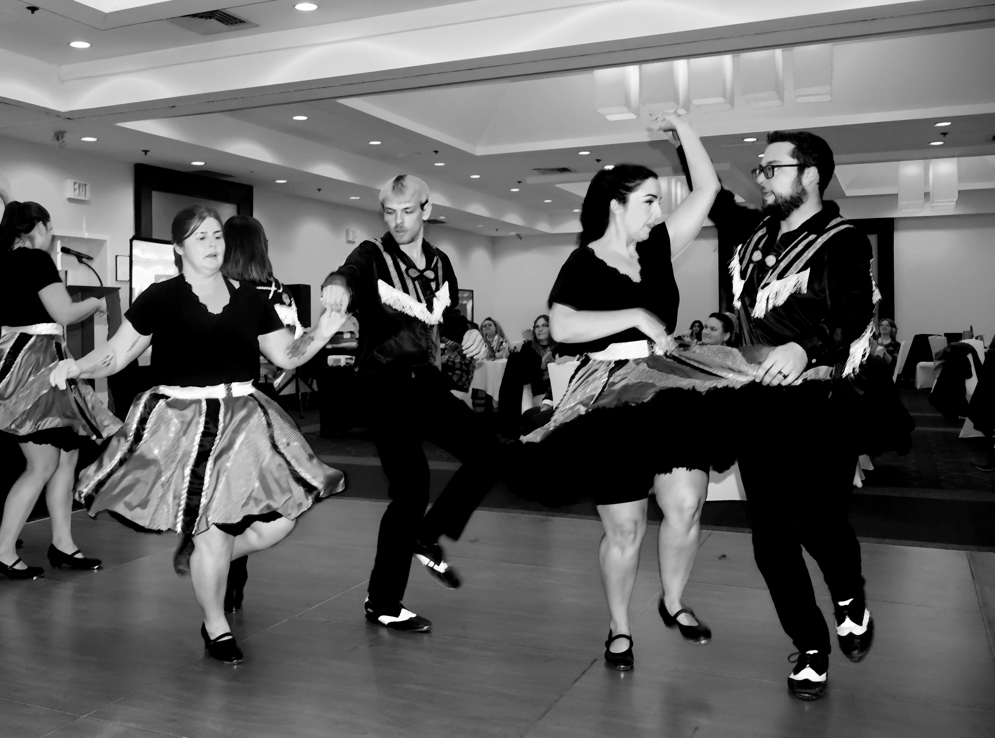
Consultation Projects
2024-2025
Advocating for distinctions-based support from the Canadian Radio-television & Telecommunications Commission (CRTC) to improve connectivity in remote areas.
Working with the Future of Sport Commission to make recommendations on concrete and effective action to improve sports safety in Canada.
Collaborating with Housing to build a consultation framework with Canada Mortgage and Housing Corporation (CMHC).

Slide 7


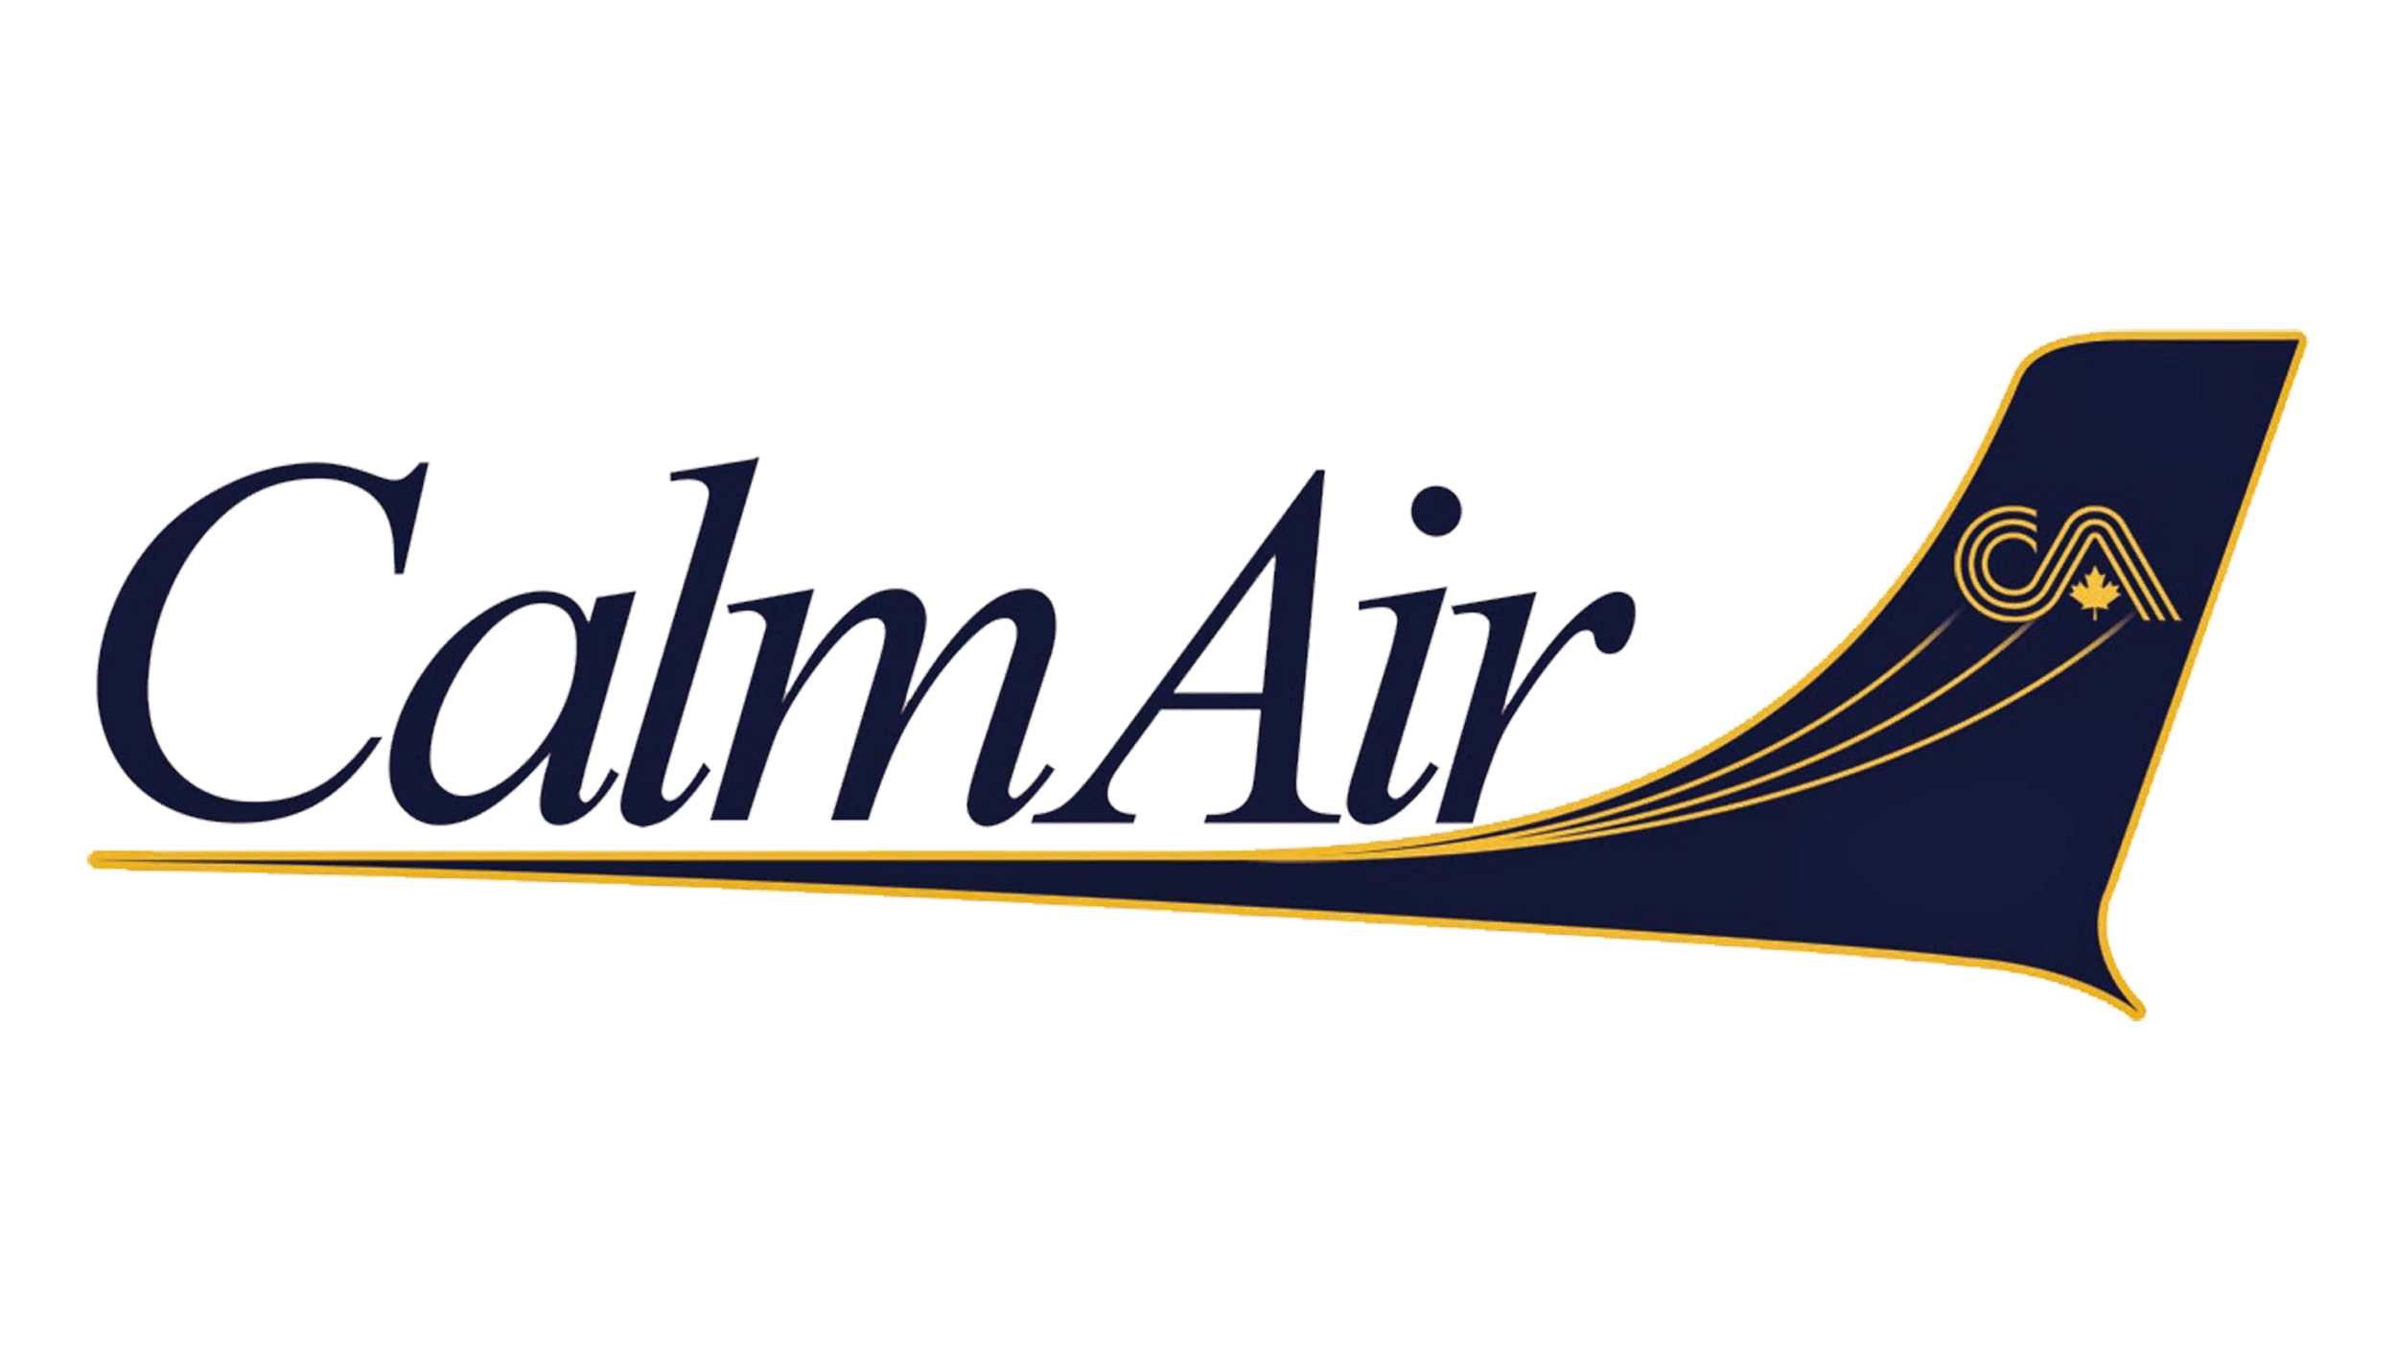




Consultation Projects
2024-2025
Land Acknowledgements
To date, we’ve met with over 180 organizations creating many opportunities to collaborate and ensure the accurate representation of the Red River Métis.
Kid's Help Phone
Calm Air
Assiniboia Downs
City of Winnipeg
True North Sports & Entertainment
Winnipeg Goldeyes
Winnipeg Symphony Orchestra
Future Community Meetings
Please visit our booth or contact us at consultation@mmf.mb.ca if you are interested in contributing your feedback at an upcoming community meeting!

Slide 8
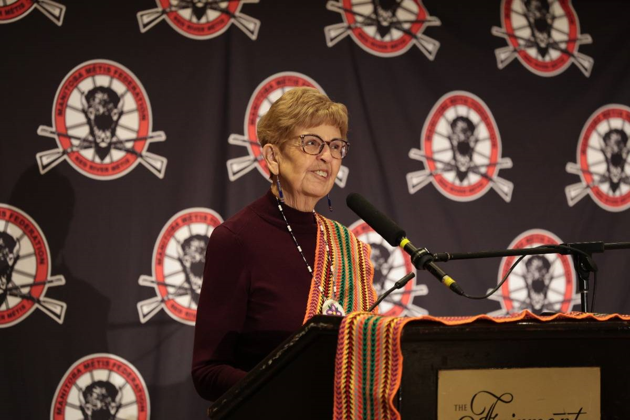
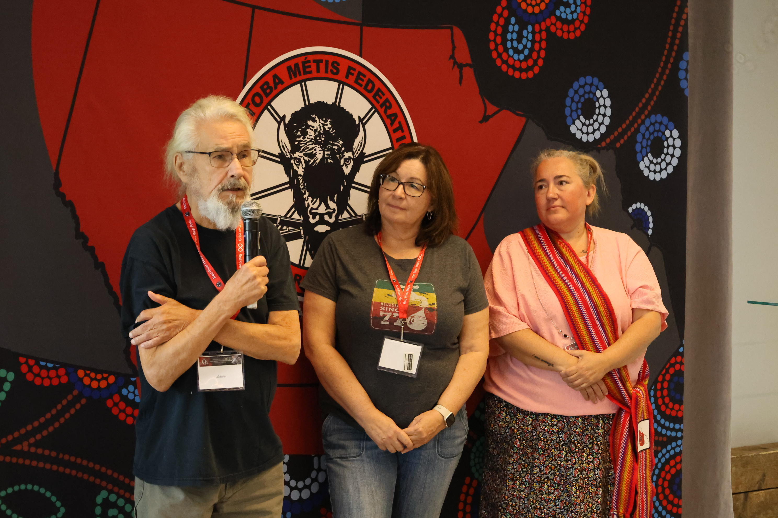
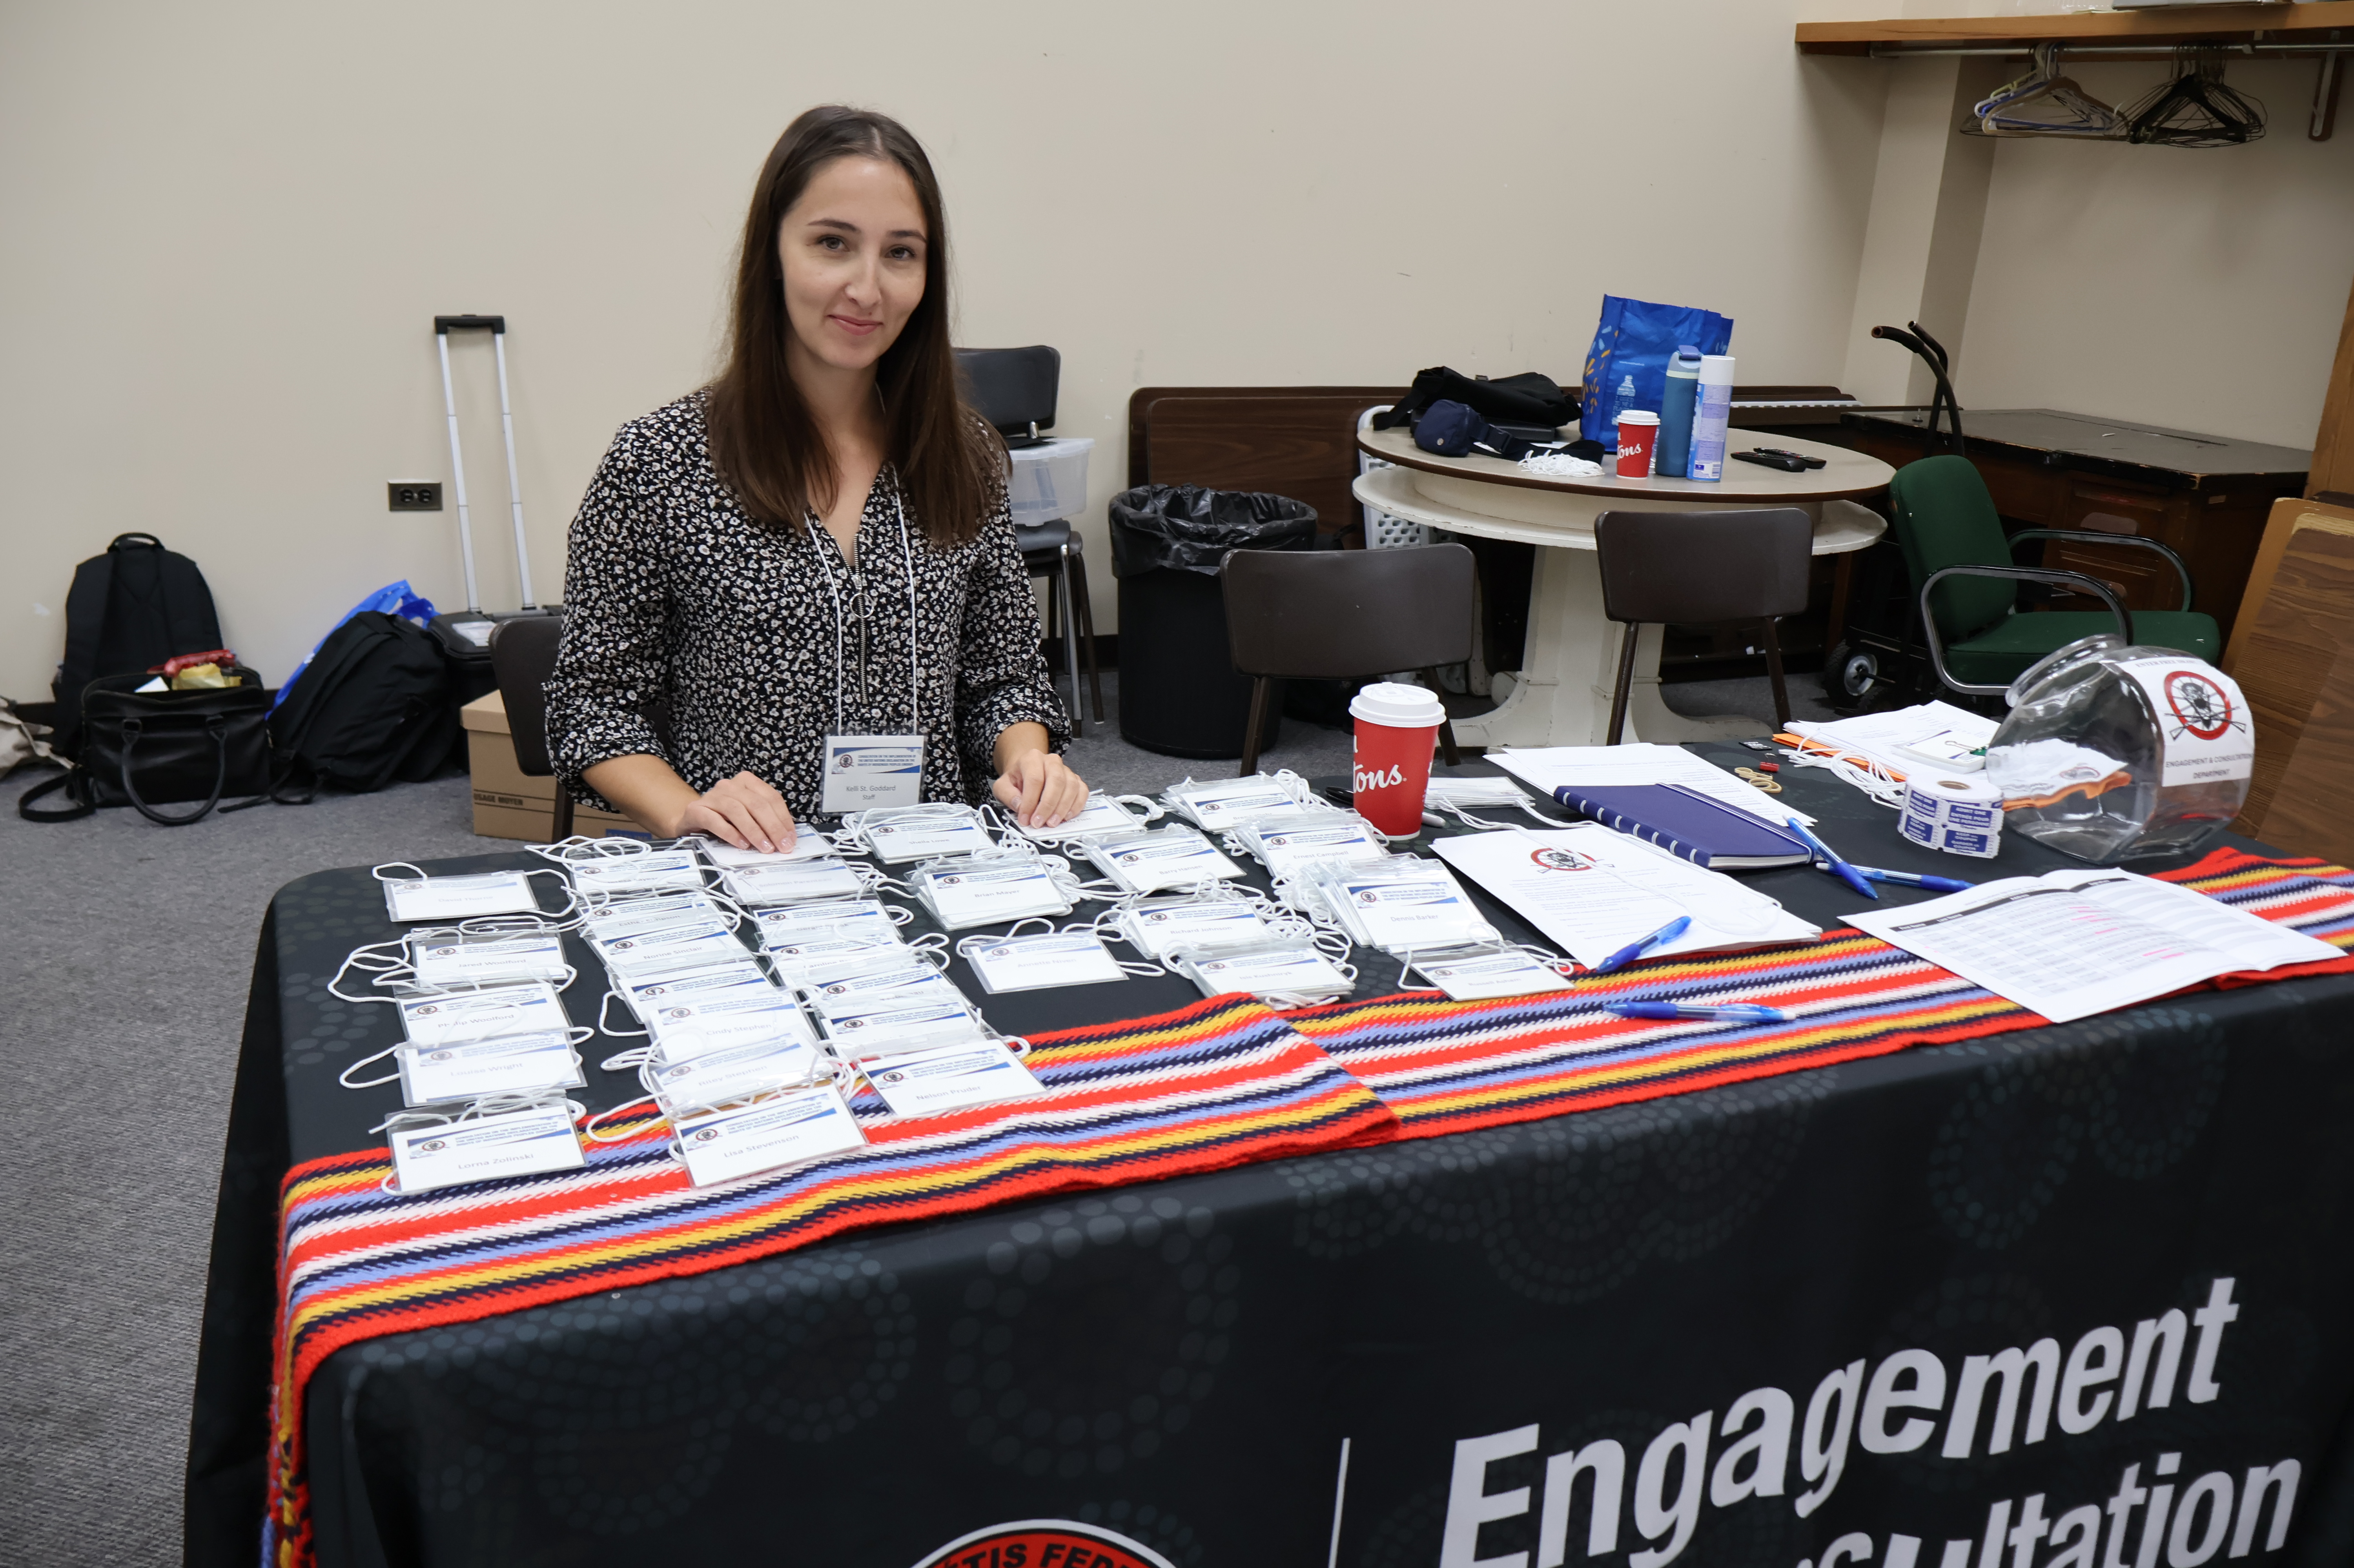
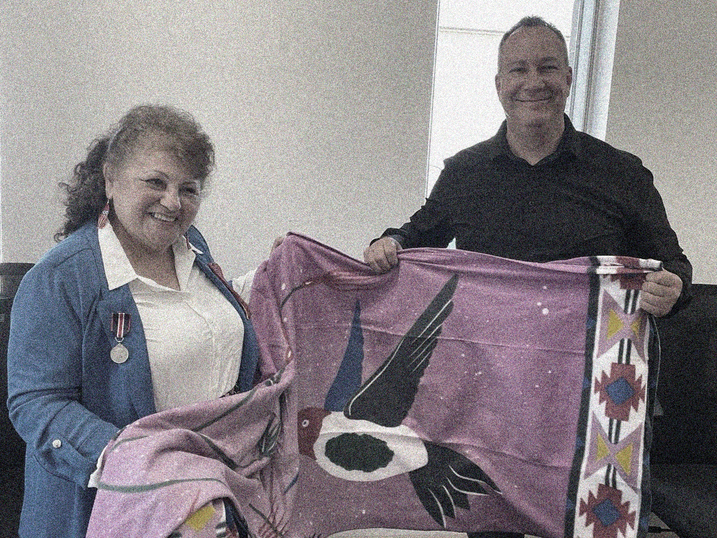

Questions/Comments?
consultation@mmf.mb.ca

