Slide 1

Environment and Climate Change Portfolio
Notes:
Hello everyone, and welcome to the Manitoba Métis Federation’s Annual General Assembly. Thank you to our Elder for the opening prayer.

Slide 2
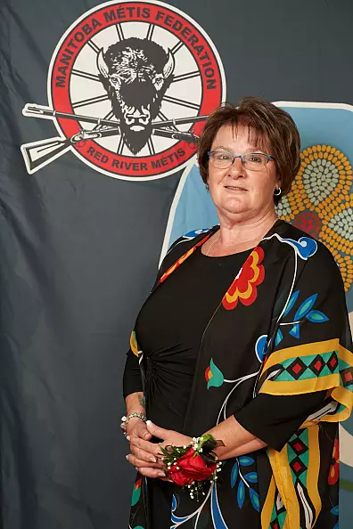
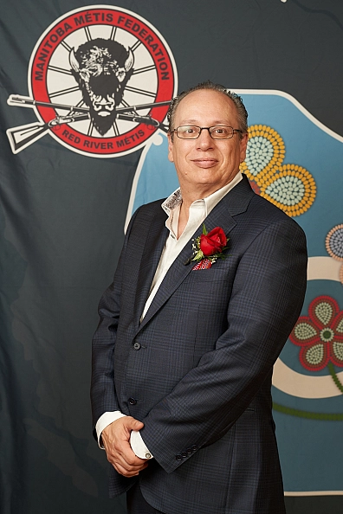
Environment and Climate Change
Minister Marielle Gauthier
Associate Minister David Beaudin
Notes:
I am Marielle Gauthier, your Minister Responsible for Environment & Climate Change. I am joined with my Associate Minister, David Beaudin.
I want to first express my gratitude, on behalf of the Southeast Region Citizens, to President Chartrand and my fellow Cabinet colleagues for their continued hard work and focus to their MMF Portfolios.
And to all MMF staff, thank you for all the hard work you put in daily, and your unwavering commitment to support our Red River Métis Citizens. Please know that it is recognized and greatly appreciated.
The MMF’s Environment & Climate Change Portfolio, housed within the MMF’s Energy, Infrastructure and Resource Management department, is implementing environment-related programs and initiatives, not only to assist Red River Métis Citizens, but to also protect our lands and waters.

Slide 3
Environment and Climate Change
“The Manitoba Métis Federation (MMF) understands the importance of protecting and conserving our traditional territory and is actively working to ensure the environment is protected for ourselves and future generations”
Notes:
Historically, Red River Métis have been deeply connected to the lands, waters, and environment which lie within the National Homeland. Citizens work closely within, and rely heavily on, our environment to provide a livelihood, sustenance, and the ability to practice traditional Métis culture.
Your Red River Métis Government, the Manitoba Métis Federation (MMF) understands the importance of protecting and conserving our traditional territory and is actively working to ensure the environment is protected for ourselves and future generations.
Without a healthy, sustainable environment, it is not possible to continue many of our traditional social and economic practices or exercise our Red River Métis rights.

Slide 4
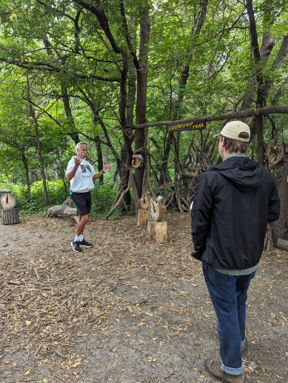
Métis Knowledge, Land-Use and Occupancy Studies (MKLUOS)
In 2024-2025, there were:
-42 MKLUOS Desktop Interviews
-4 Ground Truthing Interviews
Notes:
Through Métis Knowledge Land Use and Occupancy Studies, Red River Métis Knowledge can be used to highlight areas of historical and contemporary importance for Red River Métis Citizens throughout the National Homeland, including Beyond Borders Citizens. The data collected will be added to the MMF’s data catalogue and will help with future negotiations for proposed projects.
In the 2024-2025 fiscal year, the MMF collected 42 in-depth Red River Métis Knowledge, land use, and occupancy desktop interviews as well as 4 ground truthing Interviews.

Slide 5
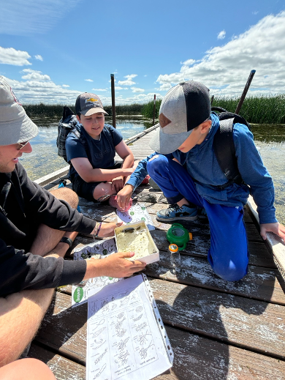
Métis Environmental Leaders of Tomorrow (MELT)
In 2024-2025, MELT events engaged 256 youth through:
Environmental Day Camps
Mini Climate Symposium
Turtle Mountain Field Days
Farm & Ranch Tours
Winter Wilderness Survival
Notes:
The Métis Environmental Leaders of Tomorrow, or MELT Program, provides land-based educational events for Red River Métis Youth, kindergarten to grade 12.
These events focus on climate education and how Youth can turn that education into climate action through utilizing Red River Métis knowledge and practices.
In the 2024-2025 fiscal year, MELT provided meaningful programming to 256 Youth through various camps, tours, and activities throughout the year. Some Events include Environmental Day Camps, Farm and Ranch Tours, and Mini Climate Symposium, to name a few.

Slide 6
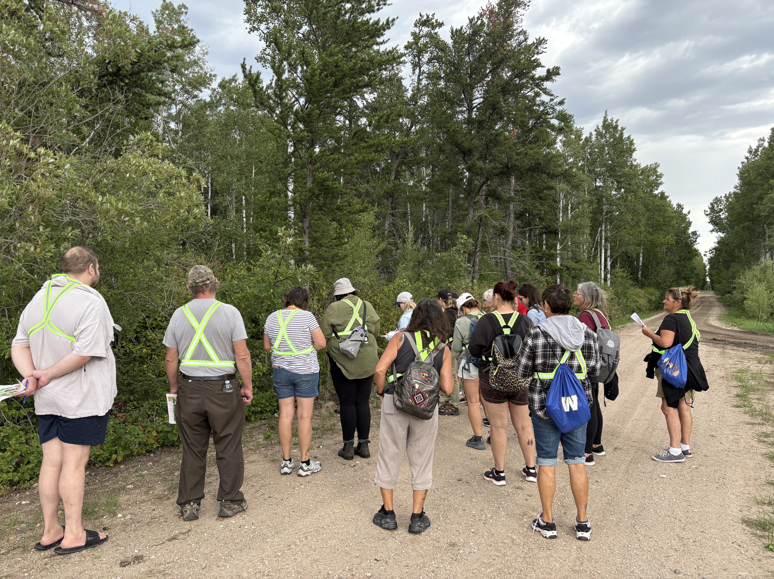
Métis Community-Based Climate Monitoring Program (MCBCM)
In 2024-2025, MCBCM programming included:
Wetland Monitoring Program
Water Quality Monitoring Program
Winter Monitoring Program
Christmas Bird Count
Great Backyard Bird Count
Monarch Monitoring Blitz
Bird Walks
Nature Walks
Notes:
The Métis Community-Based Monitoring Program braids western science with Red River Métis Traditional Knowledge, to collect and monitor climate and environmental changes across our National Homeland.
Current programming under the Métis Community-Based Monitoring Network includes the Wetland Monitoring Program, Water Quality Monitoring Program, and Winter Monitoring Program.
Also included in this Program are Citizen participation events, such as the Christmas Bird Count, Great Backyard Bird Count, Monarch Monitoring Blitz, birding walks, nature walks, workshops, and much more.

Slide 7
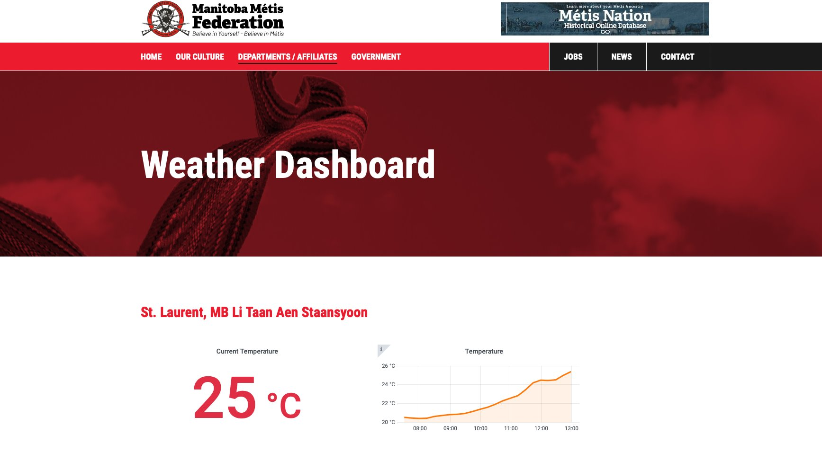
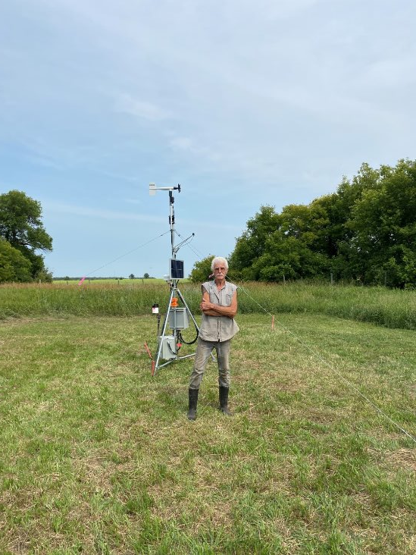
Weather Keeper Program
  Current Weather Keeper Stations are located in:
  St Laurent (Interlake)
  Lakeshore (Northwest)
  Dawson Bay (The Pas)
Notes:
In partnership with the Centre for Earth Observation Science at the University of Manitoba, the Weather Keeper Program supports the collection and monitoring of atmospheric data across the Red River Métis National Homeland.
Currently, stations are located in St. Laurent (Interlake Region), Lakeshore (Northwest Region), and Dawson Bay (The Pas Region). In 2024–2025, the program accepted applications to add two more stations and will continue to partner with interested Citizens to expand the monitoring network. The Weather Keeper Program delivers valuable insights into local weather patterns, land-use changes, and the ongoing impacts of climate change.

Slide 8
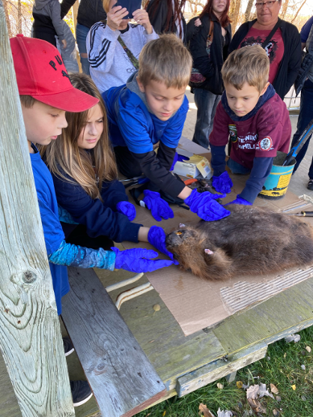
Red River Métis Stewards of the Homeland Program (RRM SOHP)
  In 2024-2025, RRM SOHP programing included:
  Turtle Mountain Field Days
  Harvesting Property Tours
  Medicinal Walks
  Ste. Madeline Days
  Kettle Hills Field Days
  Workshops
Notes:
The Red River Métis Stewards of the Homeland Program (RRM SOHP) actively works to conserve, protect, and restore the National Homeland of the Red River Métis for the continued prosperity of the environment which includes the lands and waters Red River Métis Citizens rely upon for livelihood and sustenance.
During the 2024-2025 period, 298 Red River Métis Youth and Citizens were engaged in Stewards programming. Some Citizen events include Turtle Mountain Field Days, Harvesting Property Tours, and Medicinal Walks, to name a few.
Stay tuned on MMF’s social media for updates on upcoming events and new ways to get involved in the stewardship projects!

Slide 9
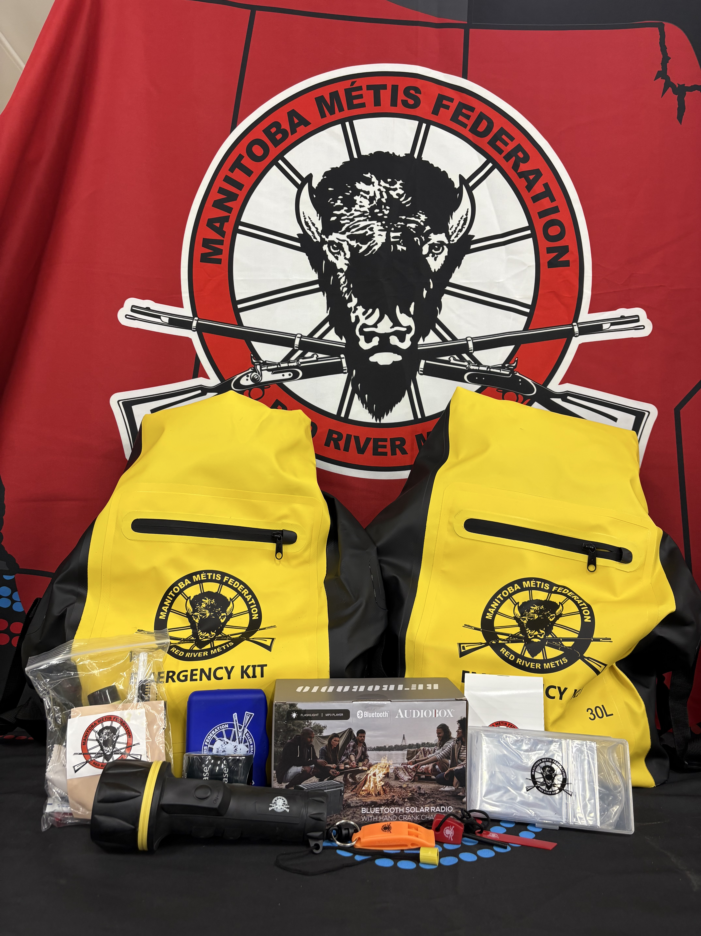
Environmental Disaster Mitigation and Adaptation
  In 2024-2025, Environmental Disaster Mitigation and Adaptation work included:
  Continued work towards Emergency Response and Disaster Management Plans
  Continued work towards Hazard Identification Risk Assessments (HIRA)
  Emergency Preparedness webinars held for Red River Métis Citizens
Notes:
MMF is working towards creating and implementing an emergency response and disaster management plan across the National Homeland. In the 2024-2025 year, The MMF continued to work towards creating Emergency Response and Disaster Management Plans along with Hazard Identification Risk Assessments (HIRA). These tools provide information on specific hazards that are likely to occur in each Region and assess the level of risk.
The MMF also hosted webinars where Citizens learned the importance of personal preparedness and emergency kits to assist in being prepared for emergency events. The MMF will continue to host additional preparedness webinars and are in the process of developing seasonal preparedness programs and other initiatives.

Slide 10
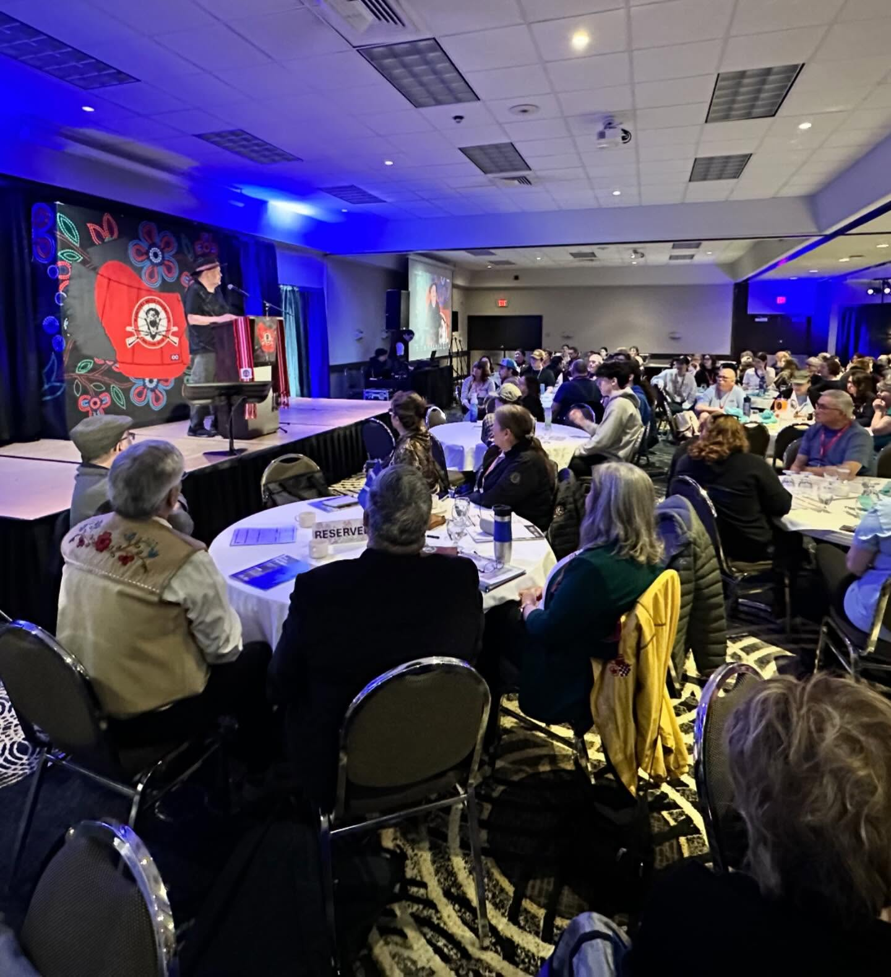
Red River Métis Climate Symposium
The 2024 Red River Métis Climate Symposium was held in Brandon, MB and included:
166 Citizens
77 Youth
11 MMF Cabinet Ministers
Notes:
The Red River Métis Climate Symposium brings together Citizens from all MMF Regions, including those living Beyond Borders, to share knowledge, experiences, and solutions related to climate change.
The 2024 symposium welcomed a total of 243 RRM Citizens, including 77 Youth, alongside 11 MMF Cabinet Ministers and a diverse group of presenters and panelists made up of Red River Métis Knowledge Holders, academics, harvesters, and industry professionals.

Slide 11

Environment and Climate Change
If you have any questions or concerns regarding the Environment and Climate Change Portfolio, please contact:
Notes:
THANK YOU and if you have any questions, please reach out to Energy Infrastructure and Resource Management.

