Slide 1

Housing and Property Management

Slide 2

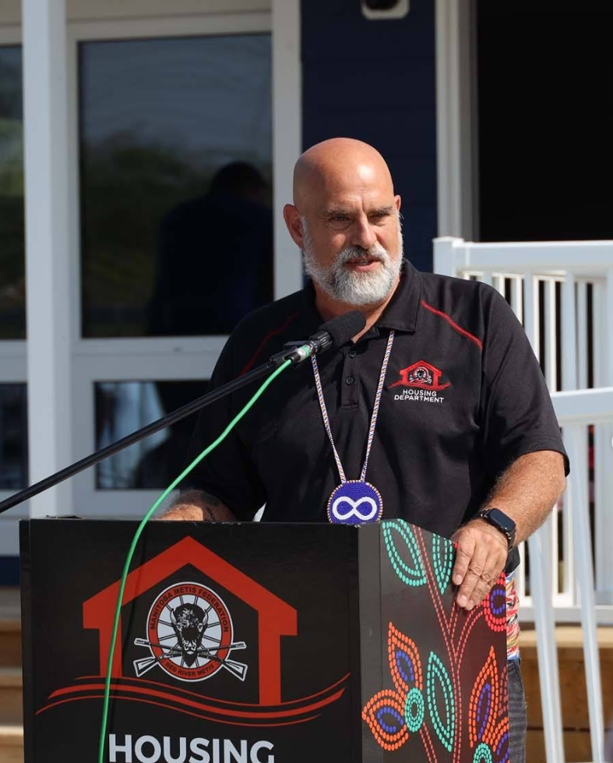
Will Goodon
Minister of Housing & Property Management

Slide 3
Housing Programs:
First Time Home Purchase Program (FTHPP)
Launched in 2019 and administered by the Louis Riel Capital Corporation (LRCC), the First Time Home Purchase Program assists Citizens who are first-time homebuyers.
5% of the home purchase price up to a maximum of $18,000.00 towards the down payment.
1.5% up to a maximum of $2,500.00 towards closing costs.
1950 applications received, with 1718 approved (at April 1, 2025): an approval rate of 88%
Has helped 2,500 Red River Métis Citizens purchase their 1st home. Including 665 children.
By April 1, 2025, the program dispersed just under $20 million in funding, leveraging $277 million in mortgages in the process.

Slide 4
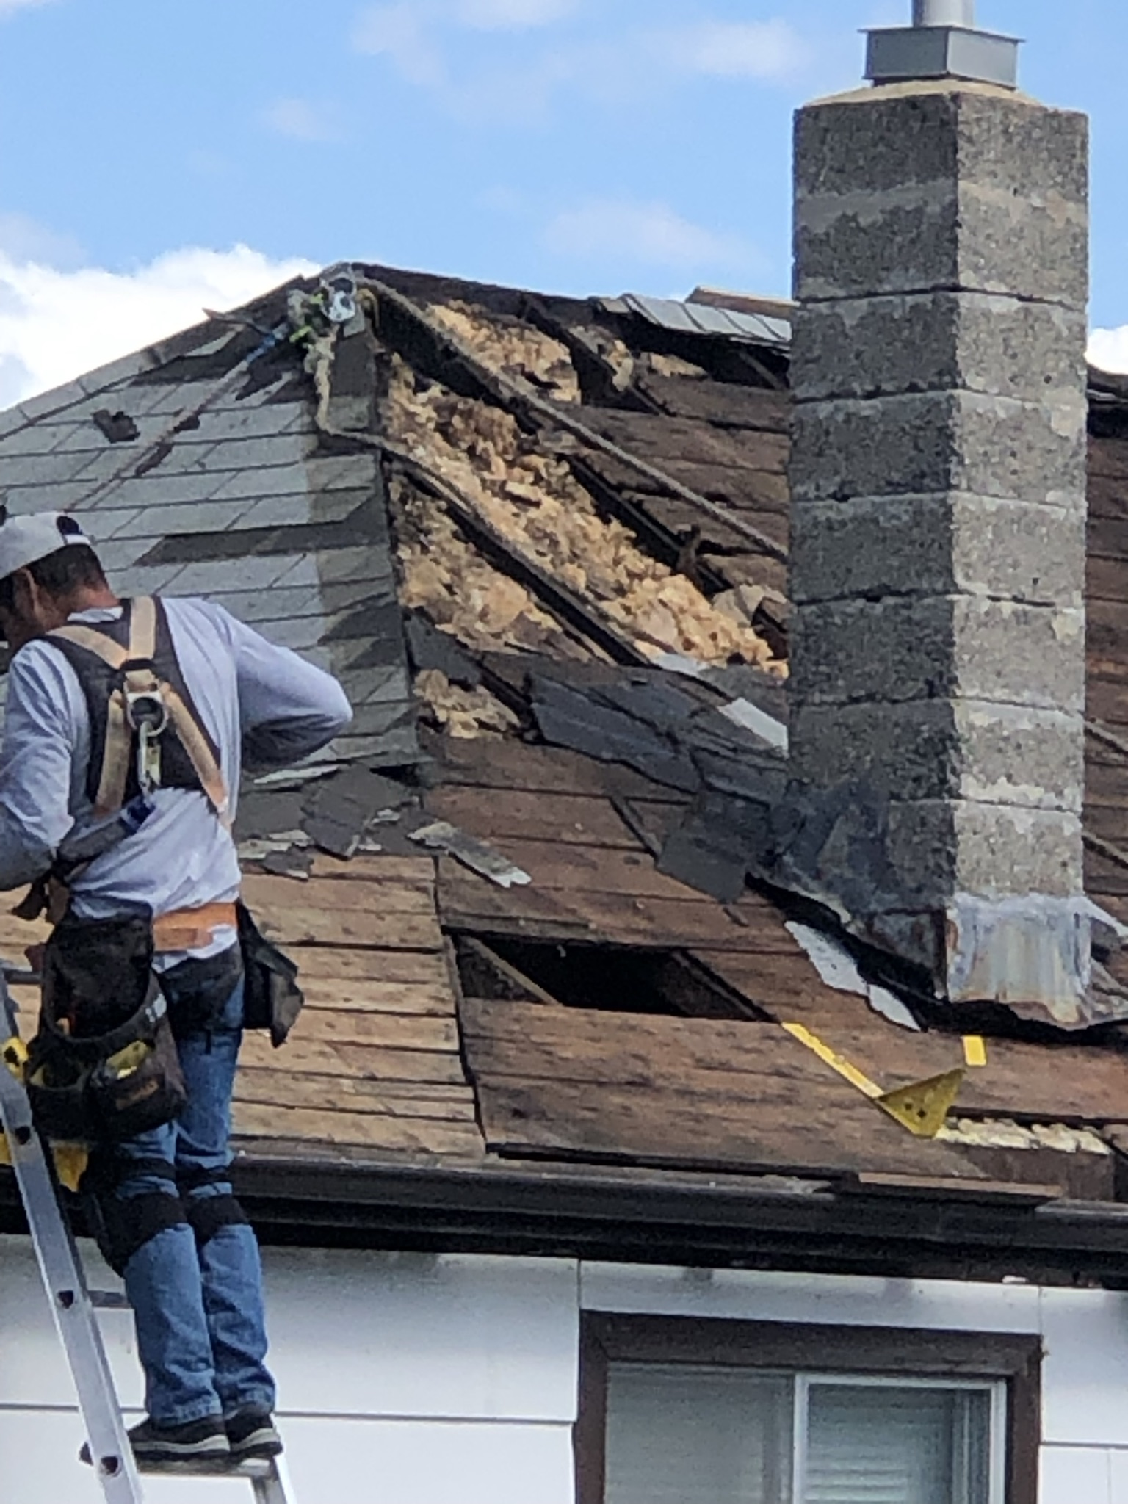
Housing Programs:
Home Enhancement Loan Program (HELP)
For low to moderate income households, HELP provides a one-time forgivable loan of up to $18,000 for emergency home repairs and renovations.
Up to$25,000 is available for Red River Métis Citizens living in Northern Manitoba.
Emergency repairs and accessibility receive priority.
2,200 Red River Métis Citizens have been approved for funding, with over $27 million invested to date.
An extremely popular program, we are working hard to catch up with our 2-year backlog of applications.
We are aggressively seeking to recruit new contractors to work with the HELP program.

Slide 5
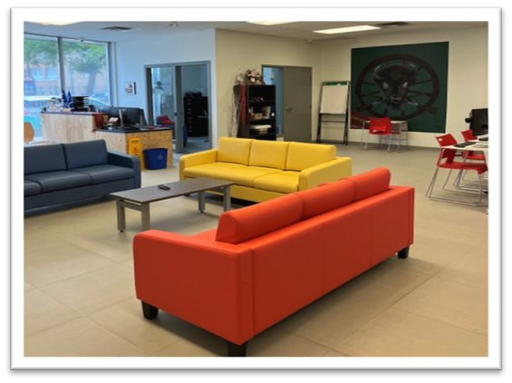
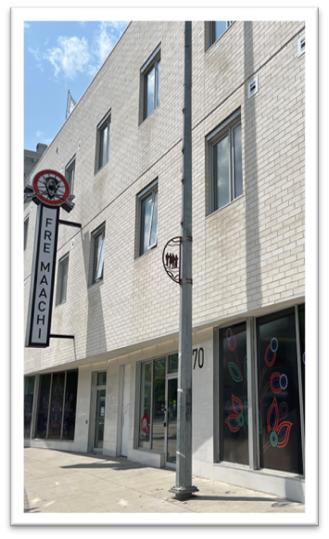
Housing Programs:
Fre Maachi and Rapid Services
MMF’s transitional housing facility: Fre Maachi (Fresh Beginnings)
Rapid Services provides services for Red River Metis Citizens who are homeless or at imminent risk of homelessness.
Fre Maachi serves as a culturally supportive transitional housing program to help Citizens develop necessary life skills to achieve housing stability.
670 Main Street: Houses Rapid Services offices and 16 studio apartments and 4 two-bedroom units
In the 2024/2025 fiscal year Rapid Services assisted individuals, including securing housing for 207 people and preventing 96 evictions.
Notes:
Collaborate with Culture and Heritage on programming

Slide 6
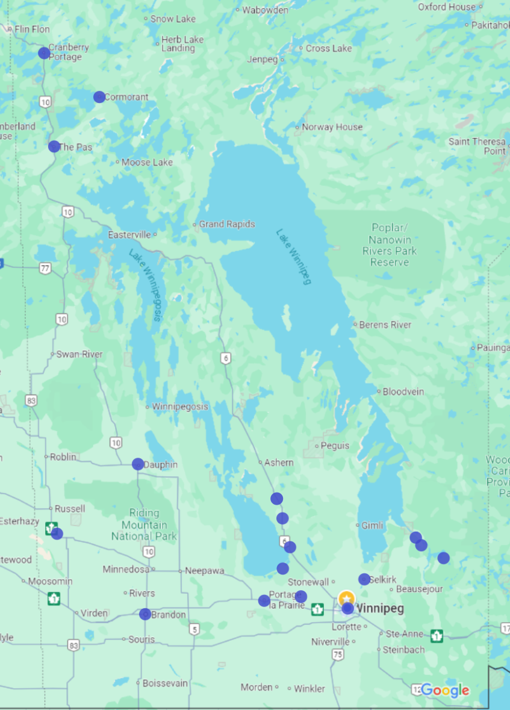
Property Portfolio (Residential)
At present, the MMF oversees 58 residential properties across 17 locations in Manitoba, comprising 152 units, with 20 designated as transitional housing units. Of these 152 units, a total of 114 units will be affordable while 38 units will be rented at market rates.
Dauphin (5 units)
Brandon (7 units), Binscarth (4 units), Portage (7 units), St. Ambroise (2 units), St. Eustache (3 units)
Selkirk (58 units), St. Laurent (11 units), Eriksdale, Lundar (2 units)
Powerview (2 units), St. Georges (8 units), Alexander
The Pas (10 units), Cormorant and Cranberry Portage
Winnipeg (29 units, incl. transitional units)

Slide 7
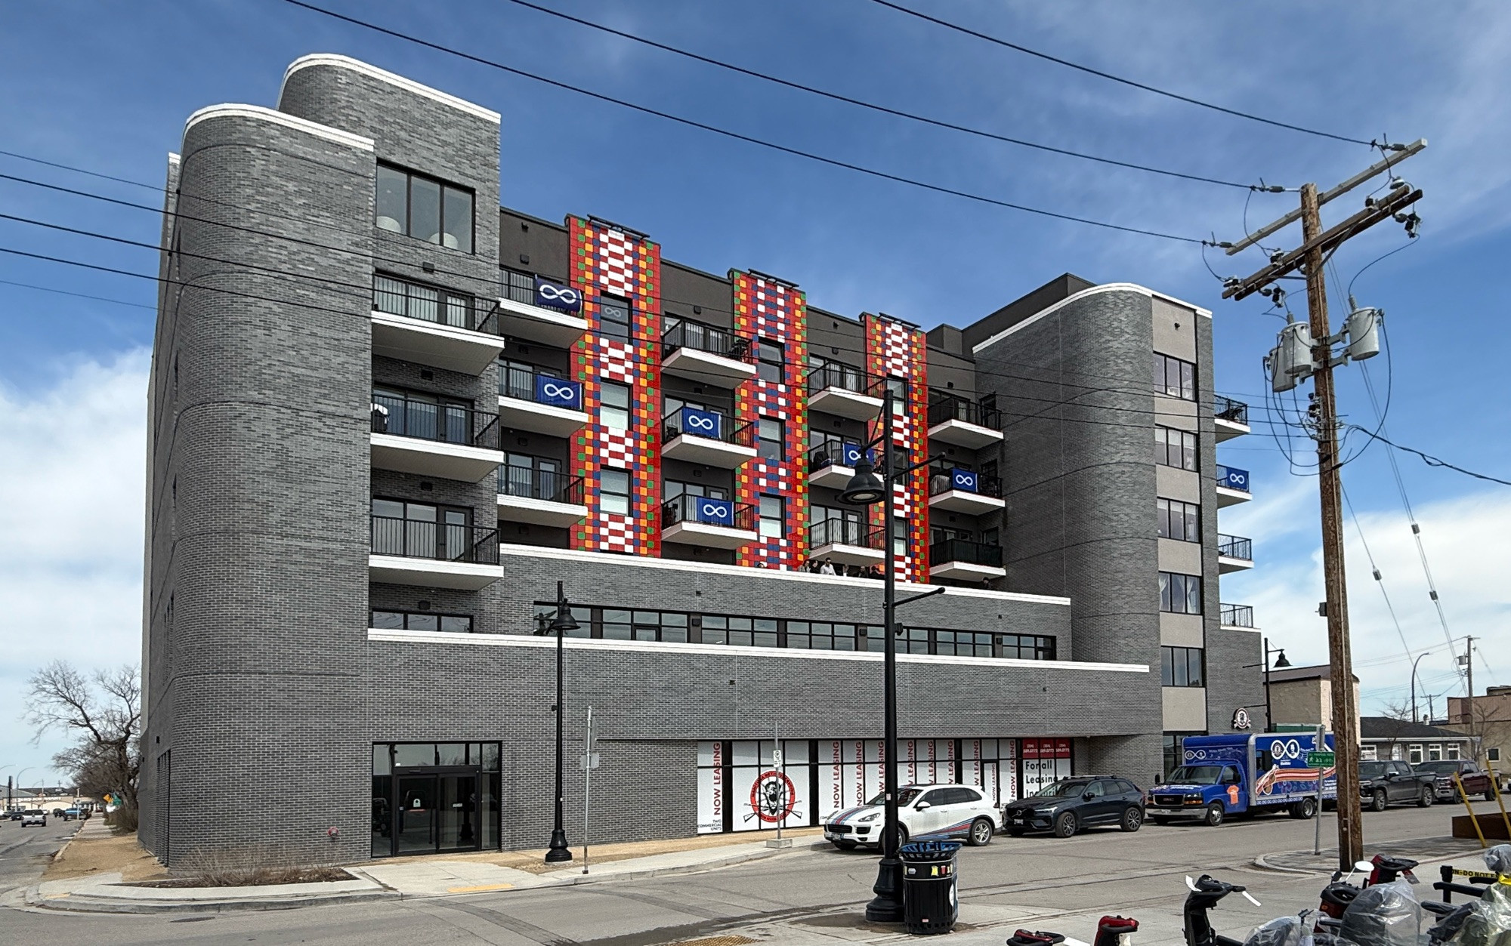
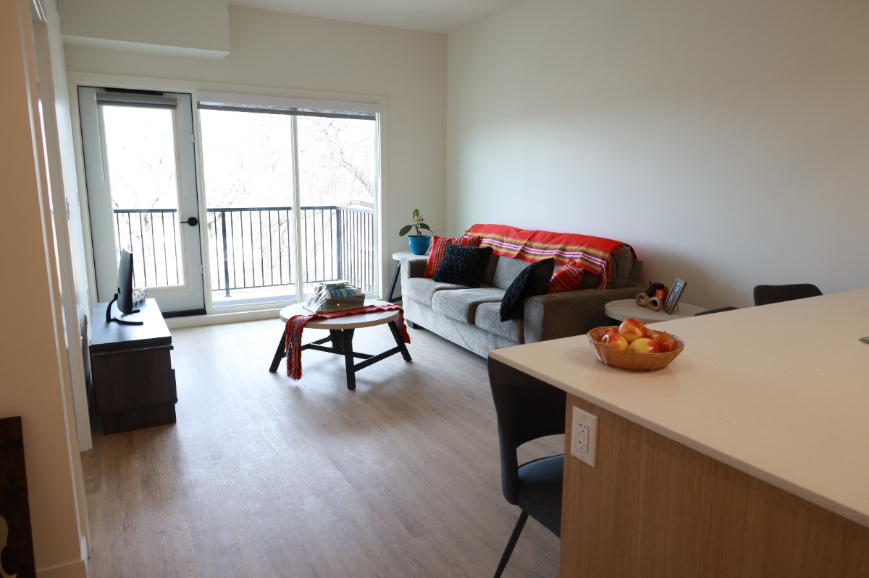
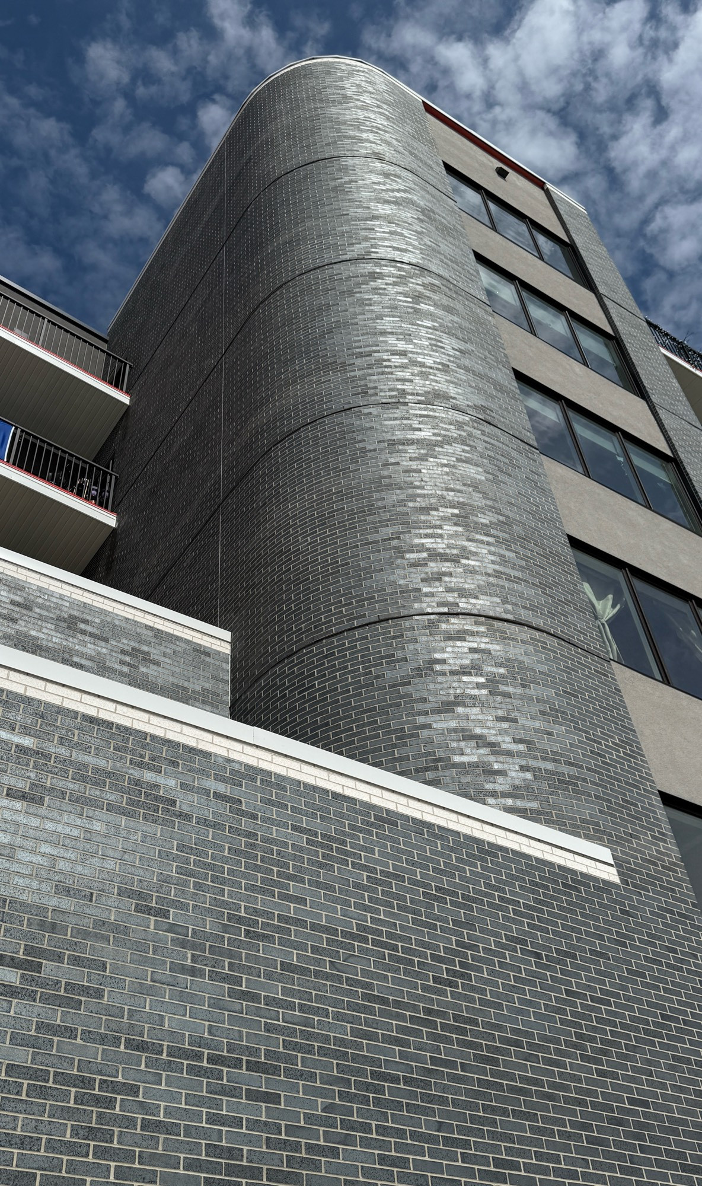
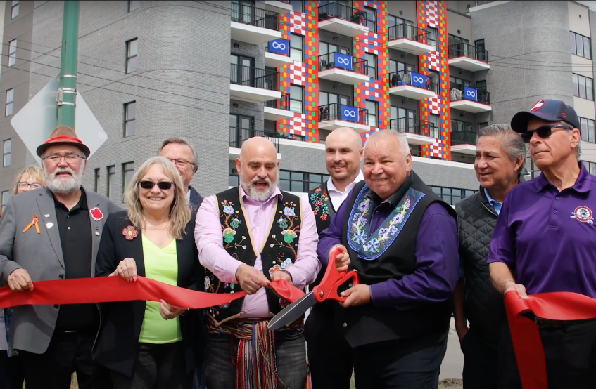
Celebrating our 55+ Apartment in Selkirk
"Our goal is to provide our Elders and seniors with a home where they will feel safe and comfortable, and we believe we have done just that with this beautiful building overlooking the Red River, which holds such a symbolic and important place in our history.“
- Minister Will Goodon

Slide 8
385 Henderson (Roxy Lanes)
7-story apartment building proposed:
60 units, including studio, 1 and 2 bedrooms
ELCC’s Ronald’s Place at ground level: a childcare and professional service centre for developmental diagnostics
Start date: Dec. 2025; Completion: Spring 2027

Slide 9
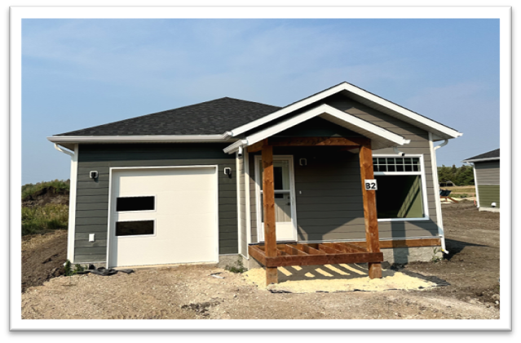
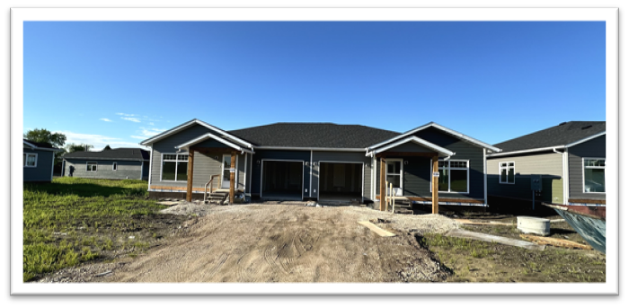
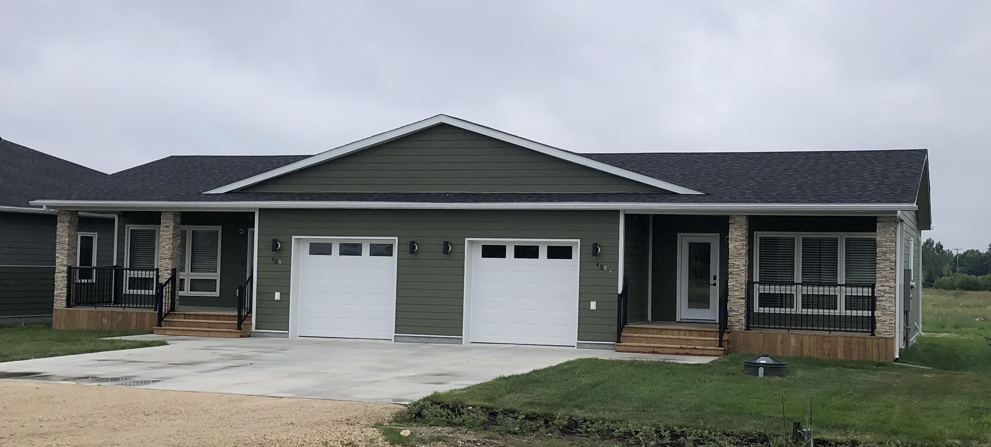
New houses in St. Georges
8 new units – 6 Seniors’ and 2 Family units

Slide 10
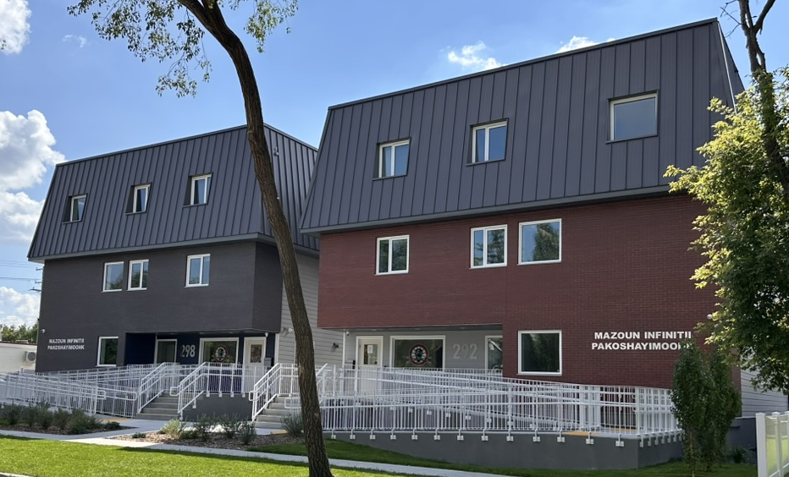
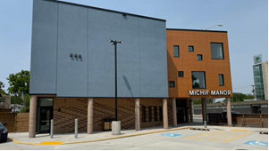
Special Builds
Mazoun Infinitii Pakoshayimoohk or “Infinity House of Hope” is now complete and will serve as transitional housing for Red River Métis youth aging-out-of-care.
Programming will be administered by Metis Child, Family and Community Services, providing culturally appropriate supports and skills training to participants.
In partnership with MMF’s Department of Health and Wellness, Michif Manor will offer culturally appropriate lodging and amenities to support Citizens travelling to Winnipeg for health reasons.
Located at 800 Notre Dame Avenue, Michif Manor will provide immediate access to various medical facilities within the Health Sciences Centre campus.

Slide 11
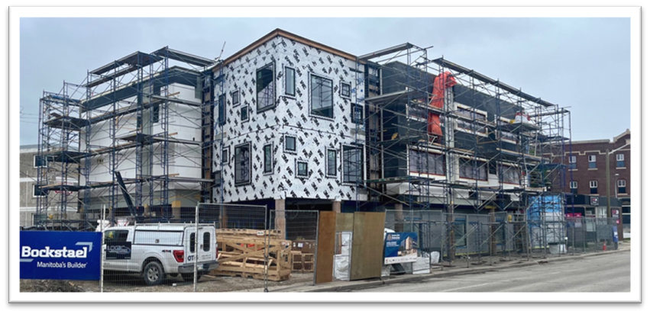
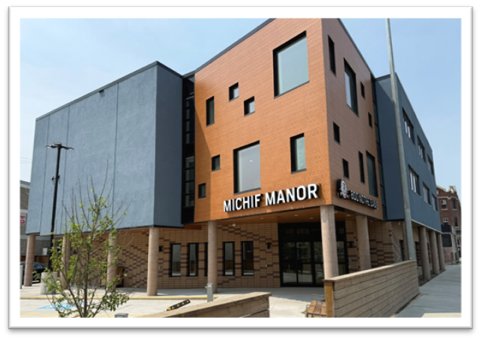
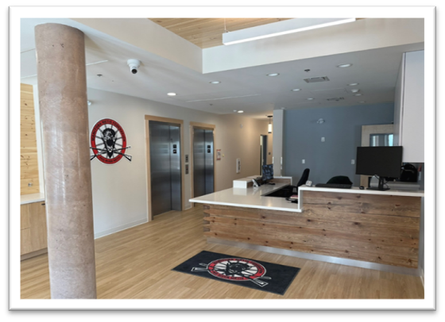
Red River Métis Economic Development
Our aim is to increase Red River Métis contractors and employment.
Michif Manor is a good example:
Six subcontracts awarded to Red River Métis-owned businesses;
Another 4 subcontractors employ Red River Métis workers accounting for 5,000 labour hours.

Slide 12
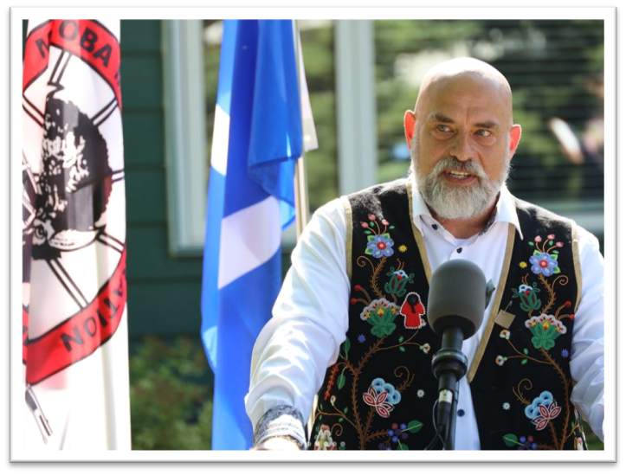
Looking Forward…
“These achievements in housing inspire us to persevere, just as our ancestors did, and to reclaim the ‘head start’ promised to our People. They shine a light on the path forward for our Red River Métis Citizens as our National Government of the Red River Métis works to provide safe, secure, and affordable homes for generations to come.”

