Slide 1





Métis Child &
Family Services

Slide 2
Overview
Mandate
Bill C‑92: An Act Respecting First Nations, Métis and Inuit children, youth and families
CSA Settlement & Distribution
Single Envelope Funding
MMF Partnerships & Agency Programming
Becoming a Caregiver

Slide 3
Mandate
Ensure citizenship supports: Collaborating with the Minister of Citizenship and MMF departments to streamline Citizenship Cards for our children prior to exiting care.
Advancing Coordination Agreement negotiations: In partnership with the PDU drafting Red River Métis CFS laws and working on negotiations of the Coordination Agreement, the MMF now awaits approval from the Federal Government to finalize negotiations.
Operationalizing MMF jurisdiction priorities: Working with relevant ministers to implement jurisdictional authority over prevention, protection, and adoption services for Red River Métis children, emphasizing culturally grounded practices.
Expanding prevention supports: Working with Ministers to increase the prevention supports available with the goal of reducing the number of families in the Métis CFS System.
Negotiate adequate funding: Advocating for funding arrangements that reflect the full costs of implementing MMF jurisdiction, advocating for sustainable, transparent resourcing to deliver culturally appropriate services.

Slide 4
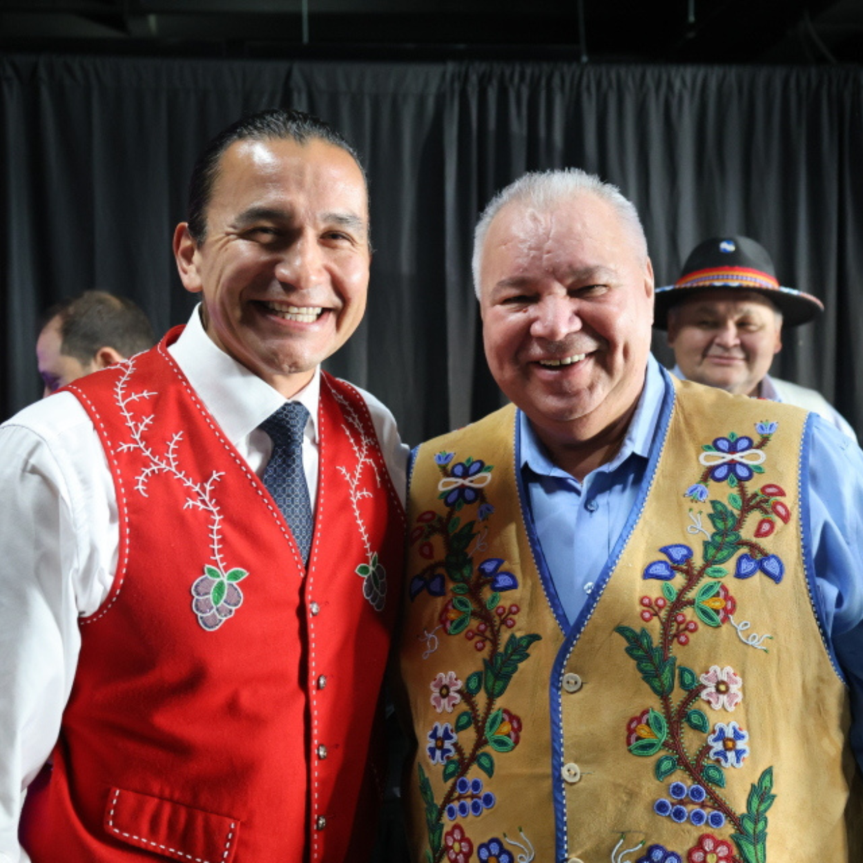
Bill C-92: An Act Respecting First Nations, Métis and Inuit children, youth and families
Enacted January 2020
Five years of negotiations to draft Red River Métis CFS laws and Coordination Agreements
Negotiations currently stalled
Joint letters from MMF Leadership and Ministers to the Federal Government
Section 12 notifications

Slide 5

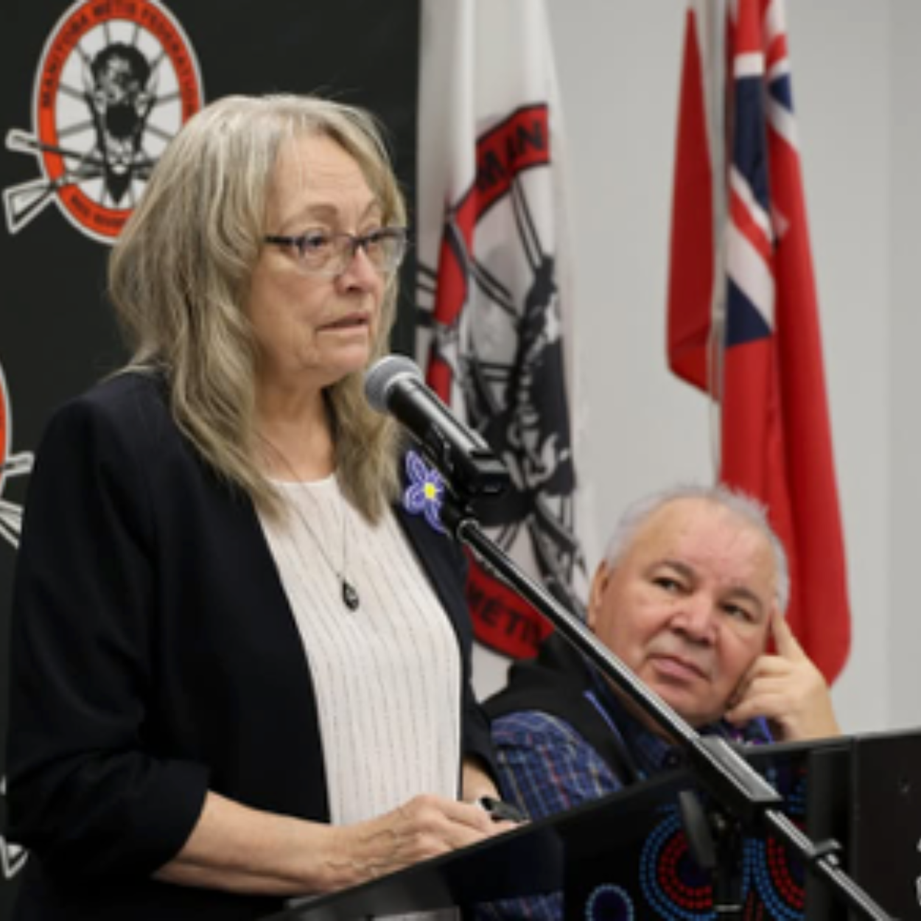
Children’s Special Allowance
Manitoba claw back (2005–2019)
Court-ordered settlement
Métis CFS Authority named Administrator & Distributor
Six-person Distribution Team
Post-distribution supports
As of October 3, 2025:
1147 Lafontaine Class Members have received a total of $29,319,517

Slide 6
Single Envelope Funding
3-year model (2019–2022) evaluation to follow
Now in our 7th year (Apr 1, 2025) no evaluation completed
Agencies expanded services and staffing to meet needs
Funding inadequate from outset
MMF, Authority & Agencies in ongoing discussions with Province
Advocacy for clarity and sustainable funding

Slide 7
MMF Partnerships
Métis Health and Wellness: collaborating on a Red River Métis Jordan’s Principle initiative and culturally grounded health supports for children and families.
Early Learning & Child Care (ELCC): distributing “Little Métis Boxes” to shelters and partnering on early learning, cultural programming, and supports for children in care.
Department of Housing & Property Management: co‑developing Mazoun Infinitii Pakoshayimook transitional housing and coordinating wrap‑around culturally safe services for youth aging out of care.
Central Registry Office: facilitating citizenship registration for children, youth and families served by Métis CFS agencies to ensure eligibility and identity documentation for federal transition.

Slide 8
MMF Partnerships
Energy, Infrastructure and Resource Management – Métis N4 Construction: conducting capital needs and facilities assessments to identify infrastructure requirements for transitioning to federal CFS legislation.
Child, Family & Community Institute (CFCI): providing program development, training, evaluation and post‑distribution supports for CSA class members under Director Brittany Butler.
Métis Justice Institute: supplying a dedicated Court Liaison Worker to prepare youth and families for court processes and reduce legal trauma.
Métis Community Resource Department (MCRD): Currently, the Métis CFS Authority provides in-kind training to department staff.
Métis Education and Training (MET): provides funding supports for our agencies’ Métis/Michif Spirit Workers.

Slide 9
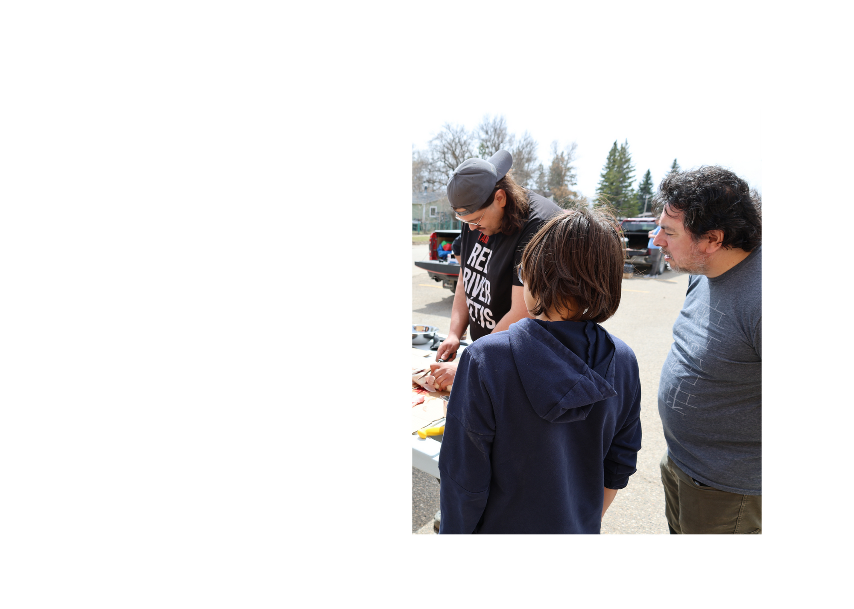
Citizenship
Citizenship Liaison Officers (CLO) work closely with the Citizenship Registry Office (CRO) to obtain citizenship for families. CLOs also assist other CFS agencies throughout Manitoba in determining whether children and youth in their care are eligible Métis Citizens.
This past year:
148 citizens identified through CLOs
127 Kinship connections for our families in MCFS
81 of the individuals determined eligible through CLOs have obtained their citizenship cards

Slide 10

Programming
Métis CART: multidisciplinary team (caseworkers, mentors, addictions & mental health workers) providing early intervention and Family Seeing approach
Works closely with Métis/Michif Connect to build sustainable care networks
2024: CART supported hundreds of families and engaged in many community network gatherings.

Slide 11

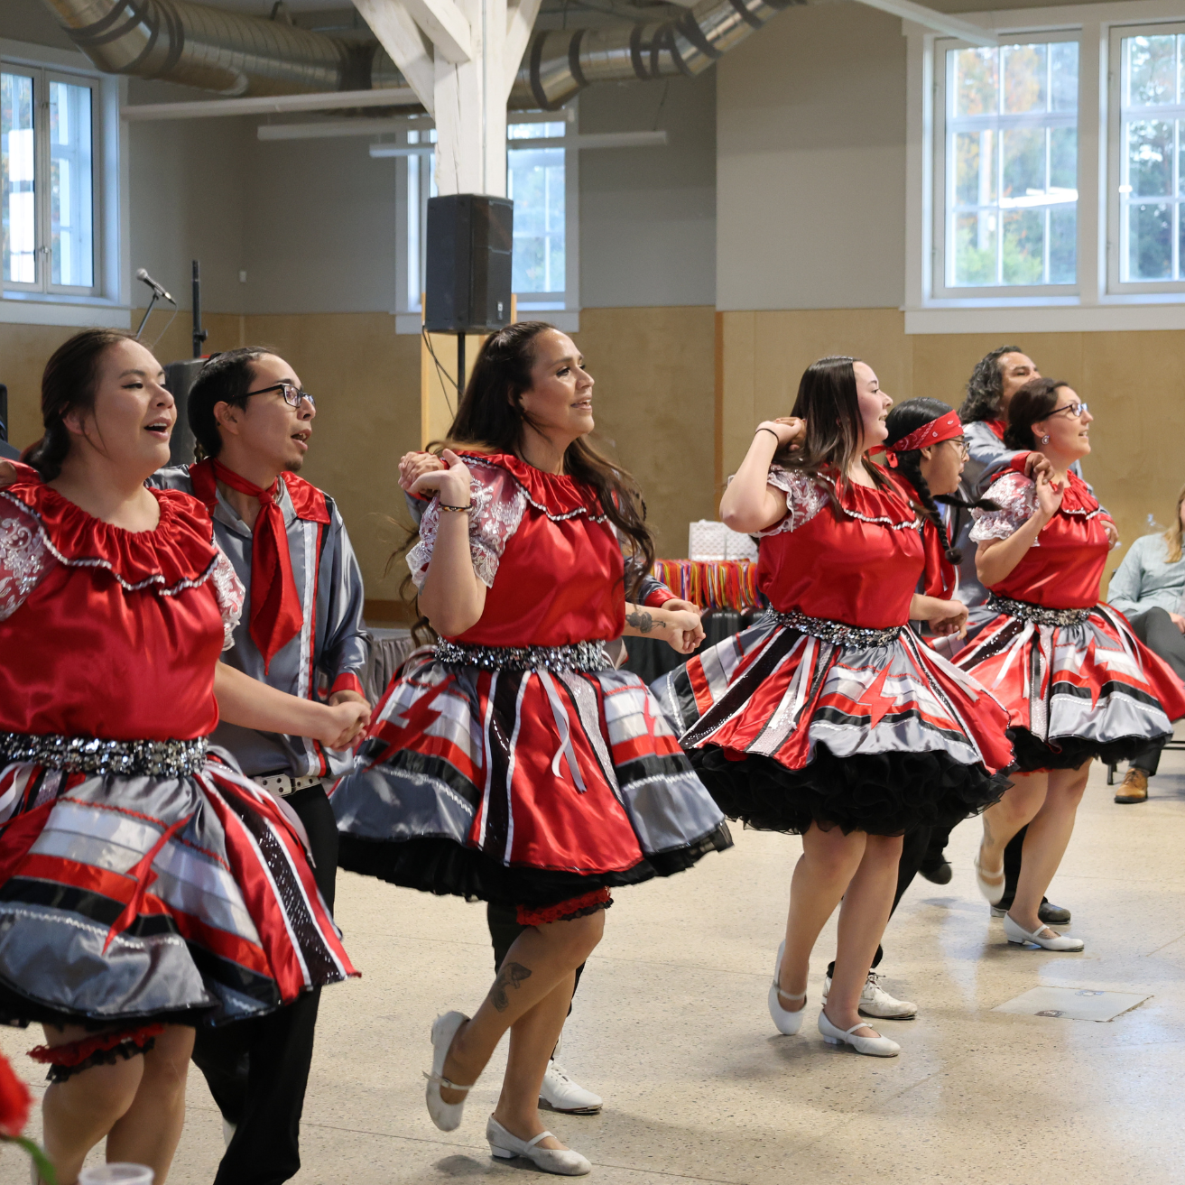
Milestones & Celebrations
Métis Child, Family & Community Services 20‑year anniversary — staff BBQs, celebration video, and staff recognition
Annual Métis CFS Christmas Party — 1,000+ guests, rides, snacks, and entertainment
Youth celebrations recognizing accomplishments and cultural belonging.

Slide 12
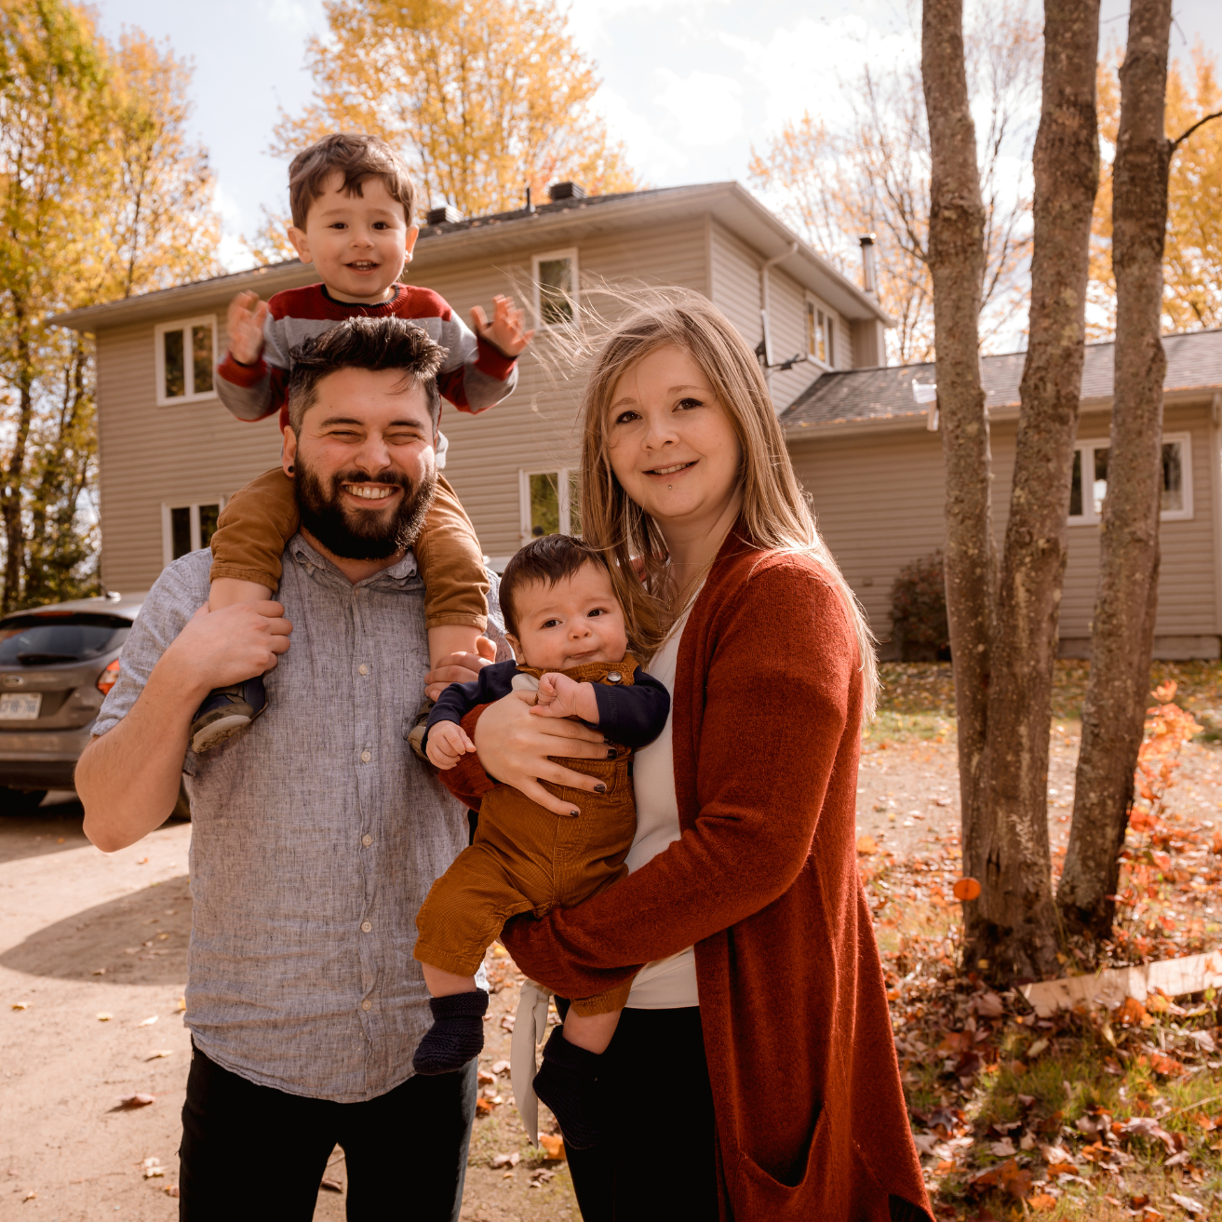
Become a Caregiver
Compassionate caregivers needed
No prior experience required
Short and long-term placements
Priority to place children with immediate/extended family or within cultural community
Join us in shaping a stronger future for Red River Métis children - contact info/next steps

