Slide 1
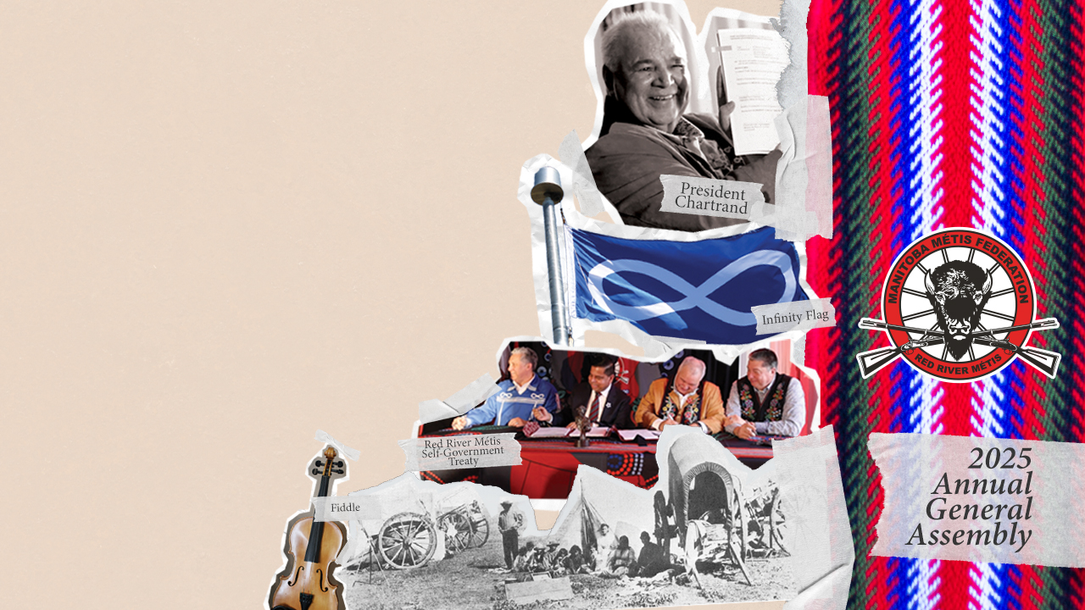
Michif and French Languages

Slide 2
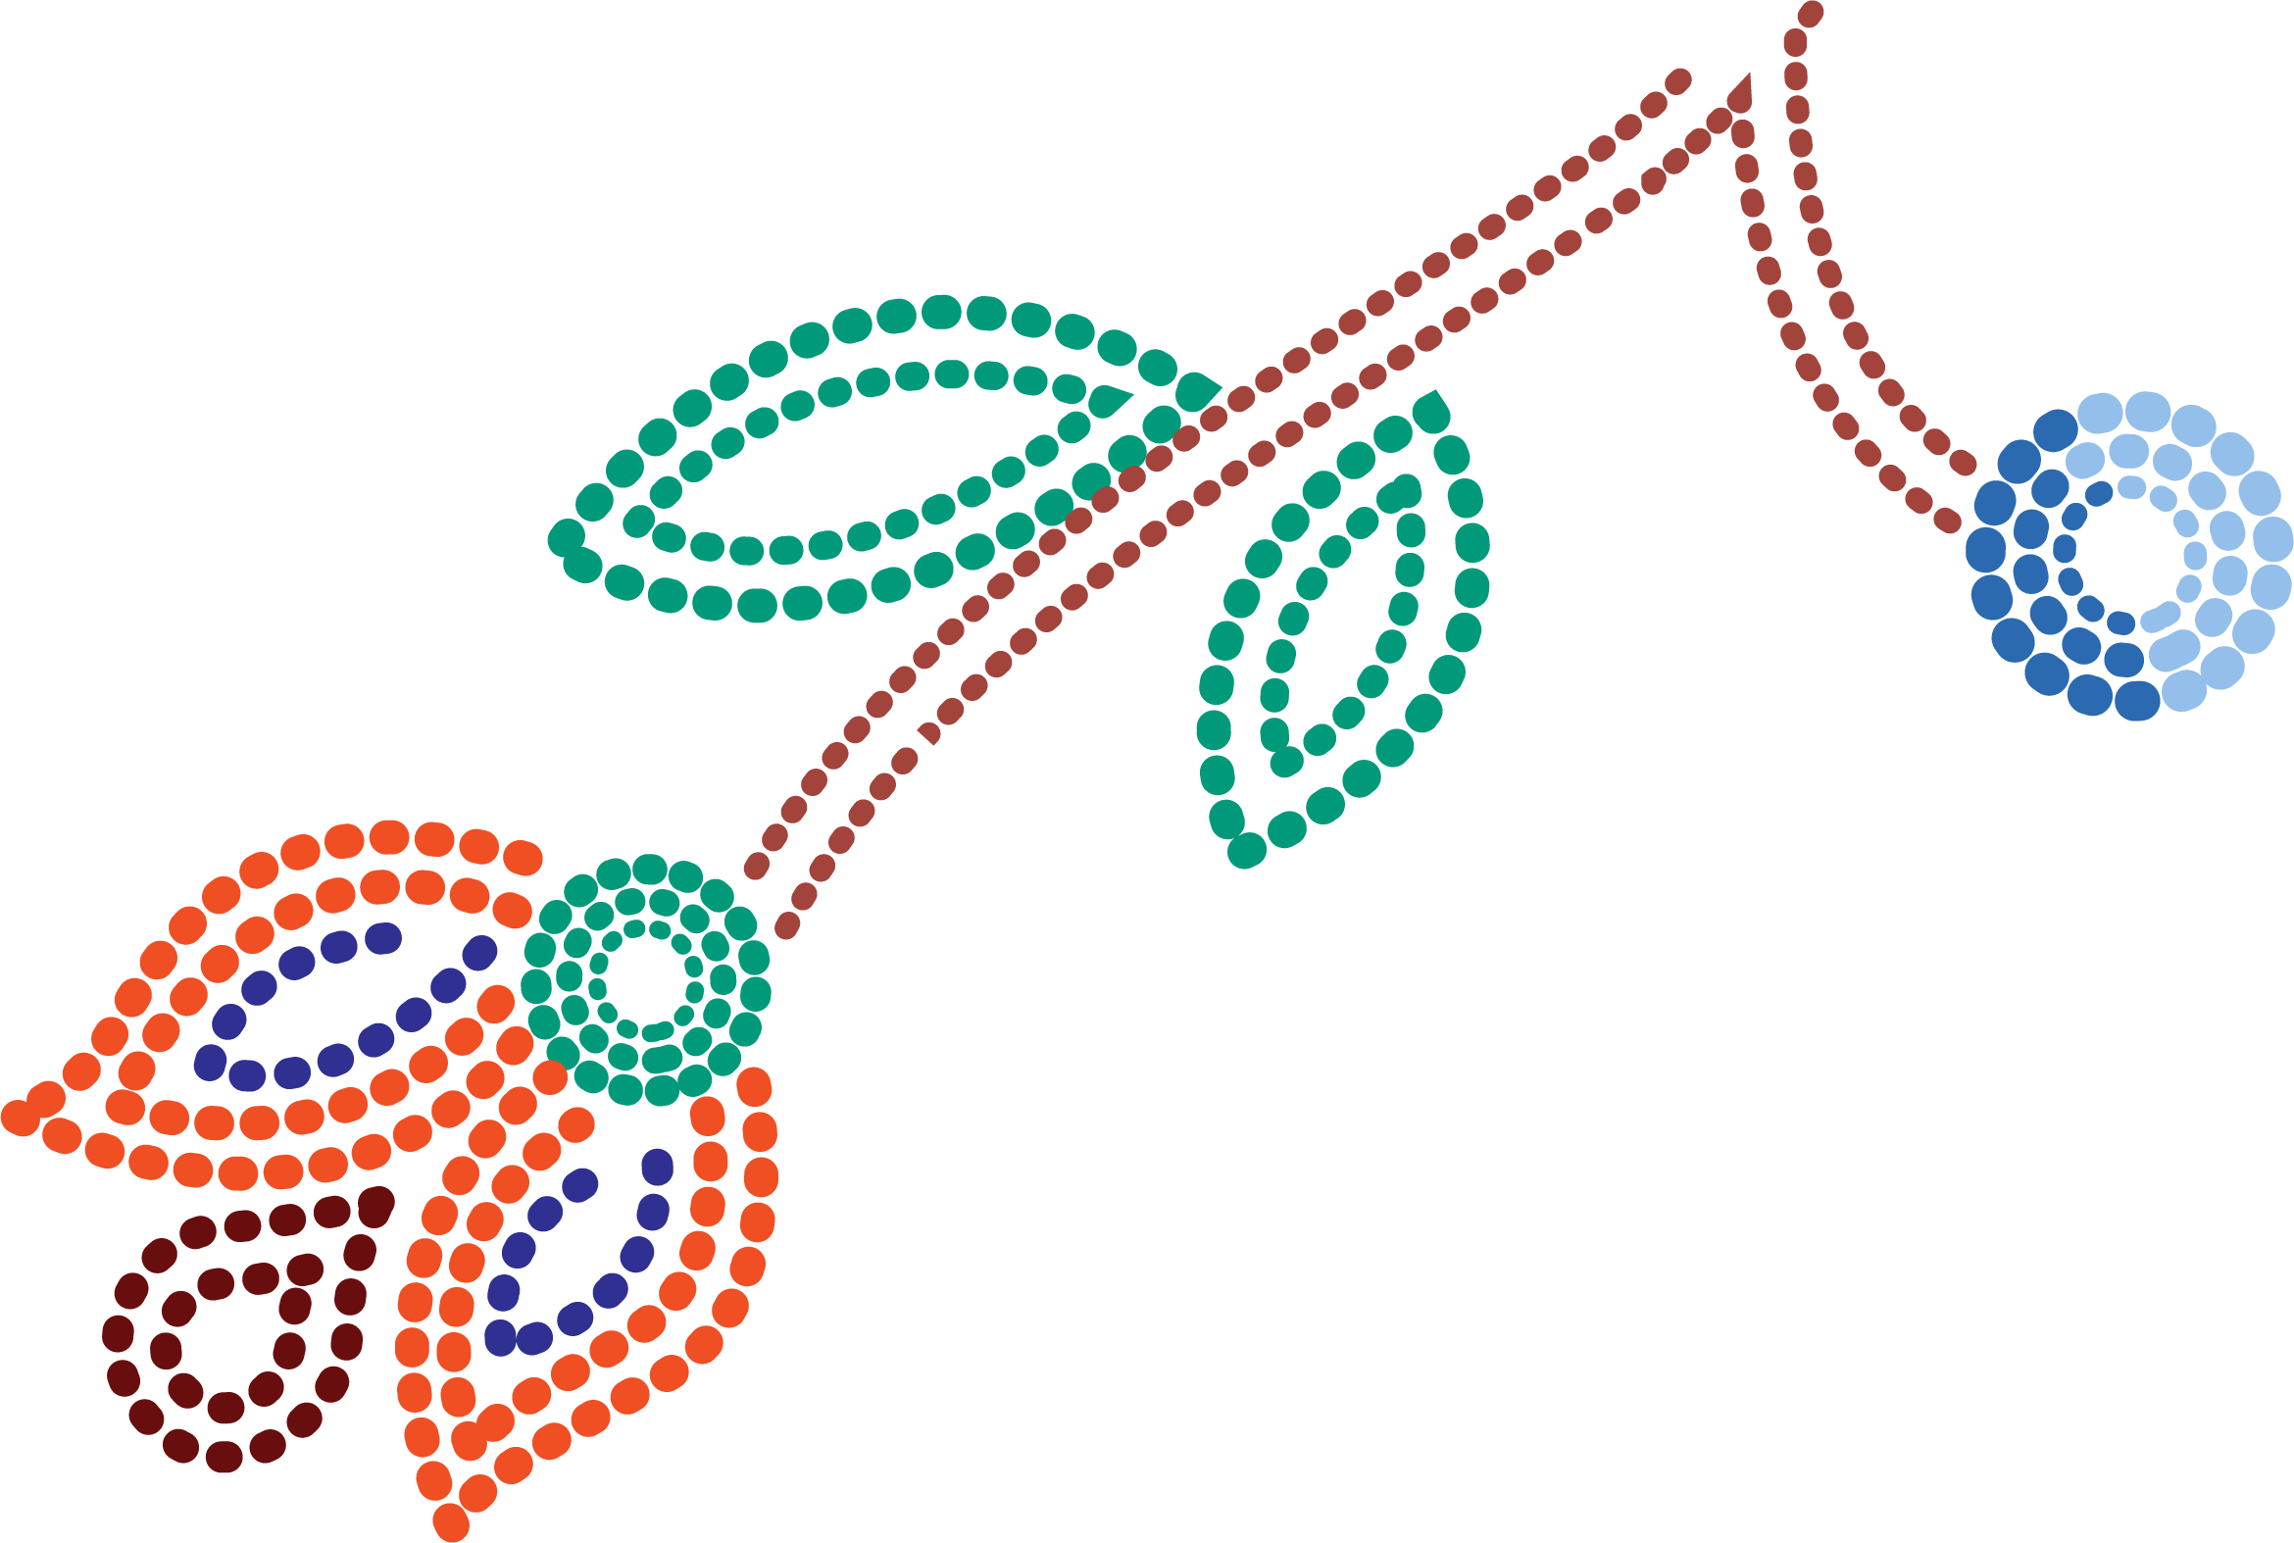
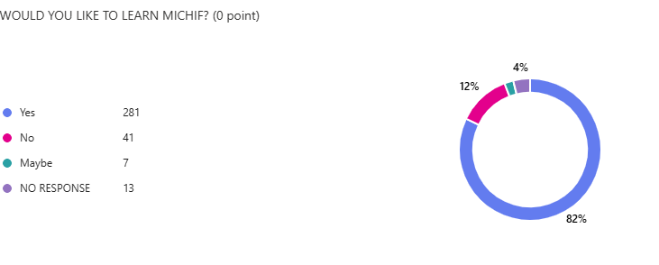
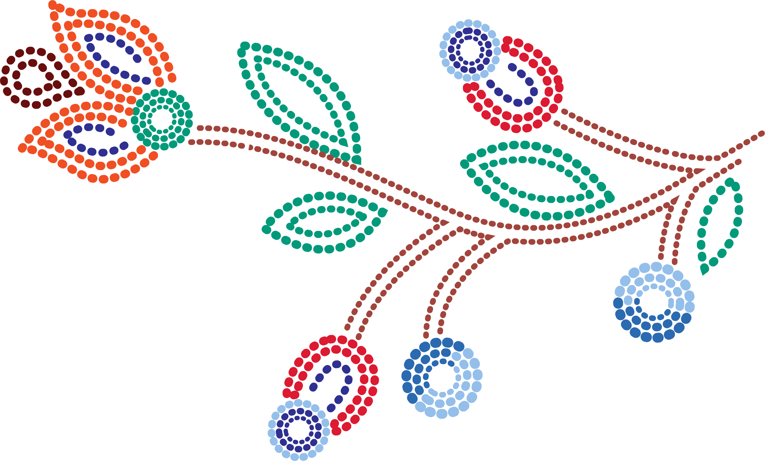
Understanding Michif Language Engagement Across the Red River Métis Nation
The Michif Language Department has been conducting surveys at MMF events and regional meetings to collect data on:
  Michif language fluency
  Interest in learning Michif
  Barriers to language learning
82% of respondents answered that they would like to learn Michif

Slide 3
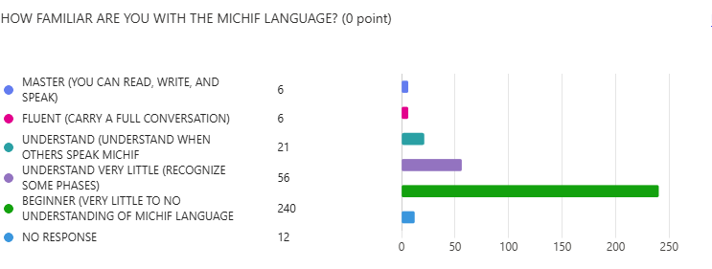
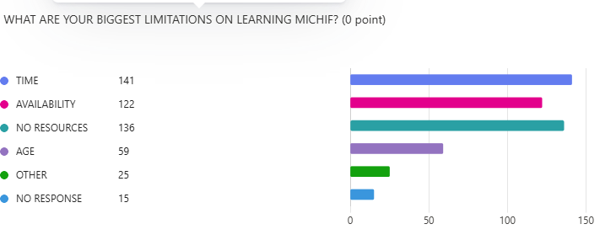
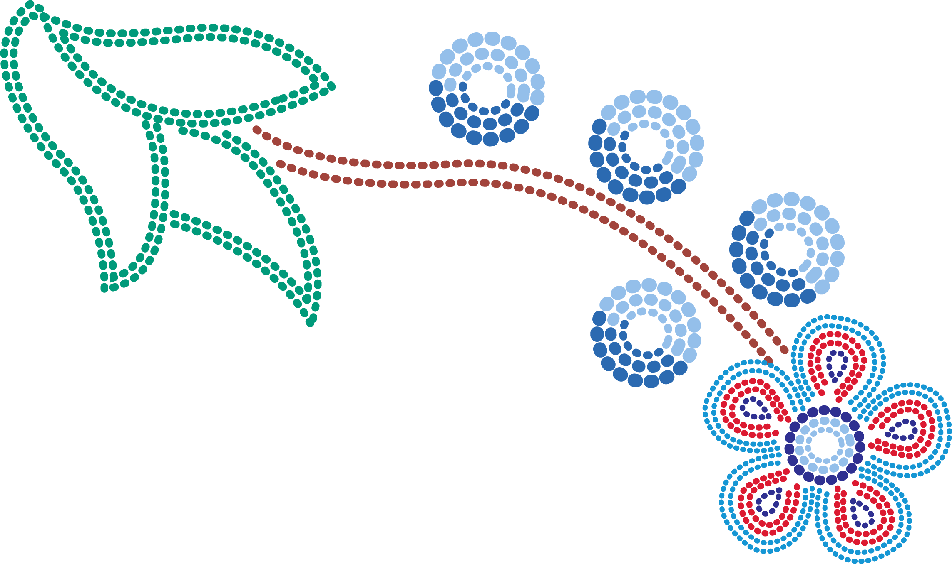
Understanding Michif Language Engagement Across the Red River Métis Nation
Key Findings:
  Approximately 70% of survey participants identified as beginners, meaning they understand little to no Michif
  The main barriers to learning:
    Lack of time
    Lack of resources and availability
Despite these challenges, our Nation has:
  Strong leaders
  Knowledgeable language keepers
  Engaged citizens working to preserve and share Michif
Notes:
The data reinforces the vital role of the Michif Language Department in supporting language revitalization within the MMF.

Slide 4
Investing in Our Language: The Michif Language Funding Application
A cornerstone initiative of the Michif Language Department designed to support projects that help:
  Revitalize the Michif language
  Protect and promote its use among Red River Métis Citizens
Application Review Process:
  All applications are reviewed by the Michif Funding Committee with priority given to projects that:
    Increase Michif language use
    Create new learning opportunities
    Engage citizens with their language and heritage
Funded Projects can include:
  Community-based learning programs
  Culturally relevant content creation
  Initiatives using modern technology to reach new audiences
Funding is open to all interested individuals, organizations, groups.
  With this funding, we are growing a vibrant future for the Michif language - rooted in tradition and reaching toward tomorrow.
Notes:
Funding applications and guidelines are available on the MMF Website

Slide 5
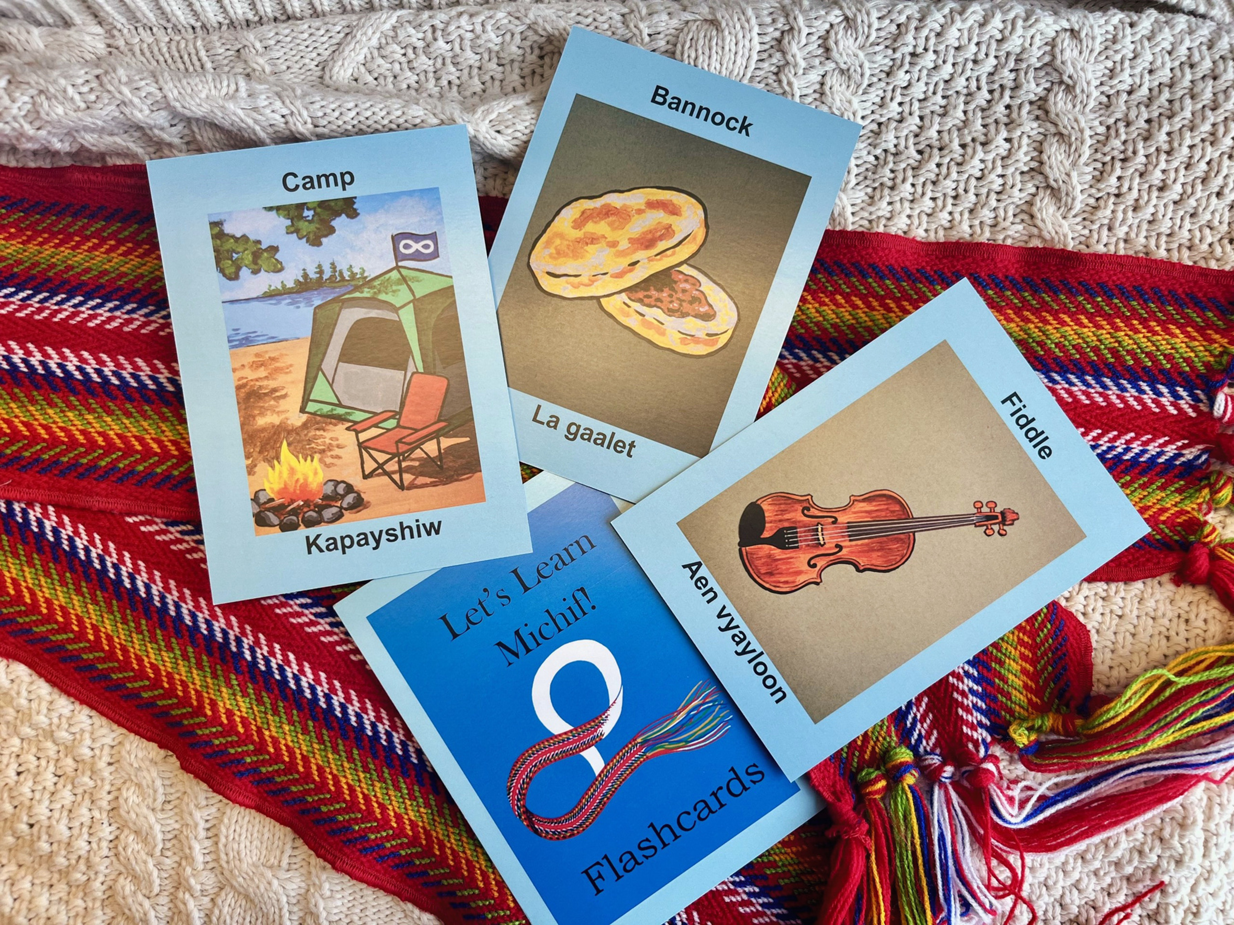
Michif Language Funded Projects
Michif in Education & Classrooms
Les Michifs de St. Eustache – St. Eustache Local
Focus: Reviving Michif-French in the St. Eustache community.
Features:
  Support from a handful of fluent Elders.
  Development of both online and physical learning materials.
  Community-led engagement with heritage language.
Michif Preschool Learning Resources – Prairie Sky Press
Focus: Creating youth-friendly resources for language learning.
Includes:
  Flashcards, storybooks, and a new website.
  Translations and recordings by Michif-speaking Elders.
  Aimed at early childhood learners.
Michif Reading & Language Exposure Program – Pemmican Publications
Focus: Bilingual children’s books (Michif & English).
Accessible language learning through storytelling.
Supports early literacy and exposure to Michif in homes and schools.

Slide 6
Michif Language Funded Projects Michif in Education & Classrooms
Piikishkweetaak aan Michif! – St. James Assiniboia School Division (Ongoing)
Goal: Build a cohort of educators who learn Michif.
Integrate Michif into K–12 classrooms.
Teacher capacity-building for sustained language exposure.
Winnipeg School Division Michif Language Teacher – Winnipeg School Division (Ongoing)
Hired a dedicated Michif Language Teacher to support schools with high Métis student populations.
Part of the Indigenous Education Team.
Teacher will provide scheduled Michif instruction across multiple schools, promoting consistent, school-based language exposure.
Notes:
St. James Assiniboine School Division has been creating a cohort of teachers that are passionate about Michif Language who will learn from language keepers then incorporate it into their classrooms
Winnipeg School Division has hired a teacher who will be going around to various classes in the division and teaching Michif-French to students

Slide 7
Michif Language Funded Projects
Michif Through Technology & AI
Michif Revival Initiative – Louis Riel Institute (Ongoing)
  Map out a revitalization roadmap.
  Conduct in-depth language research.
Integration of AI tools to support long-term Michif learning and access.
Preserving Language Through Song & Storytelling – MJ Entertainment Canada Inc. (Ongoing)
Working with Métis Elders to produce a Michif-language audiobook.
Recording and archiving oral histories, stories, and songs.
Materials will be used in and beyond the audiobook to create broader educational resources.

Slide 8
Michif Language Funded Projects
Michif Through Technology & AI
Reviving Michif Through AI – Infinity Women’s Secretariat (currently in year 2 of 3)
Innovative partnership with MMF-IT Department.
Developing “Infinity,” an AI-powered language tool (LLM) specializing in Michif with the use of artificial intelligence for future learning platforms.
Project Overview
Two introductory workshops on “Reviving Michif Through AI: A Journey of Language Resurgence” were held during the Infinity Women’s Secretariat (IWS) 12th Annual General Assembly (2024), welcoming members from all seven MMF Regions.
Purpose: To introduce the AI-driven Michif revitalization project and gather feedback for future pilot cohort planning.
Participation & Engagement
Total attendance: 202 IWS members. 162 evaluation forms received, indicating strong engagement.
Workshops were rated useful or highly useful by 93% of attendees.
These workshops laid the foundation for future pilot cohorts and active community involvement.
Notes:
Infinity Women’s Secretariat is on stage 2 of developing their AI for learning Michif.

Slide 9
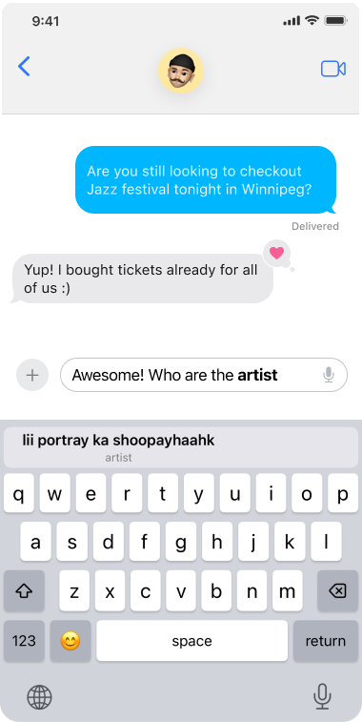
Michif Language Funded Projects
Michif Through Technology & AI
Michif AI Writing Keyboard & Translator – Renterii (Ongoing)
Project Goal: Develop a mobile app featuring a Michif keyboard with translation capabilities.
Will support all Michif dialects, available on Android and Apple.
Translates English to Michif to support everyday use and language immersion.
Notes:
The Michif Keyboard for your phone – you can also take pics and it will tell you what it is in English and Michif

Slide 10
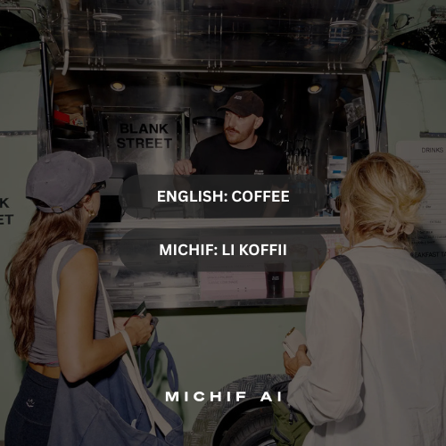
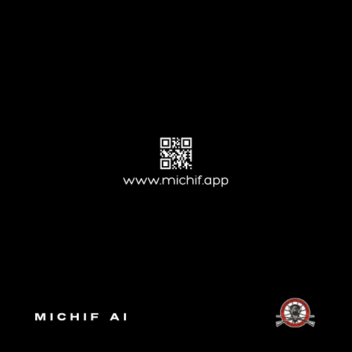
Michif Language Funded Projects
Michif Through Technology & AI
The Michif AI Writing Keyboard and Camera Translator provides a modern tool to address Red River Métis language loss. Through accessible technology, it enables people of all ages to practice Michif daily—whether through texting, social media, or other mobile apps. With the support of an AI-powered writing keyboard and translator, users can write using English words and phrases while automatically translating into Michif, making language revitalization part of everyday life.

Slide 11
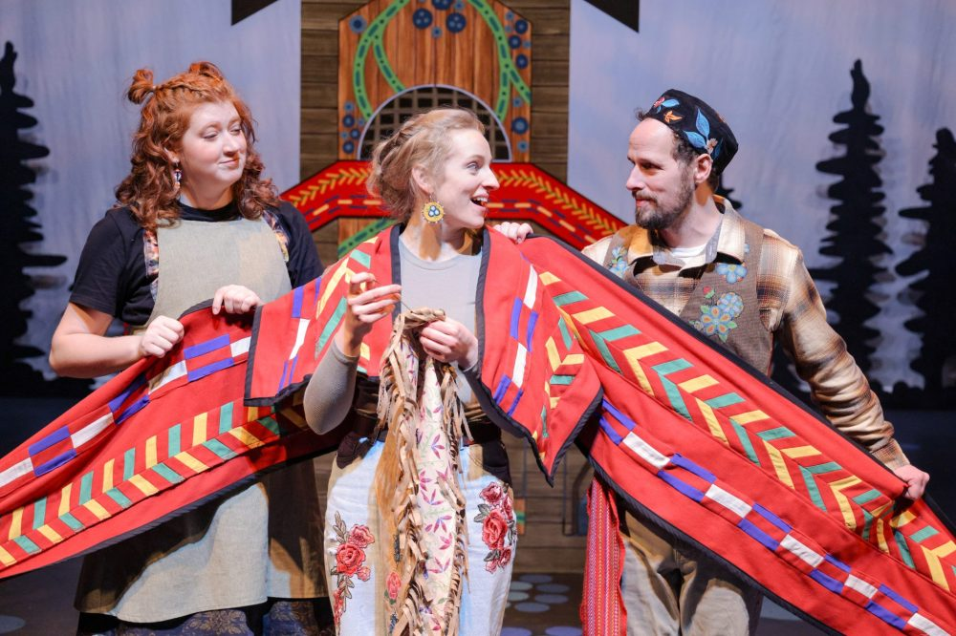
Michif Language Funded Projects – Language in the Arts & Grassroots Learning
Blue Beads and Blueberries – Manitoba Theatre for Young People
A live interactive play featuring Red River Métis actors.
Audience members learned Michif words and phrases through storytelling.
Encouraged cultural learning in an engaging theatrical setting.
Les Raasu de les Michif – Thompson Region (Ongoing)
Project to support intergenerational learning.
Citizens of all ages gathered to:
  Attend classroom-style lessons.
  Engage with lesson plans and videos.
NWMC Indigenous Languages Revitalization – Northwest Metis Council (Ongoing)
Deliver mentor-apprentice language workshops.
Focused on bridging Elders and Youth.
Strengthening intergenerational Michif language transmission.

Slide 12
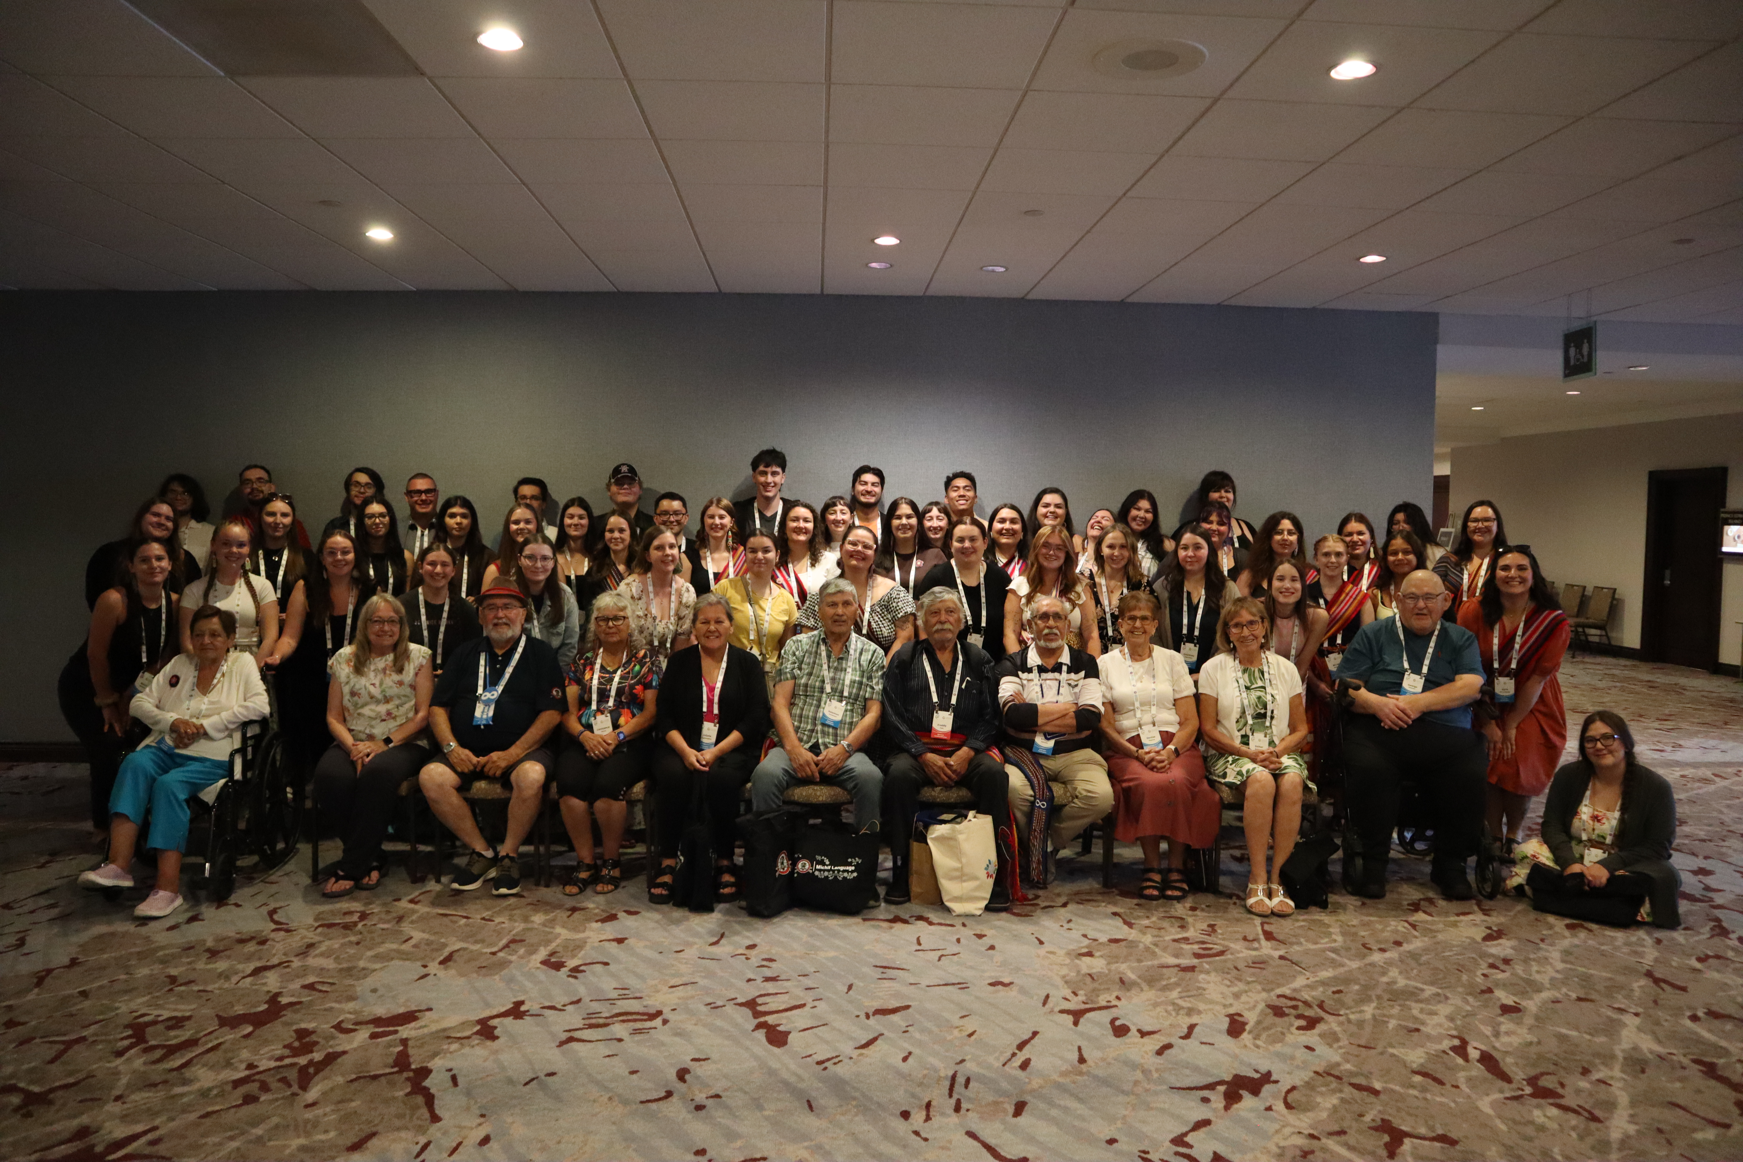
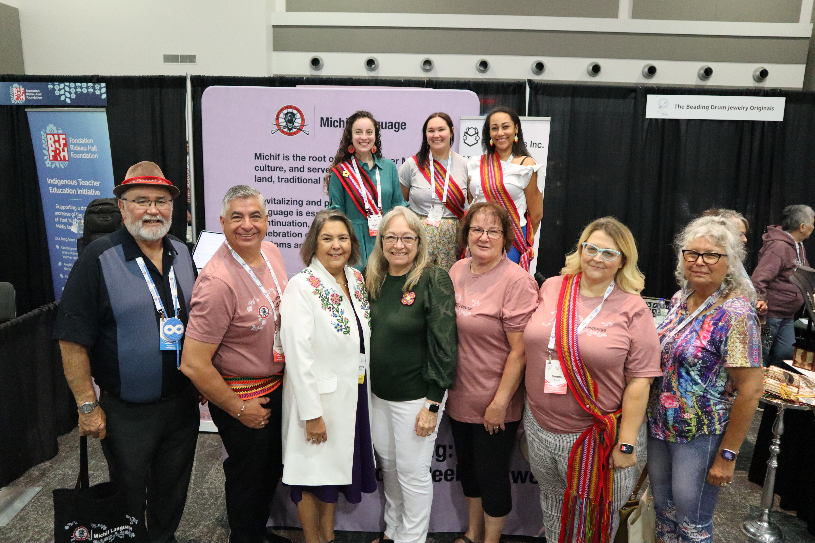
Building Tradition Through Community
WAVES 2025
The Michif Language Department and a few Cabinet Ministers, along with 50 MMF youth 9 Elders attended WAVES 2025 Global Indigenous Languages Summit.
The goal of the Summit was to support Indigenous Peoples worldwide in Reclaiming, revitalizing, preserving, and strengthening their languages.
Shared the Red River Métis Culture and the Michif Language
Built networks with Indigenous language leaders worldwide
Brought new ideas and innovations back to strengthen Michif revitalization locally.

Slide 13
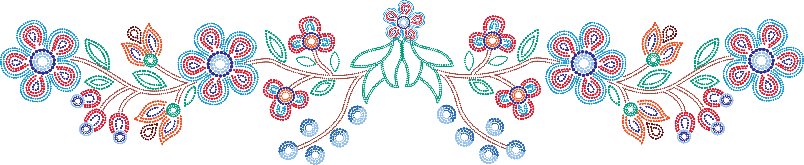
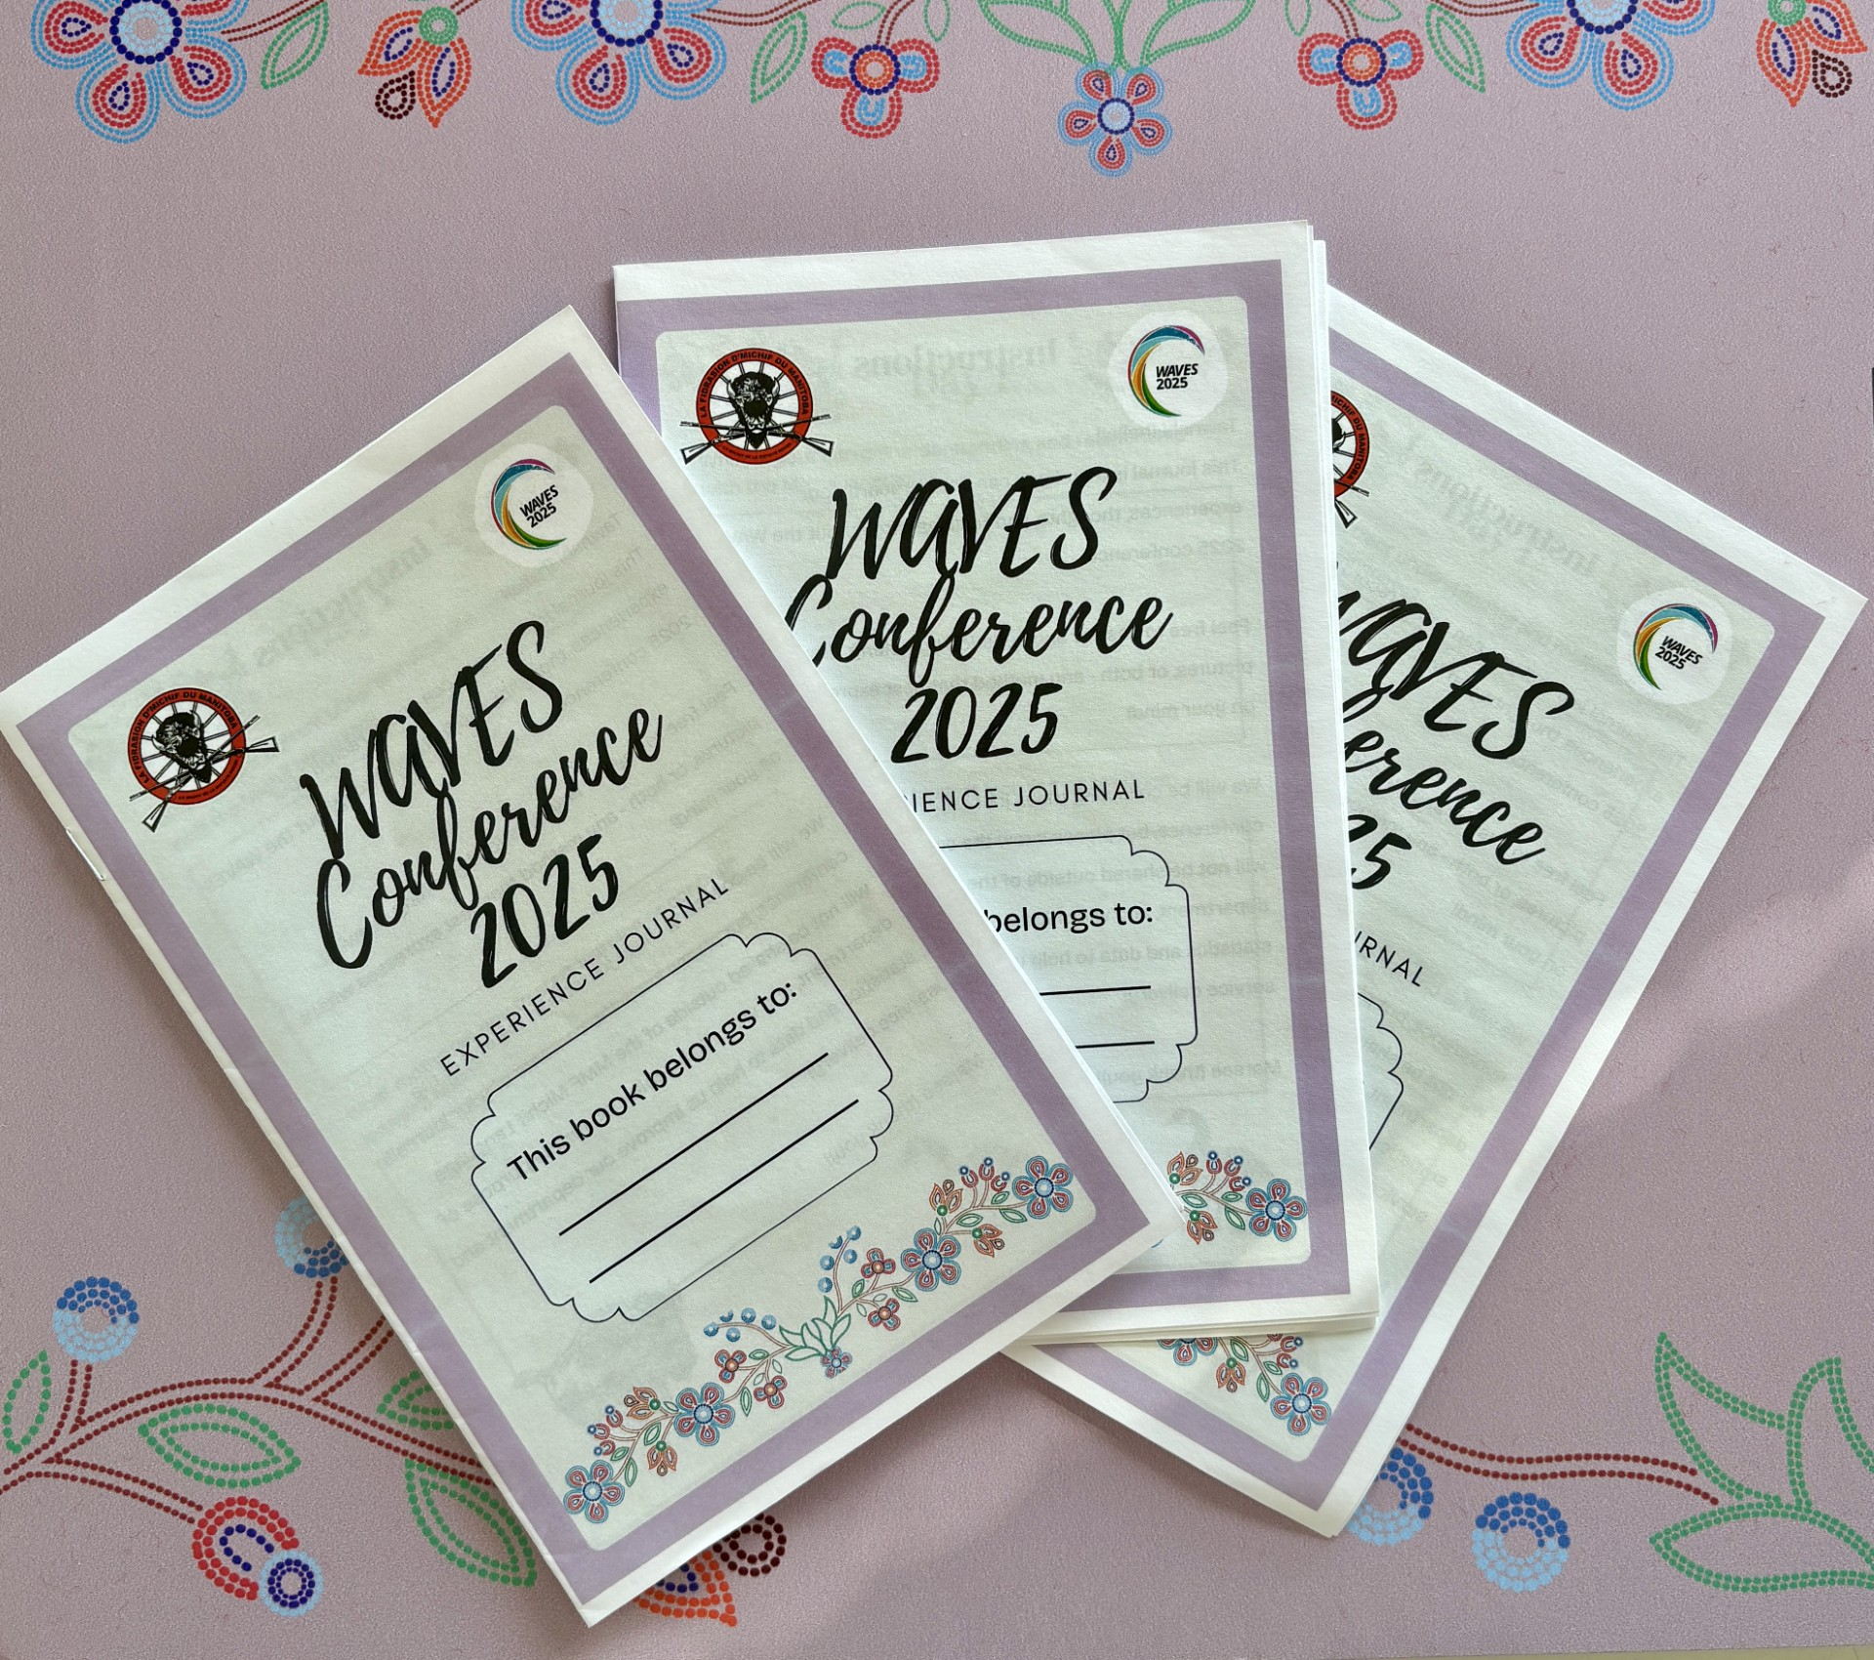
Building Tradition Through Community
The delegation of 50 youth from throughout the Regions in attendance were each given personal journals to reflect on what they learned and gathered from this experience. Youth participation and representation ensures our youth gain invaluable knowledge of the Michif Language that will benefit them in their language learning journey.
“Being able to speak the language of our people is an important step towards reclaiming our heritage”
"I started learning Michif because I want to raise my future children with Michif as a first language. I want to teach them so it can be our love language"
"I'm taking away a lot of new resources i.e. websites and flashcards. I am also leaving with many new connections that I'm looking forward to reaching out to practicing language with!"
"Language is a big part of who we are. It explains relationships to the land, each other, and our past, present and future. without language, we lose who we are."

Slide 14
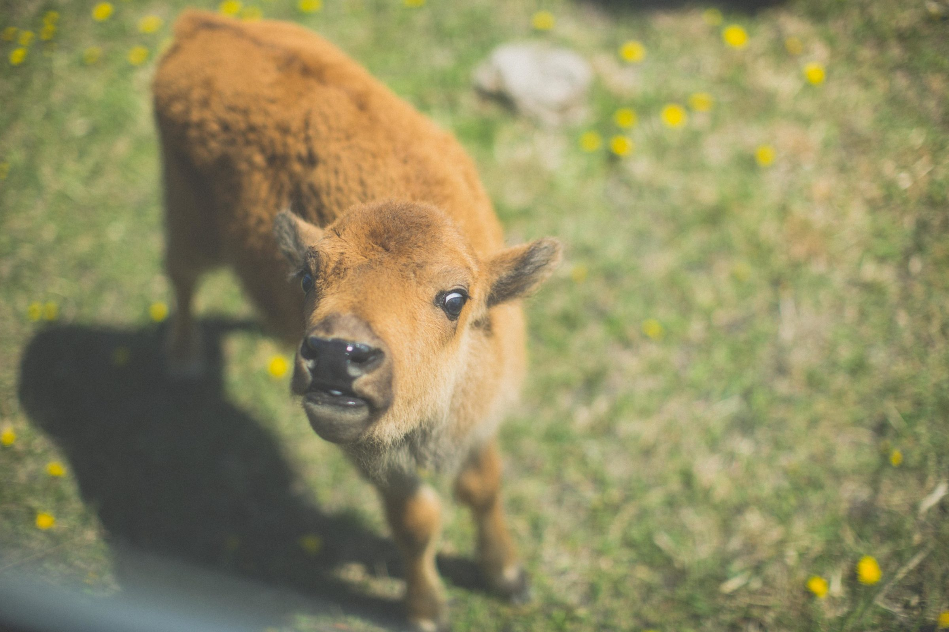
Looking Ahead – Building Tradition Through Community
FortWhyte Michif Language & Métis Culture Programming – FortWhyte Alive (Ongoing)
Day camp programming rooted in land-based learning.
Participants engage in Michif workshops, cultural teachings, and outdoor activities.
Fosters a direct connection between language, land, and identity.
Waterways Land-Based Michif Program – Waterways Canada (Ongoing)
Land-based day camp format, but with a specific focus on waterways as teaching spaces.
Michif is woven into land, water, and cultural teachings, supporting immersive learning for youth and families.

Slide 15
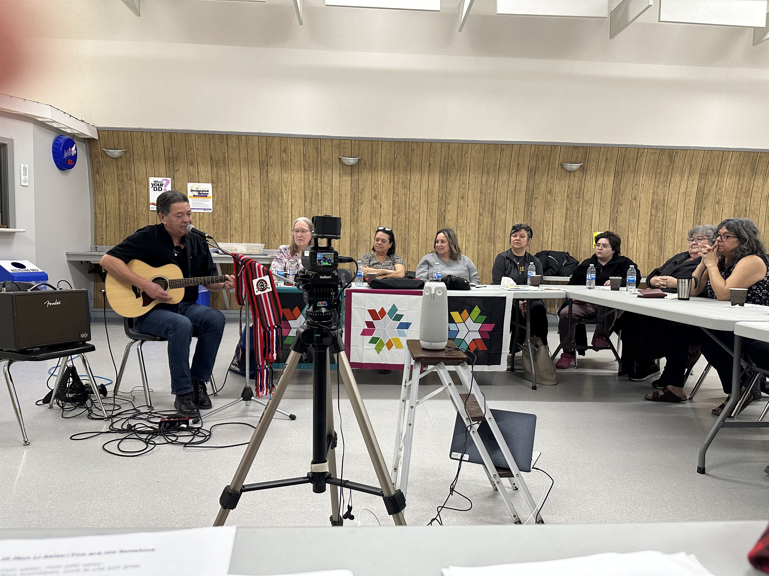
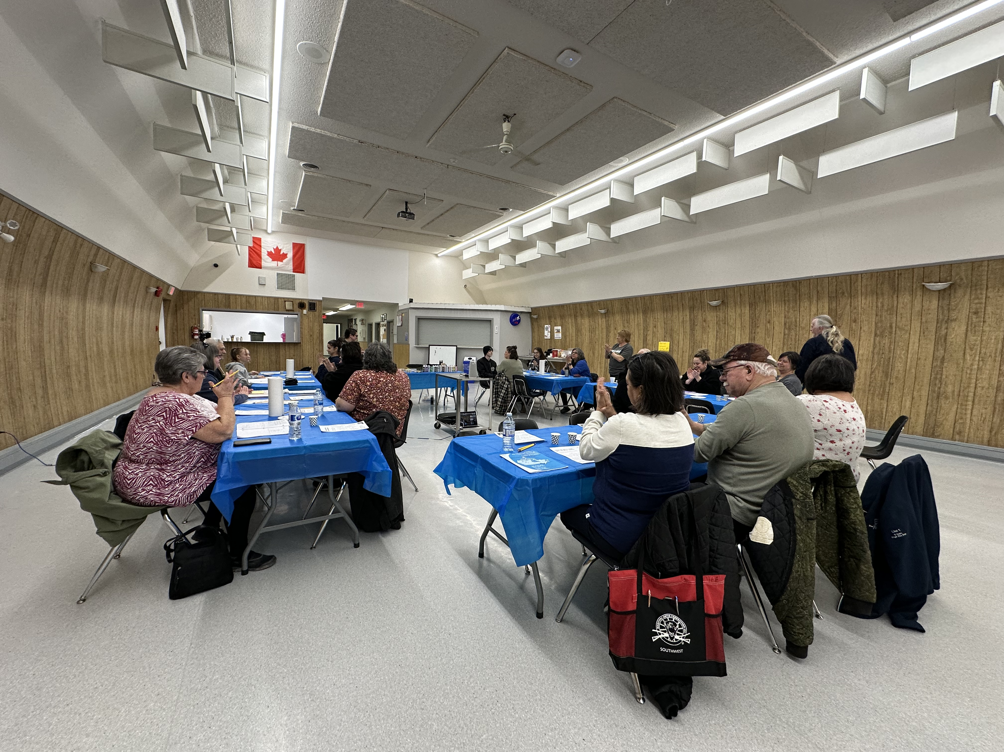
Funding Success Stories - St. Eustache Local
Project Overview
These workshops focused on revitalizing Michif French, a language once widely spoken in the St. Eustache community.
The program combined the knowledge of fluent Elders with accessible digital and physical learning resources to support participants of all levels.
Participant Engagement
27 participants attended all classes and completed the initiative.

Slide 16
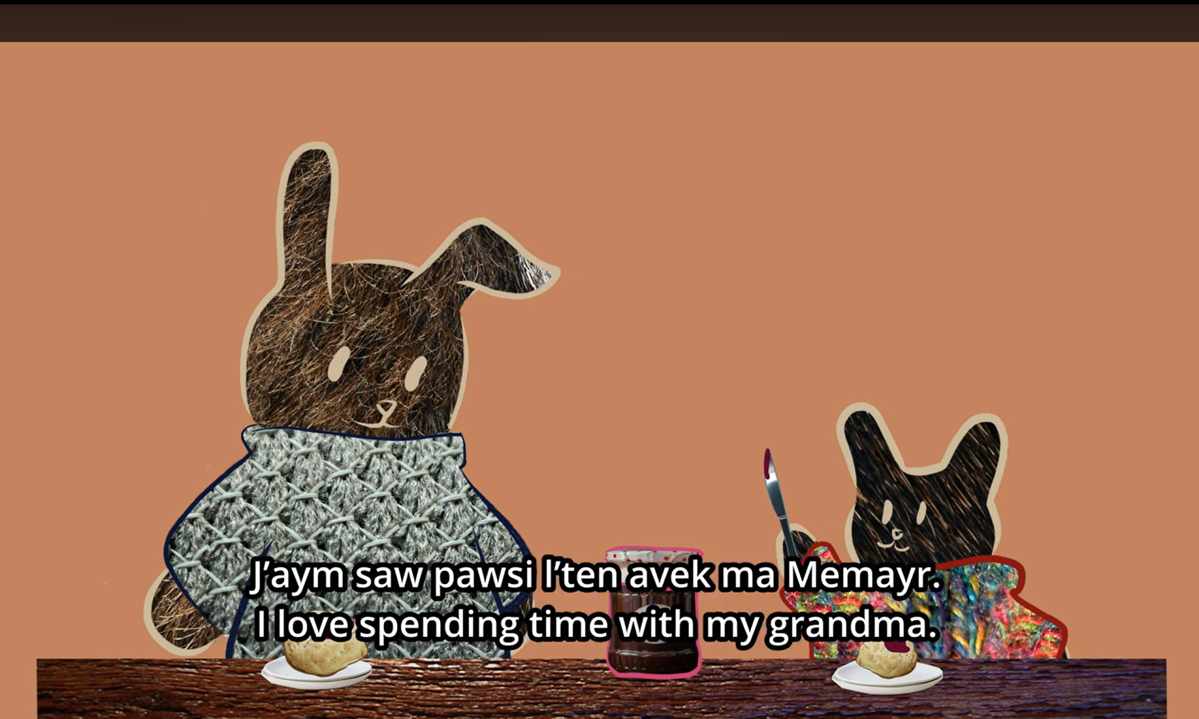
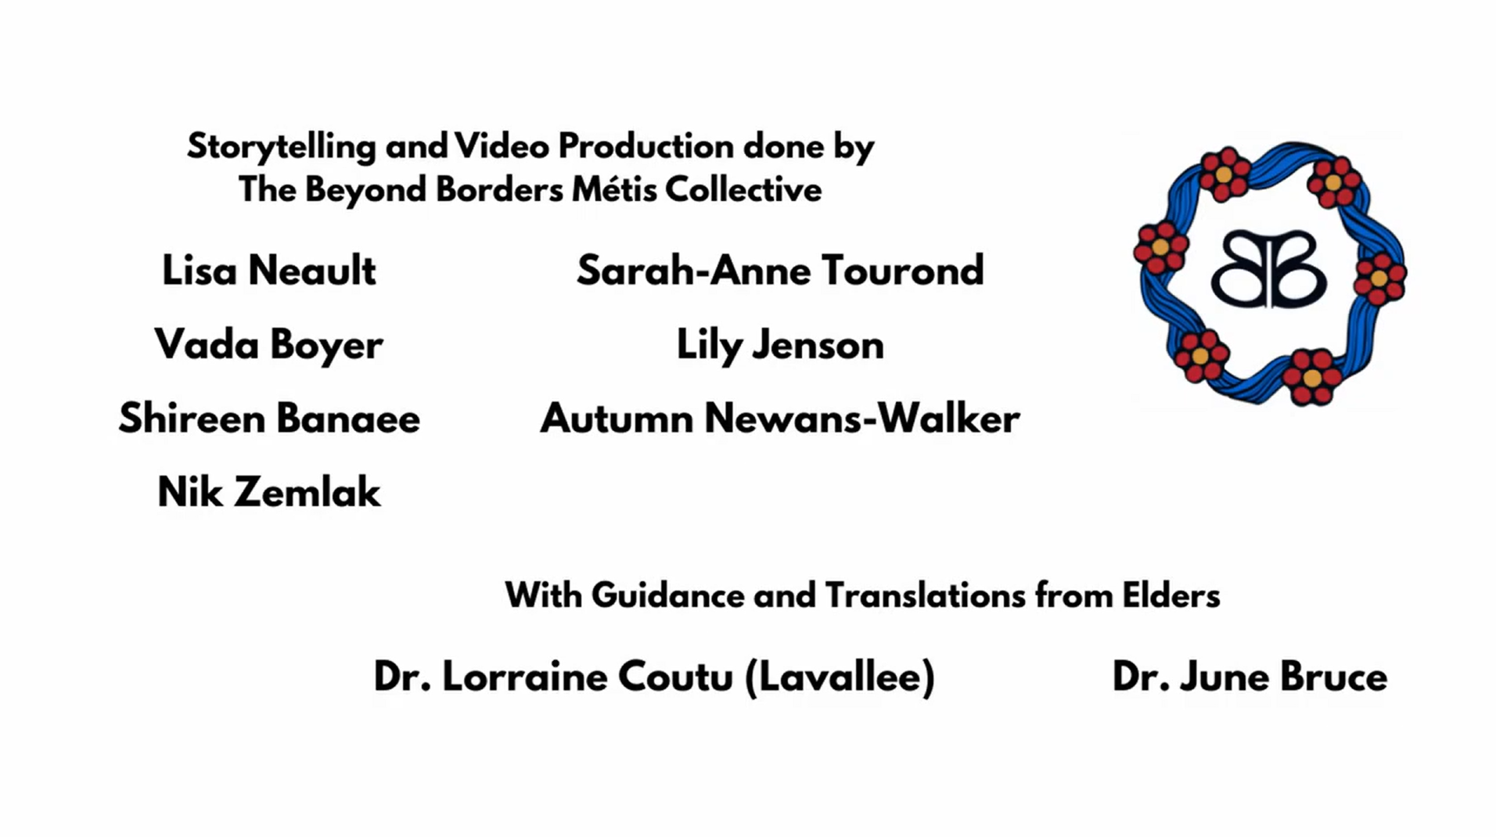
Funding Success Stories - Beyond Borders Metis Collective
Project Overview
A national storytelling initiative focused on Michif language revitalization through the voices of Métis youth. This project brought together young people with ancestral and cultural ties to the Red River, representing the Métis Nation from coast to coast.
Youth Engagement
20 applications received from Métis youth across Canada, 10 confirmed and 5 youth completed the full series of storytelling and language sessions.
Youth expressed a strong desire to stay connected and continue contributing to the revitalization of Michif and Métis culture.
The project fostered a sense of belonging, empowerment, and leadership among a new generation of Métis storytellers and language keepers.

Slide 17

Preserving the French Language in the Red River Métis Community
MMF French Language Initiatives:
Cultural Preservation and Visibility: Actively working to keep the French language vibrant within the Red River Métis community. Promoting the use of French in cultural programming and events.
Resource Development: Collecting and curating French-language materials relevant to the community. French newsletters being produced for Citizens
Staff Training: Offering opportunities for Department staff to improve their French proficiency.
Sustaining and Expanding Efforts:
Funding Research: Investigating funding streams suitable for MMF’s French language initiatives.
Collaborative Outreach: Engaging with the Province of Manitoba’s French Language Services Secretariat for partnerships and support.
Strategic Planning in Progress: Organizing a Strategic Planning session with Department, Policy staff, and key stakeholders to develop a blueprint for the MMF’s French Language Strategy.

Slide 18
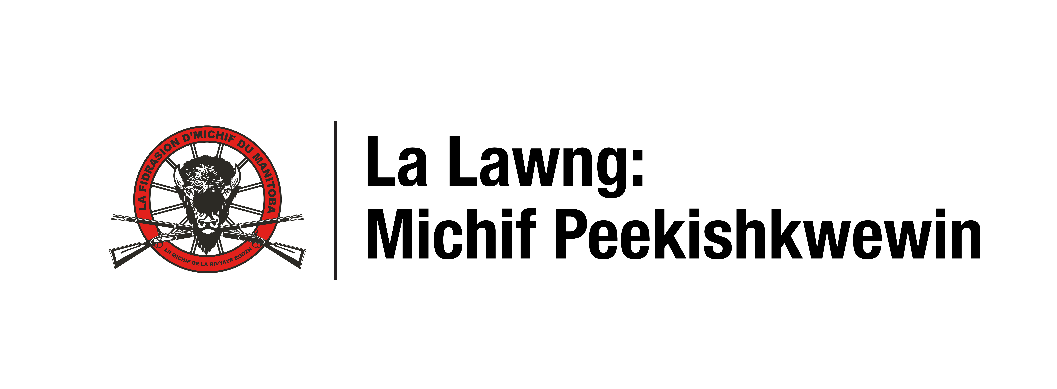
Ki shaakiihitin
taanishi
Kischi marsii
Taanishi kiiya
Ni miyeuhayn aen nakishkatann
miyoonakishkatoohk
Ki shaakiihitin
Ni miyeuhayn aen nakishkatann
Bonn apray mijii

