Slide 1

Energy Infrastructure and Resource Management:
Mining Portfolio

Slide 2
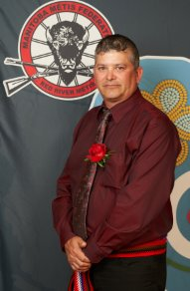
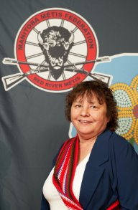
Mining Ministers
Minister ​
Vincent Mark Parenteau
Associate Minister ​
Mildred Dorion

Slide 3
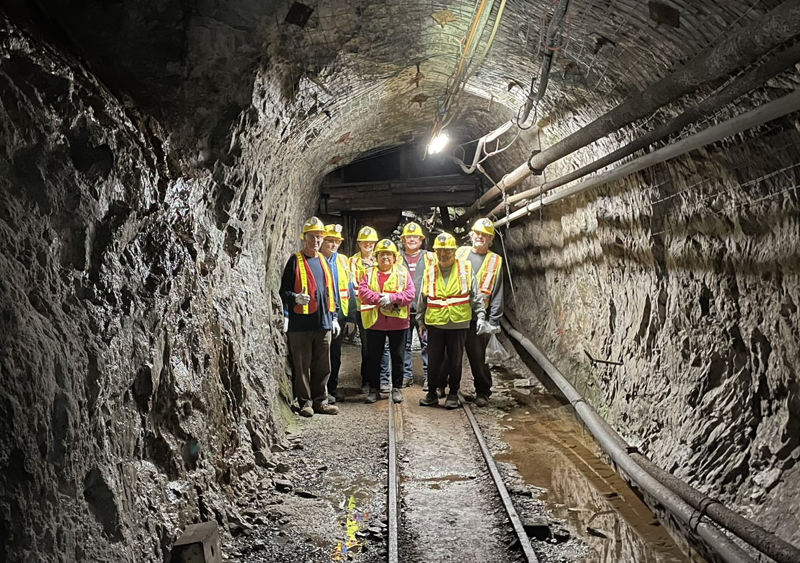

Digging Deeper: Red River Métis Exploration of Mining
Increasing awareness of mineral exploration, mine development, and the potential impacts of mining projects.
Creating opportunities for interest and participation in the mining industry.

Slide 4
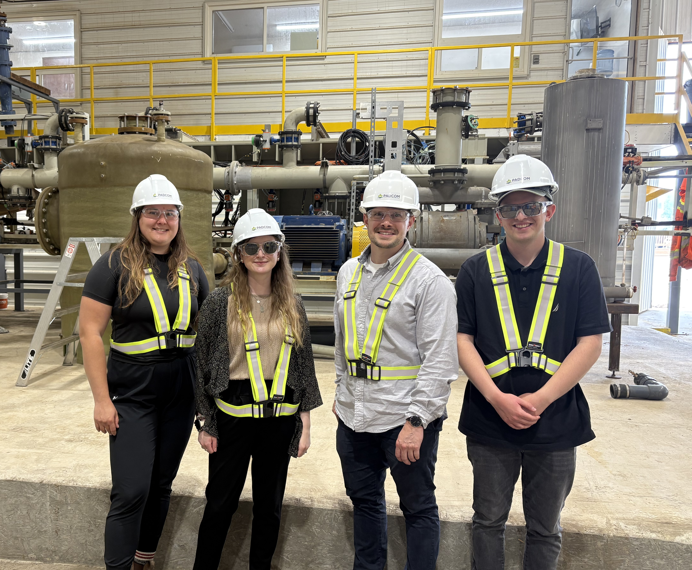
Potash and Agri-Development Corporation of Manitoba (PADCOM)
On February 28, 2025, PADCOM signed a Royalty Agreement with the MMF, cementing an important relationship that will benefit the MMF and Red River Métis Citizens.
The MMF Mining Portfolio is continuing to engage with PADCOM on environmental monitoring and education opportunities.

Slide 5
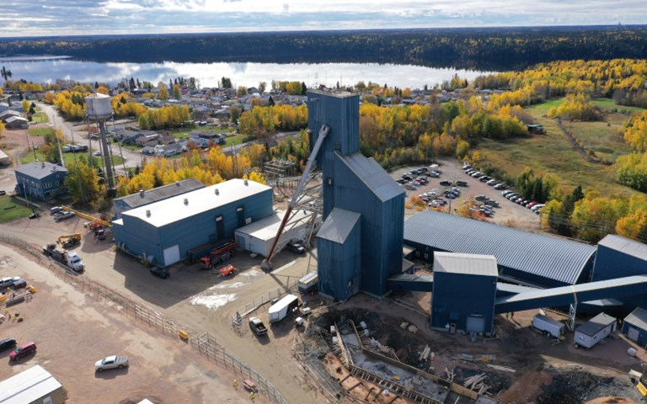
Consultation with Manitoba on Mineral Exploration
Advocating for section 35 rights of the Red River Métis.
Ensuring impacts from mineral exploration is mitigated and accommodated.

Slide 6
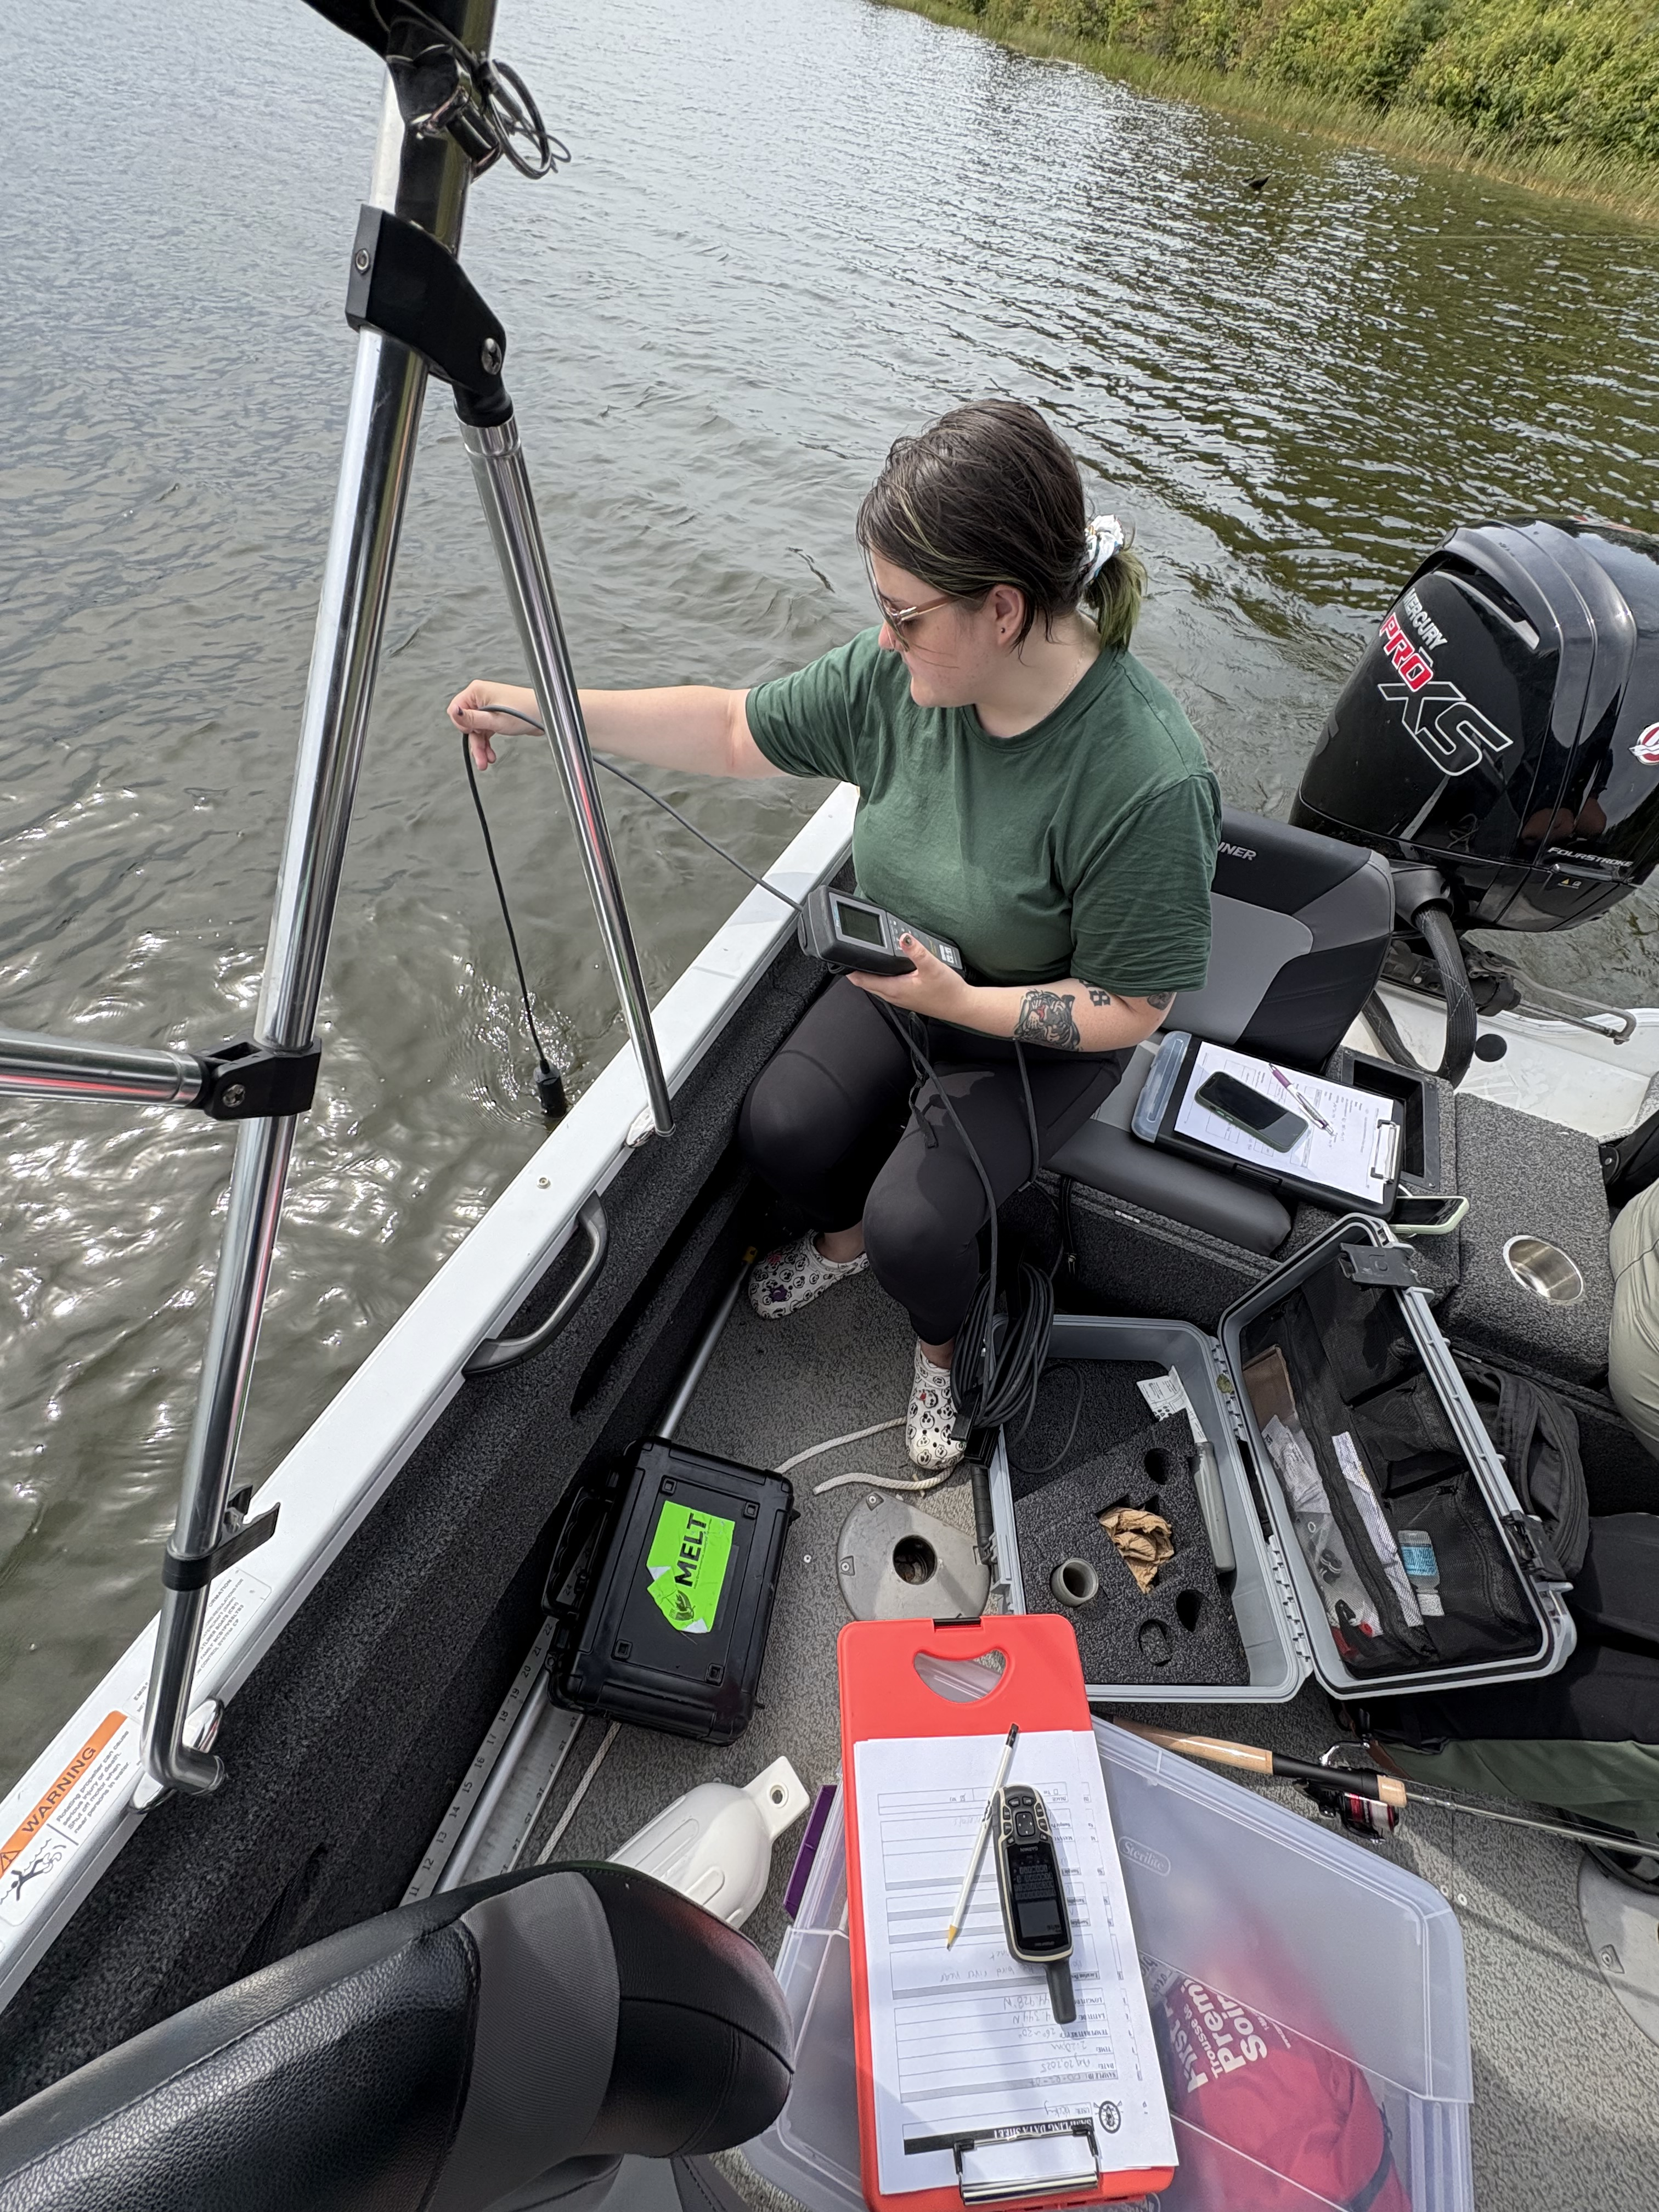
Engagement with Mining Companies
Tantalum Mining Corporation of Canada (TANCO)
Grid Metals Corp.
Hudbay Minerals Inc.
T2 Metals Corp.

Slide 7
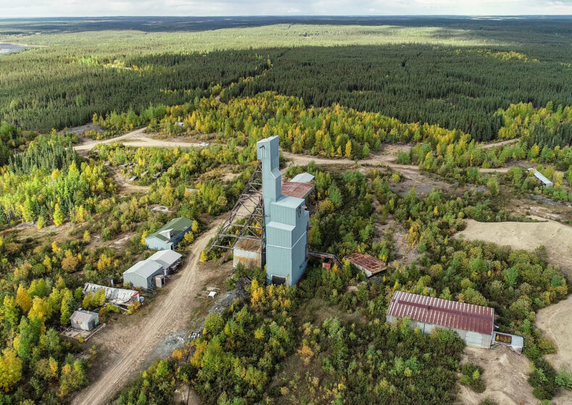
Upcoming Mining Projects
Alamos Gold – Lynn Lake Gold Mine
Sio Silica – Vivian Silica Sands Project
Canadian Premium Sands (CPS) – Wanipigow Silica Sand Mine and Selkirk Processing Facility
The MMF will continue to engage with these companies to ensure that necessary mitigation and accommodation measures are in place to protect the rights of Red River Métis Citizens.

Slide 8
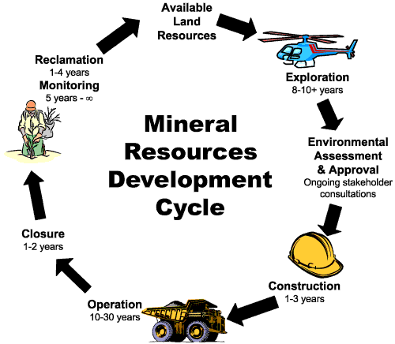
Red River Métis Mineral Development Protocol
The MMF received funding from Manitoba to develop a Red River Métis-specific Mineral Development Protocol.
Community Consultation Meetings will be held soon to gather feedback on the protocol.

Slide 9
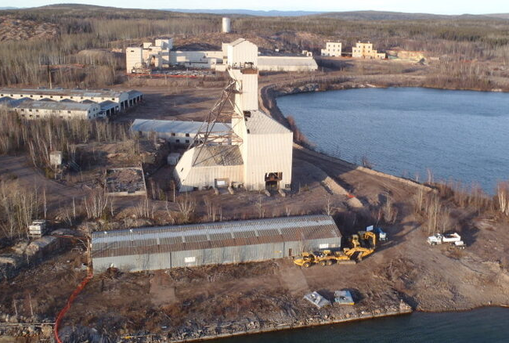
Manitoba’s Orphaned and Abandoned Mines Program (OAM)
Since February 2024, the MMF has been meeting quarterly with the Orphaned and Abandoned Mines team to hear updates on their monitoring and remediation activities.

Slide 10
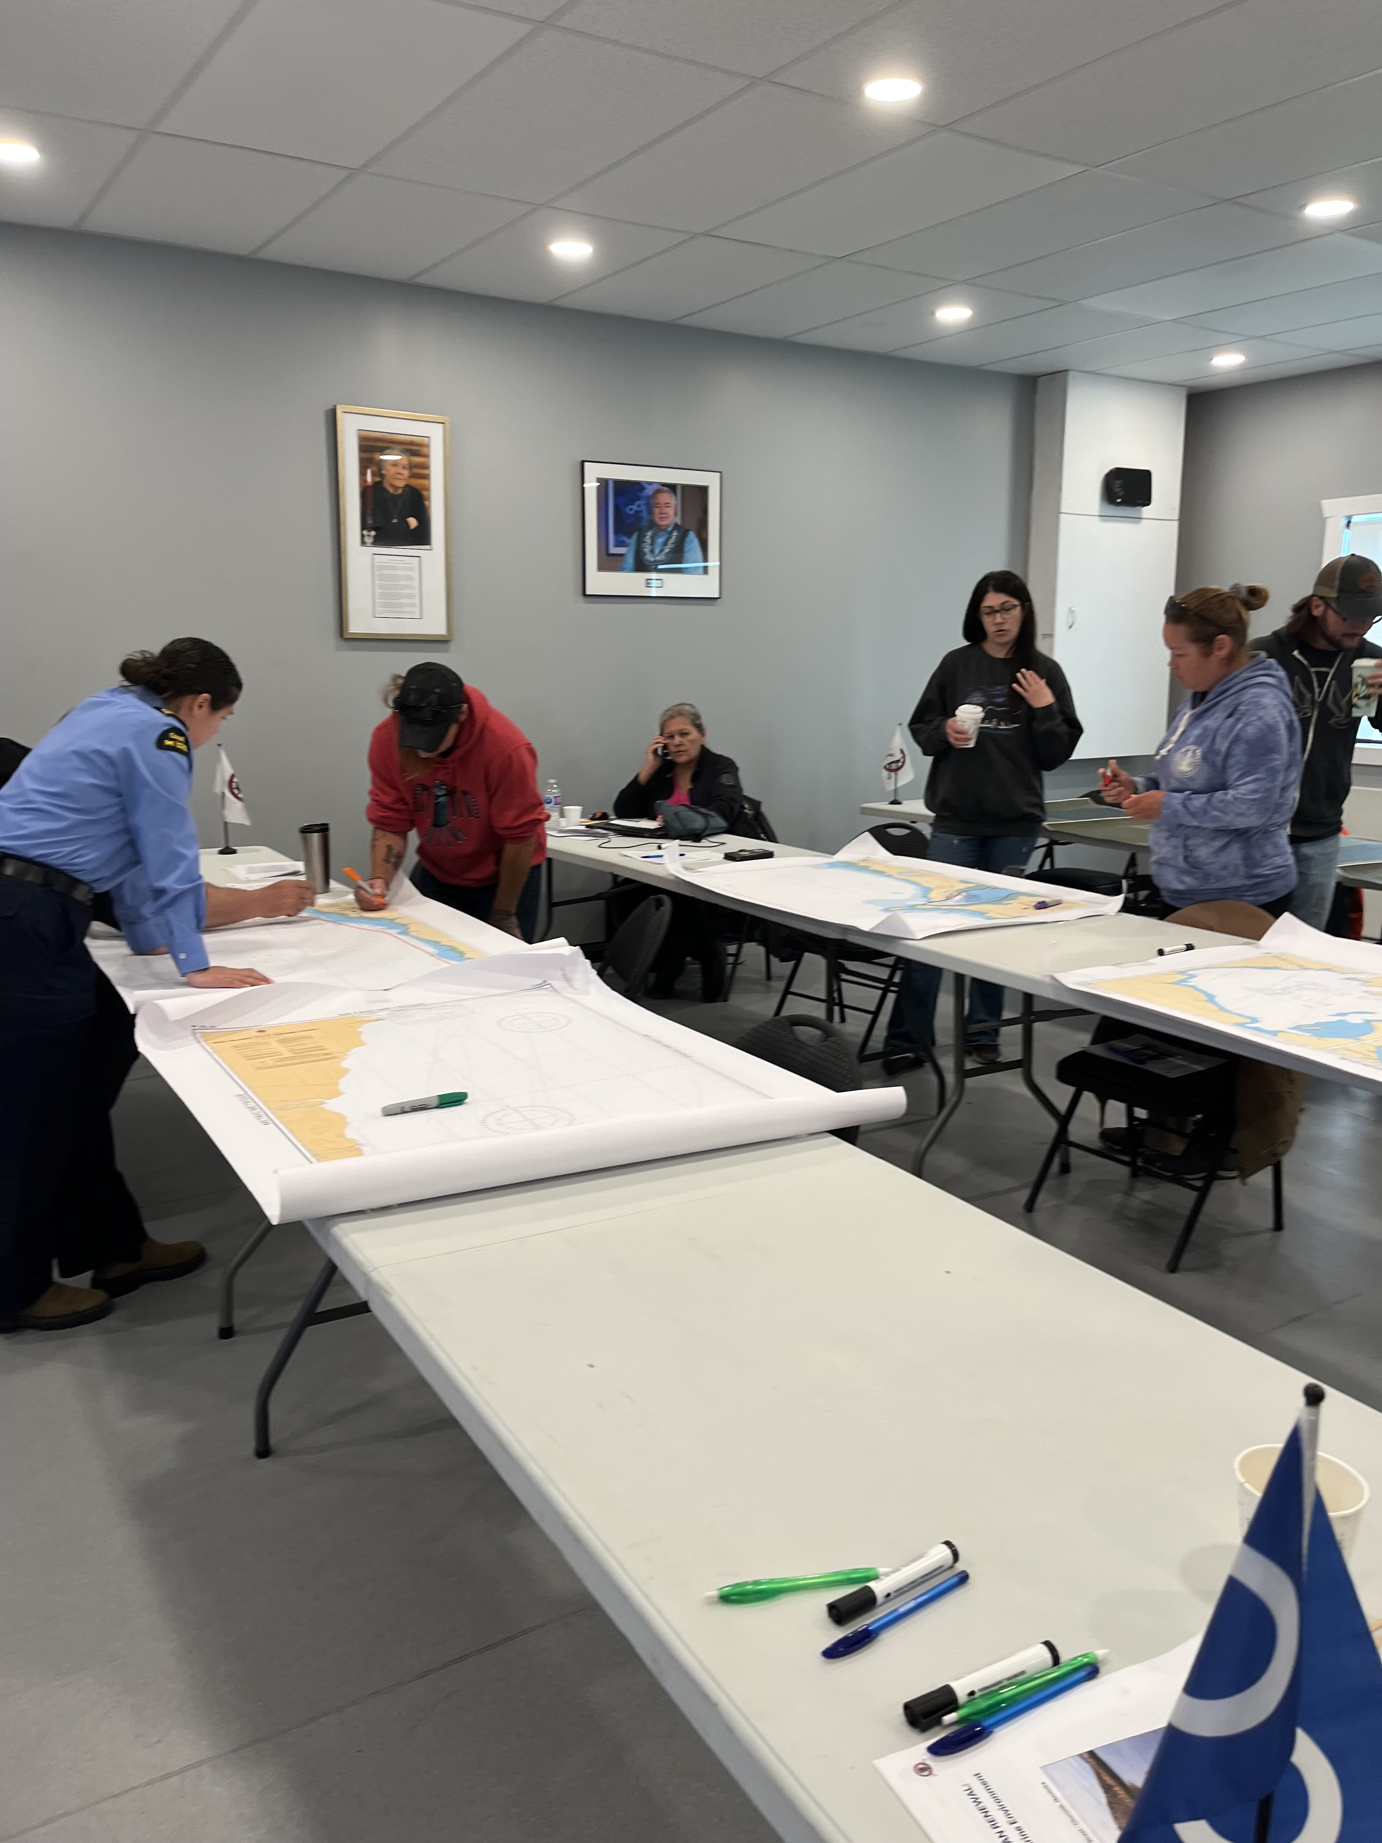
Red River Métis Oil Spill Impact Study and Response Plan
Understanding the biological effects of oil spills on species of importance and aquatic areas.
Look out for mapping workshops in your Region!

Slide 11

Thank you!
We are always looking for input, comments, questions, and concerns from Red River Métis Citizens regarding mining.​​
If you would like more information about the Mining Portfolio, please contact:
minesandminerals@mmf.mb.ca

