Slide 1


Slide 2
Trapper / Raw fur Program
The Red River Métis Fur Company (RRMFC) continued its operations to purchase furs and hides from Métis trappers and harvesters in fiscal year 2024/2025. RRMFC offers prices 25% higher than the current market value, which significantly boosted participation.
The 2024/2025 season has seen 56 trappers.

Slide 3
Trapper / Raw fur Program
Total Dollar purchases for 2024/2025 totaled $163,389 compared to $180,340 in the prior year, representing a decrease of $16,951.
This variance is primarily due to fur purchases that occurred in March of the prior year but were carried over to April in the current year.
First buying trip will be in December, dates and times will be posted in November

Slide 4
Per region breakdown
The Pas (3 trappers / $9,990)
Northwest (27 trappers / $54,528)
Southeast (10 trappers / $50,707)
Southwest (4 trappers / $1245)
Interlake (5 trappers / $10,842)
Winnipeg (2 trappers / $13,350)
Thompson (5 trappers / $22,727)
Total: 56 Trappers / $163,389

Slide 5
Artisan Program
Program started in Fall of 2023
Furs and leathers will be provided at no cost to artisans, all end products will be bought back by the Red River Métis Marketplace Store
54 Artisans have joined the fur and leather program
$50,000 has been provided at cost for furs and leathers

Slide 6
Kischi marsii to Our Métis
Trappers / Artisans
The Red River Métis Fur Company sincerely wants to thank all the trappers and artisans for their hard work. We recognize the time and effort involved in harvesting, pelt preparation, sewing, beading, etc. and look forward to continue building the relationships with trappers and artisans in the future.

Slide 7
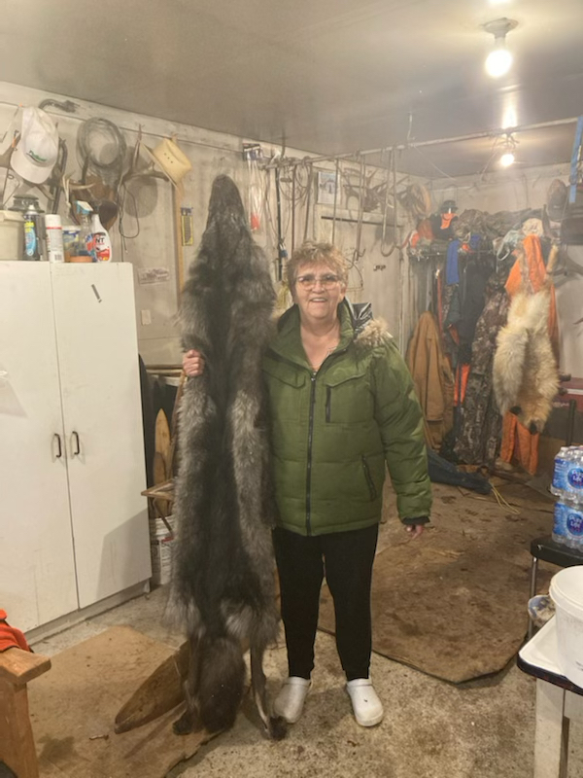
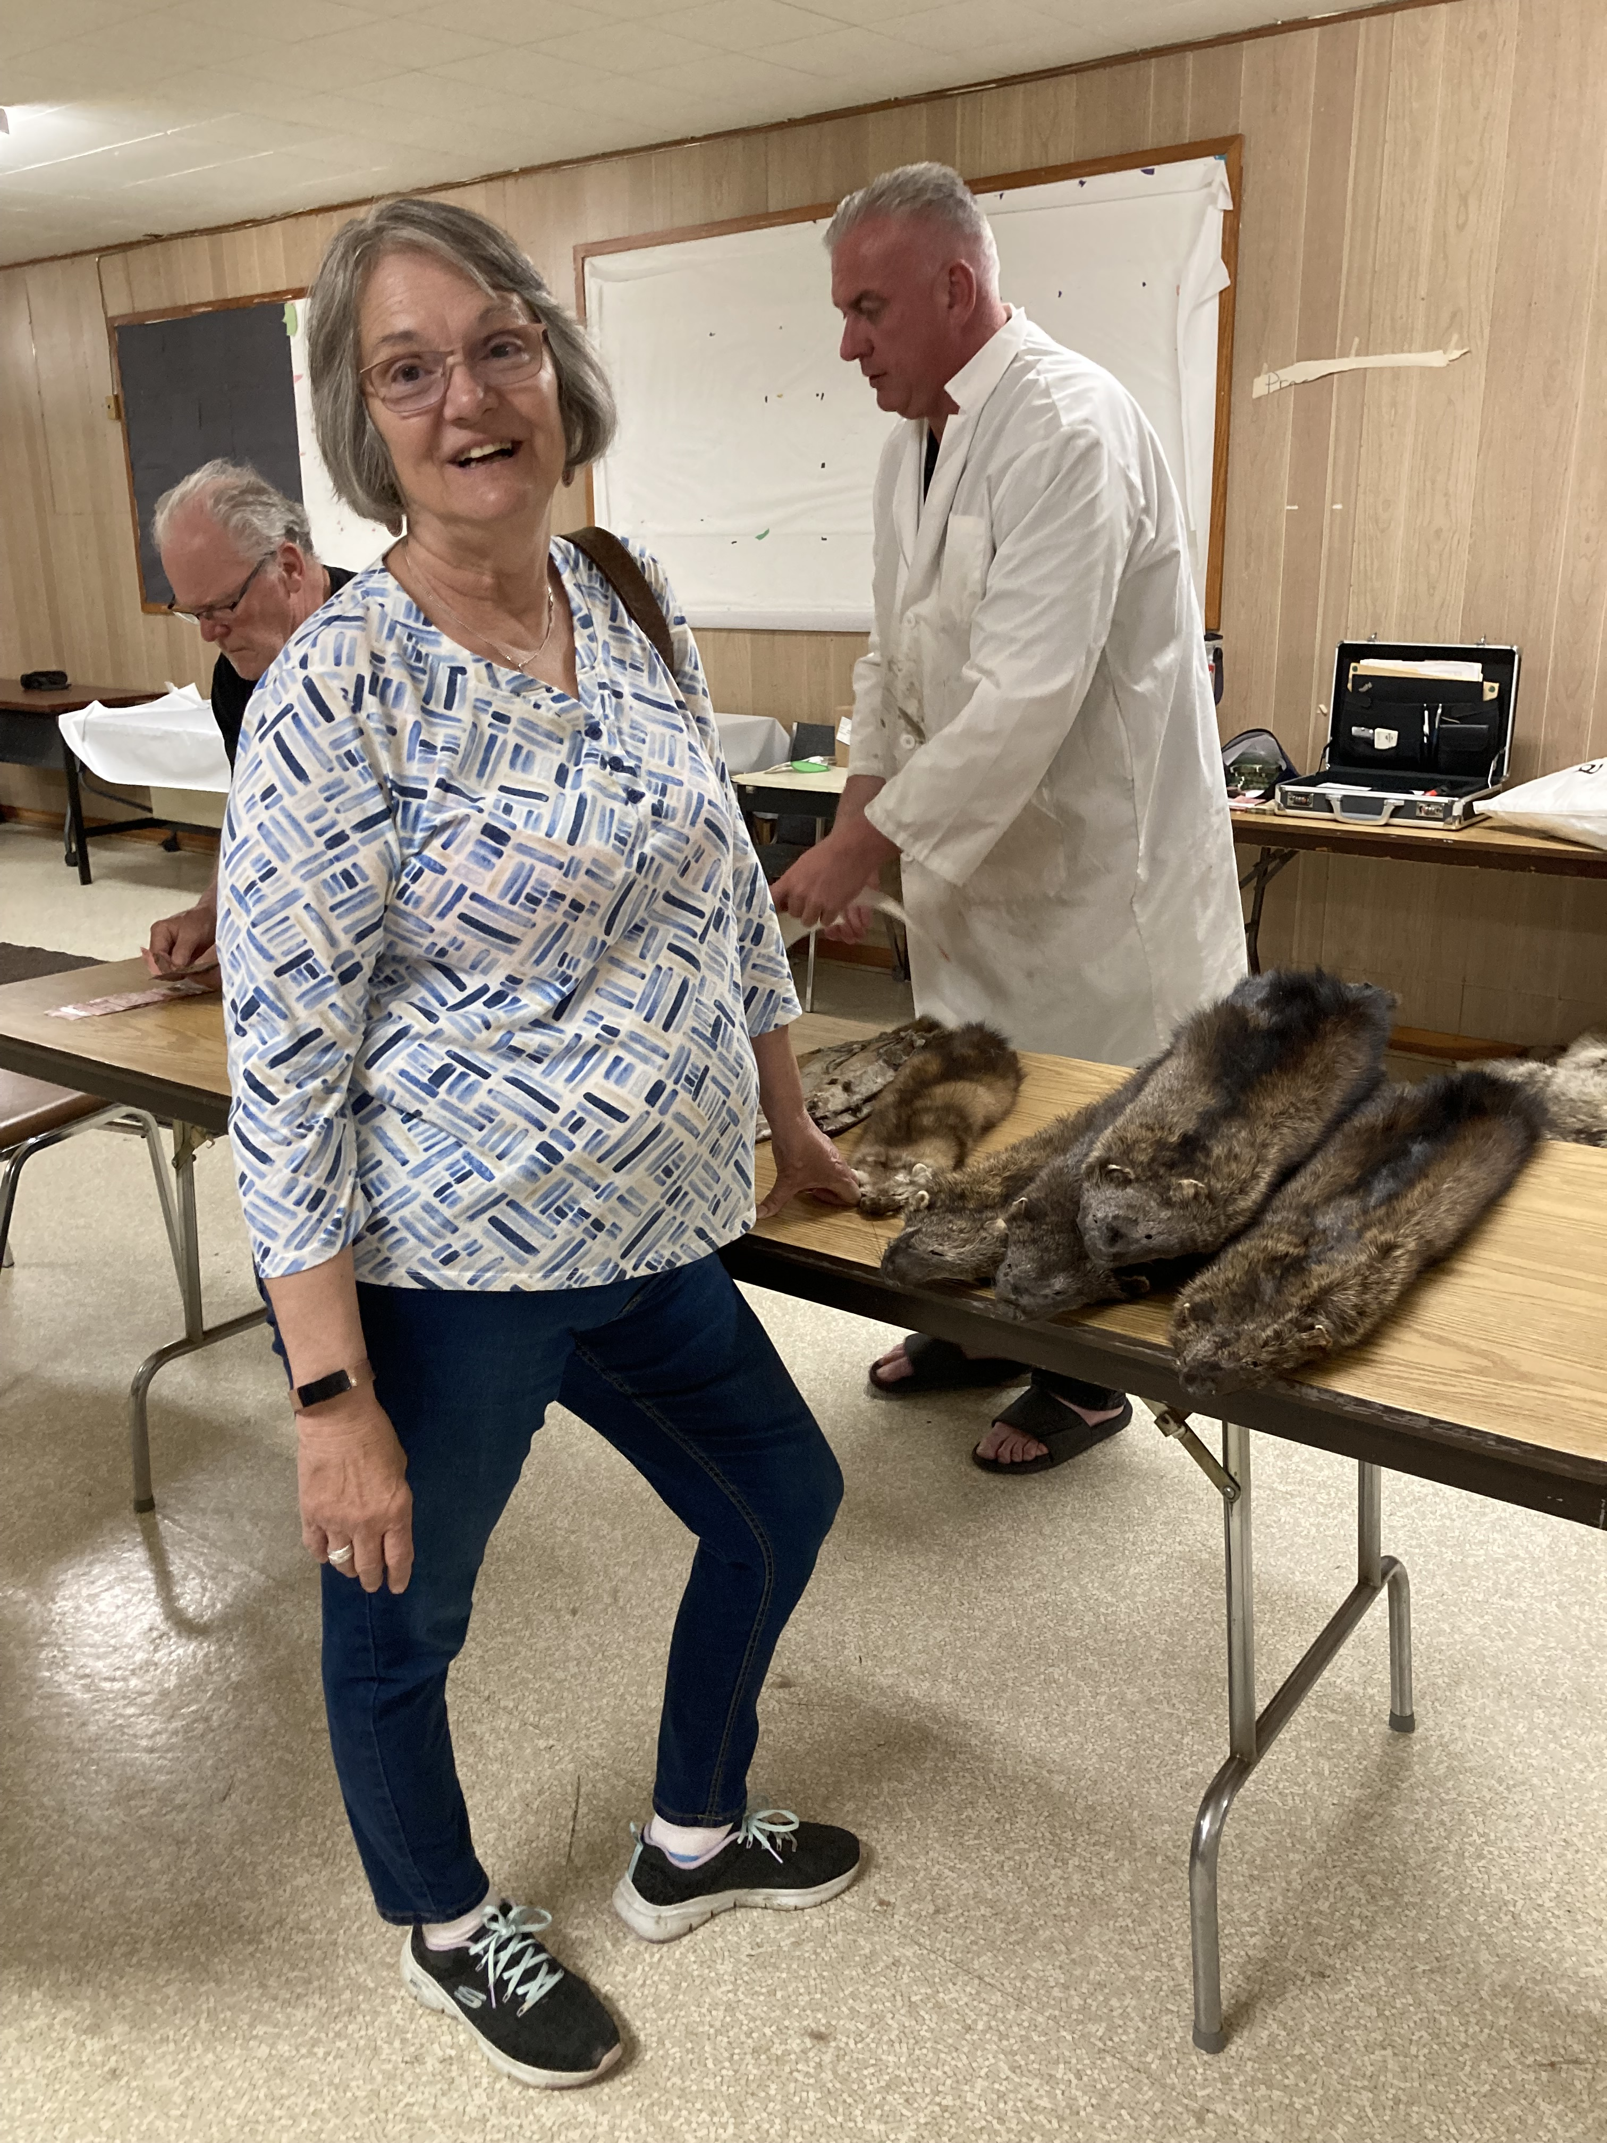
Proudly Standing with Our Métis Trappers

Slide 8
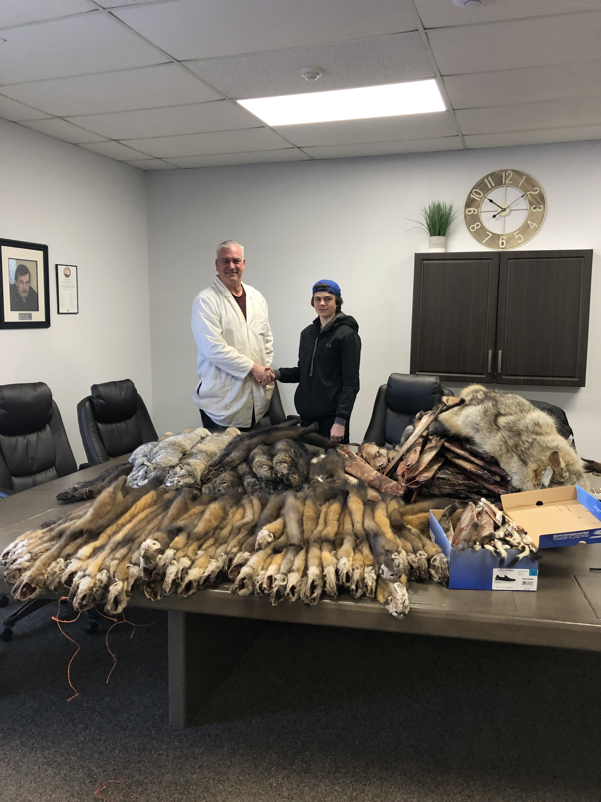
Proudly Standing with Our Métis Trappers

Slide 9
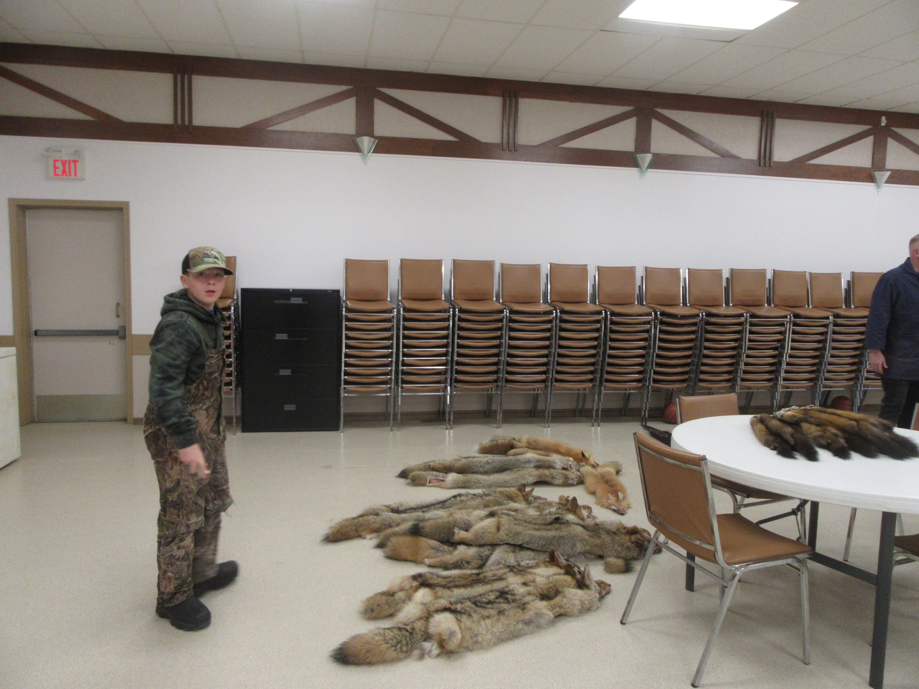
Proudly Standing with Our Métis Trappers

Slide 10
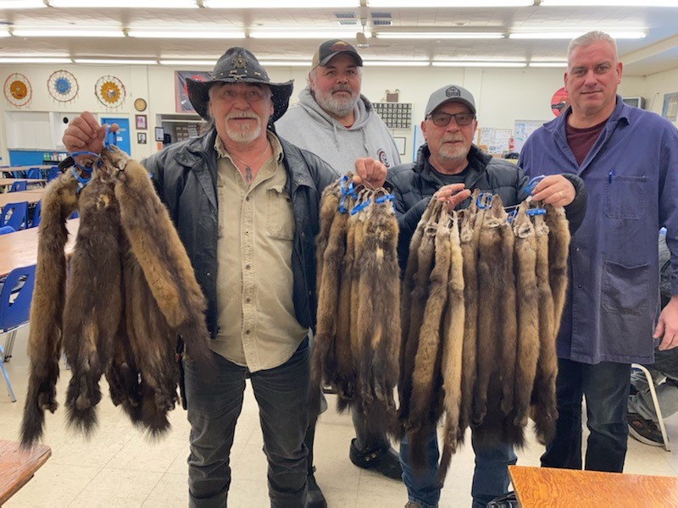
Proudly Standing with Our Métis Trappers

Slide 11
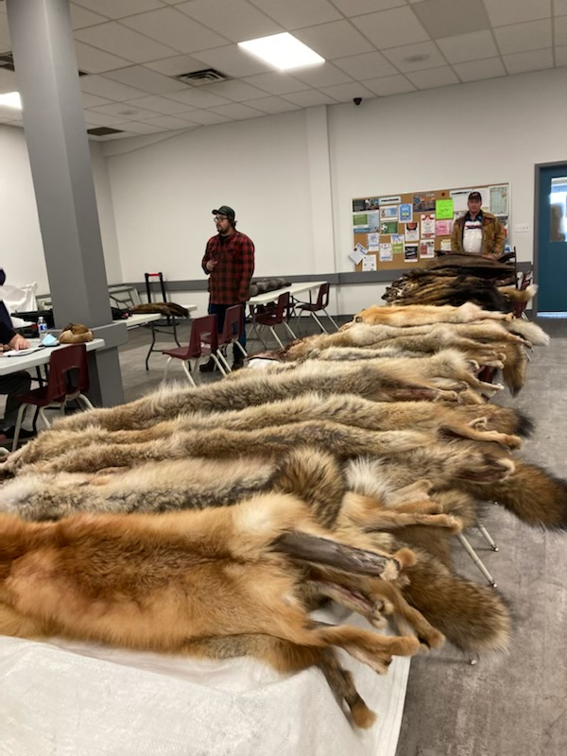
Proudly Standing with Our Métis Trappers

