Slide 1

Traditional Economies
Minister Darrel Ferland

Slide 2
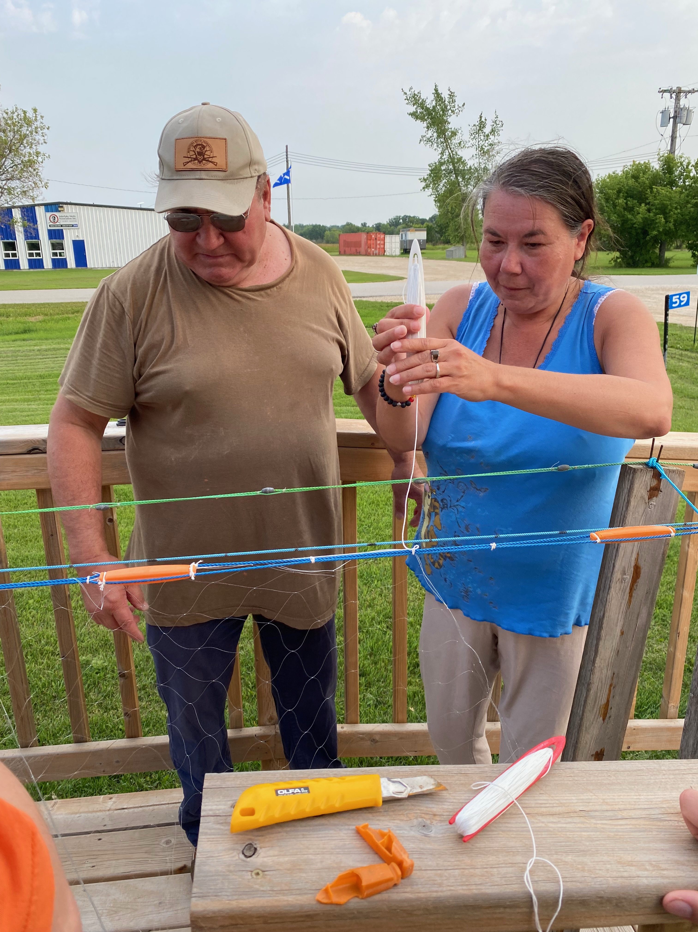
Fisheries
Commercial Fisher Net Program
Fisheries Act Authorization Consultations with Fisheries and Oceans Canada

Slide 3
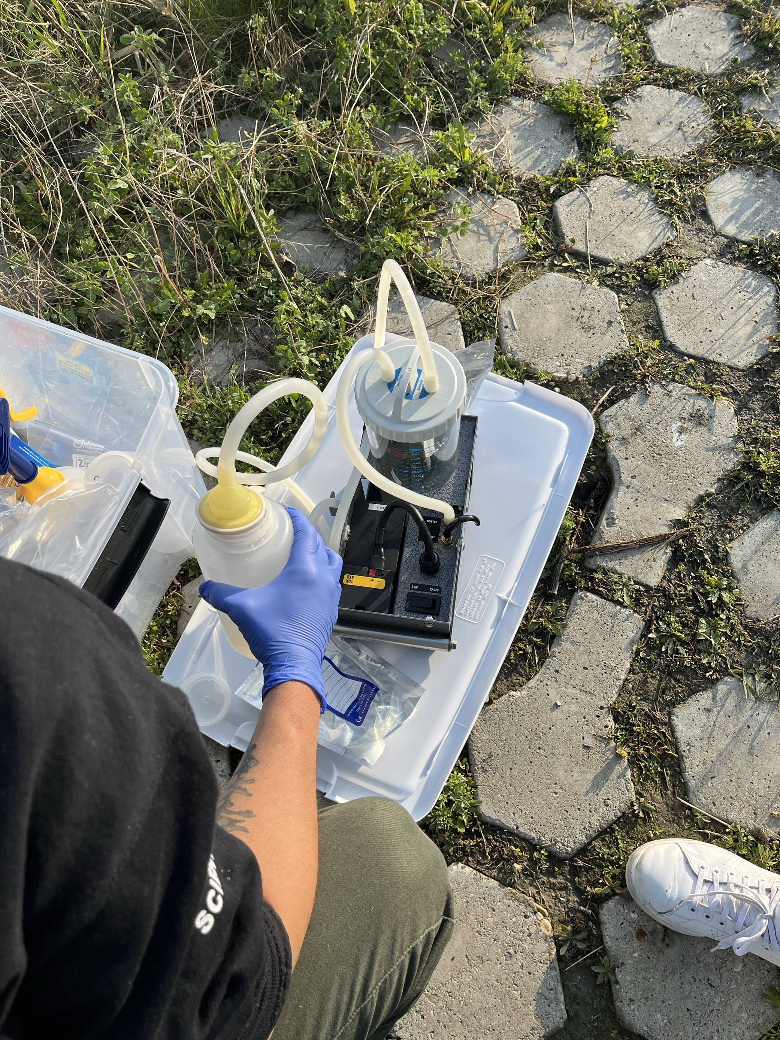
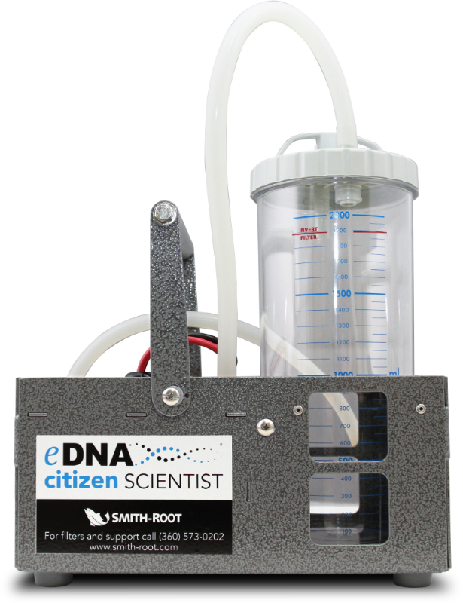
Mapleleaf Mussel eDNA Sampling
Water samples used to determine the distribution of Mapleleaf Mussels throughout the province

Slide 4
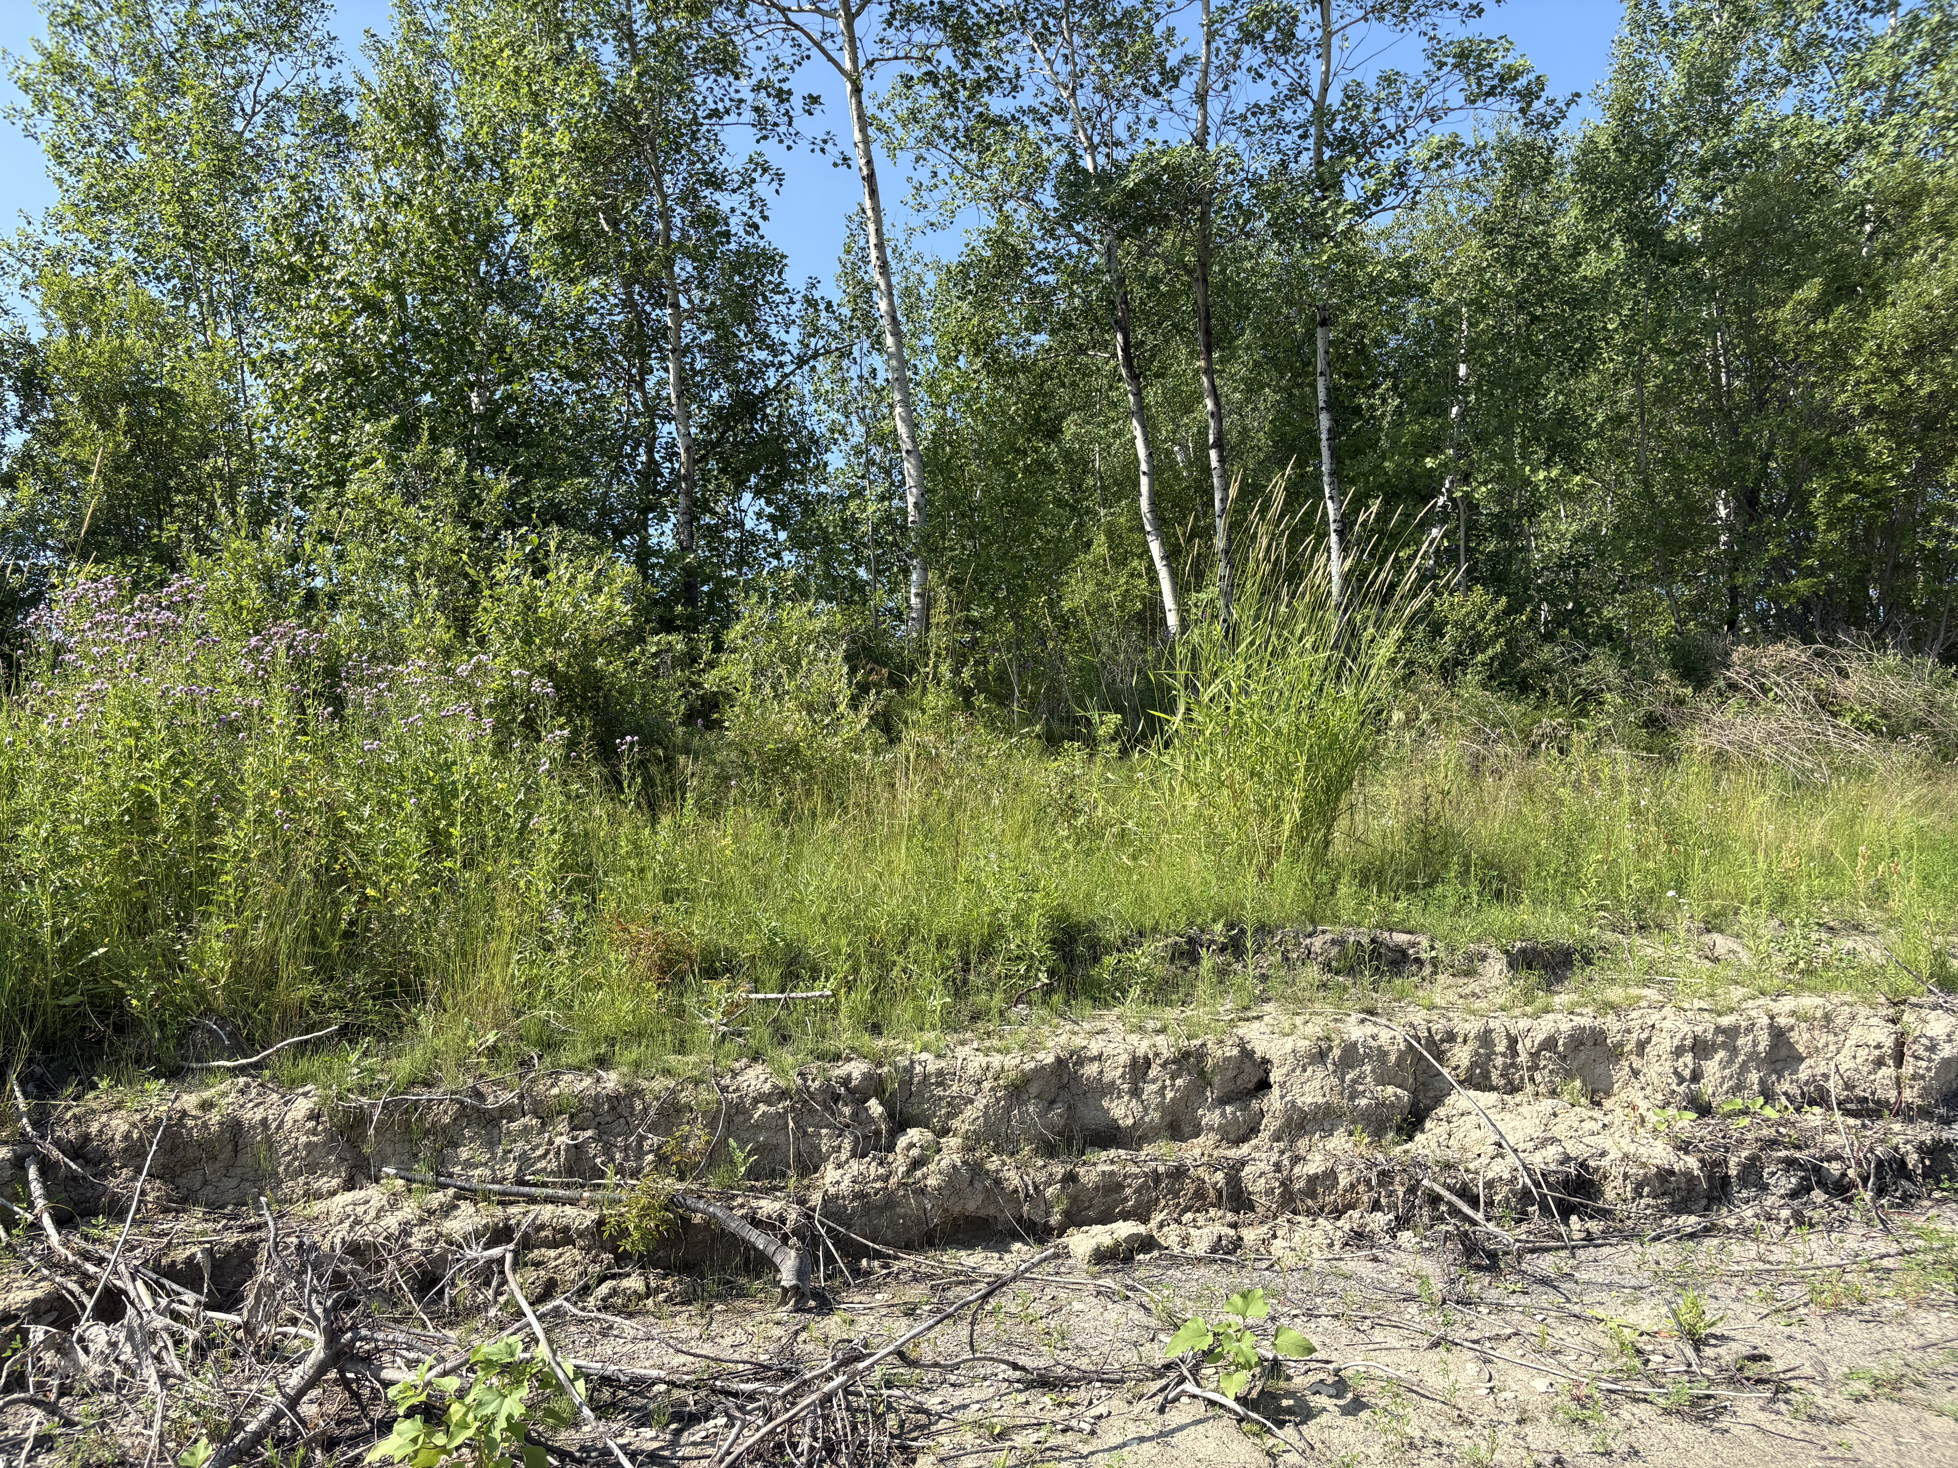
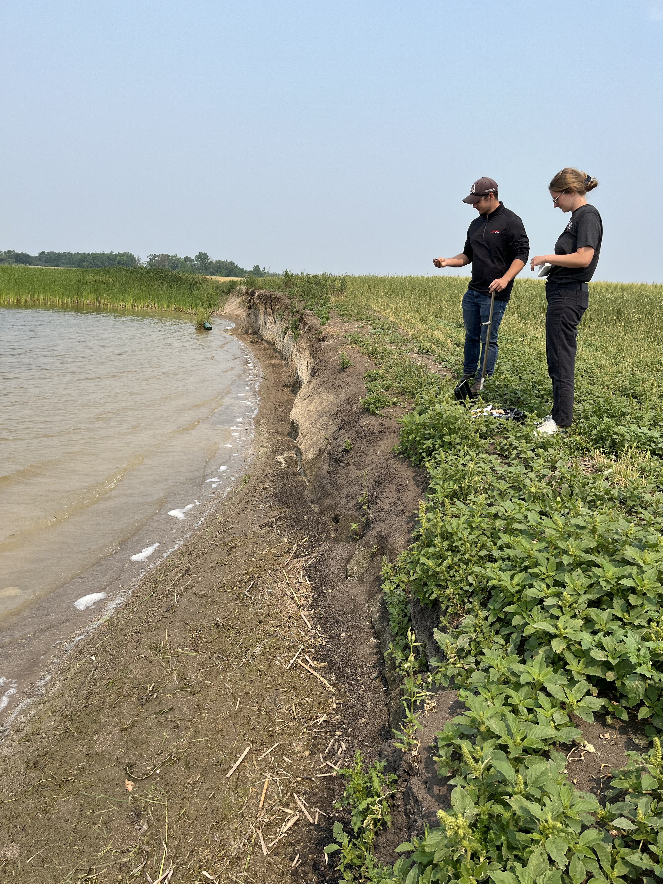
Lake Winnipeg Basin Riparian Restoration
Riparian restoration on Red River Métis Citizen’s properties which are experiencing erosion

Slide 5
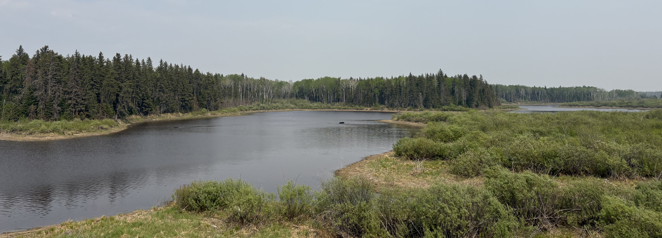
Restoration Priorities
Consultation with Fisheries and Oceans Canada to determine aquatic areas which would benefit from targeted restoration efforts
Meetings took place in Winnipeg, Thompson, and Brandon

Slide 6
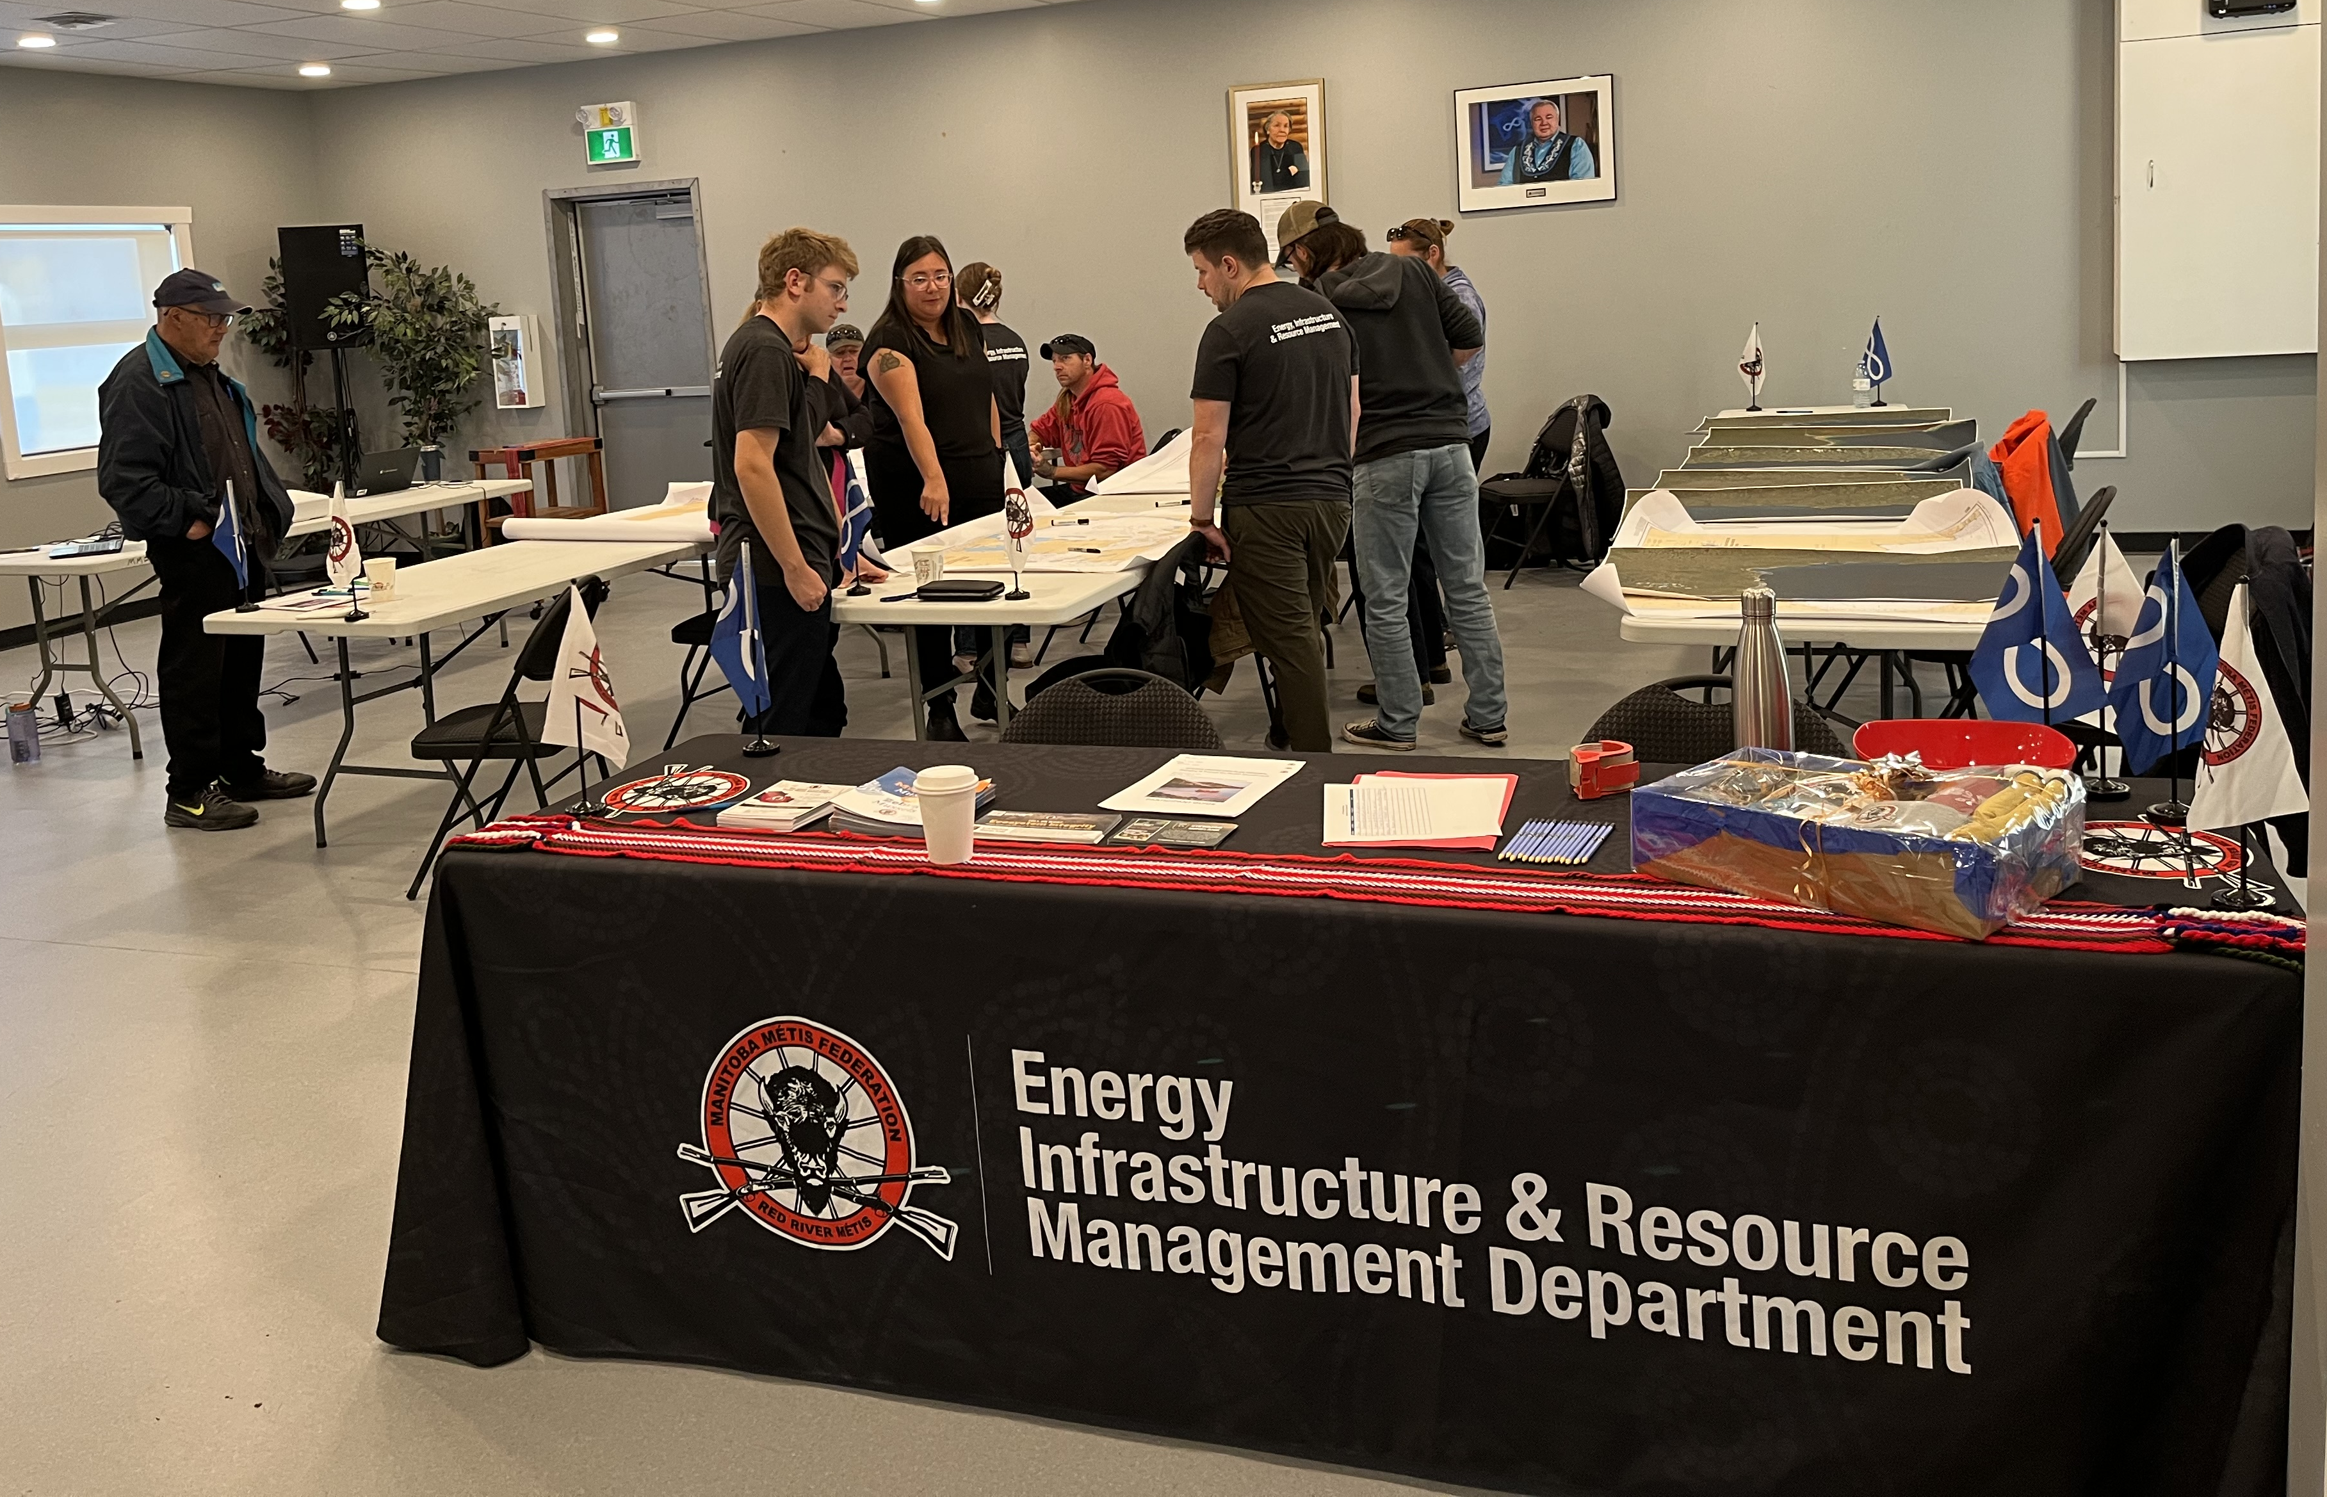
Ocean Protection Plan
MMF continues to work with the Canadian Coast Guard on various initiatives within the Ocean Protection Plan
2025 focus is marine emergency response preparedness in the Arctic

Slide 7
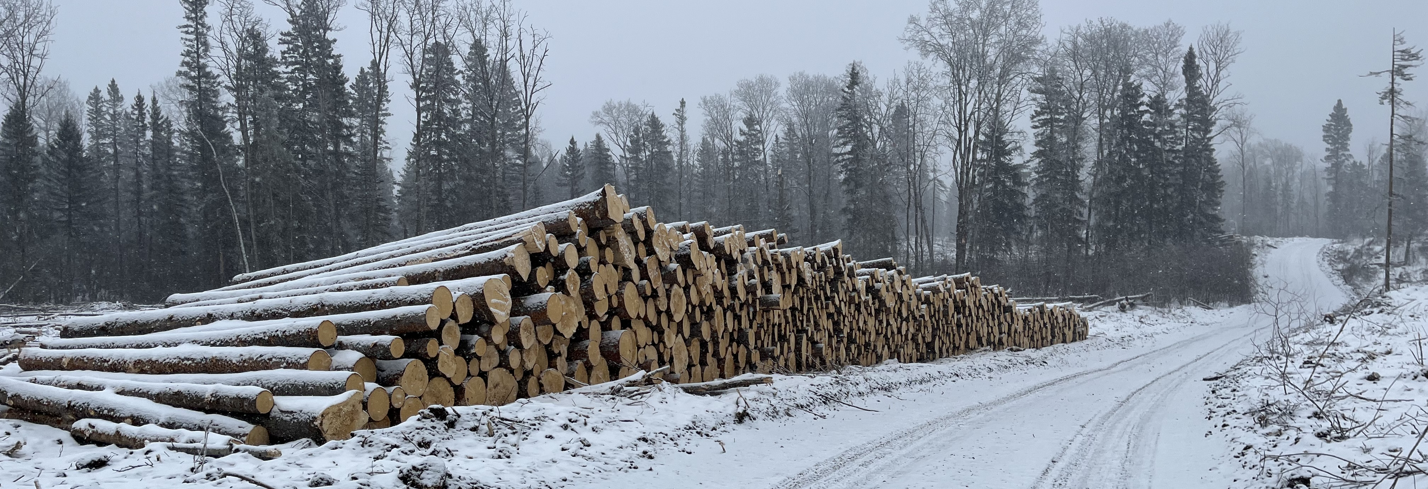
Forestry and Peatlands
Nisokapawino Forestry Management Corporation’s 20-Year Operating Plan
Louisiana Pacific’s 2024-2026 Forest Management Plan

Slide 8

Thank you!
If you have any questions regarding the Traditional Economies Portfolio, please contact:

