Slide 1

Culture and Heritage
Minister Alfred Anderson

Slide 2
Culture and Heritage Department Mandate
Develop initiatives to promote pride and understanding of Red River Métis experiences and culture;
Work with the Minister of Economic Development and Minister of Traditional Economies to develop a strategy which will support the growth of our artisans and crafters;
Work with grassroots partners to attend events that will help grow the understanding of Red River Métis history and culture within the broader Canadian community;
Work closely with the Ministries of French and Michif Languages as well as Provincial Education to develop MMF-led Michif programming; and
Work closely with the Policy and Delivery Unit to develop the Red River Métis National Heritage Centre.

Slide 3
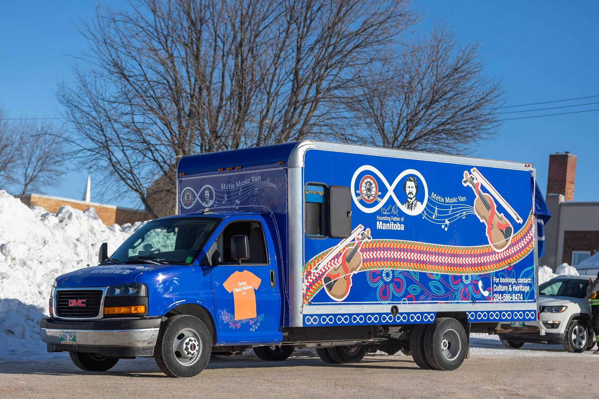
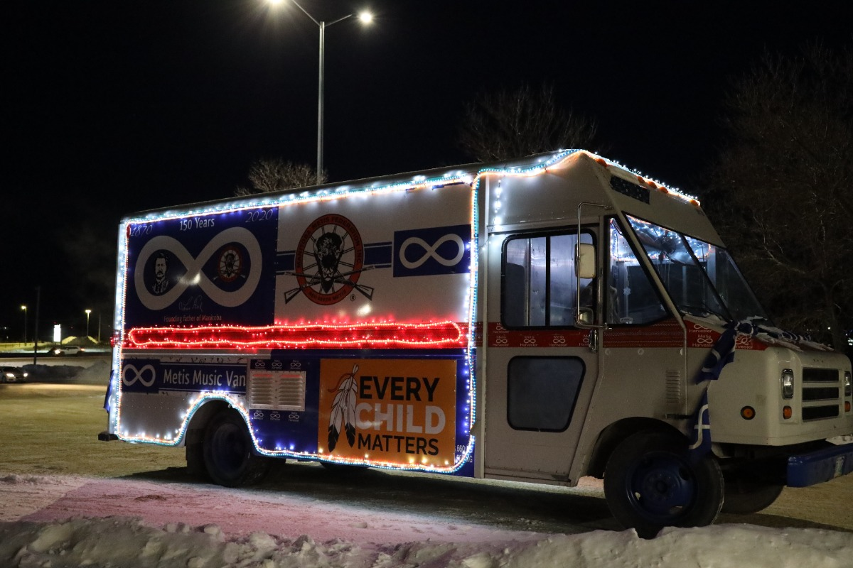
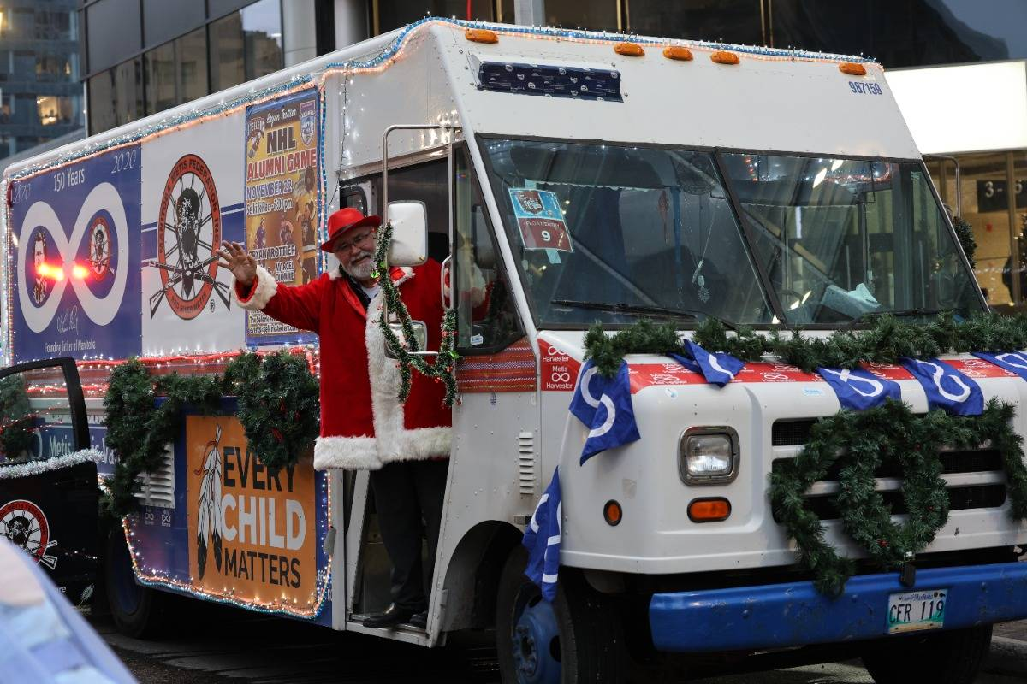
Programming – Metis Music Van

Slide 4
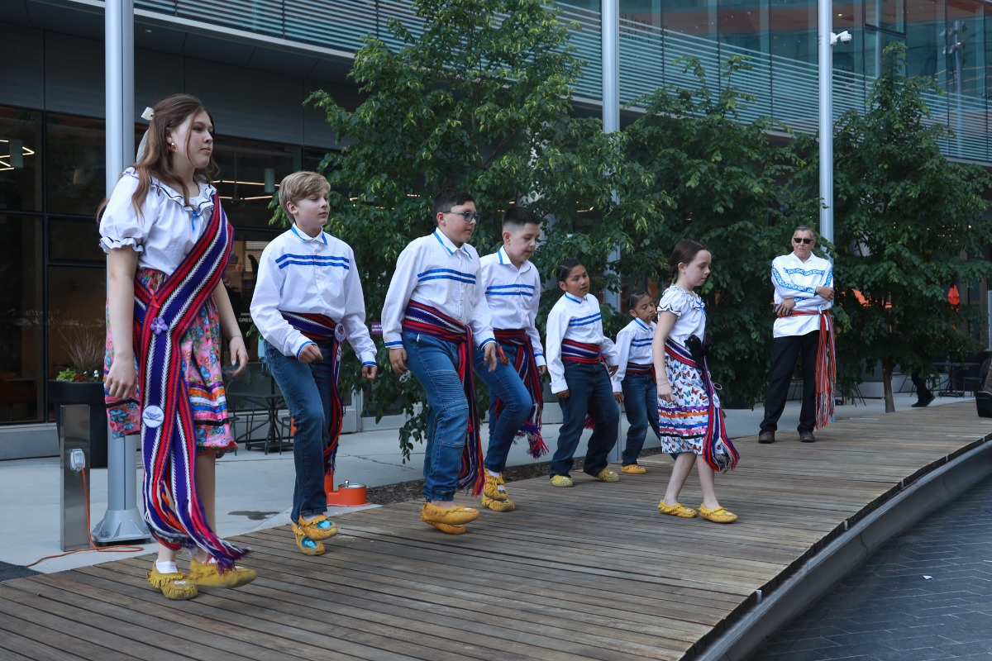


Events – National Indigenous Peoples Day

Slide 5
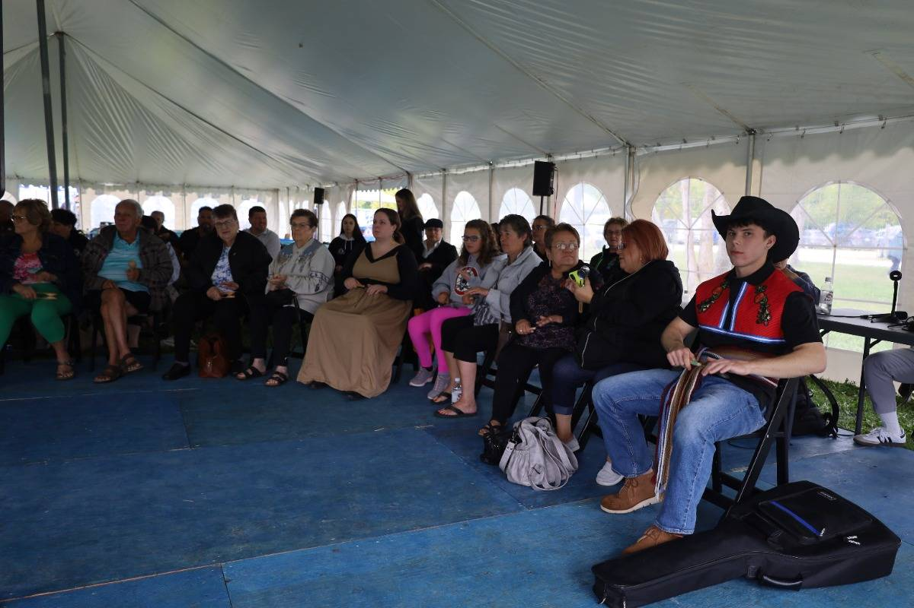
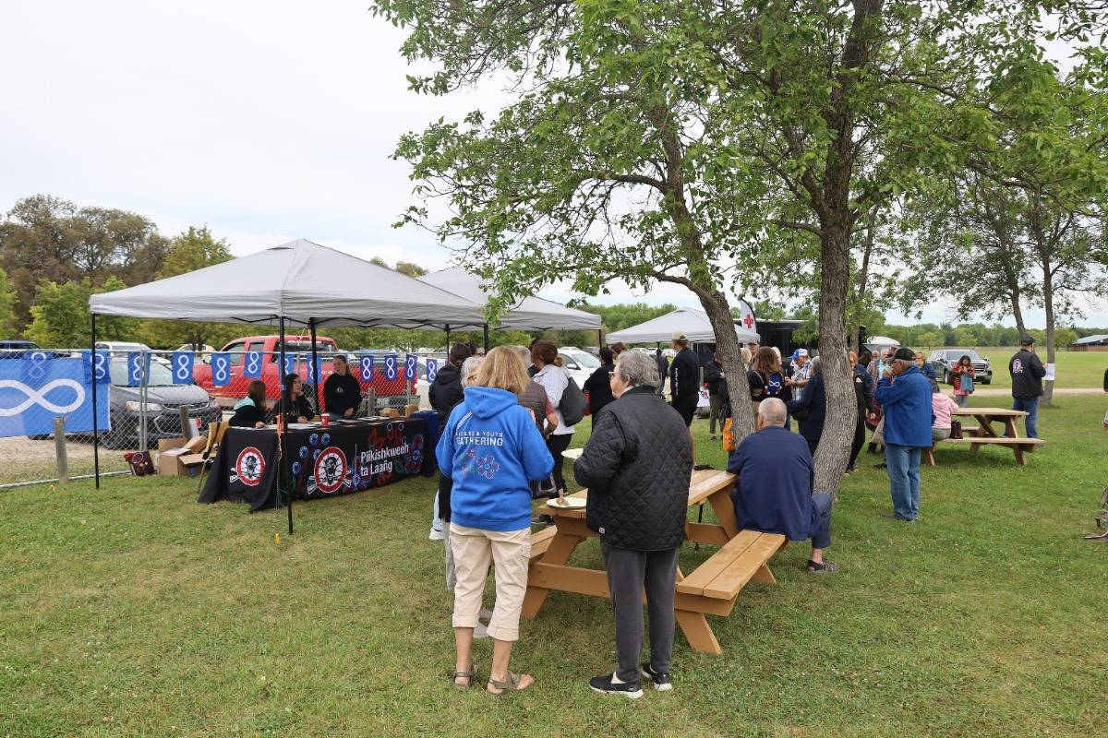
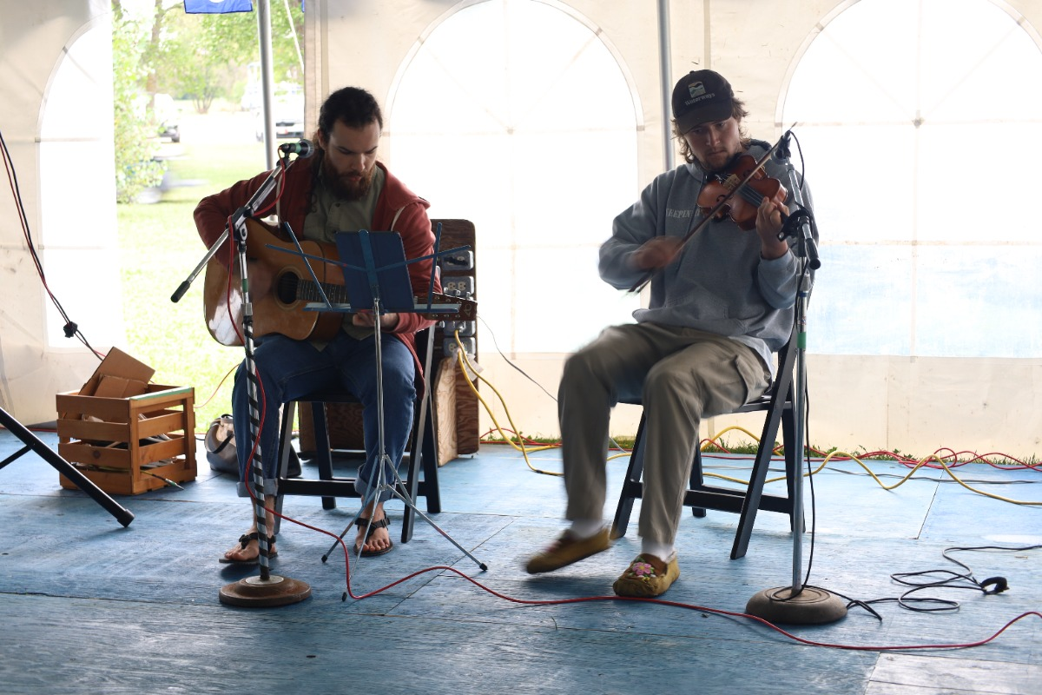
Elders & Youth Gathering

Slide 6
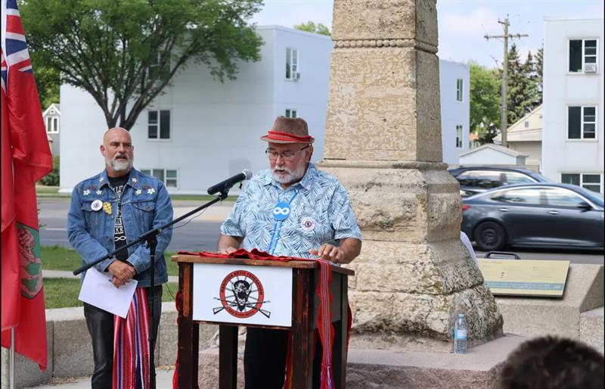
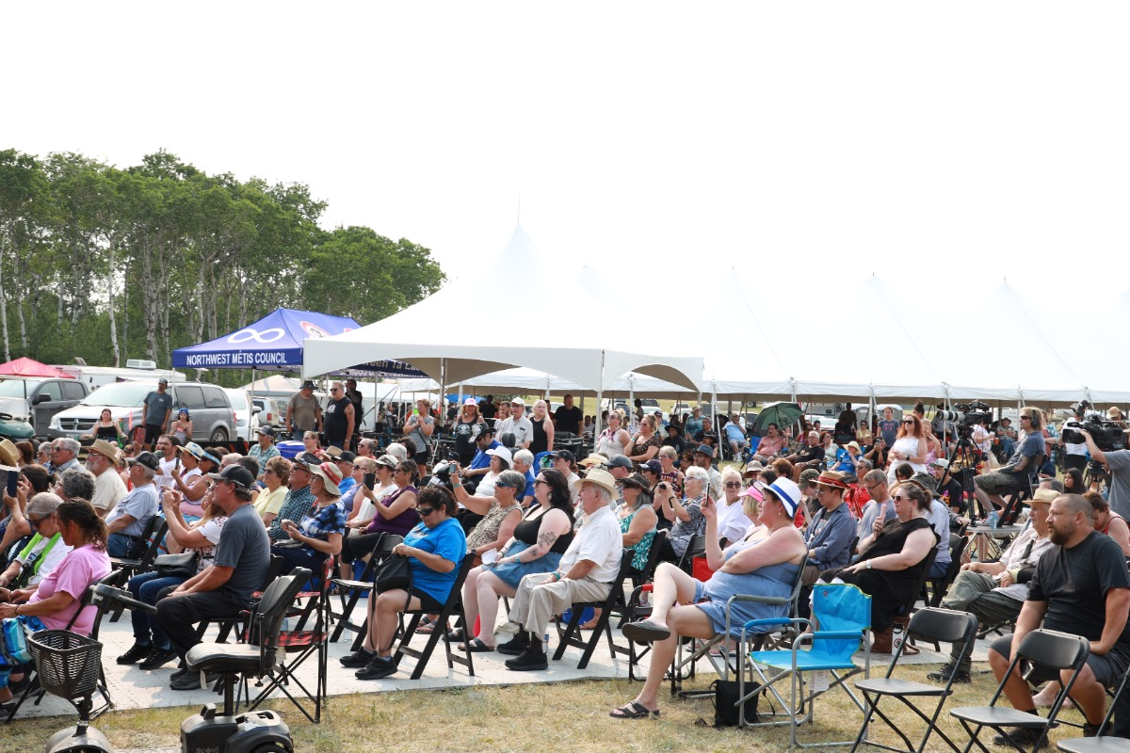
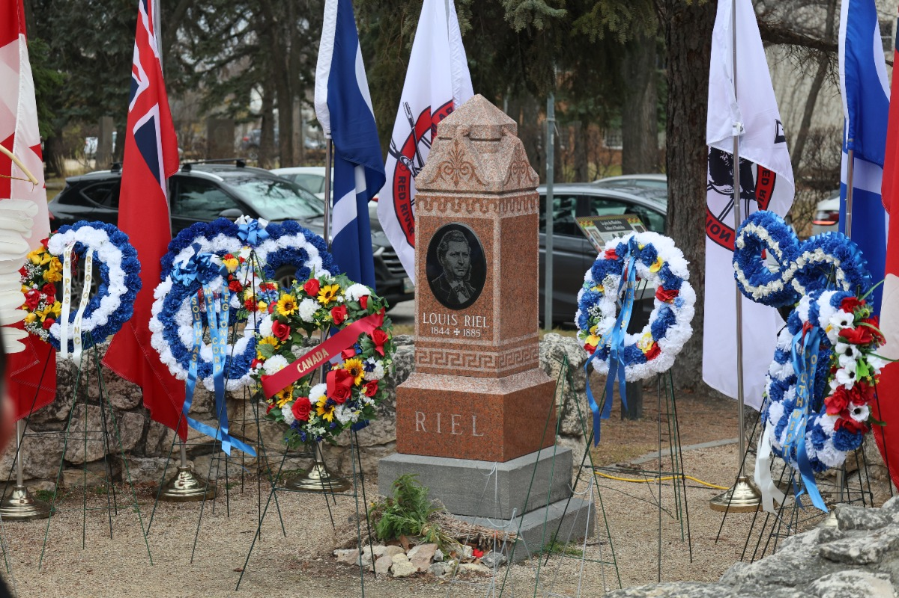
Commemorative Events

Slide 7
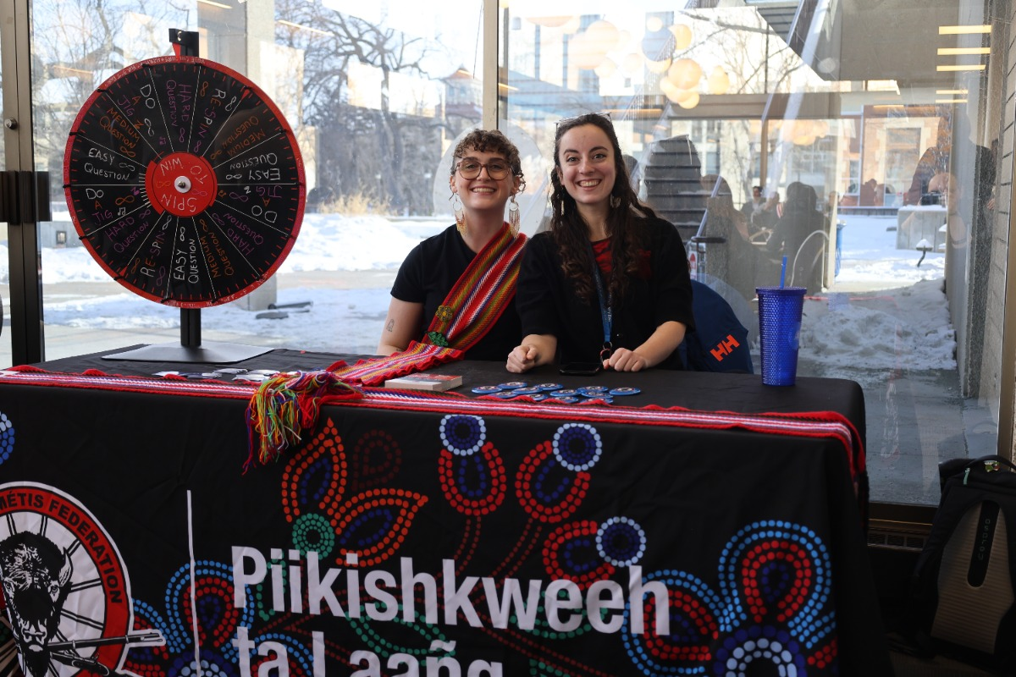


Events Cont.

Slide 8
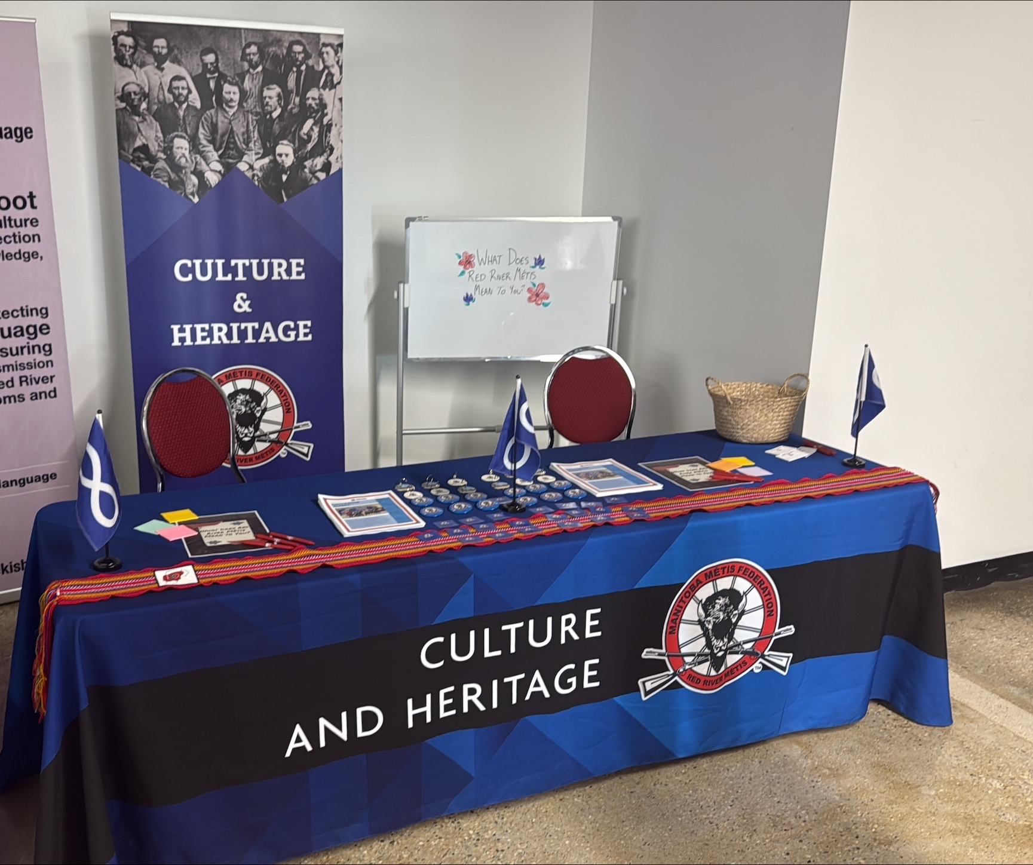
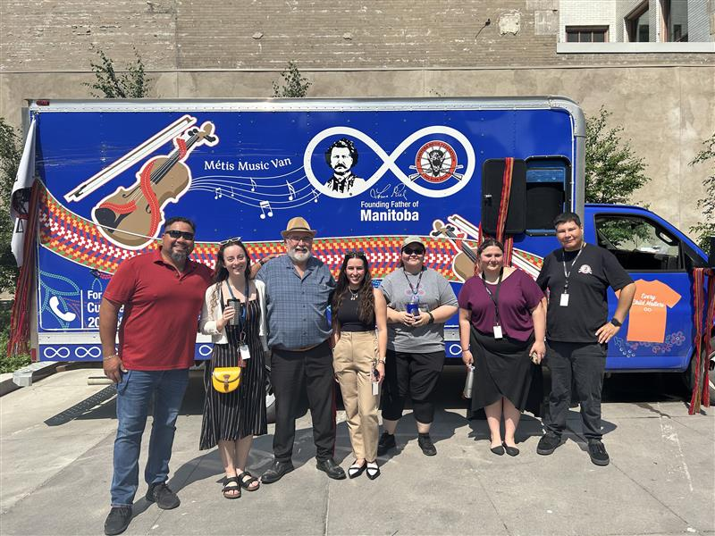
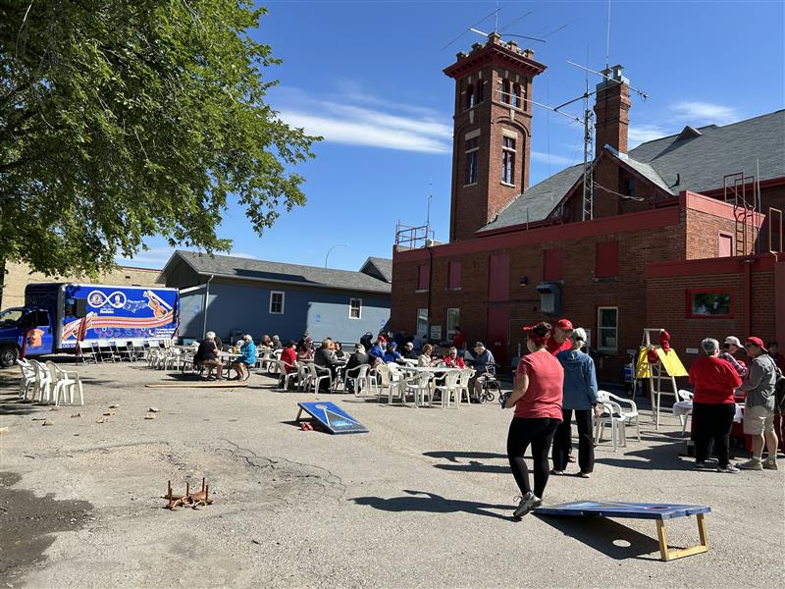
Looking Ahead

Slide 9
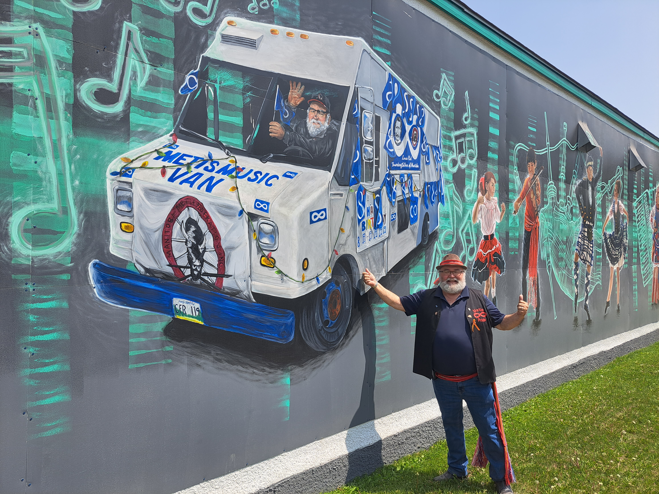
Thank you!

