Slide 1

Education
Minister Remillard

Slide 2
MMF Annual Report 2025
MMF Education Department (PSESP)
Louis Riel Institute (LRI) and Louis Riel College (LRC)
Notes:
Taanishi. Good [morning/afternoon], President Chartrand, fellow Cabinet members, Elders, youth, and Citizens of the Red River Métis Nation
.
It is an honour to stand before you today at our Annual General Assembly, surrounded by the strength, resilience, and unity of our Nation. I want to begin by acknowledging the leadership and vision of President Chartrand and the trust that has been placed in me to serve our people.
My name is JoAnne Remillard, and I have had the privilege of serving as the MMF Minister of Environment and Climate Change for three and half years. This year, I am humbled to take on a new role—as the MMF Minister of Provincial Education. In this new portfolio, I am proud to support our Nation’s path forward in education, including oversight of the Louis Riel Institute, Louis Riel College, and our Post-Secondary Education Support Programs.

Slide 3


Slide 4
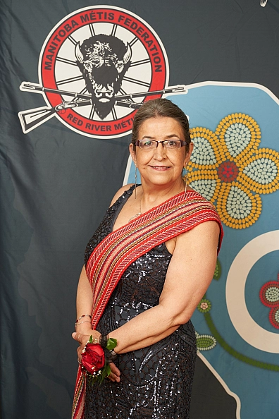
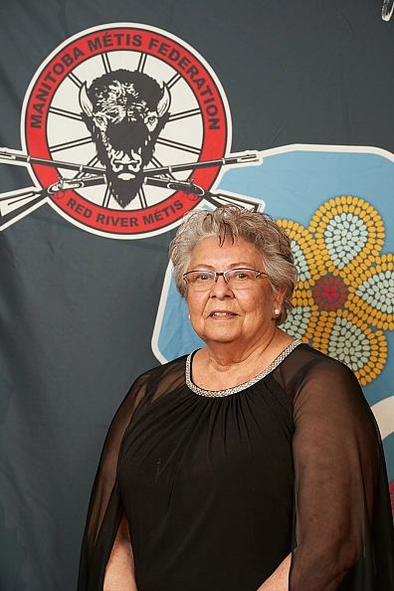
Education Ministers
JoAnne Remillard
Minister of Provincial
Education
Joan Ledoux
Associate Minister of Provincial
Education

Slide 5
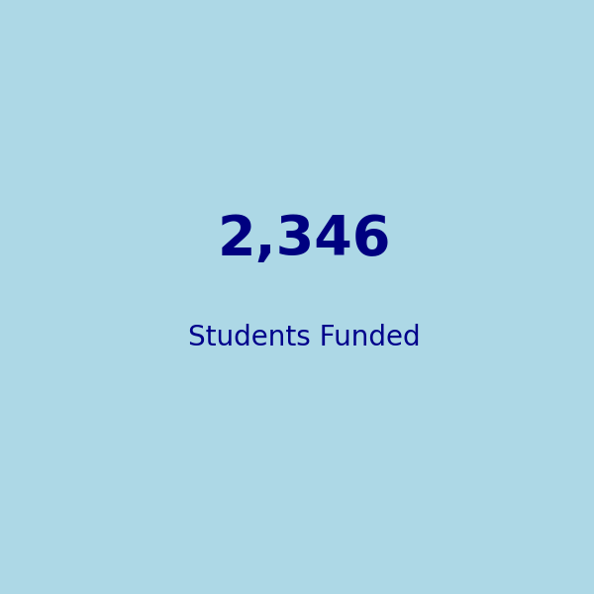

Post-Secondary Education Support Program (PSESP)
Student Funding (2024-25)
• Largest intake since launch in 2019

Slide 6
PSESP Student Funding by Region (2024-25)
Region | Total PSESP Funding Disbursed | Number of Students
Interlake Region | $1,114,743.54 | 279
Northwest Region | $402,100.00 | 97
Southeast Region | $1,172,200.00 | 286
Southwest Region | $919,150.00 | 233
The Pas Region | $142,150.00 | 35
Thompson Region | $67,750.00 | 17
Winnipeg Region | $4,908,750.00 | 1208
MET Final Year (various regions) | $955,000.00 | 191
TOTAL | $9,681,843.54 | 2,346

Slide 7
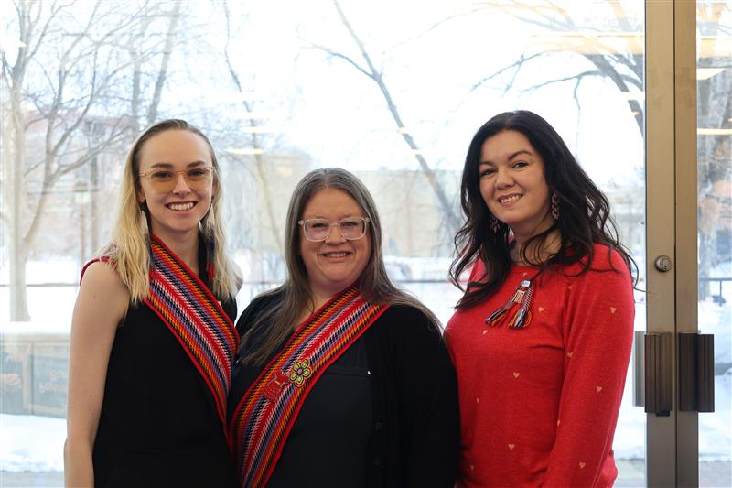
Red River Métis Inclusion Coordinators
Offer one-on-one student support on campus
Help Red River Métis students navigate resources within the MMF and their institutions
Plan and host cultural programming on campus
University of Manitoba
Jessica Burzuik – j.burzuik@mmf.mb.ca
University of Winnipeg
Candice Allard – candice.allard@mmf.mb.ca
Brandon University
Nicole Braun – nicole.braun@mmf.mb.ca

Slide 8


Slide 9

Louis Riel Institute
Our Programs:
Traditional Art Workshops
Tours and Presentations
Riel House National Historic Site
Archives & Special Collections
Red River Métis Languages
Adult Learning Centre
Post-Secondary Bursaries & Awards

Slide 10
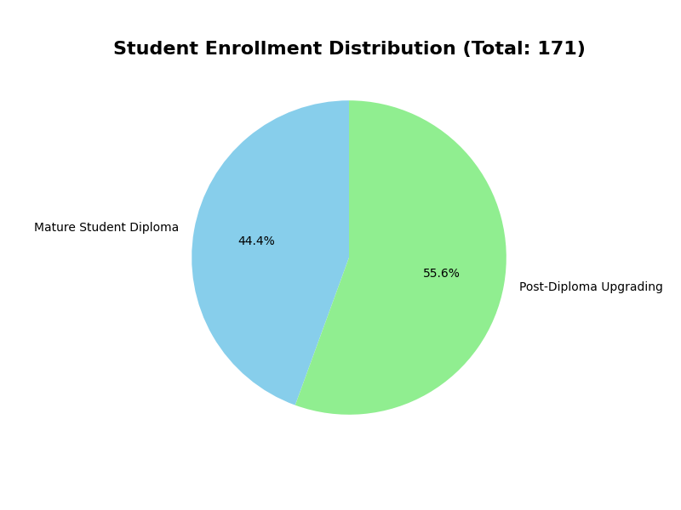


Adult Learning Centre (ALC) Enrollment 2024-25
• 171 total students enrolled
• 76 in Mature Student Diploma
• 95 in Post-Diploma Upgrading
Notes:
Adult Learning Centre (ALC)
Offers non-traditional high school education with unique Métis-focused courses.
Two streams: Mature Student Diploma & Post-Diploma Upgrading.
171 total students from April 1, 2024, to June 30, 2025:
76 Mature Student Diploma
95 Post-Diploma Upgrading
34 Red River Métis students
34 International students
26 graduates, 10 of whom were Red River Métis.

Slide 11
Cultural Programming
2359
Notes:
1,533 learners successfully completed the course in 2024-25
• Available online and customized for different audiences
• 822 participants engaged
• Activities included sash-making, jigging, and Métis art
• Delivered to schools, community orgs, and institutions

Slide 12
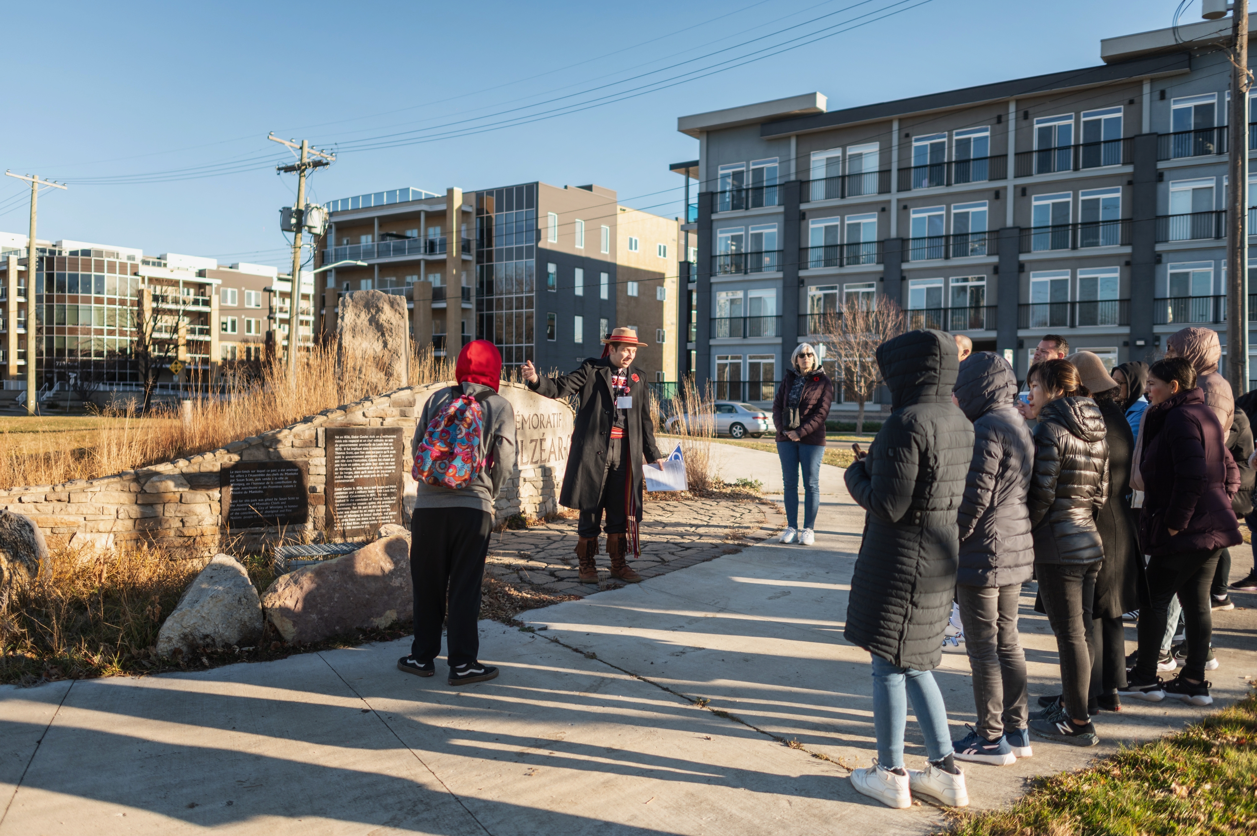
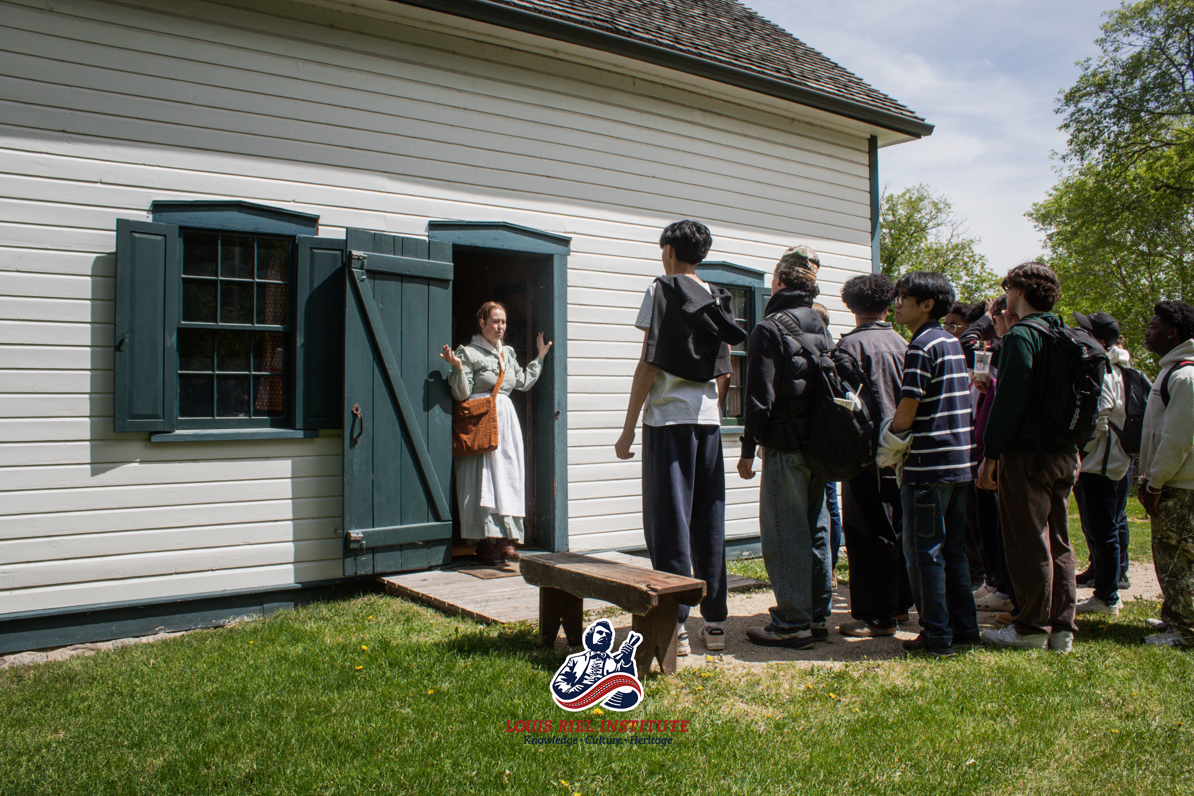
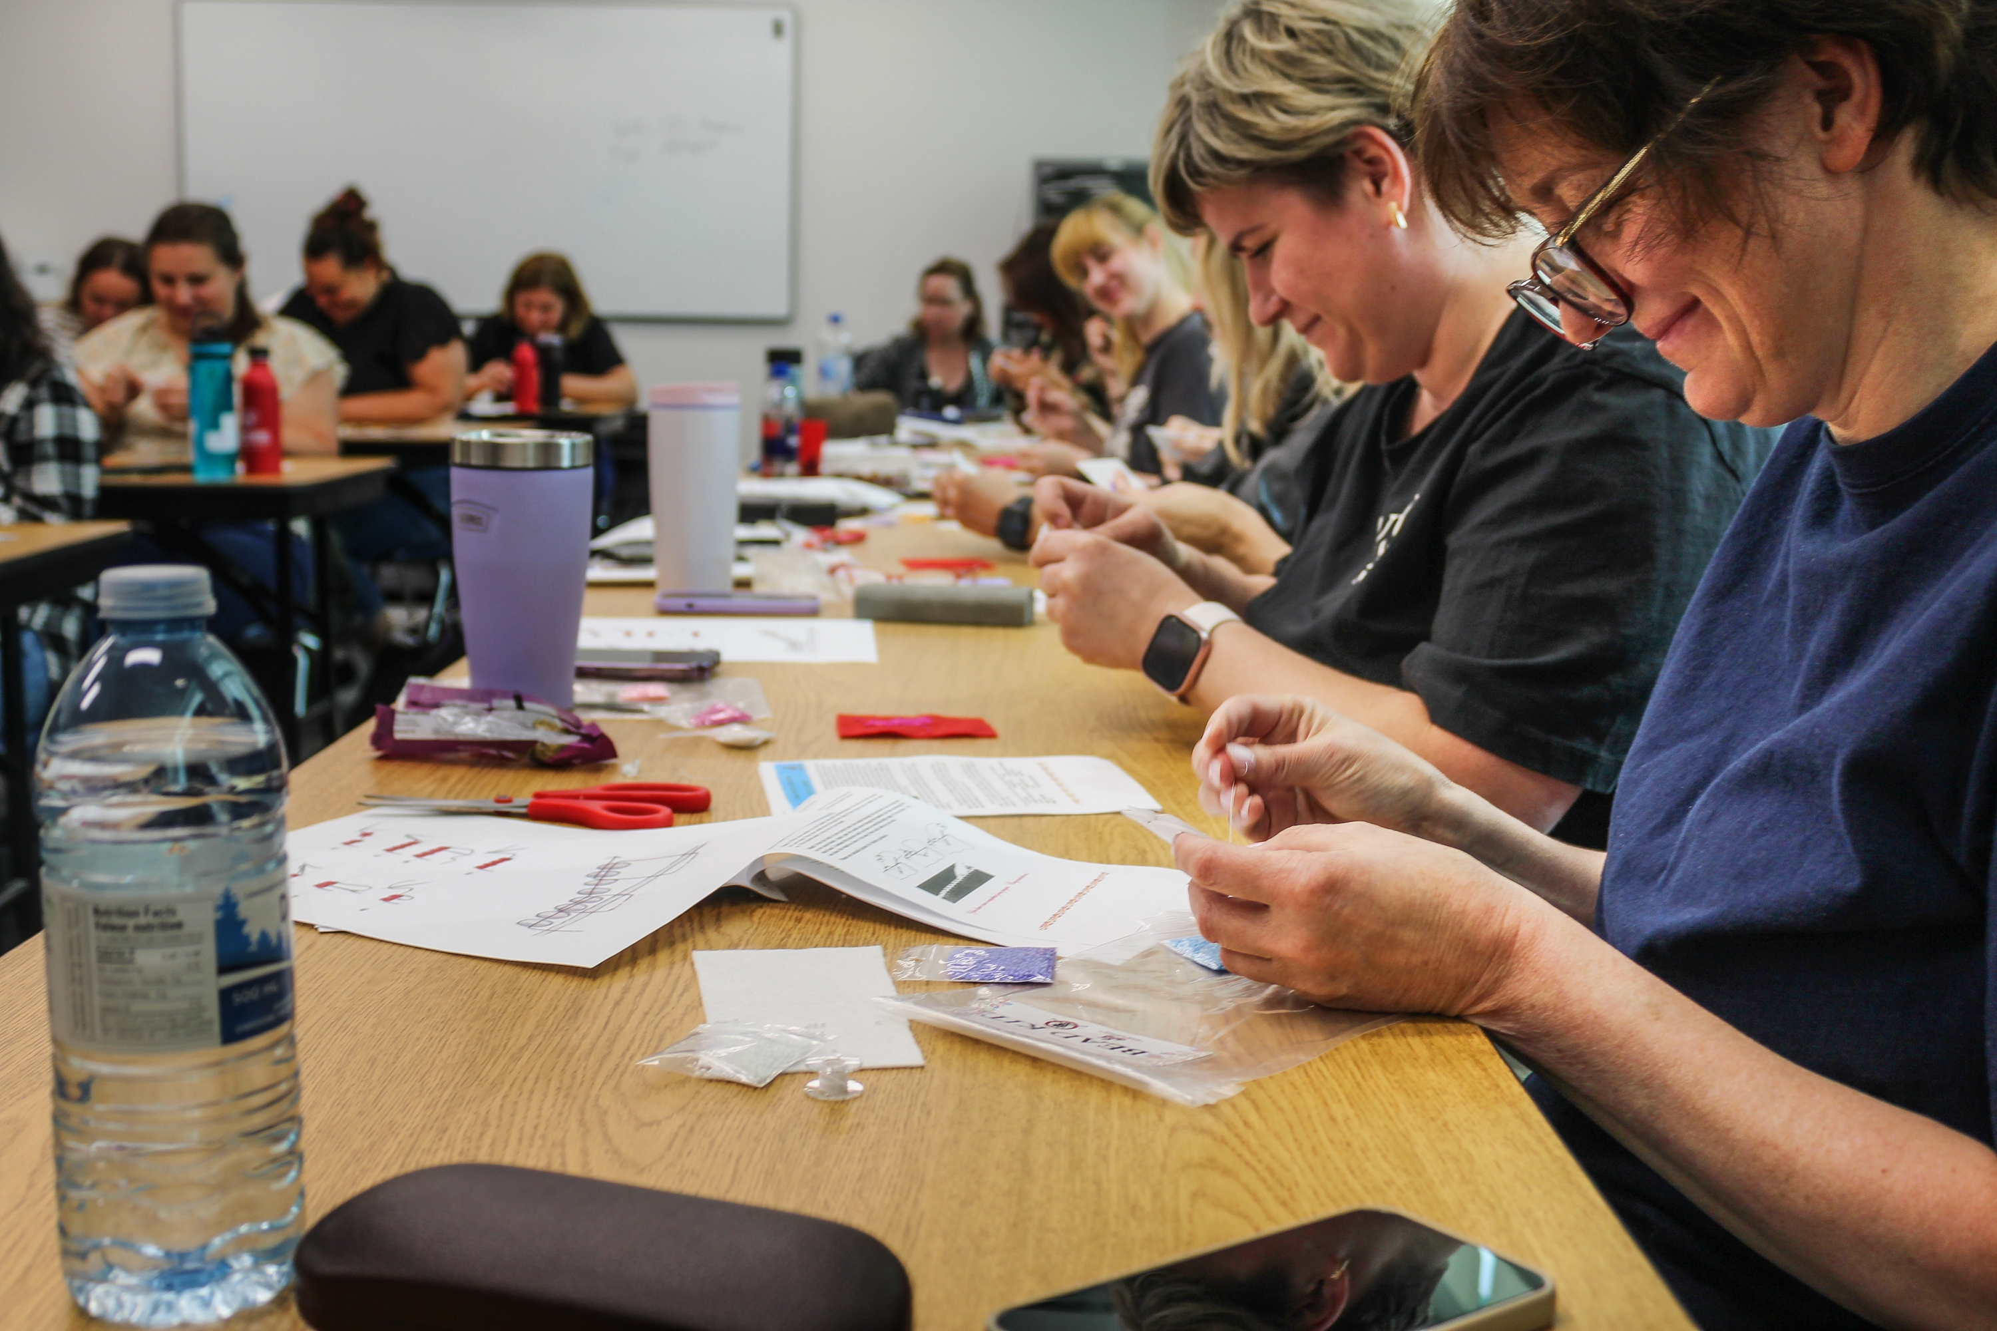
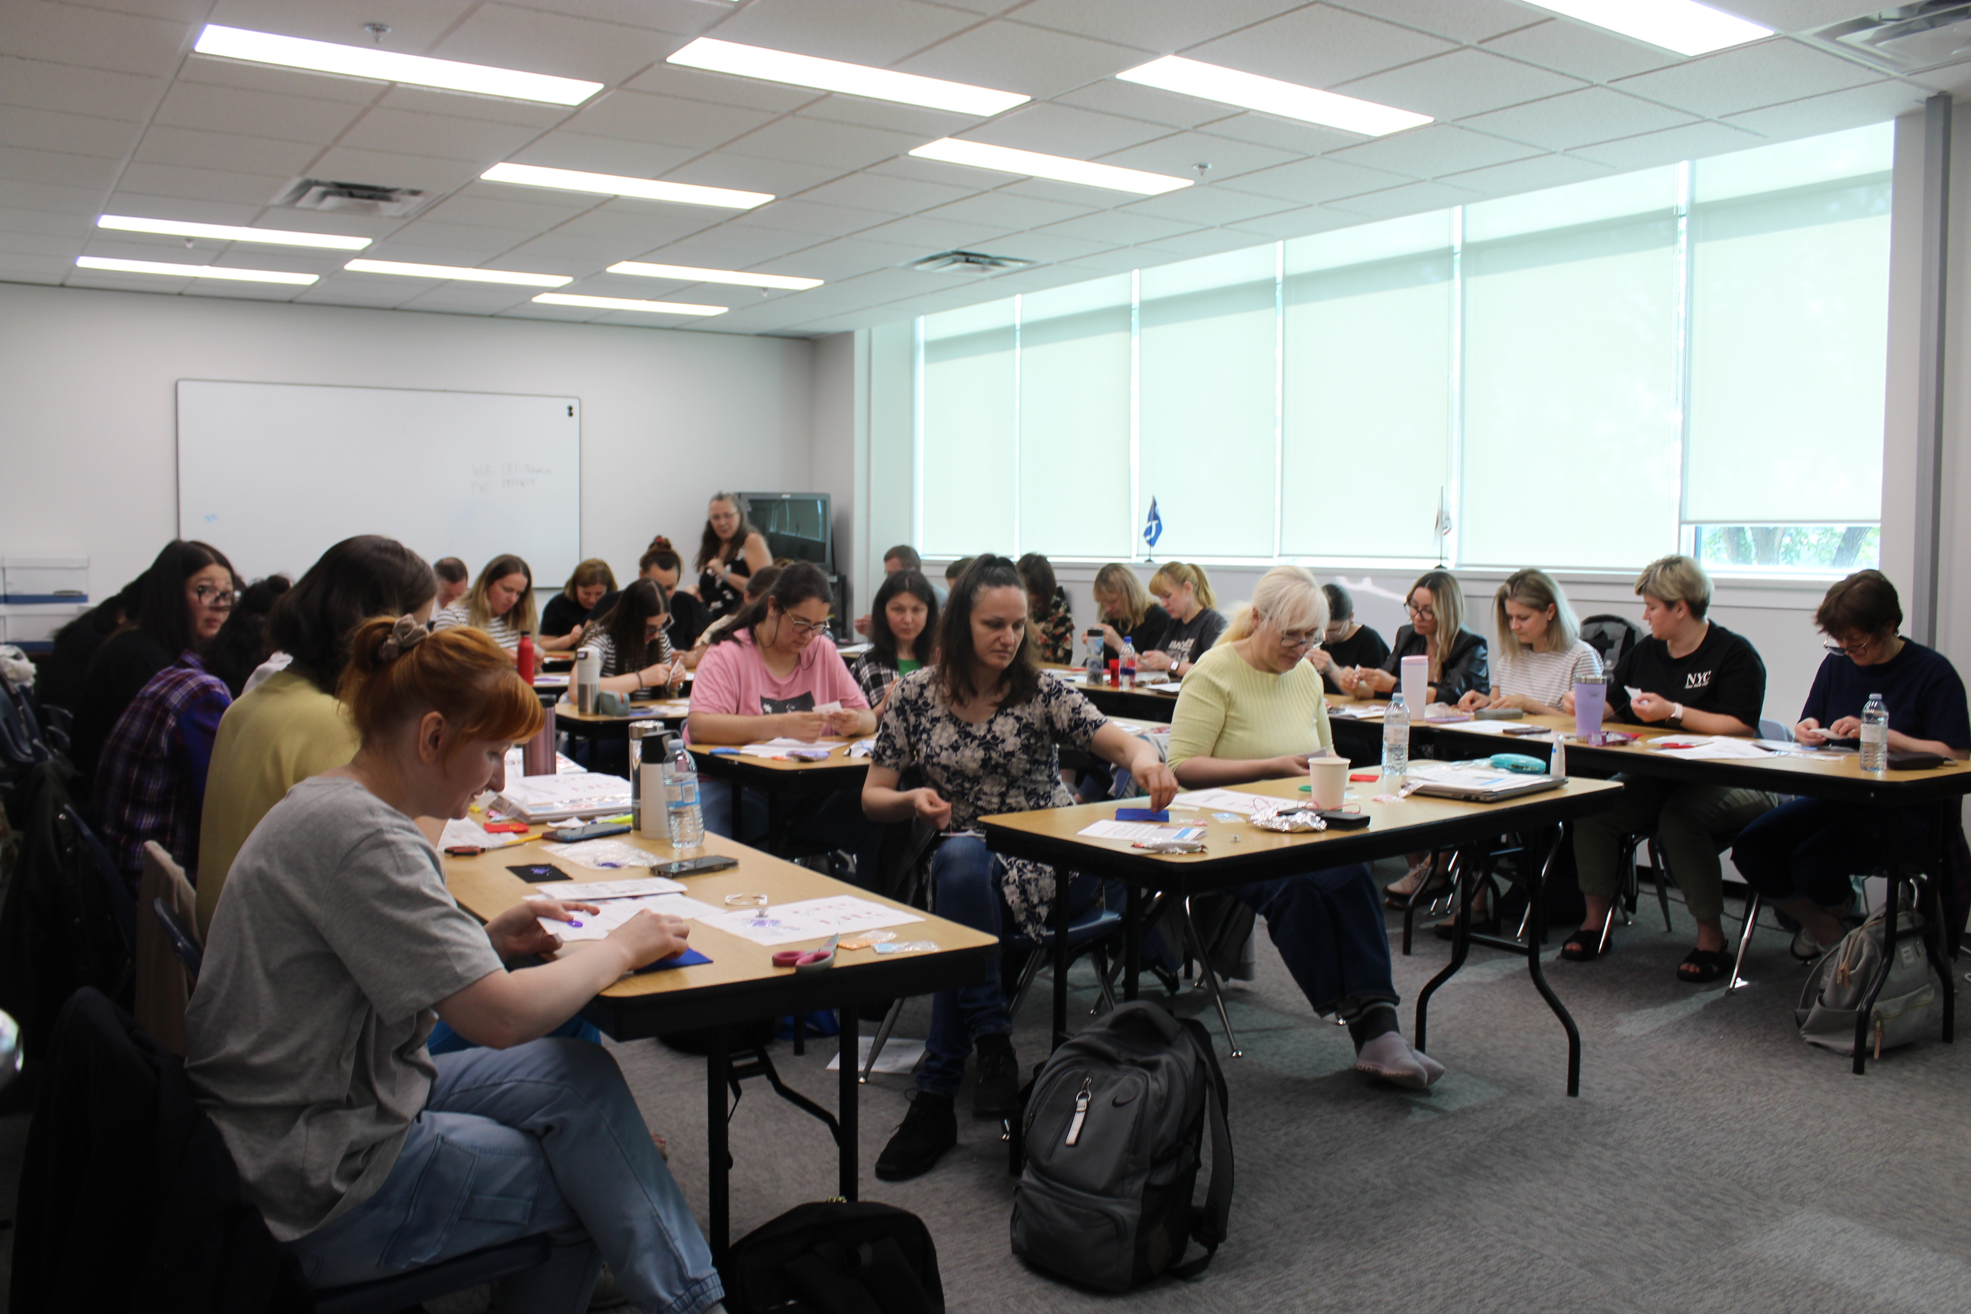
Cultural Programming 2024-2025
Cultural Tours
Participant: 226
Riel House
Participant: 2359
Cultural Workshops
Participant: 785
Cultural Presentations
Participant: 417
Total Participants: 3787

Slide 13
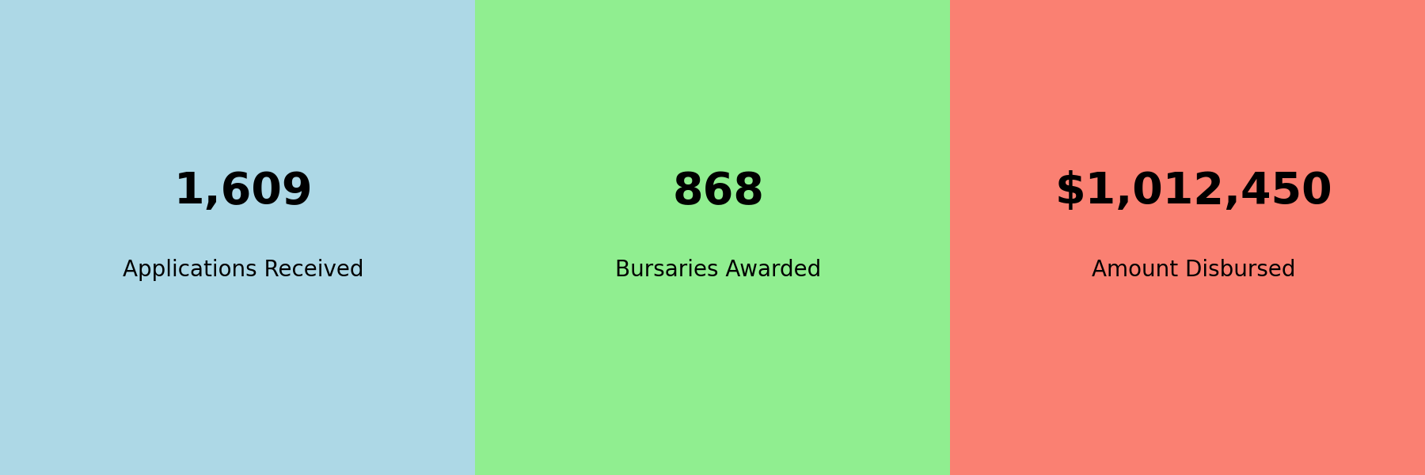
Louis Riel Bursary Distribution (2024-25)
Notes:
• 1,609 applications received
• 868 bursaries awarded
• $1,012,450 disbursed to students

Slide 14


Slide 15
LRC – Programs
Presently, LRC proudly offers the following six diploma programs:
Health Care Aide
Business Accounting
Medical Office Assistant
Indigenous Focused Early Childhood Educator
Employment Counsellor
Educational Assistant
Each of our diploma programs includes a mandatory Red River Métis culture and history component, nurturing a strong sense of identity and heritage among our students.

Slide 16
LRC – Programs
LRC has expanded its Health Care Aide program to offer two additional specialized tracks:
Health Care Aide Challenge Program: This program is designed for individuals who possess relevant health care experience and wish to challenge the certification exam. By providing targeted training and comprehensive preparation, LRC equips participants to excel in the certification process, enabling them to become competent and certified health care aides.
Health Care Aide Bridging Program: LRC is proud to offer this program, which facilitates the transition of existing health care aides to meet the requirements of Shared Health.

Slide 17









LRC – Partnerships
Partnerships: MMF ELCC, MET, LRI, Shared Health, Swan Valley SD,
City of Winnipeg, Winnipeg Airport Authority, Tanco Mine, Cross Lake, Fairford First Nation

Slide 18
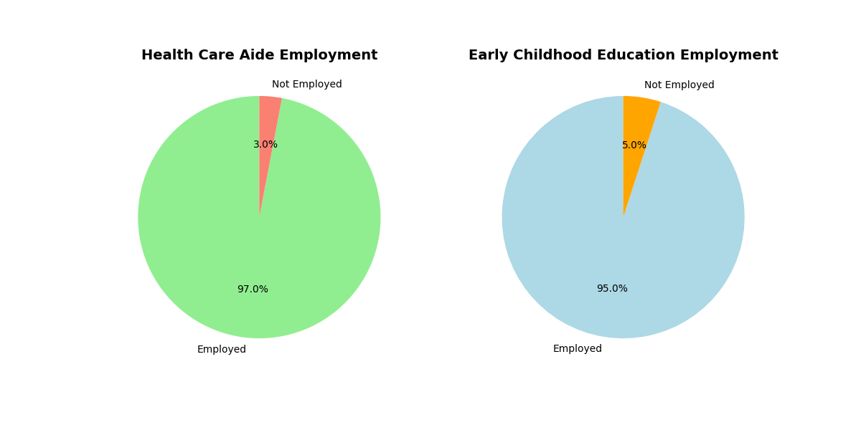
LRC – Impact
Notes:
97% Health Care Aide grads employed; 95% Early Childhood Education grads employed

Slide 19
Thank you!
Contact Us!
MMF Provincial Education
General inquiries: provincial.education@mmf.mb.ca
PSESP: psesp.info@mmf.mb.ca
Phone: (204) 229-7647
Louis Riel Institute
Email: lri@lrilearn.ca
Phone: 204-984-9480
Louis Riel College
Email: admissions@mmf.mb.ca
Phone: 204-586-8474 ext 2817
Notes:
And that concludes my report. Thank you for listening, and here is our contact information.

