Slide 1

Health and Wellness Department
Minister Frances Chartrand
Notes:
Good afternoon, everyone and welcome. It is my pleasure to present our Health and Wellness report showcasing the hard work our dedicated team completed this past year.
Since the very beginning of the Health & Wellness Department, our goal has always been to improve the health and well-being of Red River Métis Citizens through community programming, clinical services, support programs and services, and health research focused specifically on Red River Metis.
We are happy to report that we continue this important work and have succeeded in implementing several new programs for our Citizens.

Slide 2
VISION
A Well Métis Community
COMMUNITY HEALTH PROGRAMMING
HEALTH
RESEARCH
CLINICAL
SERVICES
POLICY & HEALTH INFORMATION
MICHIF
MANOR
Navigation, prescription drug program, vision care, mental health
Research, education, and partnerships
Mobile clinic, clinical programs
Health information to support policy and services
Accommodation for Citizens travelling for medical care
Notes:
The HWD was established in 2005 with a clear vision: “A Well Métis Community”.
The HWD has 5 branches who work together to achieve this vision: Community Health Programming, Health Research, Clinical Services , Policy and Health Information, and our newest addition, the medical housing initiative, Michif Manor. I’m happy to tell you all more about them and their work!

Slide 3





Health Research
We center Red River Métis voices to shape health knowledge that reflects our culture, values, and lived experiences.
The Research Team has engaged Citizens in projects such as:
Tobacco Reduction Strategy
Distance to Care: Cancer Outcomes for Citizens in Rural Manitoba
Maternal Health in Red River Métis Citizens
Riel Personalized Healthcare
Citizen Perspectives on Medical Assistance in Dying
Notes:
The Health Research team’s goal is to create Red River Métis-specific health knowledge using our Citizens’ lived experiences through consultations, discussion groups, interviews, and surveys.
The Research team has engaged Citizens on a wide range of topics, with some examples given here:
Living Smoke Free: Red River Métis Tobacco Reduction Strategy
Distance to Care: Cancer Outcomes for Red River Métis Citizens in Rural Manitoba
Riel Personalized Healthcare
Citizens Perspectives on Medical Assistance in Dying
And, Maternal Health in Red River Métis Citizens

Slide 4

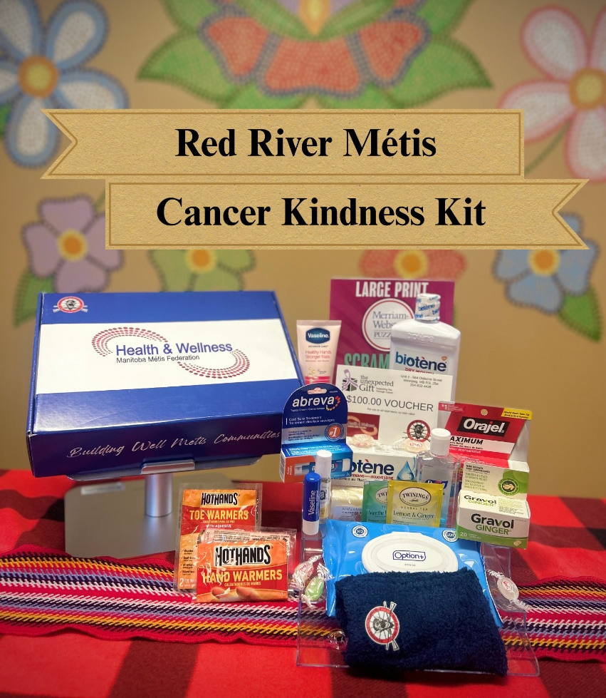
Health Research
Notes:
As a part of our cancer project “Riel Personalized Healthcare”, the Health Research team created Cancer Kindness Kits for Citizens navigating cancer. These kits are filled with comfort and self-care items to support our Citizens as they go through cancer.
If you or someone you know is going through a cancer journey, email the Health Research team at healthresearch@mmf.mb.ca to request your Cancer Kindness Kit.

Slide 5
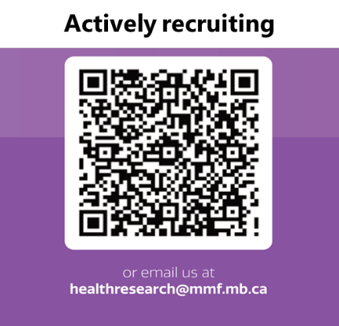

Health Research
Notes:
The Maternal Health in Red River Métis project aims to increase access to maternal health information and support, as well as raising awareness about risks of maternal and child illness amongst Red River Métis women
Through the Mommy & Me info session, our project aims to gather the lived experience and maternal health journey of Red River Metis women to inform future programs specifically tailored to the Red River Métis community.
As a part of the project, our team rolled out the Mommy & Me Wellness Baskets for Red River Métis women currently pregnant or who have had a baby within 6 months.
These baskets are designed to support Red River Métis mothers and their babies with essential items for health and comfort. They contain baby care products, breastfeeding aids, postpartum care essentials, and educational materials on prenatal care.
Recruitment for the Maternal Health Awareness and Support Project is ongoing. You can scan this QR code or email the Research Team (healthresearch@mmf.mb.ca) to be part of this initiative.

Slide 6
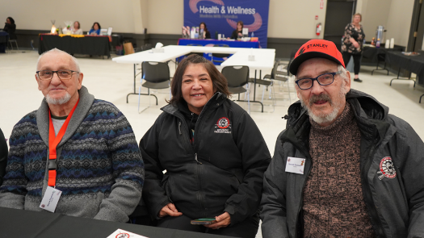
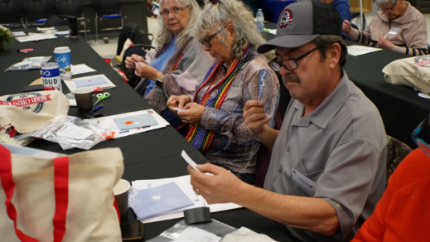
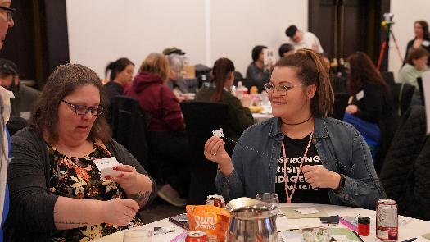
Health Research
Health Consultations
  The goal of consultations is to engage Citizens and get feedback to promote the health and well-being of Citizens
Citizens’ Health Consultations, Feb 2025
Citizens’ Health Consultations, Nov 2024
Notes:
HWD hosts annual Health Consultations to hear the individual and collective health needs of Citizens from all seven Regions
In November, HWD consultations were held in Swan River with Citizens from The Pas, Thompson, and Northwest Regions.
In February, we held consultations in Winnipeg with Citizens from Winnipeg, Southwest, Southeast, and Interlake Regions.
During these consultations, Citizens shared their perspective on a range of important health issues and had a chance to engage in cultural activities like beading, painting beaded flowers, and Michif Bingo.
In March, consultations with Red River Métis health professionals from across the seven MMF Regions took place.

Slide 7







Policy and Health Information
The Policy And Health Information team gathers and develops Red River Métis–specific health information to support policies, programs, and services for our Citizens, promoting informed decision-making.
Long-Term and Continuing Care Framework
COVID-19 Surveillance and Future Pandemic Planning
Perspectives on Missing and Murdered Indigenous Women, Girls and 2SLGBTQI+ People
Red River Métis Regional Health Survey
Cancer Data Monitoring
Distance to Care: Cancer Outcomes for Citizens in Rural Manitoba
Arthritis & Mental Health Yoga Program
Notes:
The Policy & Health team has continued to work on a number of initiatives to develop Red River Métis specific information to support policies, programs, and services for Citizens.
Some of the Policy & Health team’s projects include:
The Long-Term and Continuing Care Framework for Red River MétisCitizens
COVID-19 Surveillance and Future Pandemic Planning
Perspectives on Missing and Murdered Indigenous Women, Girls, and 2SLGBTQQIA+ People
Red River Metis Regional Health Survey
Cancer Data Monitoring
And the Arthritis & Mental Health Yoga Program, this project invited Citizens living with arthritis engaged in mind-body interventions including yoga and meditation to help manage symptoms and improve quality of life.

Slide 8

Policy and Health Information
Red River Métis Regional Health Survey
Preliminary Findings:
30.0% reported fair or poor general health.
31.3% agree that there has not been a doctor or a nurse available in their area.
53.7% have not had a complete physical examination in the last 12 months.
Notes:
In 2022, the team distributed the first Metis Regional Health Survey to gather information about the health status of Citizens. The results are currently being analyzed.
The survey results will contribute to policy and programming to improve the health and wellness of Red River Métis Citizens across our Homeland
These results are why we work so hard, we want to change these numbers and improve the health and wellbeing of our Citizens.
Preliminary findings
30.0% fair or poor general health
21.4% reported worse health than 1 year ago
26.5% have a long-term condition
31.3% agree that there has not been a doctor or a nurse available in their area.
16.2% have felt that they were treated differently and/or experienced stigma and discrimination when seeking or receiving health care.
53.7% have not had a complete physical examination in the last 12 months
29.9% have not had a blood pressure test in the last 12 months
57.5% have not had a cholesterol test in the last 12 months
50.5% have not had a blood sugar test in the last 12 months

Slide 9
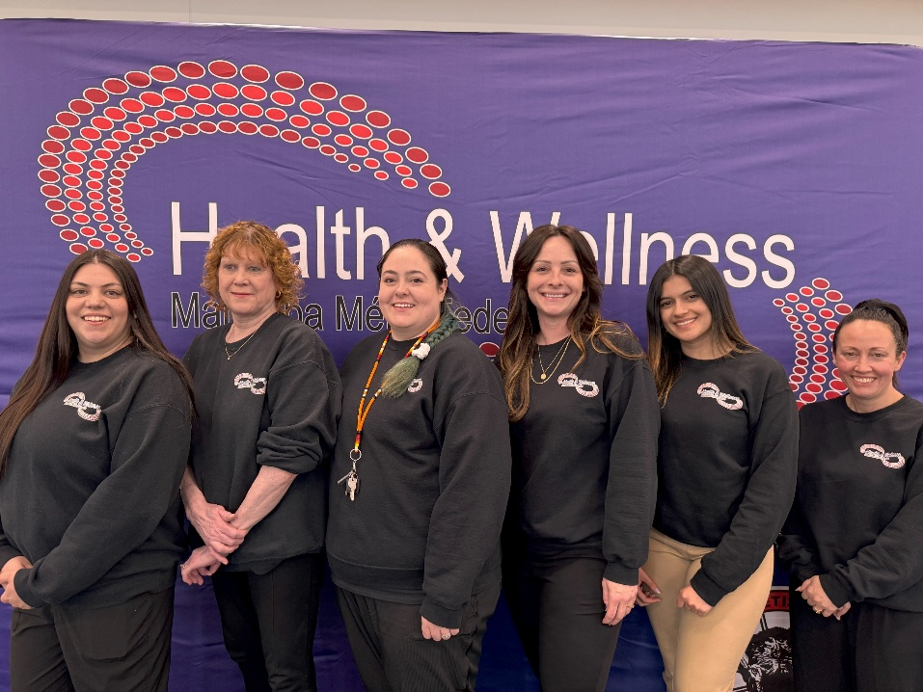
Clinical Services
Objective
Improve the health and wellness of Red River Métis Citizens across all seven Regions in Manitoba through education and support
Services
  5-minute check-ins with Registered/Licensed nurses
  Blood sugar level tests
  Cholesterol level tests
  COVID-19 and other vaccinations
  Diabetic footcare
Notes:
The Clinical Services branch was established in January 2021, and this team is dedicated to serving Red River Métis Citizens across Manitoba. This past year the team has done numerous visits to our communities and Citizens, bringing diabetes and heart health screening tests, footcare nurses, and general health checks.
Our Clinic team provides:
5-minute check ins with registered/licensed nurses
Tests on blood sugar and cholesterol levels
COVID-19 and other vaccinations
Diabetic footcare

Slide 10
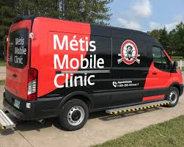
Clinical Services
Mobile Clinics
Provides Citizens with general health and wellness services including:
General health checks
Blood sugar tests
Cholesterol level tests
Footcare
Vaccines
Education Events and Other Programs
Diabetes Wellness Session
Mental Health and Addictions sessions
Educational Resources for Chronic Illness Prevention
Aging Well At Home (AWAH) Pilot Project
Embracing Wellness, Mental Health, and Addictions
Notes:
Clinical Services coordinates two Mobile Health units in the Southern and Northern regions. These Health Units travel across our 7 Regions to offer blood pressure monitoring, diabetic footcare, and Point-of-Care Testing for health issues such as diabetes and high cholesterol, and health education

Slide 11
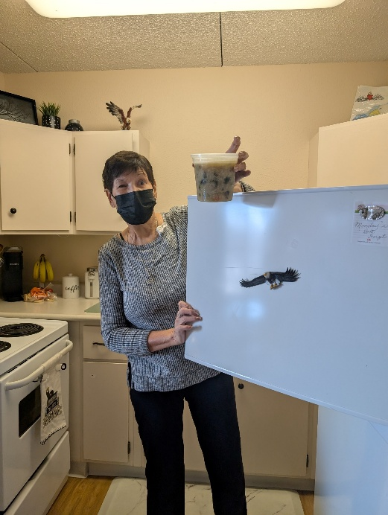
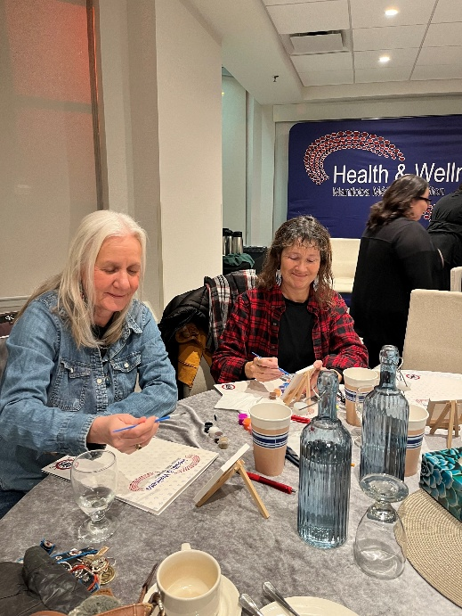
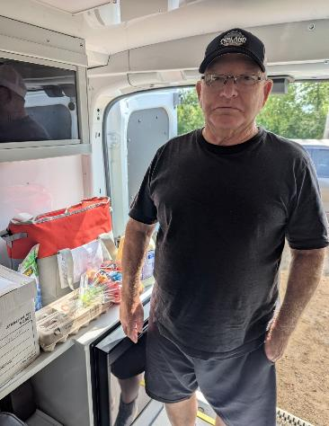
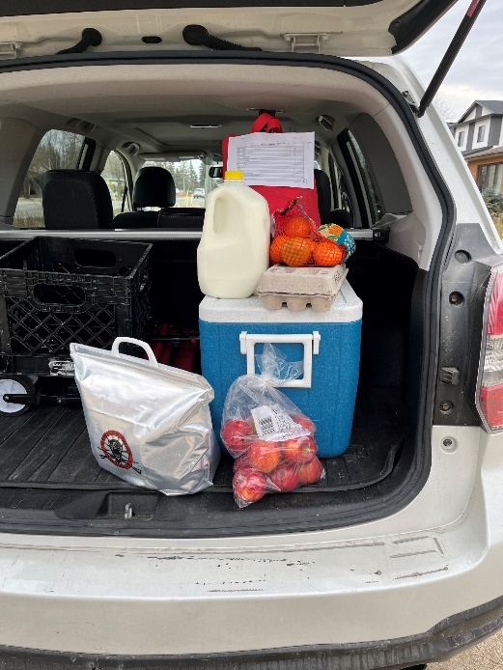
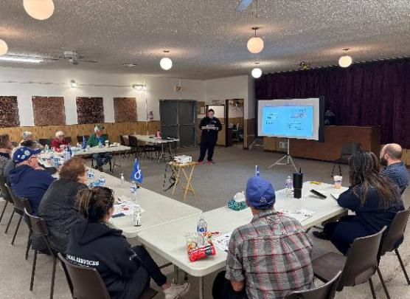
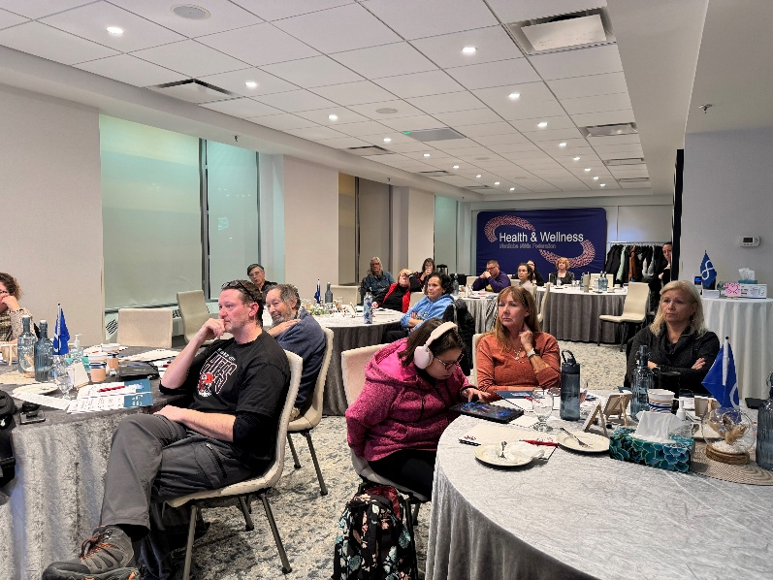
Clinical Services
Notes:
Our Clinic Team offers lots of educational events and programming to support our Citizens’ health. These photos showcase some of the programming they held this year, including food basket deliveries from our Aging Well at Home initiative, and support events from our Substance Use and Addictions Program

Slide 12

Community Health Programming
Community Navigation
Métis Senior Vision Care
Prescription Drug Program
Community navigators are located throughout the province to support Citizens with their health needs
Aids aging Citizens in managing their eye health, including regular eye exams and prescription eyeglasses
Pays eligible Citizens’ calculated deductible throughout the year for Pharmacare-eligible drugs
Notes:
The Community Health Programming branch works directly with Citizens to support their health.
Our Community Navigators are spread across the province to support our Citizens in accessing healthcare wherever they live
Through the Métis Senior Vision Care initiative, we recognize that vision is a vital part of maintaining independence and overall wellness of our Citizens. This initiative offers vision care services including managing healthy eye care, eye examinations and prescription eyeglasses.
Through The Prescription Drug Program, the MMF pays eligible (over 55 years old and income less than $35,000) Red River Métis Citizens’ deductible throughout the year for Pharmacare-eligible drugs.
The program is a collaboration between the MMF Health & Wellness Department and MEDOCare Pharmacy

Slide 13

Community Health Programming
Mental Wellness Support Line
Mental Wellness phone line provides free support for Red River Métis Citizens experiencing sadness, stress, or anxiety.
Citizen Support Program
Emotional support, guidance, and access to resources for Red River Métis Citizens.
Notes:
The HWD launched the Mental Wellness Support Line in December 2020 in the wake of the COVID-19 pandemic to offer resources and support to our Citizens struggling with mental health, isolation, loneliness, and more.
Through this phone line, Citizens have access to support from Métis counsellors and mental health resources. This has been a very successful initiative, with the phone line receiving 700 calls in its first year. This phone line operates from 7am to 11pm daily, and anyone feeling out of sorts is encouraged to reach out to us.
Our Citizen Support Program offers emotional support, guidance, and access to resources for Red River Métis Citizens. Our Mental Health Case Coordinator provides confidential assistance and connects Citizens with local services. We can provide information, referrals, and guidance to help Citizens access the resources they need to navigate difficult times.
Please confirm with Megan if it’s 24/7 still, and if we want to be advertising it if there’s some talk about stopping this service

Slide 14
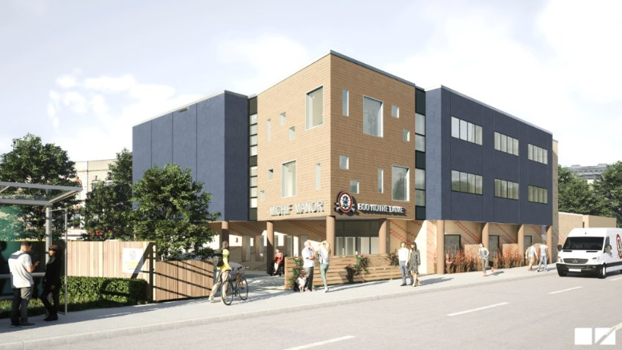
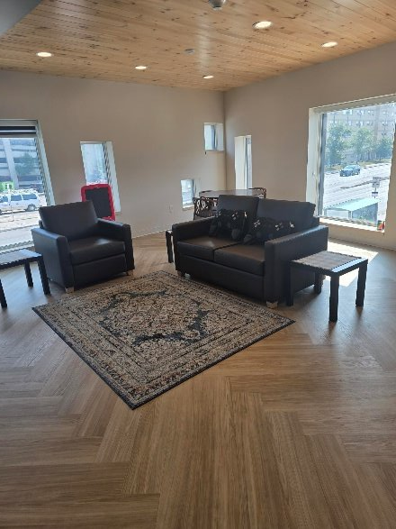
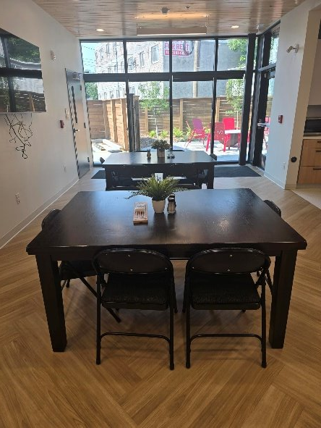
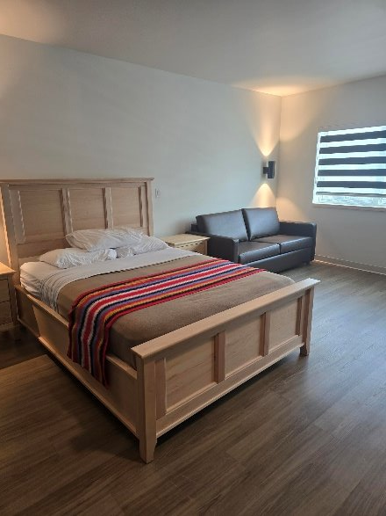
Michif Manor
Notes:
In partnership with the MMF’s Housing Department, the HWD has developed medical housing, called Michif Manor, with the goal of providing short-term accommodation to Citizens and their families who are in Winnipeg for medical appointments.
This is intended to reduce the burden of travel and cost of accommodations for Citizens who must come into Winnipeg often or for long periods of time for medical care.
During the wildfire emergencies, Michif Manor opened its doors to house evacuees with HWD employees stepping up to work various shifts to support this initiative. During the second emergency, Michif Manor was able to hire casual staff.
Michif Manor is expected to open soon to provide medical housing

Slide 15
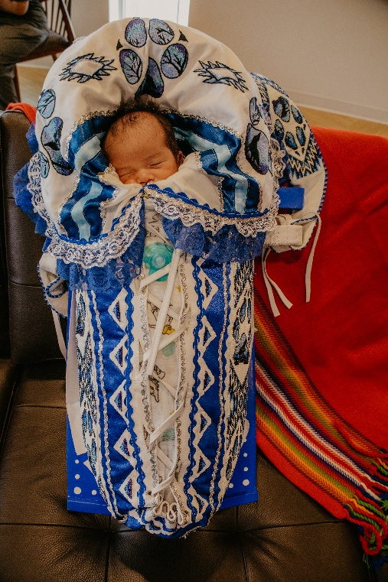
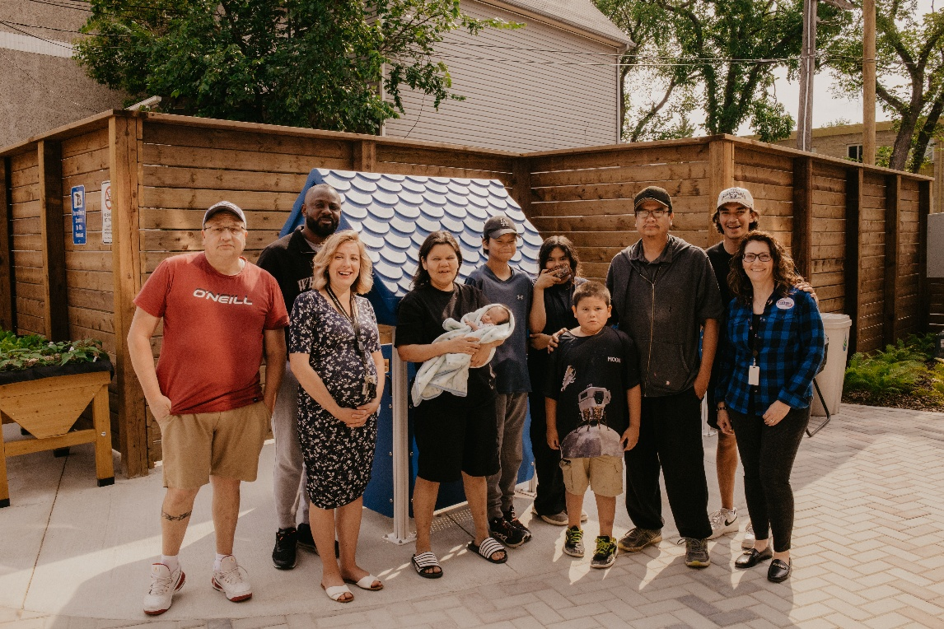
Michif Manor
800 Notre Dame, Winnipeg.
Notes:
Michif Manor is a safe and comfortable place for Citizens that have come to Winnipeg for medical reasons. The facilities include:
12 rooms total (Including 2 family suites)
Accessible accommodations
Communal kitchen
Fitness room
Entertainment lounge
On site laundry
Outdoor patio and children’s play area

Slide 16
Health and Wellness Department Priorities
Support the Overall Health and Well-being of Citizens
Increase Access to Programs and Services
Enhance Community Engagement and Collaboration
Promote physical, mental, emotional, and cultural wellness
Ensure programs reflect Métis values and lived experiences
Expand the number of mobile clinic visits per year
Reach more rural and remote communities
Strengthen wraparound supports for Citizens
Engage regularly with Citizens
Integrate feedback into program design and delivery
Build partnerships with local health providers and organizations
Notes:
The Health & Wellness Department’s priorities for this next fiscal year:
Continue to promote the physical, mental, emotional, and cultural wellbeing of our Citizens, and develop programs that reflect Citizen needs and experiences.
Expand the number of mobile clinic visits per year and reach out to more rural communities.
Continue to strengthen holistic and wraparound support for Citizens.
Enhance engagement and collaboration by building partnerships with local health providers and organizations and engaging with our Citizens.
Integrate feedback into program design and delivery to best meet the needs of Red River Métis Citizens.

Slide 17
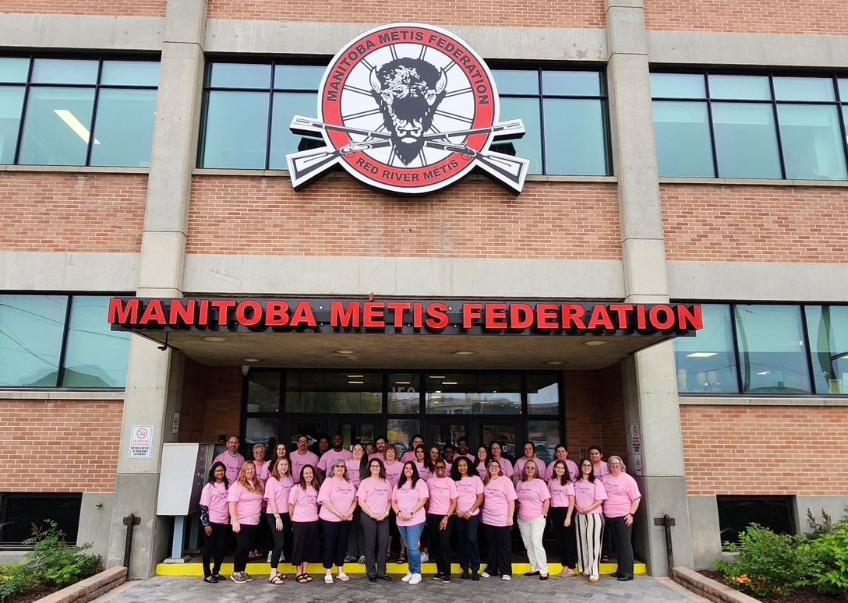
Health and Wellness Team
Thank you!
Notes:
In conclusion, the Health & Wellness Department remains committed to collaborating closely with Red River Métis families and communities, as well as our partners, and funders while we strengthen the department and improve programming throughout the province.
Looking ahead to the next year, the MMF-HWD anticipates continued growth and progress, with a passionate team of experienced staff working together to create knowledge and enhance programs and services for the well-being of our valued Red River Métis Citizens

