Slide 1


Métis Employment & Training (MET)

Slide 2


Slide 3
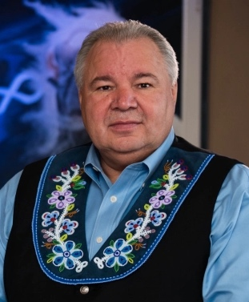
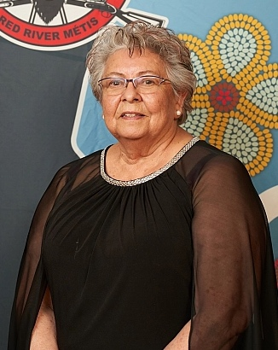
Leadership
Moving Forward
Following Minister Fleury’s passing, MMF President David Chartrand has assumed the role of Acting Minister of Métis Employment & Training (MET).
Minister Joan Ledoux continues as Associate Minister of MET.

Slide 4
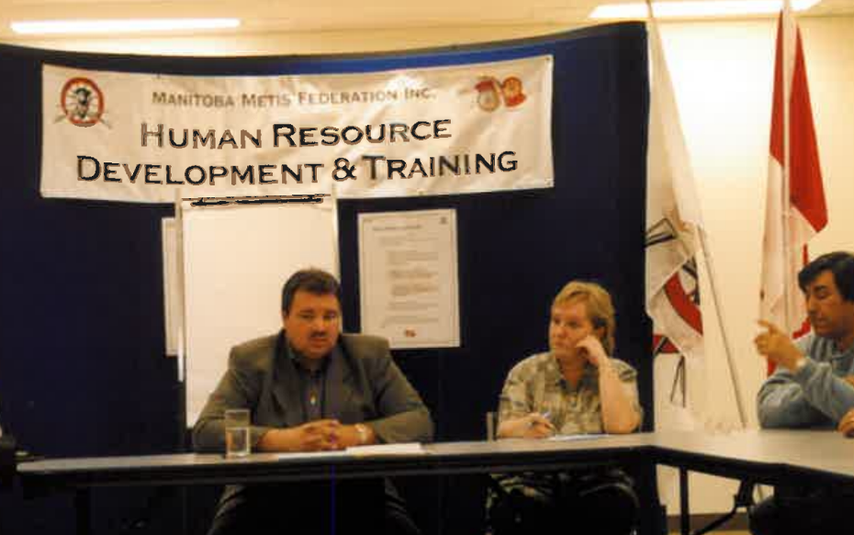

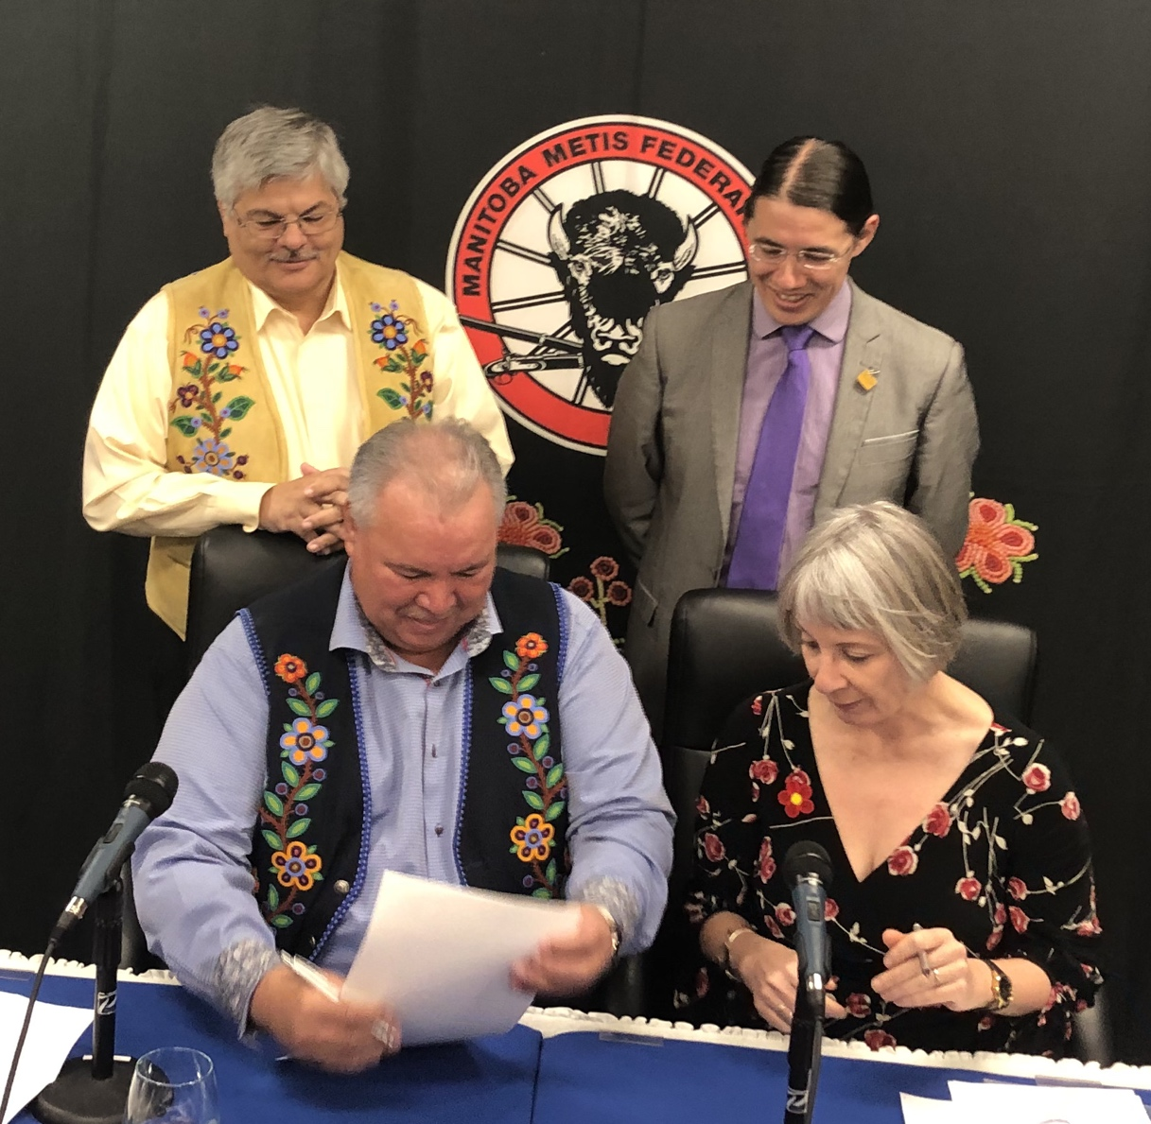
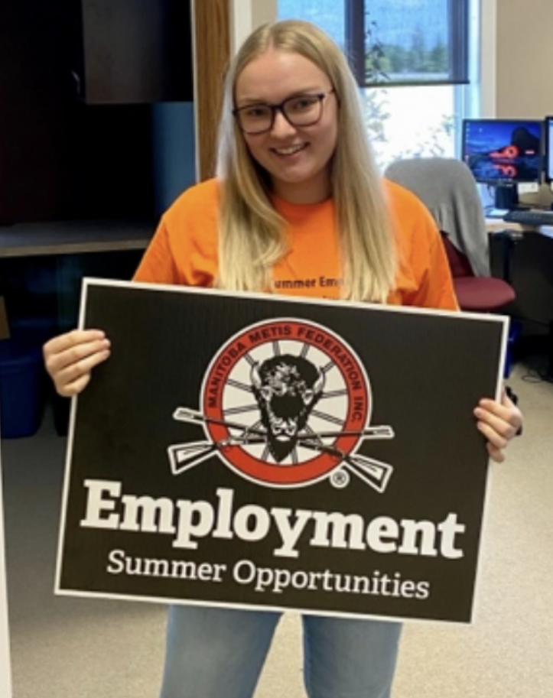
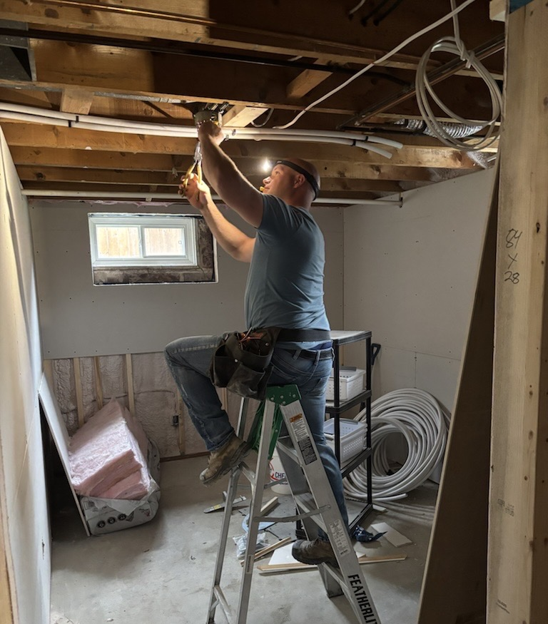

ABOUT
MET
MÉTIS EMPLOYMENT & TRAINING

Slide 5

Métis Employment & Training (MET)
26 YEARS OF EXCELLENCE
MET HISTORICAL RESULTS
DIRECTLY IMPACTED
RETURNED TO SCHOOL
EMPLOYED
51,636
11,543
16,978

Slide 6
2024-2025 Budget
Métis Employment & Training (MET)
$15,600,000
STRONGER SKILLS. BETTER JOBS. BRIGHTER FUTURES.
* The 2024–2025 ISET budget of $15.6M has been supplemented by an additional $2 million, bringing the total ISET allocation to $17.6 million.

Slide 7
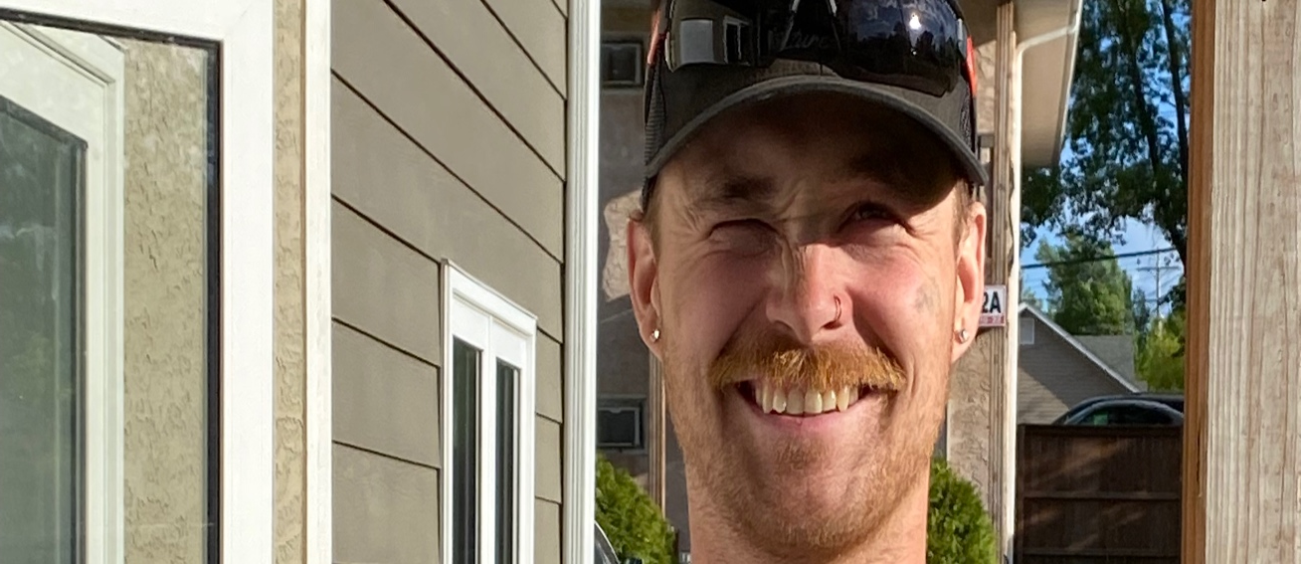
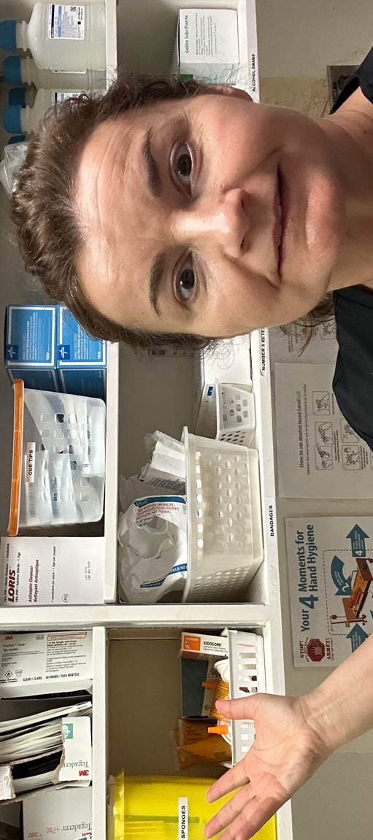

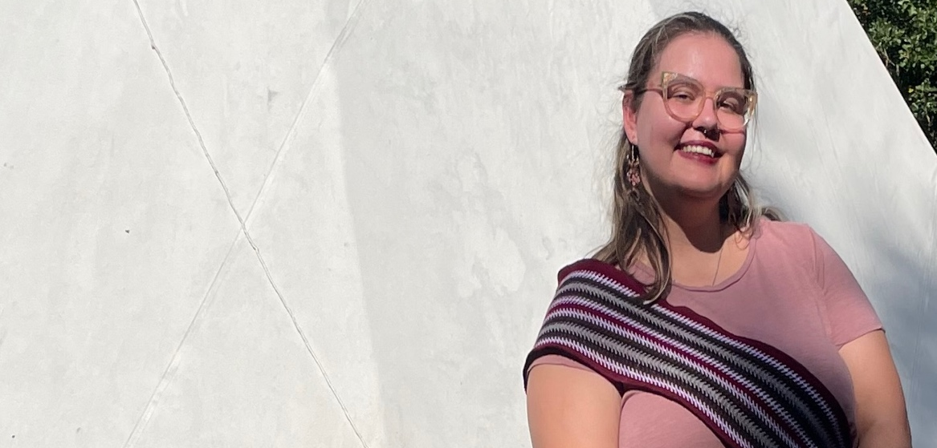
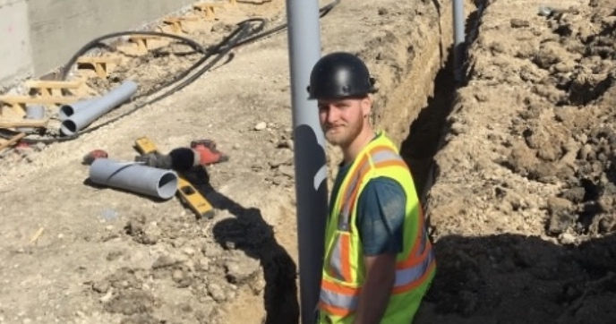
971
Supported in Sponsored/Funded Programs
810
2,245
2024-2025
KEY
RESULTS
Employed
Red River Métis Clients Served
+112.5% of target
669
Returned to School
391
+174.2% of target
Supported in Project-Based Training

Slide 8
2024-2025
KEY RESULTS
OF 2,245 CLIENTS SERVED…
GENDER DEMOGRAPHICS
YOUTH UNDER 30
53.7%
78%
Female
45.1%
Male

Slide 9
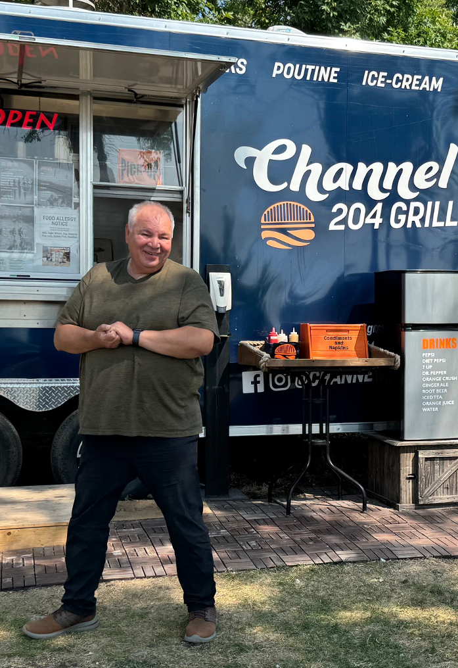

SUMMER STUDENT EMPLOYMENT STRATEGY
Summer Jobs.
Lifelong Impact.
318
177
Summer Employment Positions Supported
Employer Partners
& MMF Locals
$2.6M
Invested in Red River Métis Youth Summer Jobs

Slide 10



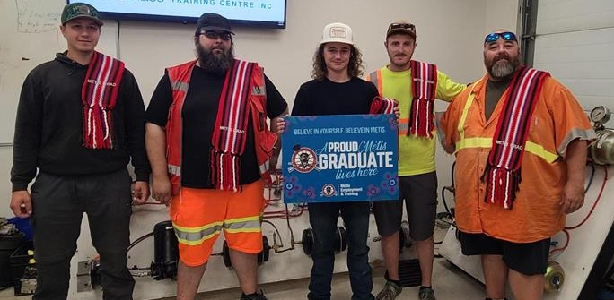












Building Strong Partnerships
Delivering training, employment and skill development opportunities across our Homeland to Red River Métis Citizens
SOME OF OUR EMPLOYER PARTNERS:
215
Active Employer Partners

Slide 11

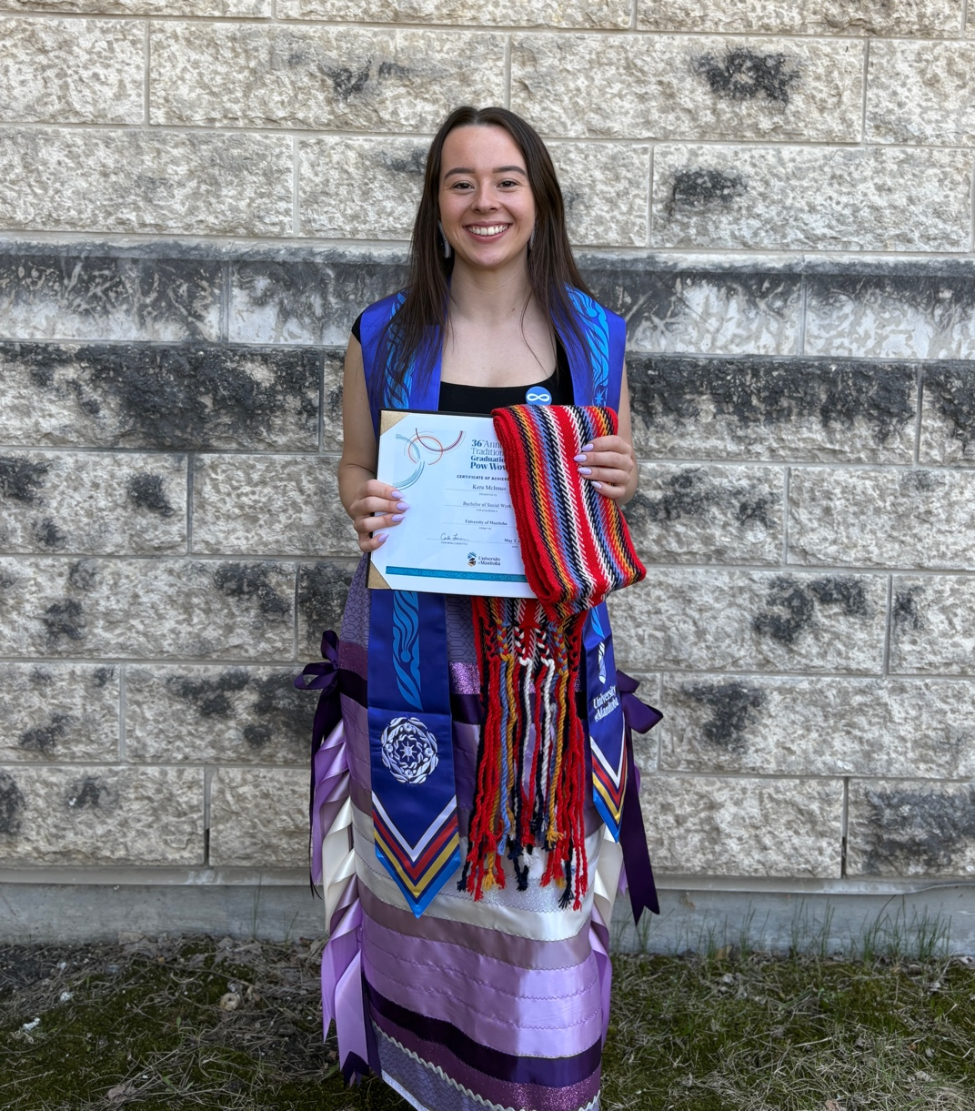
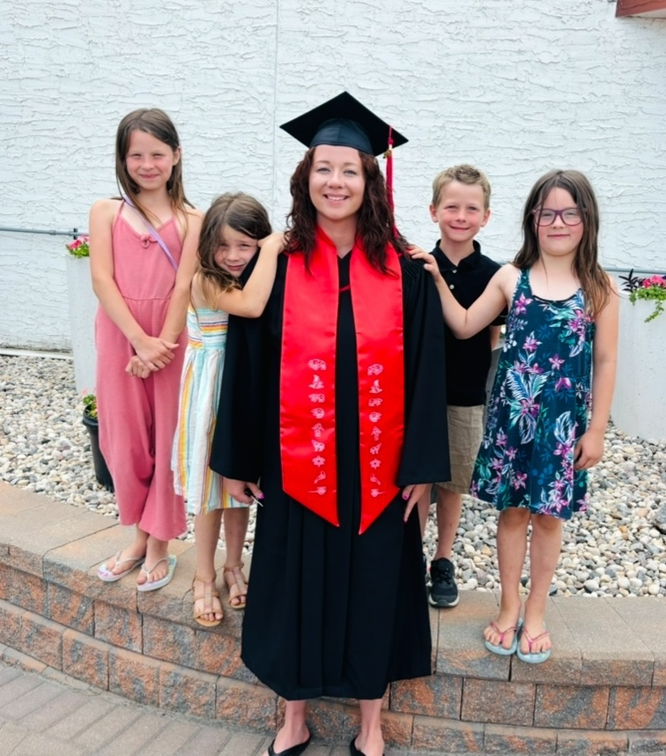

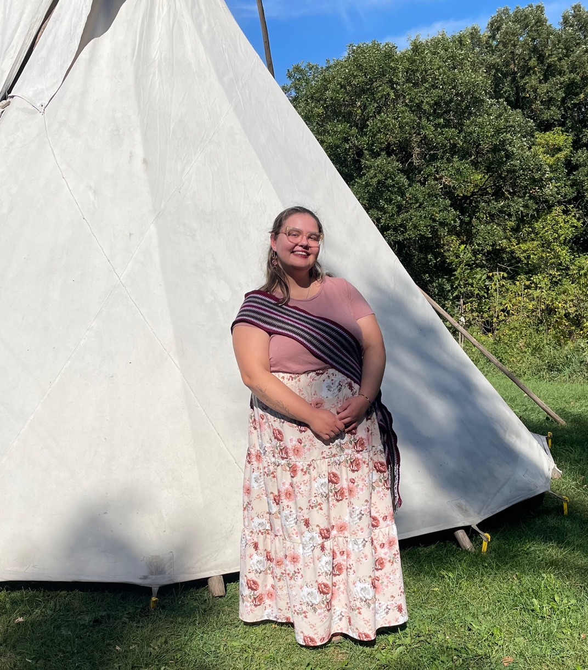
CELEBRATING
RED RIVER MÉTIS
SUCCESS

Slide 12



Métis Employment & Training (MET)
CONNECT WITH US!
Interlake MET Southeast MET MET Recruitment
St. Laurent, MB Grand Marais, MB Winnipeg, MB
(204) 646-4091 (204) 754-3112 (204) 586-8474 ^{ext 2731}
INTMET@mmf.mb.ca SEMET@mmf.mb.ca MET@mmf.mb.ca
Northwest MET Southwest MET
Dauphin, MB Brandon, MB
(204) 638-9485 (204) 725-7525
NWMET@mmf.mb.ca SWMET@mmf.mb.ca
The Pas MET Thompson MET
The Pas, MB Thompson, MB
Phone: (204) 632-5701 (204) 677-1430
PASMET@mmf.mb.ca THOMET@mmf.mb.ca
Winnipeg MET MET Home Office
Winnipeg, MB Winnipeg, MB
(204) 589-4327 (204) 586-8474
WPGMET@mmf.mb.ca MET@mmf.mb.ca

