Slide 1

Red River Métis Veterans Department
AGA Report

Slide 2
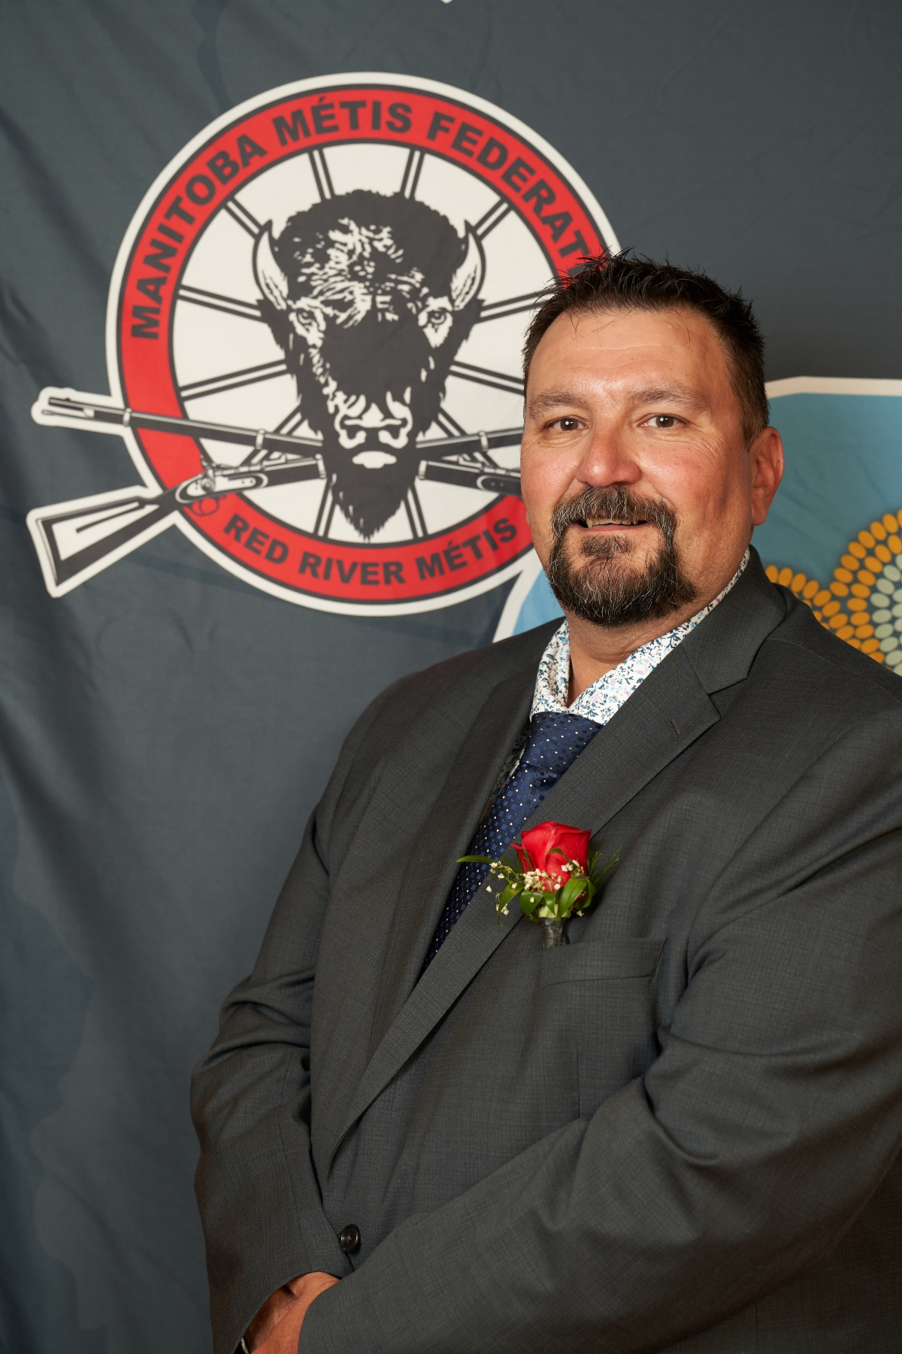
2024/2025 Highlights
Funding from Veterans Affairs Canada for the Red River Métis Veterans Archive
3rd Annual Indigenous Veterans Ceremony
Red River Métis Veteran representation on international stages

Slide 3
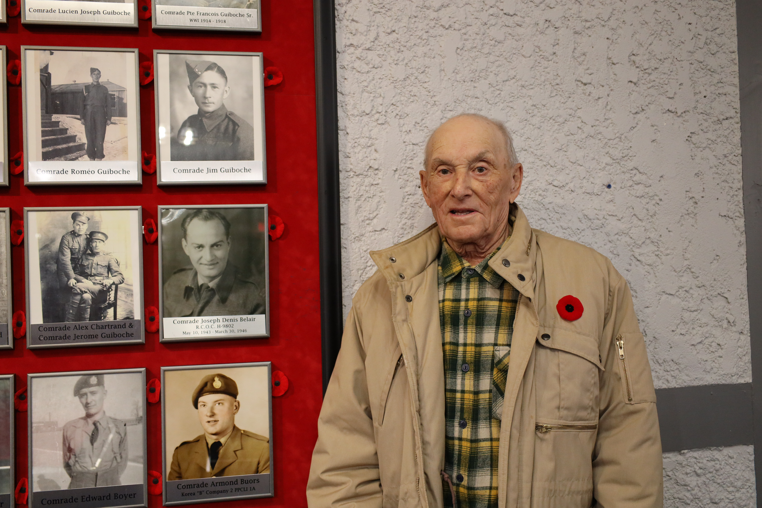
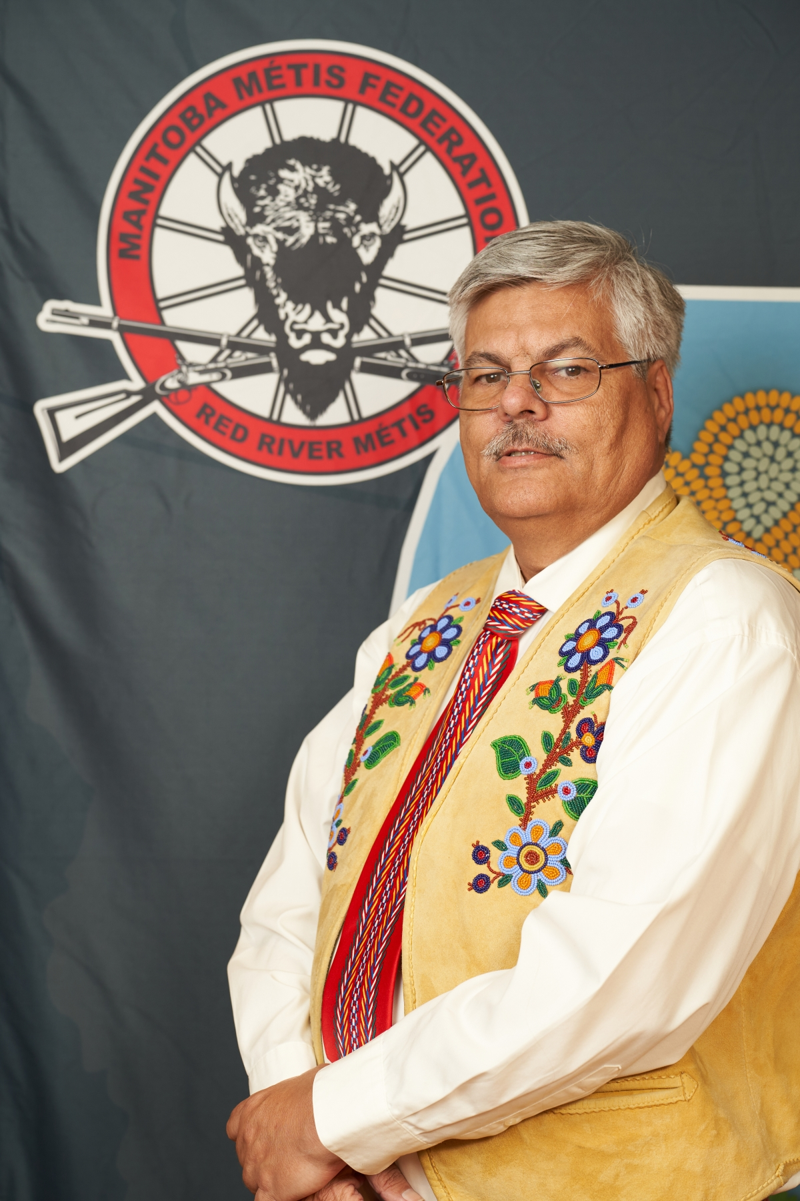
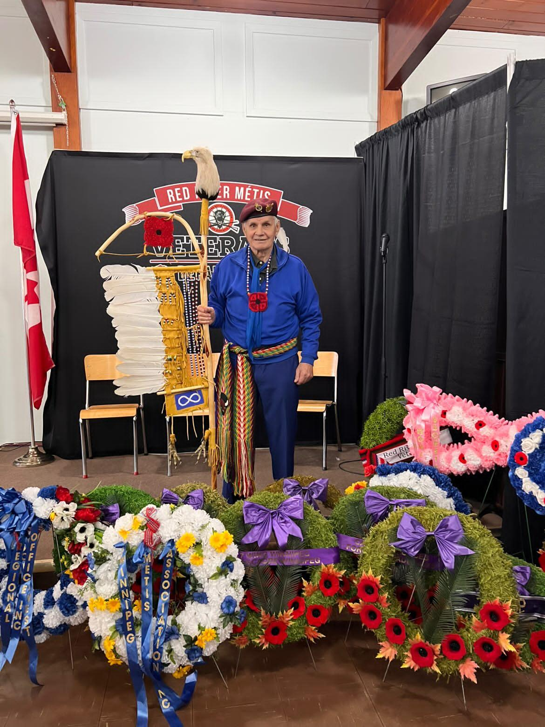
In Memoria
Veteran Armand Buors
Veteran Minister John Fleury
Veteran Joseph Courchaine

Slide 4
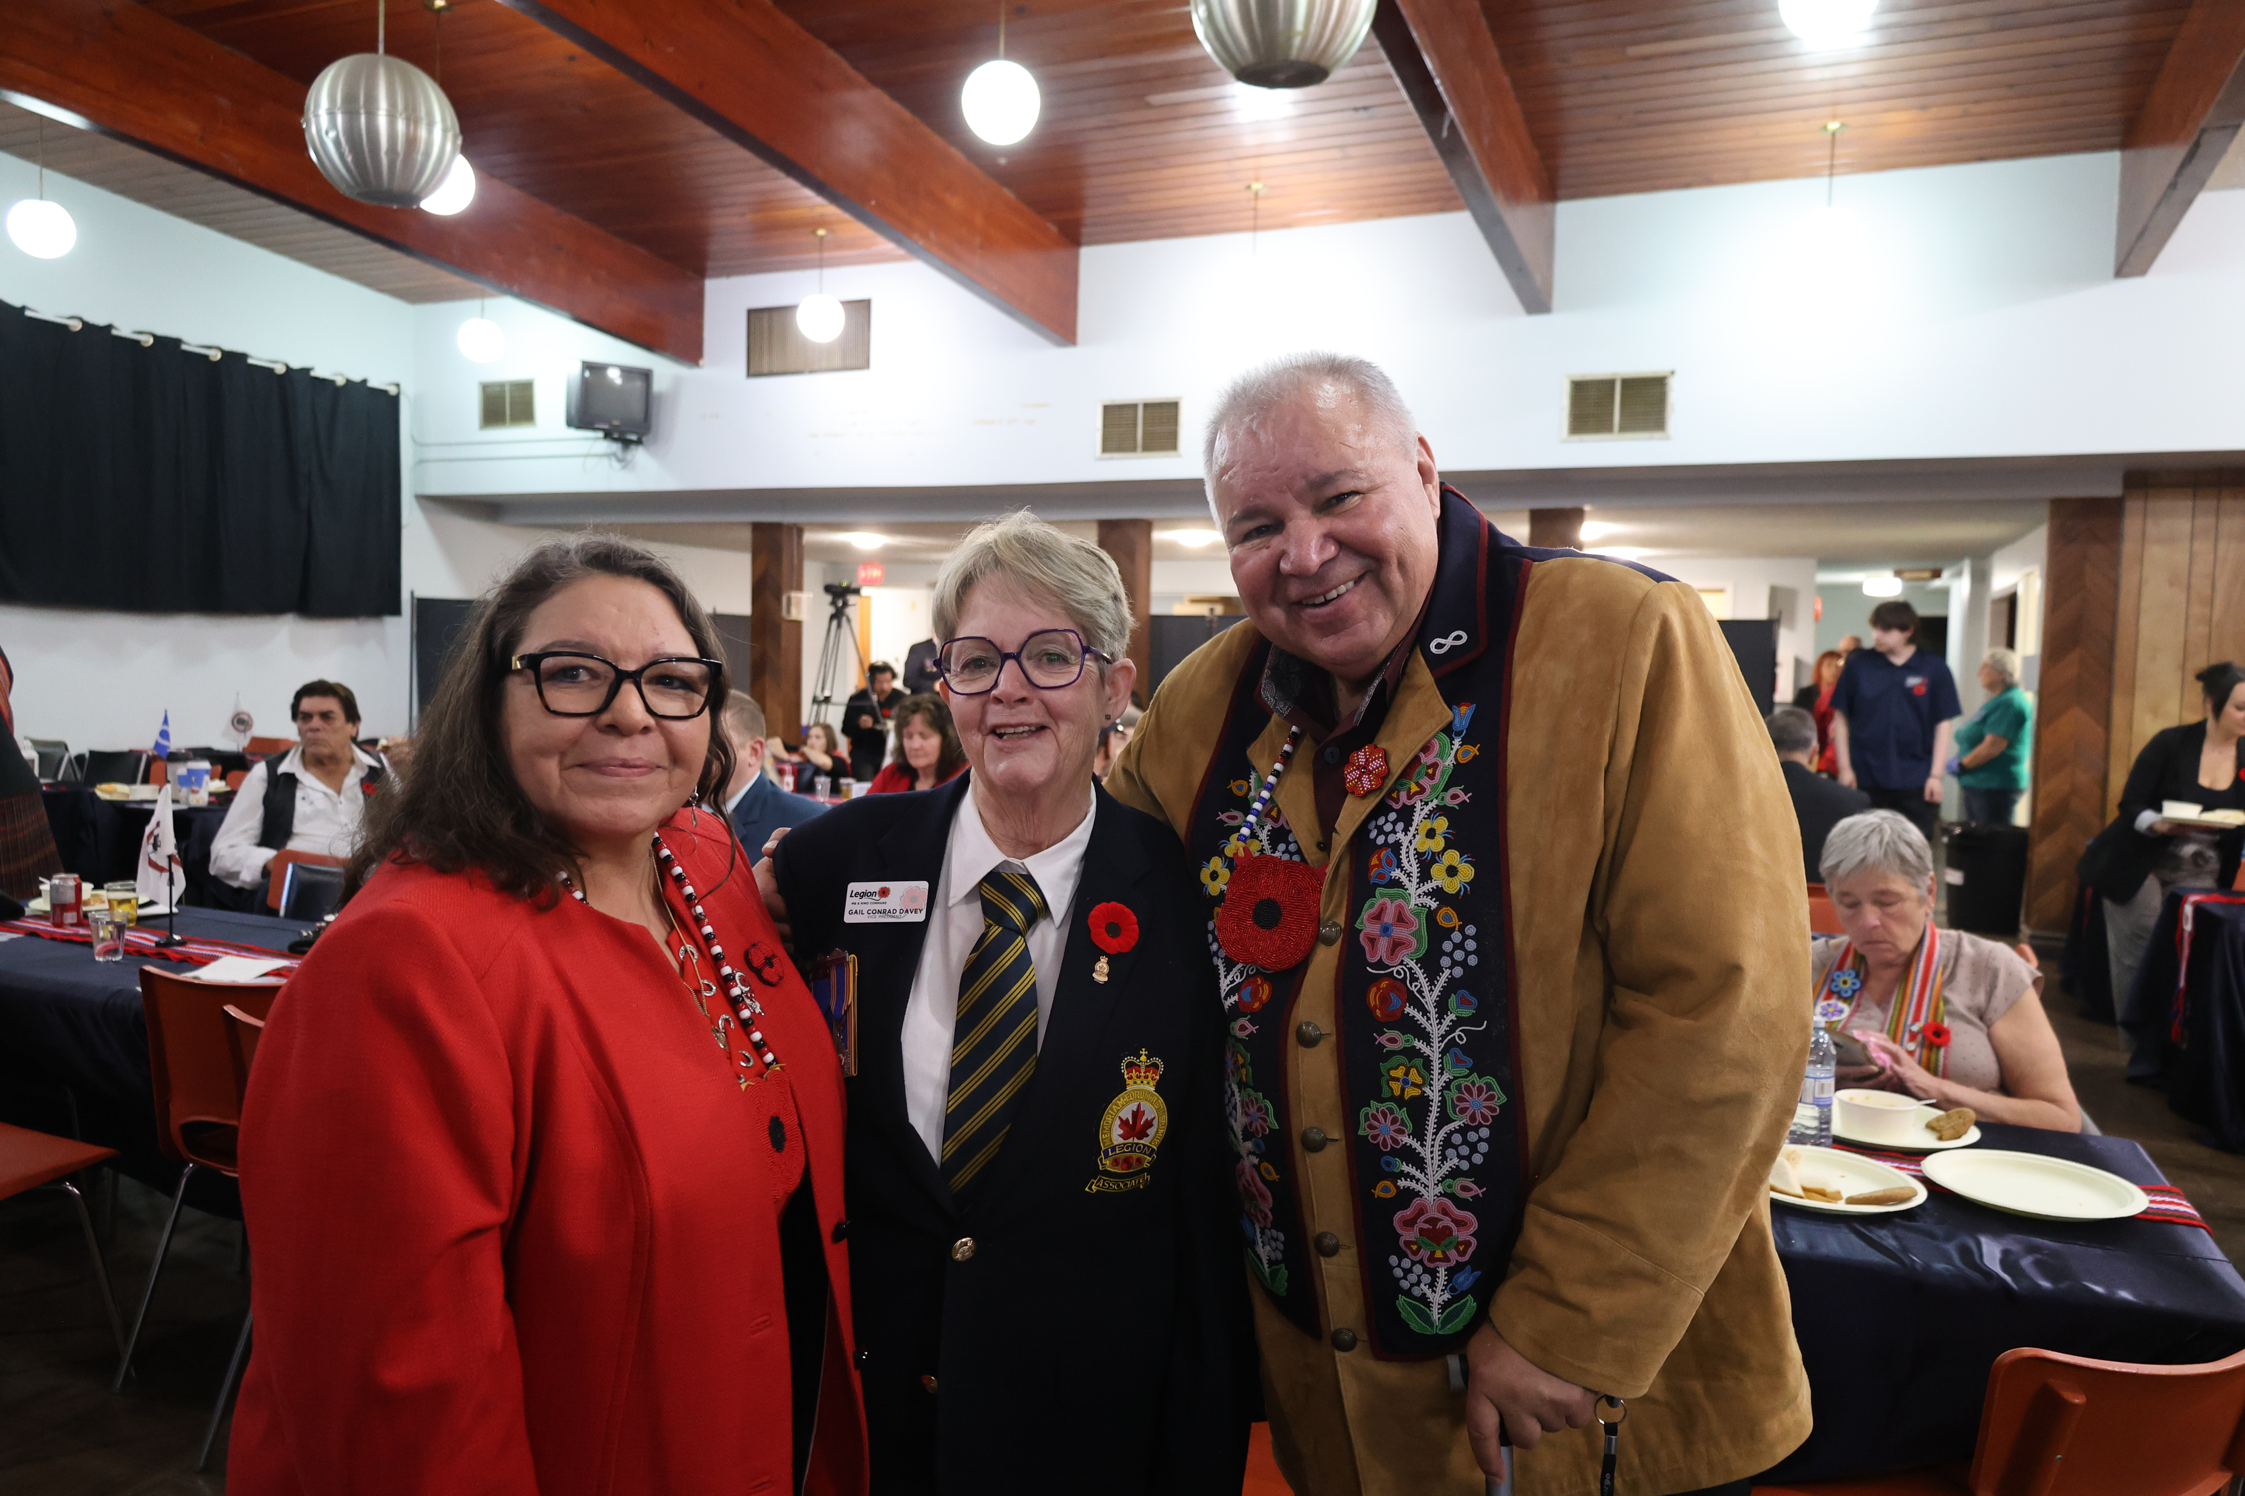
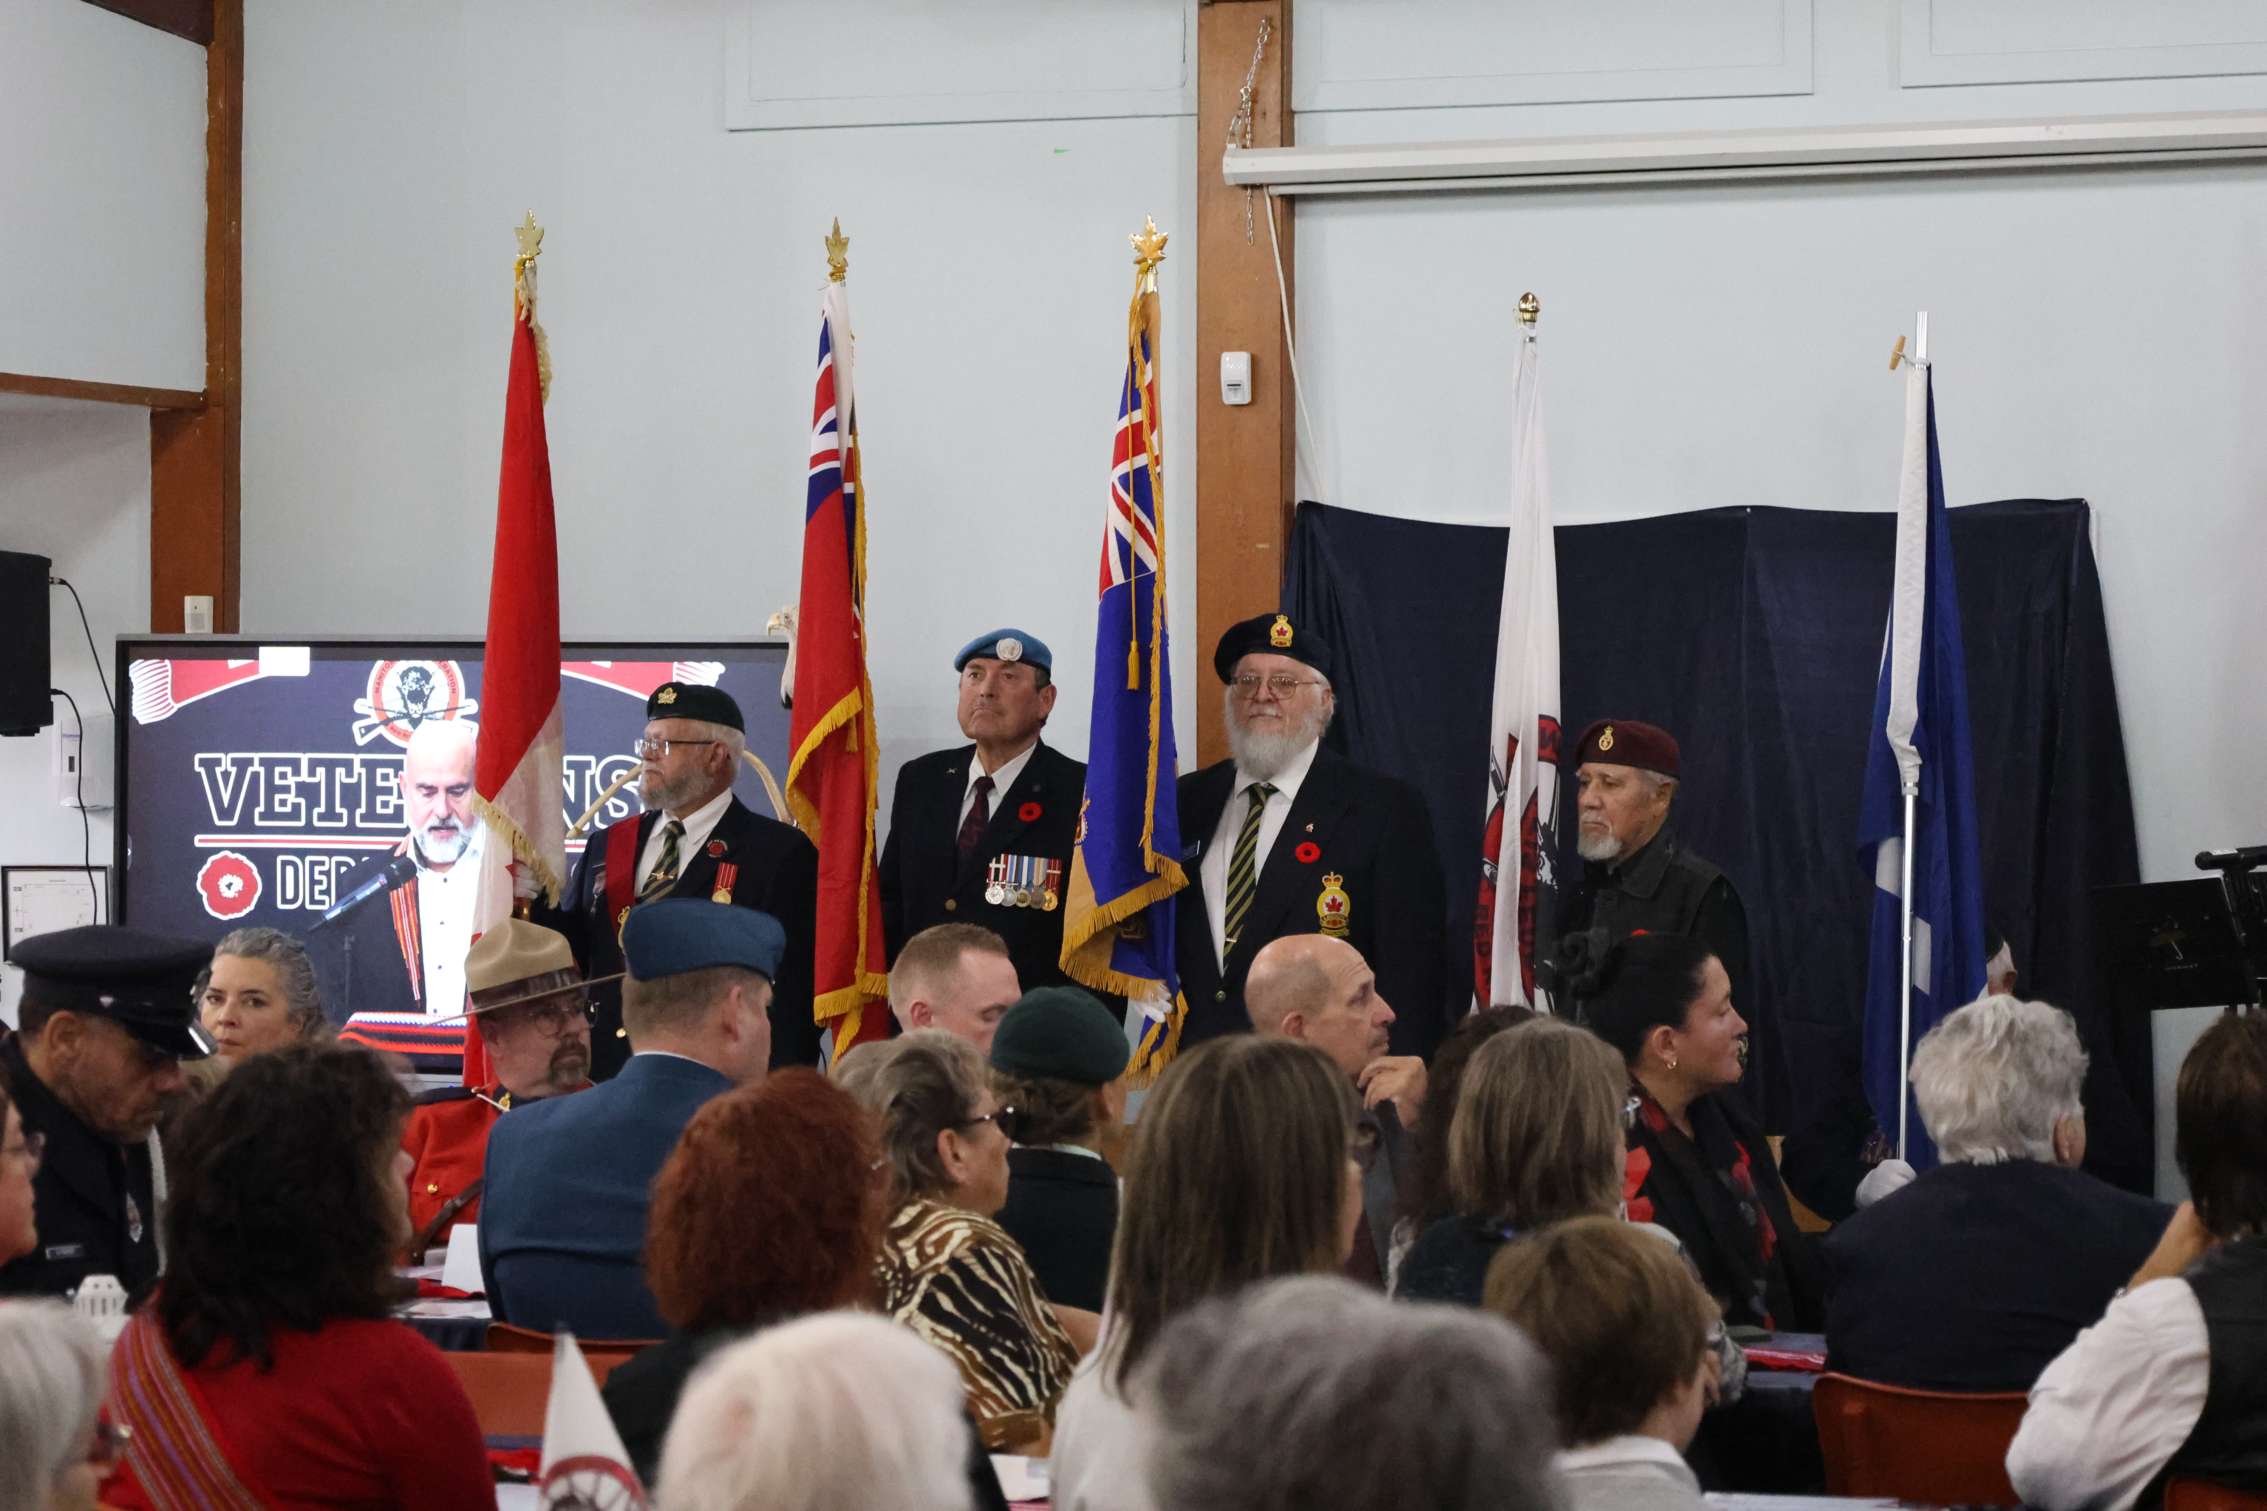
Indigenous
Veterans Day
Held in partnership with the Royal Canadian Legion Portage la Prairie Branch 65, the Southwest Region, and the Portage la Prairie Local.
Featured a flypast from the RCAF, Métis Veterans, Métis youth, Elders, and dignitaries.
Reception with performances by Métis musicians and dancers
200 people in attendance, and 343 online viewers.

Slide 5

Indigenous Veterans
Day 2025
We are pleased to have our 4th Annual
Indigenous Veterans Day Ceremony in the
Southeast Region.
This ceremony is free to attend, but has limited
capacity. The event will also be livestreamed
through MMF social media.

Slide 6
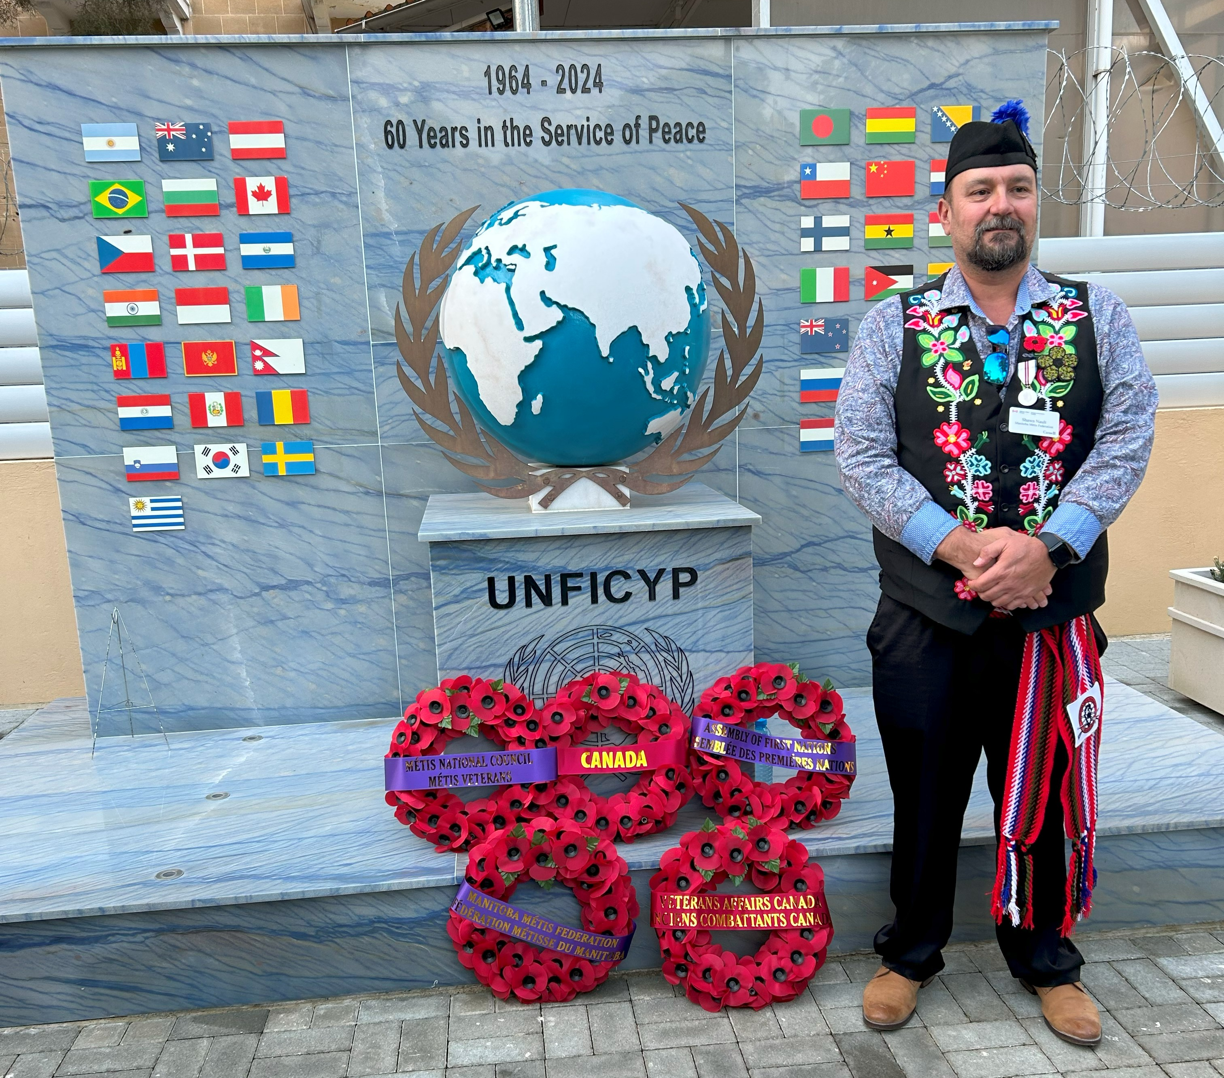
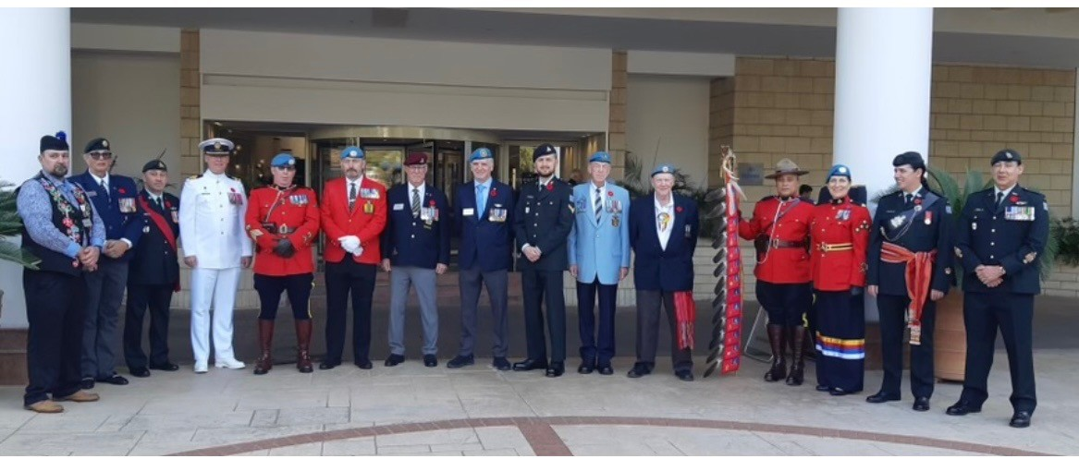
VAC Delegation to Cyprus
Honouring Canadians who served with the United Nations Peacekeeping Mission.
Marking the 60th anniversary of the conflict and 50th anniversary of the 1974 war.
Representing and honouring Red River Métis Veterans who served in Cyprus

Slide 7
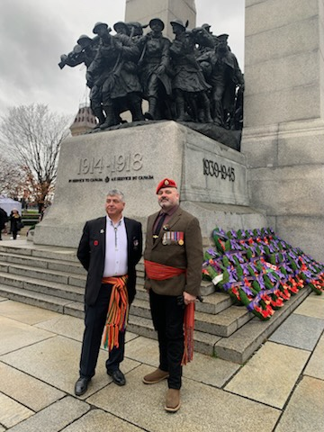
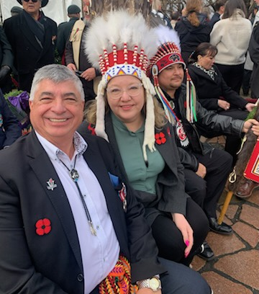
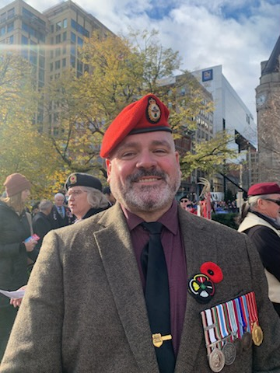
National Remembrance Ceremony - Ottawa

Slide 8
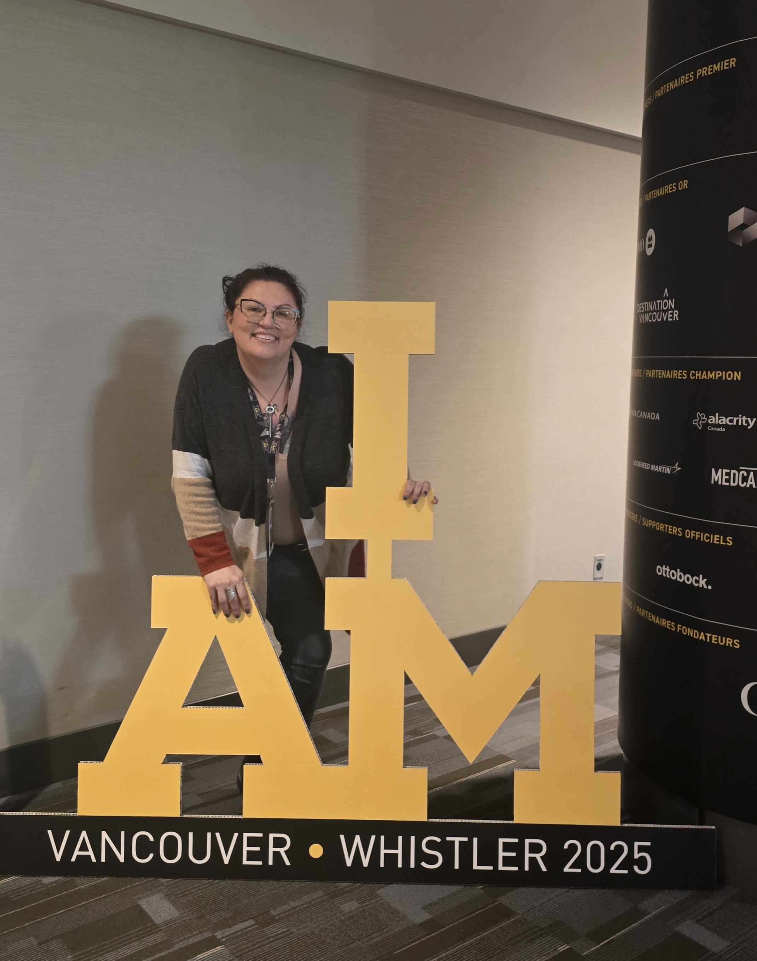
Invictus Games 2025
“I thoroughly enjoyed the [camaraderie] between all the Veterans on the VIP Indigenous delegation team and the collective views on Veteran wellbeing and initiatives that are starting up across the country.” Veteran Cheryl LeBlanc, MMF Nominated Red River Métis Veteran representee

Slide 9

Red River Métis Veterans Archive
February 2025, Veterans Affairs Canada committed $400,000 through the Veteran and Family Well-being Fund, towards the Red River Métis Veterans Archive. This funding will support the archive over the next 3 years of its development.
Creation of a resource manual:
  Collected information regarding over 122 Veteran-based services
  Met with 23 organizations so far regarding their services

Slide 10
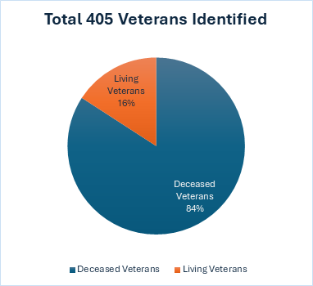
Red River Métis Veterans Archive
405 Red River Métis Veterans identified
  64 living
  341 deceased
Database will collect:
  Veteran’s stories
  Service information
  Photos
  Artifacts
Working collaboratively with CRO on Archive creation
2 Métis Veterans Interviewed
4 relatives of Métis Veterans Interviewed
Ensuring process is done correctly in a respectful, secure, and culturally centred manner

Slide 11
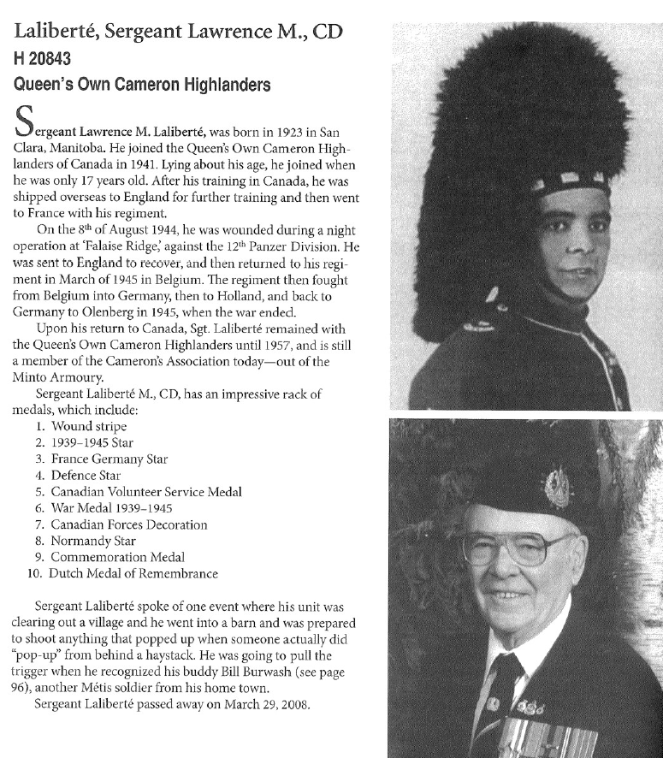
Veteran Commemorative Projects
Archive will allow the Department to create more public commemorative projects on Veterans
Working with the Communications Department on Veteran Commemorative Stories
2 projects to be released in the new fiscal:
  Armand Buors
  Lawrence Laliberté
Métis Veterans of Manitoba: From Buffalo to Battlefields

Slide 12

Métis Veterans Legacy Program
Visit metisveterans.ca for more information

Slide 13
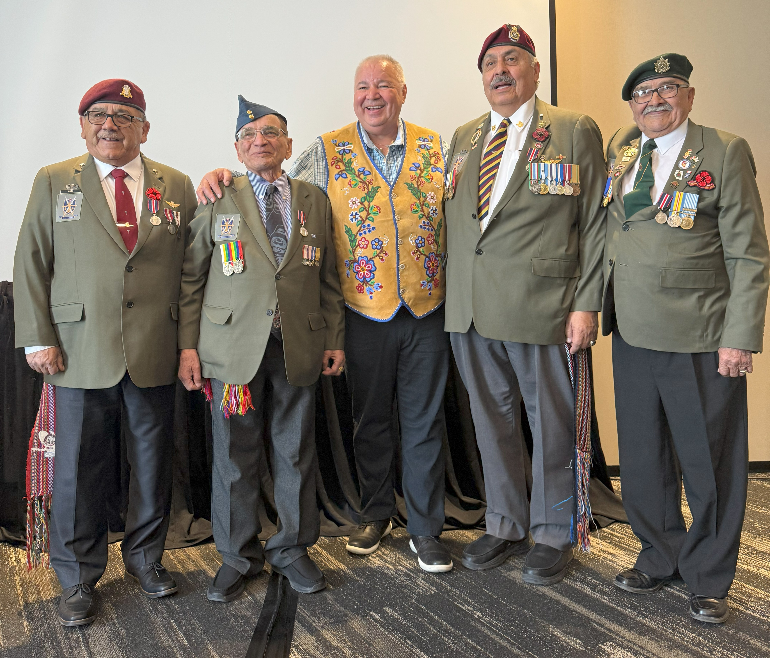
MVLP Commission
From L-R: Veteran Jack Park (Commissioner Chair), Veteran Jimmy Durocher (Elder), President David Chartrand, Veteran Alex Maurice (Commissioner), Veteran Harry Hope (Commissioner)
The 3 Commissioners and Elder were awarded the King’s Coronation Medal for their military service and dedication to the Métis Nation following their service.

Slide 14
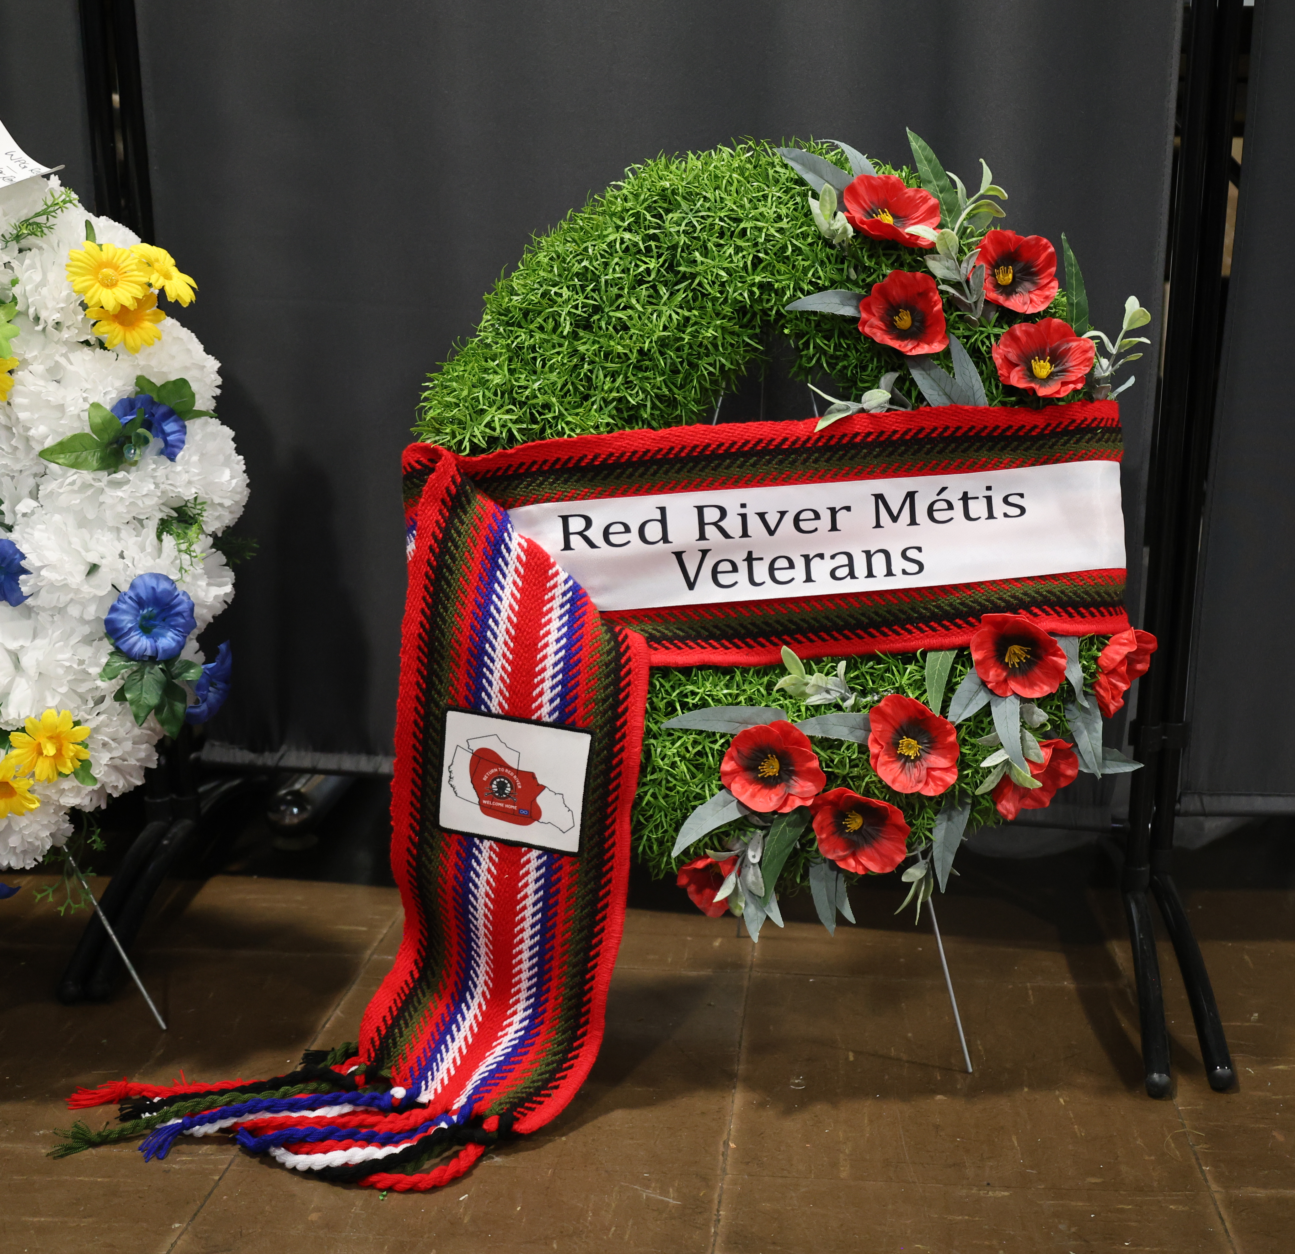
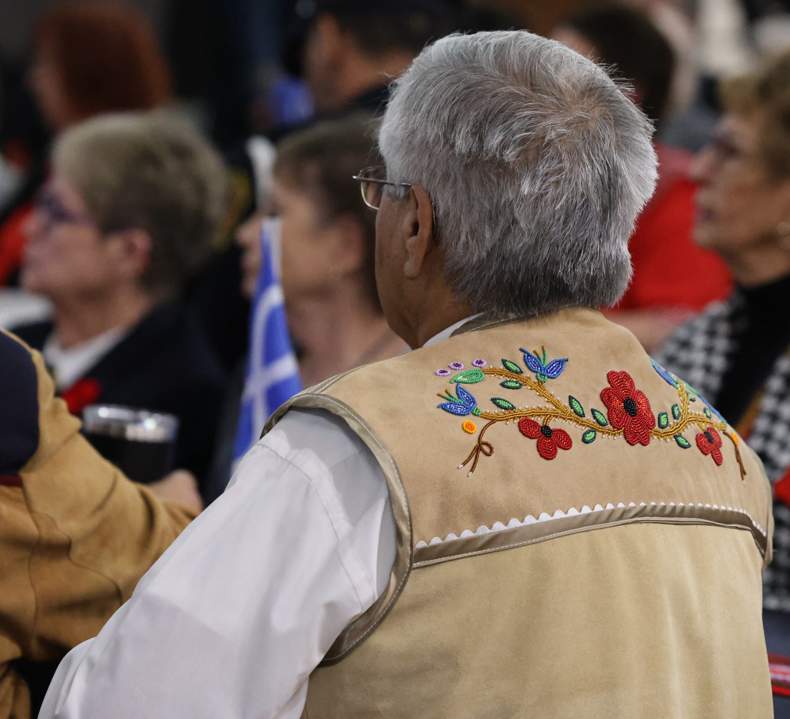
Thank You, Marsii
If you have any questions or have a Métis Veteran that has not been added to the Archive list, please get in touch with the Department via email at
rrmvreception@mmf.mb.ca

